Slide 1
Modeling and Toolpath Generation for Consumer-Level 3D Printing
H. Quynh Dinh
Filipp Gelman
Sylvain Lefebvre
Frédéric Claux
Notes:
Welcome to the course on 3D printing…
Presented by myself, Quynh, my colleague at MB, Filipp G., and our collaborators from INRIA, Sylvain F and Frederic C.

Slide 2
HOW is 3D Printing Used?
Rapid Prototyping:
Reducing the design cycle
(from weeks to hours)
PROTOTYPE
DESIGN
EVALUATE
Notes:
3D Printing has been around for a long time, but Desktop 3D printing has only taken off in the last 10 years or so. And it has enabled some significant changes in the way people work.
Prototyping has been reduced from weeks to hours, when we go from injection molding to 3D printing.
And because of this accelerated design cycle, 3d printing is especially good for designers, such as ….

Slide 3
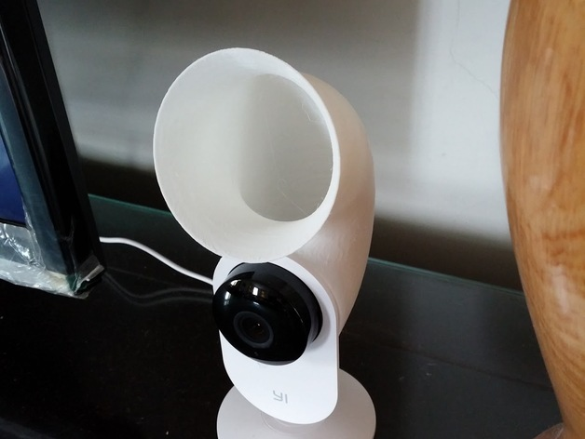
HOW is 3D Printing Used?
Industrial Design
[Xiaomi Yi Baby Monitor Amplifier (sokunmin) / CC BY-SA 3.0]
Notes:
…Industrial designers. Designers can quickly iterate on a design and even test out how well it works.
3D printing also enables novice and individual designers to create, prototype, and evaluate with little cost compared to sending a design out to be manufactured.
Attribution:
http://www.thingiverse.com/thing:923574
http://www.thingiverse.com/sokunmin/about
http://creativecommons.org/licenses/by-sa/3.0/

Slide 4
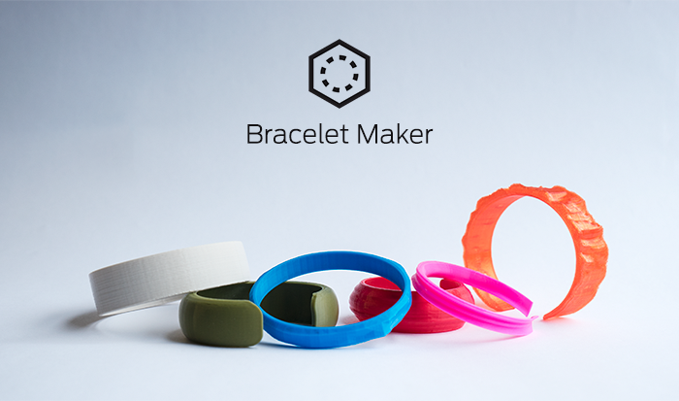
HOW is 3D Printing Used?
Fashion Design:
Especially jewelry
Notes:
It enables jewelry designers to produce and distribute with different colors and materials.
Attribution:
http://www.thingiverse.com/thing:200808

Slide 5
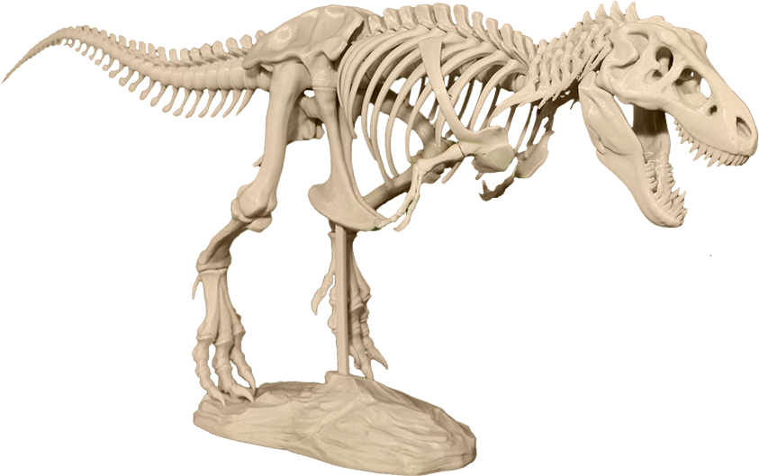
HOW is 3D Printing Used?
Educational & Scientific:
Fossils & archiving
Notes:
For re-creating fossils and archiving existing delicate fossils.
In the classroom, be able to print a fossil that you find online and really be able to physically manipulate it.

Slide 6
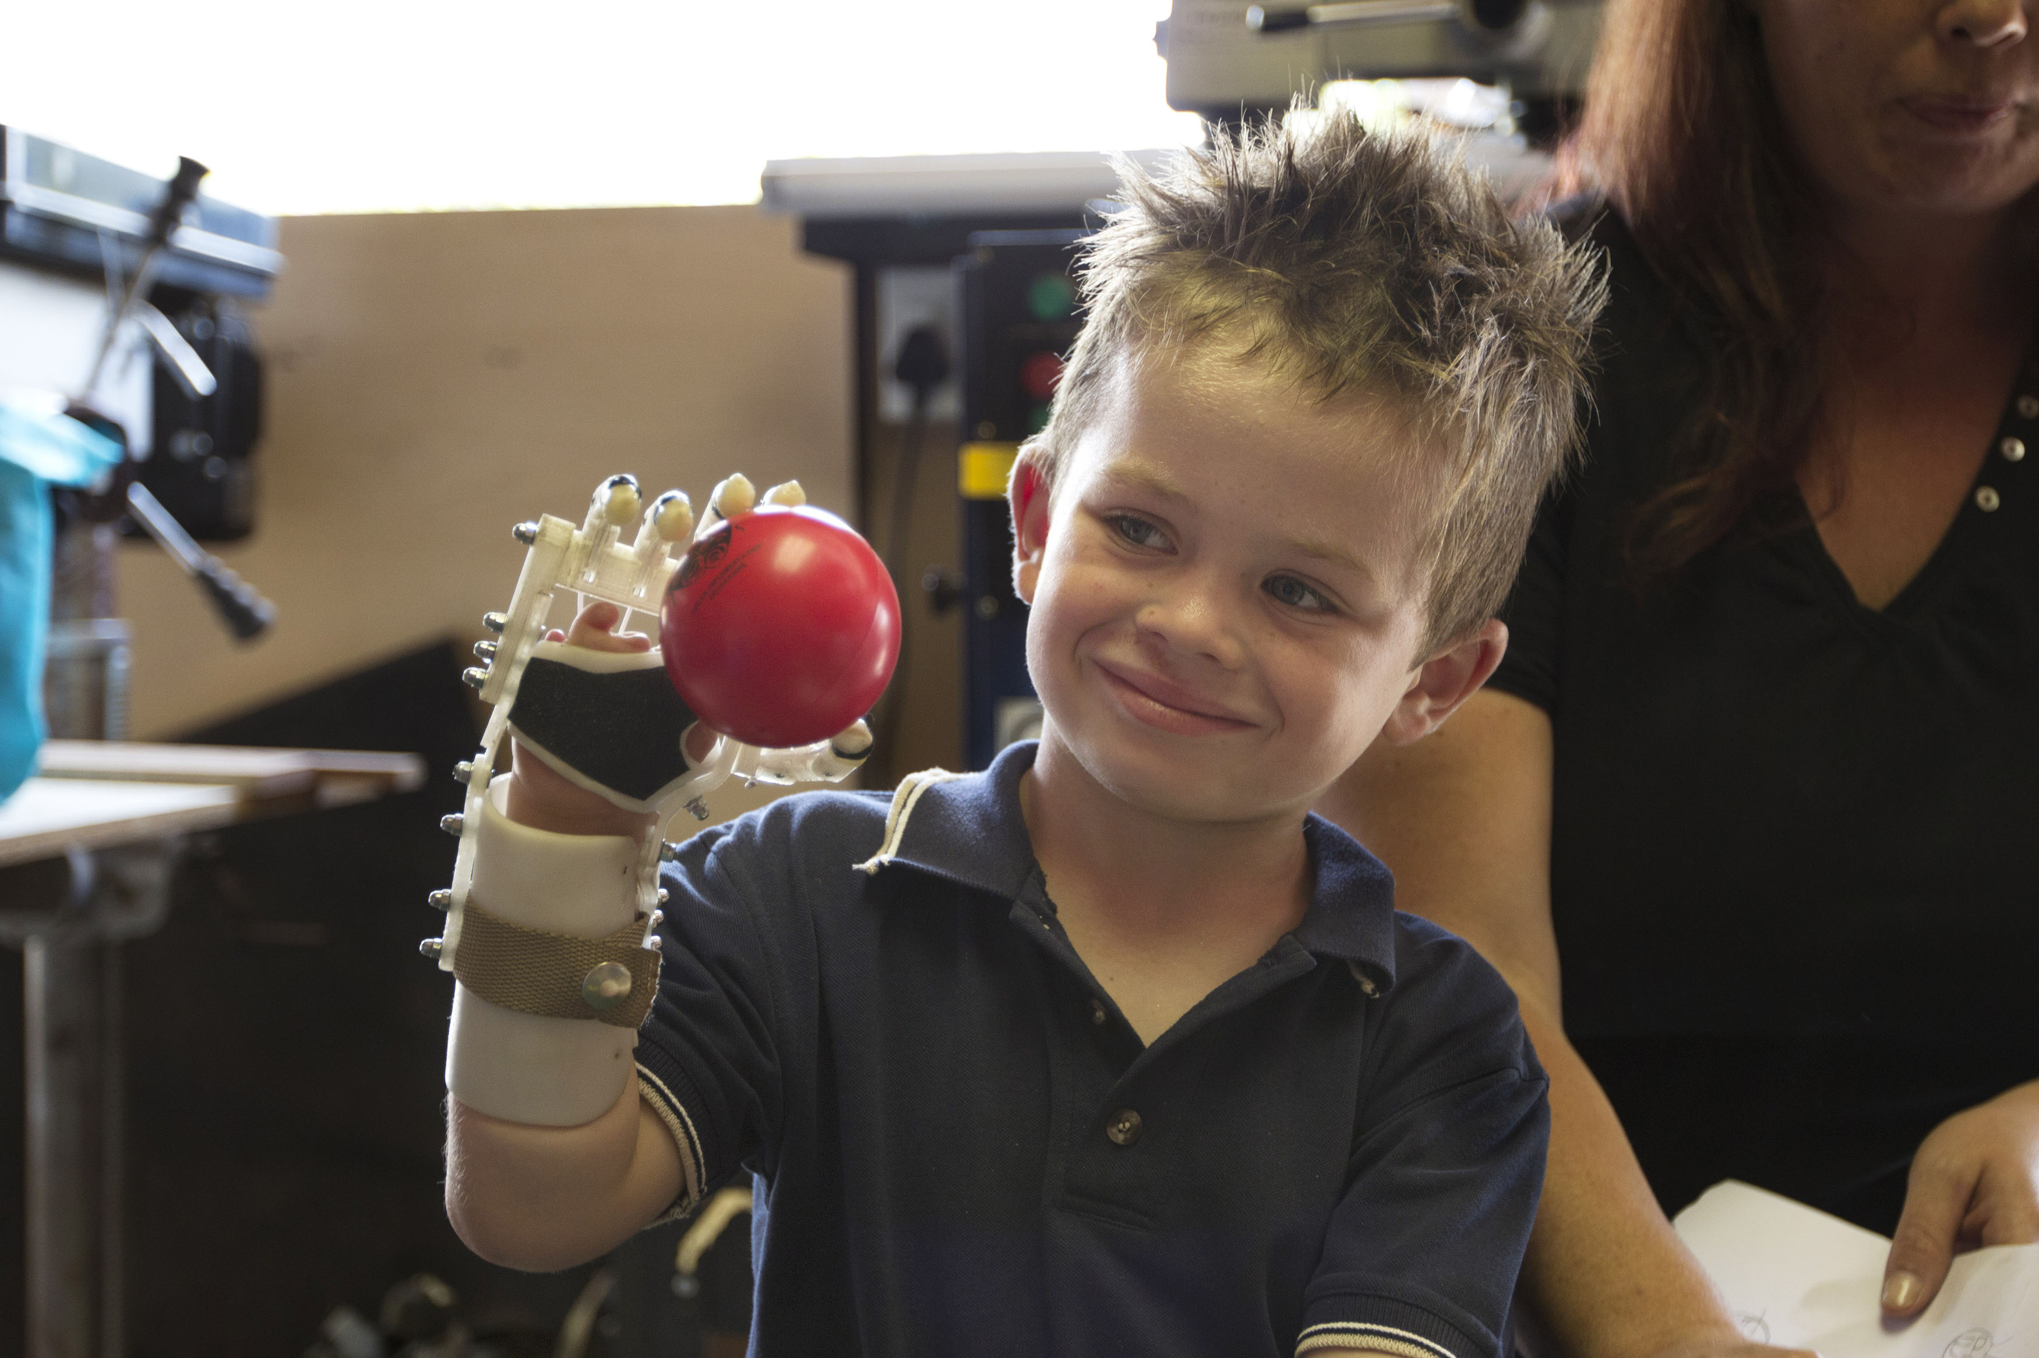
HOW is 3D Printing Used?
Customization:
Insoles, prosthetics
[Robohand]
Notes:
This is particularly relevant to medical applications

Slide 7
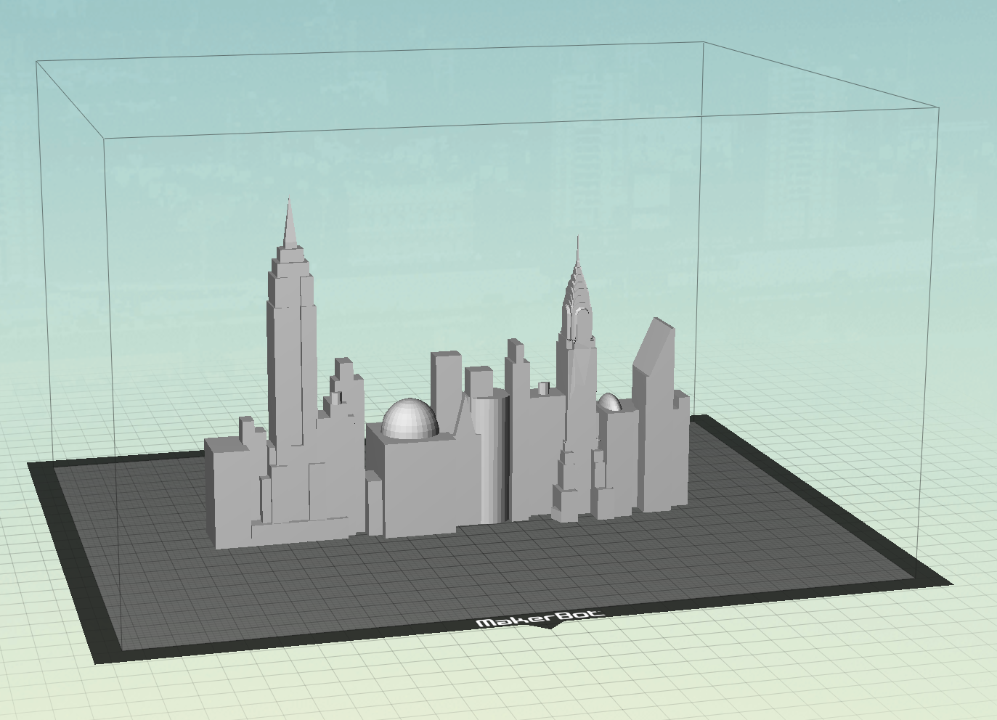
What is 3D Printing?
[NYC Skyline (AnthonyM) / CC BY 3.0]
3D MODEL
TOOLPATH
3D PRINTED OBJECT
Notes:
The type of 3d printing that we are covering in this course is Fused Deposition Modeling (FDM) wherein plastic filament is melted and layed down in a layer-by-layer fashion to build up a 3D object.
We start with a 3D digital model. This is a model of the NYC skyline in our print preparation software, MBD, formerly known as Makerware
http://www.thingiverse.com/thing:81848
http://www.thingiverse.com/AnthonyM/about
http://creativecommons.org/licenses/by/3.0/

Slide 8
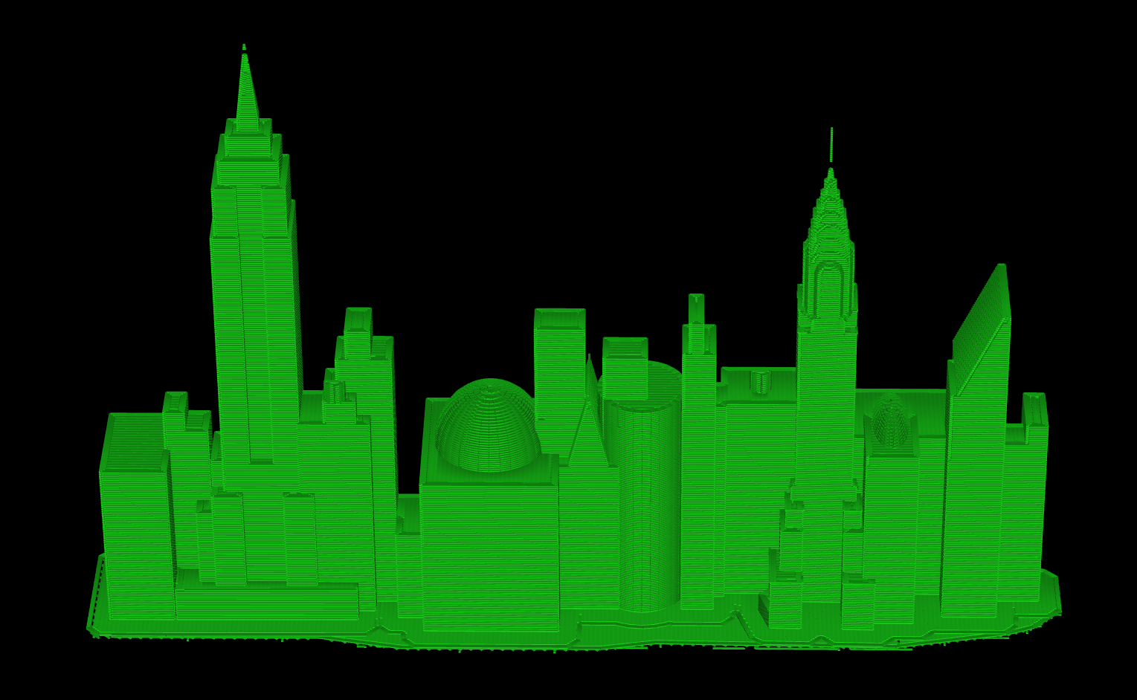
What is 3D Printing?
3D MODEL
TOOLPATH
3D PRINTED OBJECT
Notes:
Then, we generate a toolpath that tells the printer where to deposit plastic filament.

Slide 9
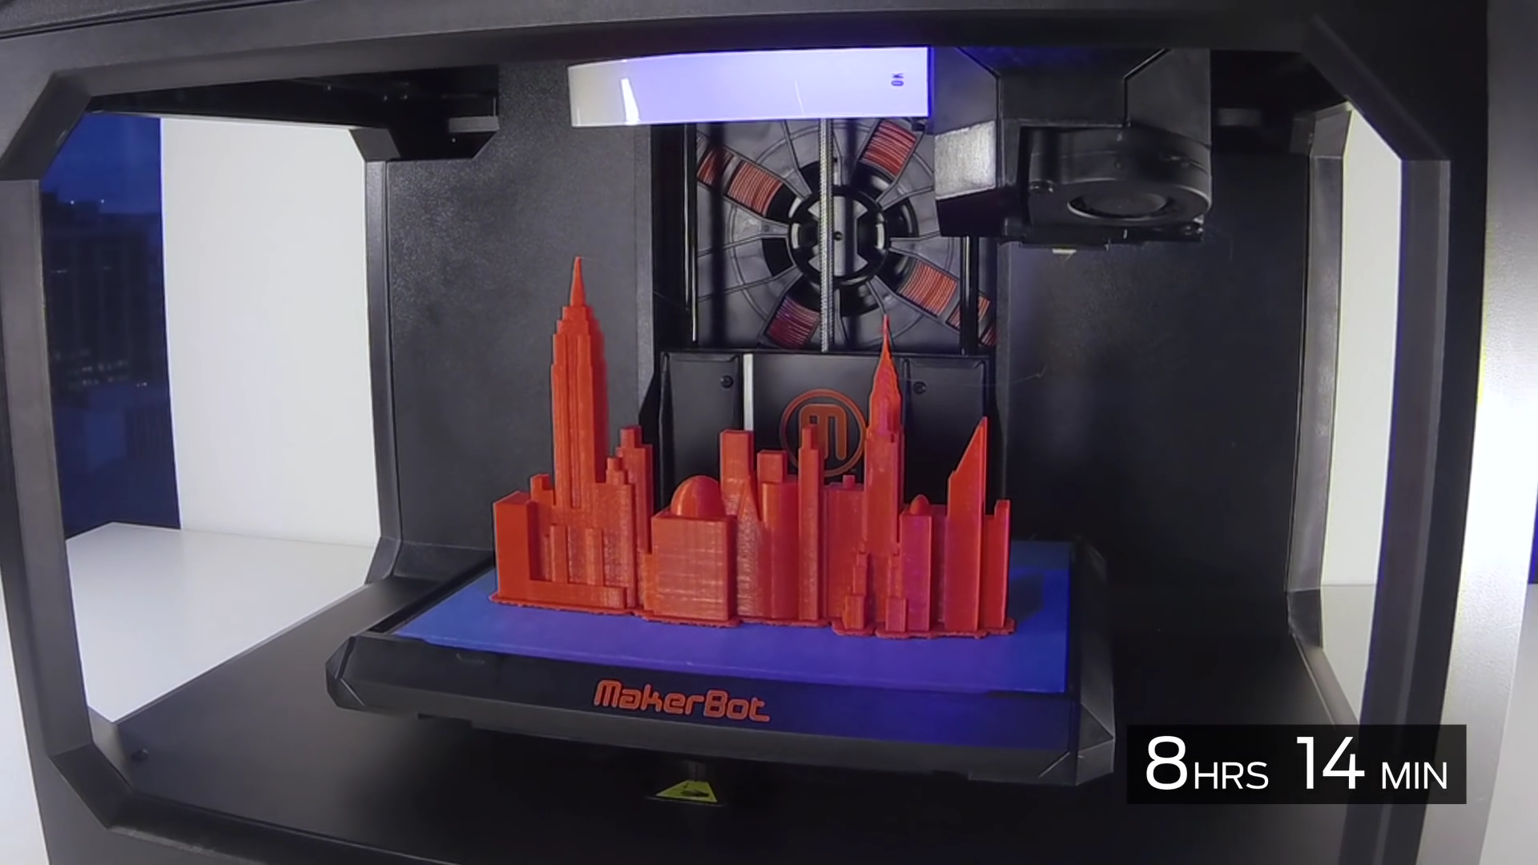
What is 3D Printing?
3D MODEL
TOOLPATH
3D PRINTED OBJECT
Notes:
The toolpath is then sent to the printer, which then builds up the 3D object in a layer-by-layer fashion as seen here. Again this process is called Fused Deposition Modeling (FDM) wherein plastic is deposited for a given layer, then the build plate on which the object sits moves down and the next layer of plastic is deposited to slowly form a 3D object.
Note how long it takes a print an object like this, approaching the volume of the Replicator. 8 hrs and 14 mins.

Slide 10
What is 3D Printing?
3D MODEL
TOOLPATH
3D PRINTED OBJECT
Notes:
This course focuses on the Software algorithms to generate a toolpath. We will touch on 3D printer mechanics, particularly aspects that we are able to leverage or compensate for in software. This is a visualization of the toolpath, again building up the object in a layer-by-layer fashion.

Slide 11
Course Overview
Goal
Learn about what’s involved in developing a slicer - issues, solutions, and open questions in printer toolpath generation
Schedule
Session 1: 3D Printing With Plastic Filament
Anatomy of a Print, Printer Mechanics, Slices,
Toolpaths, Build Plate Adhesion, Multi-material Printing
Session 2: Modeling for Filament-based 3D Printing
Overhangs & Supports, Solid Modeling & Slicing,
Large Models & Volumes
Notes:
Throughout this course, we will mention related references, but for a complete list, please see our website which will be posted at the end of the course.

Slide 12
Anatomy of a Print
3D Printing with Plastic Filament
Notes:
Let’s first look at what a 3D print consists of. The terms I’ll be covering here are integral to the language of Software algorithms in 3D printing.

Slide 13
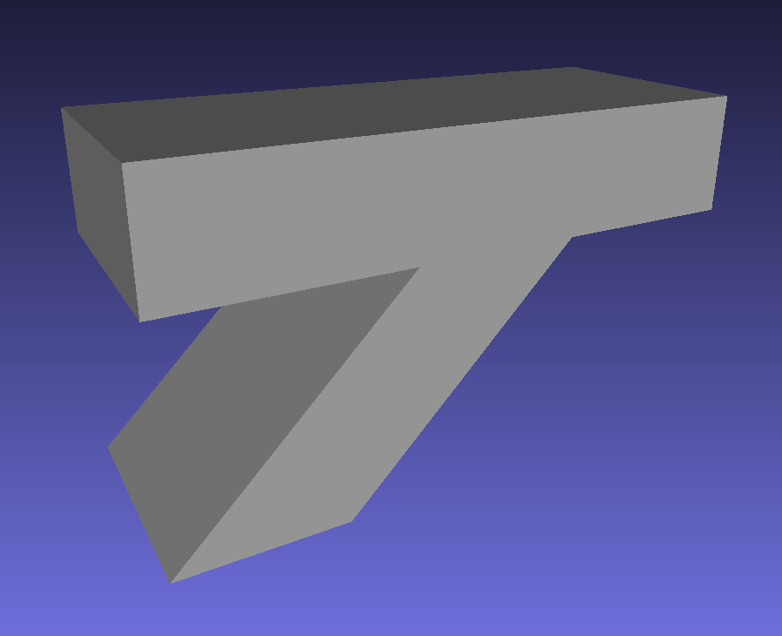
Anatomy of a Print
[Support test model, MakerBot]
Notes:
This is one of our test models. It’s a fairly simple model, but as you’ll see, it enables us to examine the parts of a 3D print.

Slide 14
Anatomy of a Print
Notes:
Left: Completed print, right off the print bed, before we’ve removed extra material that is required to achieve the best print quality.
Right: After we’ve removed the extra material, and you can see that it is the physical embodiment of the digital model I just showed.

Slide 15
Anatomy of a Print
Cover (Roof)
Overhangs
Notes:
Looking at the print, the top of the object is exposed and this is called a Cover. When the cover is at the top, another term for them is roofs, similar to the roof of a house.
Overhangs are parts of the model where the layer above extends well beyond the layers below, and gravity will cause the printed plastic to droop down, like printing over air if they are not supported. Supports will be covered in more detail in a later session.
But this is what it looks like if we print w/o supports.

Slide 16
Anatomy of a Print
Notes:
You can see all the drooping plastic because the overhangs were printed over air w/o anything to support it.

Slide 17
Anatomy of a Print
Overhangs
Covers
(Floors)
Floors
Notes:
The bottom parts of the print are exposed and thus are “covers” as well. At Makerbot, we call bottom covers floors. Floors may be supported if they are overhangs as shown here.
The small areas that are exposed on the leg of the T as we go up layer by layer are also considered floors.
Note that the floors under the T are slightly rough. This is because the supports could not be removed completely. I’ll come back to this.

Slide 18
Anatomy of a Print
Shells
Infill
Supports
Supports
Raft
Raft
Notes:
In this image, I’ve stopped the printing of the object mid-way so that you can see the interior parts of the print.
Shells are generated from the contours of the model and the outer-most shell forms the exposed surface that you see on a printed object.
Infill is the interior surrounded by shells to give the printed object strength and to hold up the tops (a.k.a. roofs) of the printed object. Infill can be printed at any density, but is typically printed much lower (around 10%) to speed up the printing process.
Supports hold up overhanging regions of the object as previously mentioned.. Overhangs are parts of the model where the layer above extends well beyond the layers below.
Rafts are not part of the object, but are printed to make it easy to remove the object from the build plate and reduce warping in the first few layers of the object. Rafts will be covered in more detail in later.
Regions to be filled in are often called “islands”.
Note that the supports and infill are similar – they just differ in density and pattern.

Slide 19
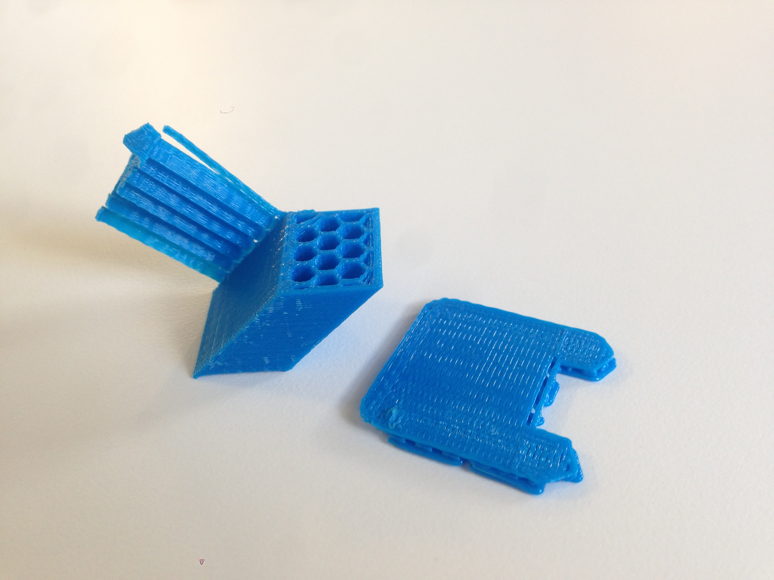
Anatomy of a Print
Shells
Supports (removed)
Infill
Roofs
Cover
(Roofs)
Raft
Notes:
Here, I’ve detached the supports and raft from the previously shown print, and you can see the leg of the T forming.
Again, roofs are the tops of the object. In this case, the small areas that are exposed as we go up layer by layer, are roofs.
Supports may be printed on top of roofs as seen here to support parts of the object that overhang farther up in Z-height.

Slide 20
Special Features
Single-filament walls
Bridges
[Stretchy Bracelet (emmett) / CC BY-SA 3.0]
Notes:
There are several special types of prints.
One are single-filament walls. Typically a print is composed of several layers of shells surround infill as shown in the previous example. Here, each layer of the print is composed of a single strand of filament without infill. Single-filament objects like this exhibit “elastic” behavior.
Attribution:
http://www.thingiverse.com/thing:13505
http://www.thingiverse.com/emmett/about
http://creativecommons.org/licenses/by-sa/3.0/

Slide 21
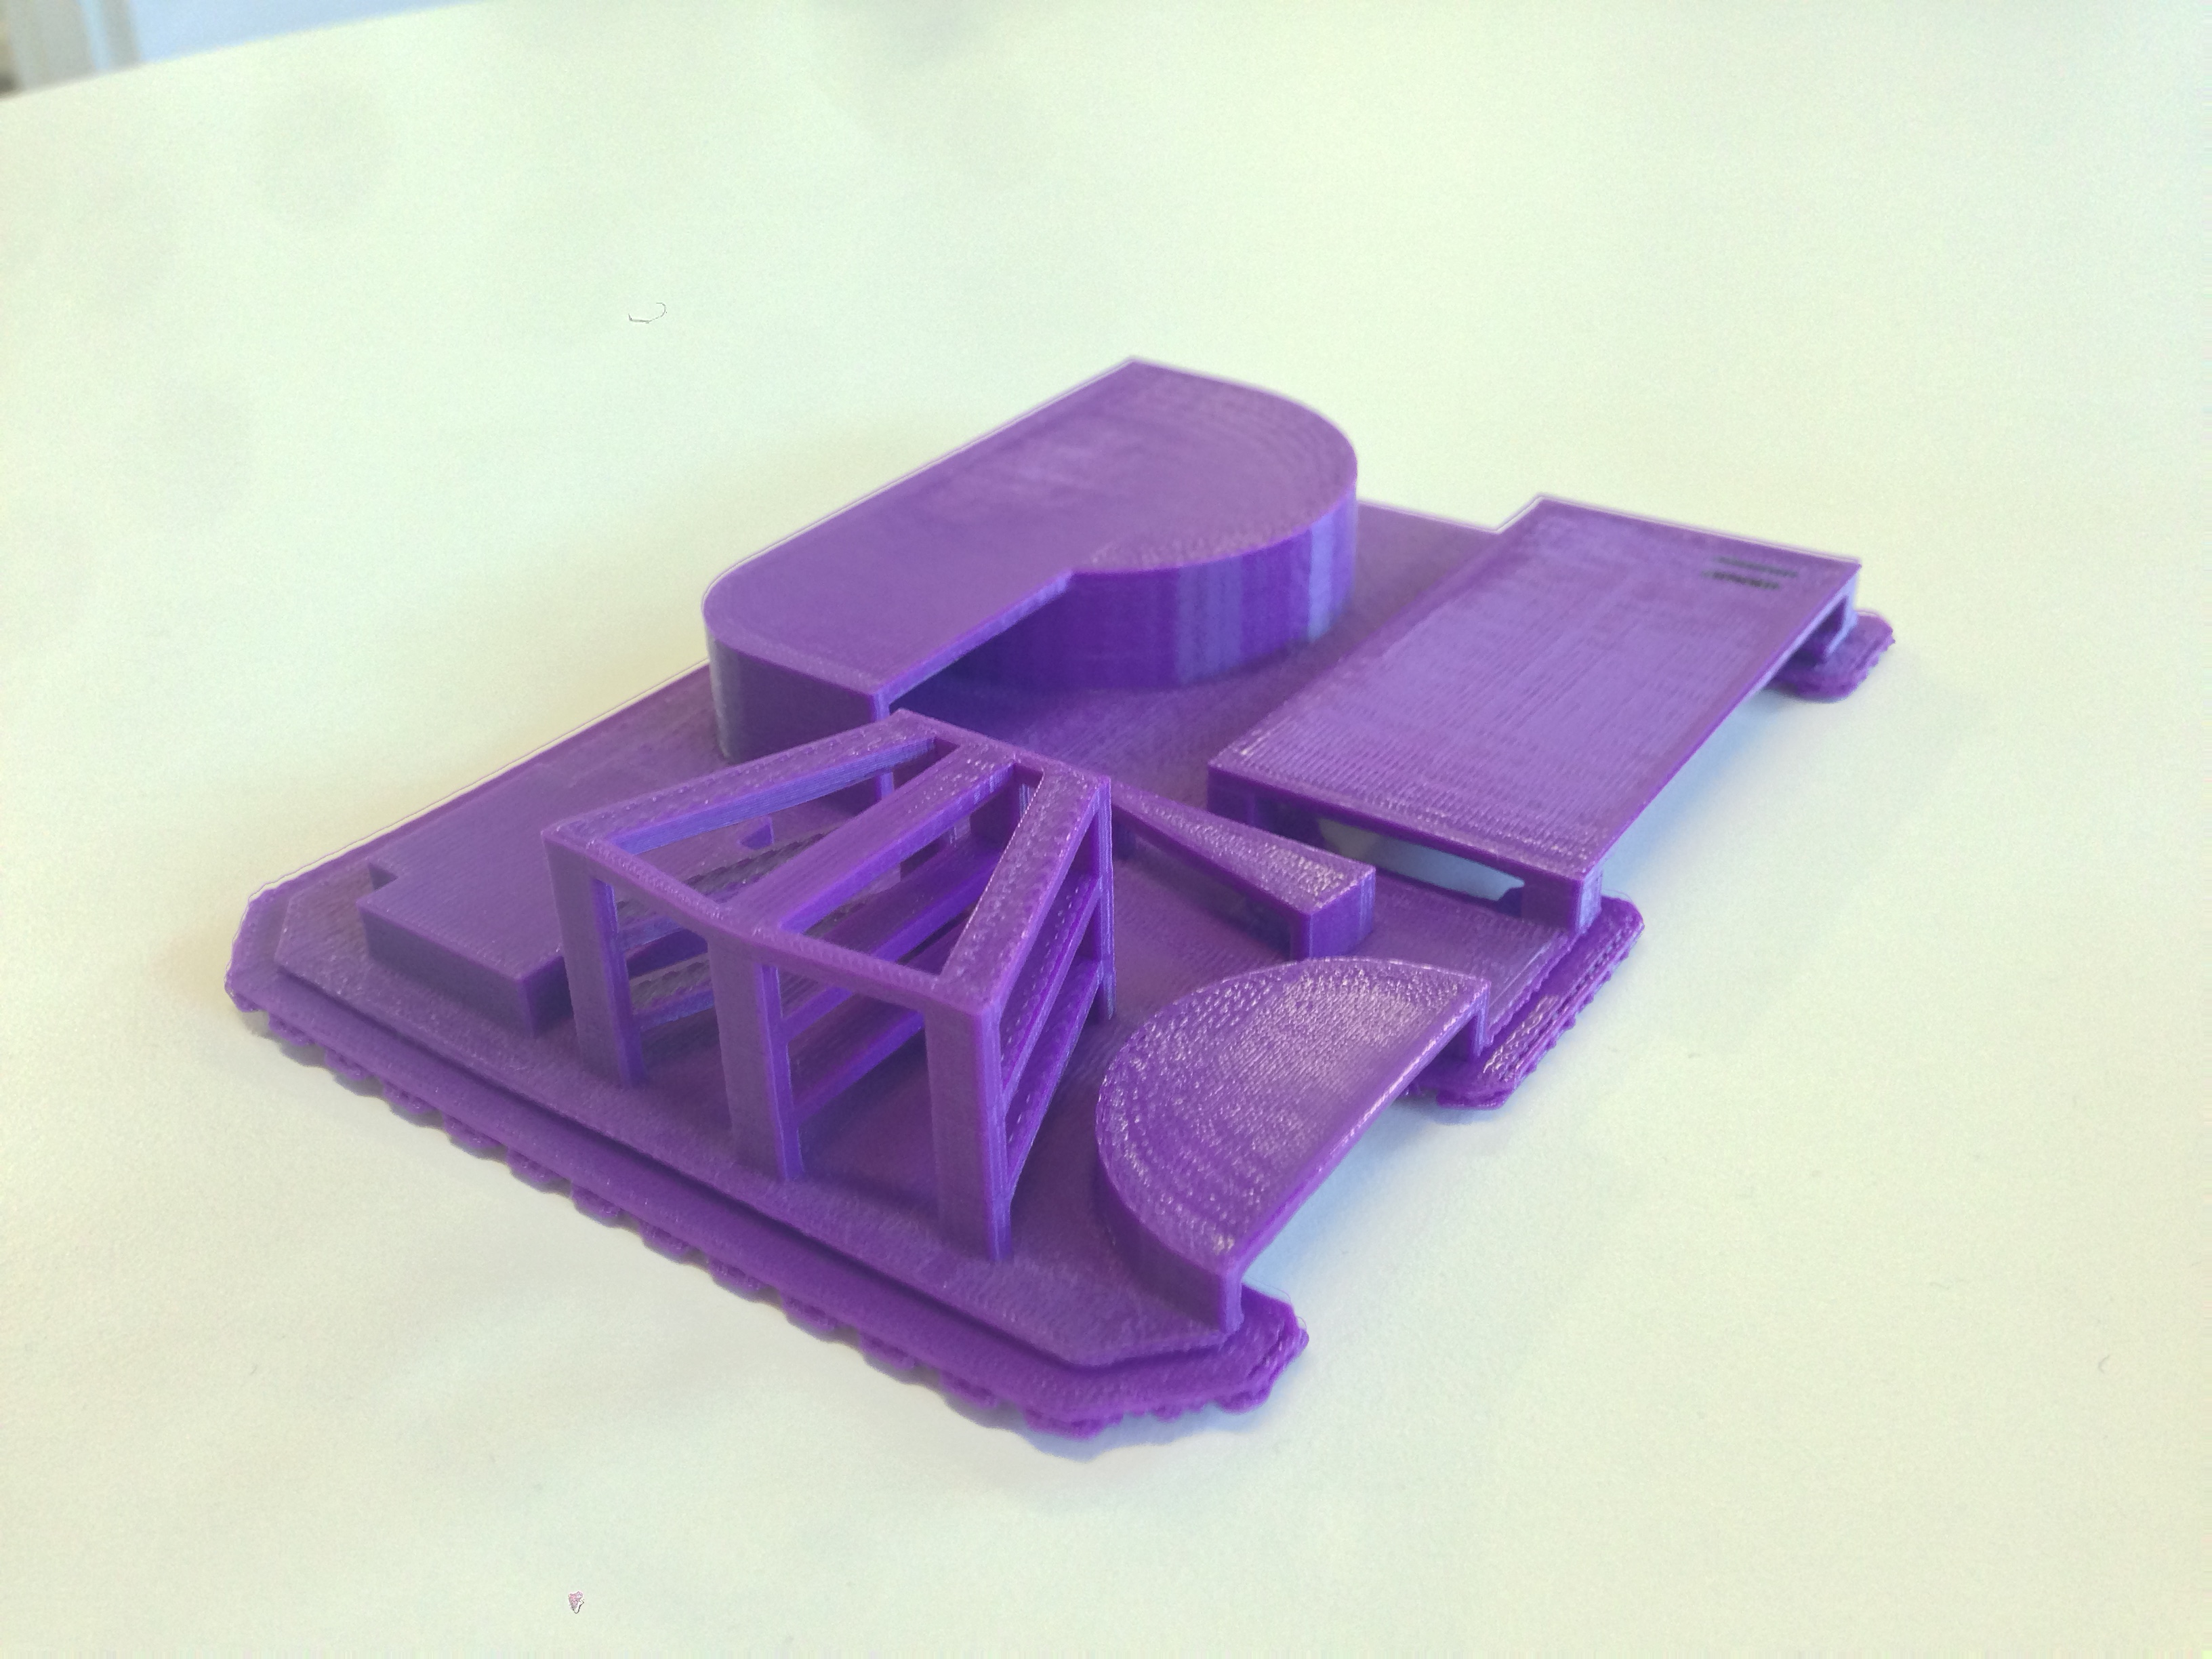
Special Features: Bridges
Single-filament walls
Bridges
[Bridges test model, MakerBot]
Notes:
Second are bridges which are floors anchored on either side and printed over air w/o supports. The contracting forces of plastic filament as it cools enable bridges to stay up and not droop. The maximum bridge span is limited, typically to 30 or 40 mms.
Bridges will be covered in more detail in a later session.

Slide 22
Print Defects: Bridging
Notes:
Now I would like to turn your attention to the problems and artifacts that we encounter in 3D printing. There are Software solutions to some of these problems, and we will cover them throughout this course.
I just showed an example of bridges. This image shows the underside and how bridges can fail. At the top is a successful bridge, whereas on the bottom, the bridge has detached from its anchors. The cause is primarily because the bottom bridge span is too far, but heating can also have an effect, so for a given printer, the max bridge span is a tunable parameter.

Slide 23
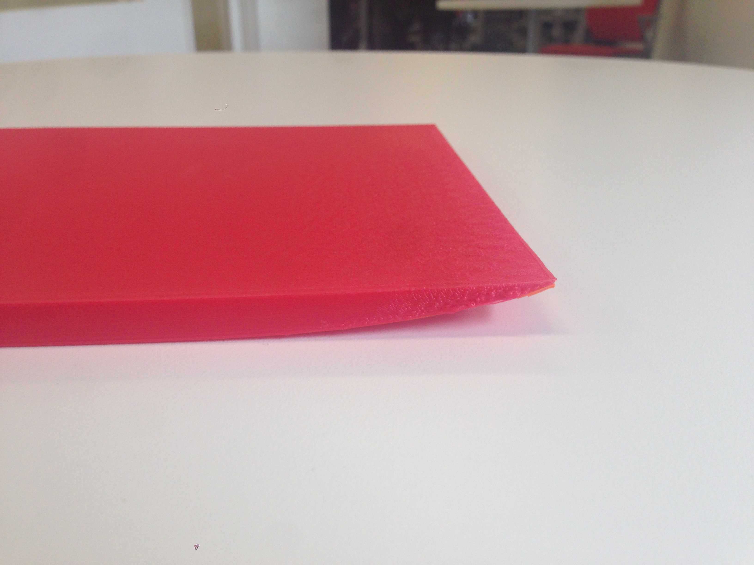
Print Defects: Warping
Notes:
Also related to heating are warping effects.
In this example, the print has detached from the build plate and the first few layers have curled up, resulting in a squooshing of the layers at the corner. This typically occurs when printing an object that has a large footprint.

Slide 24
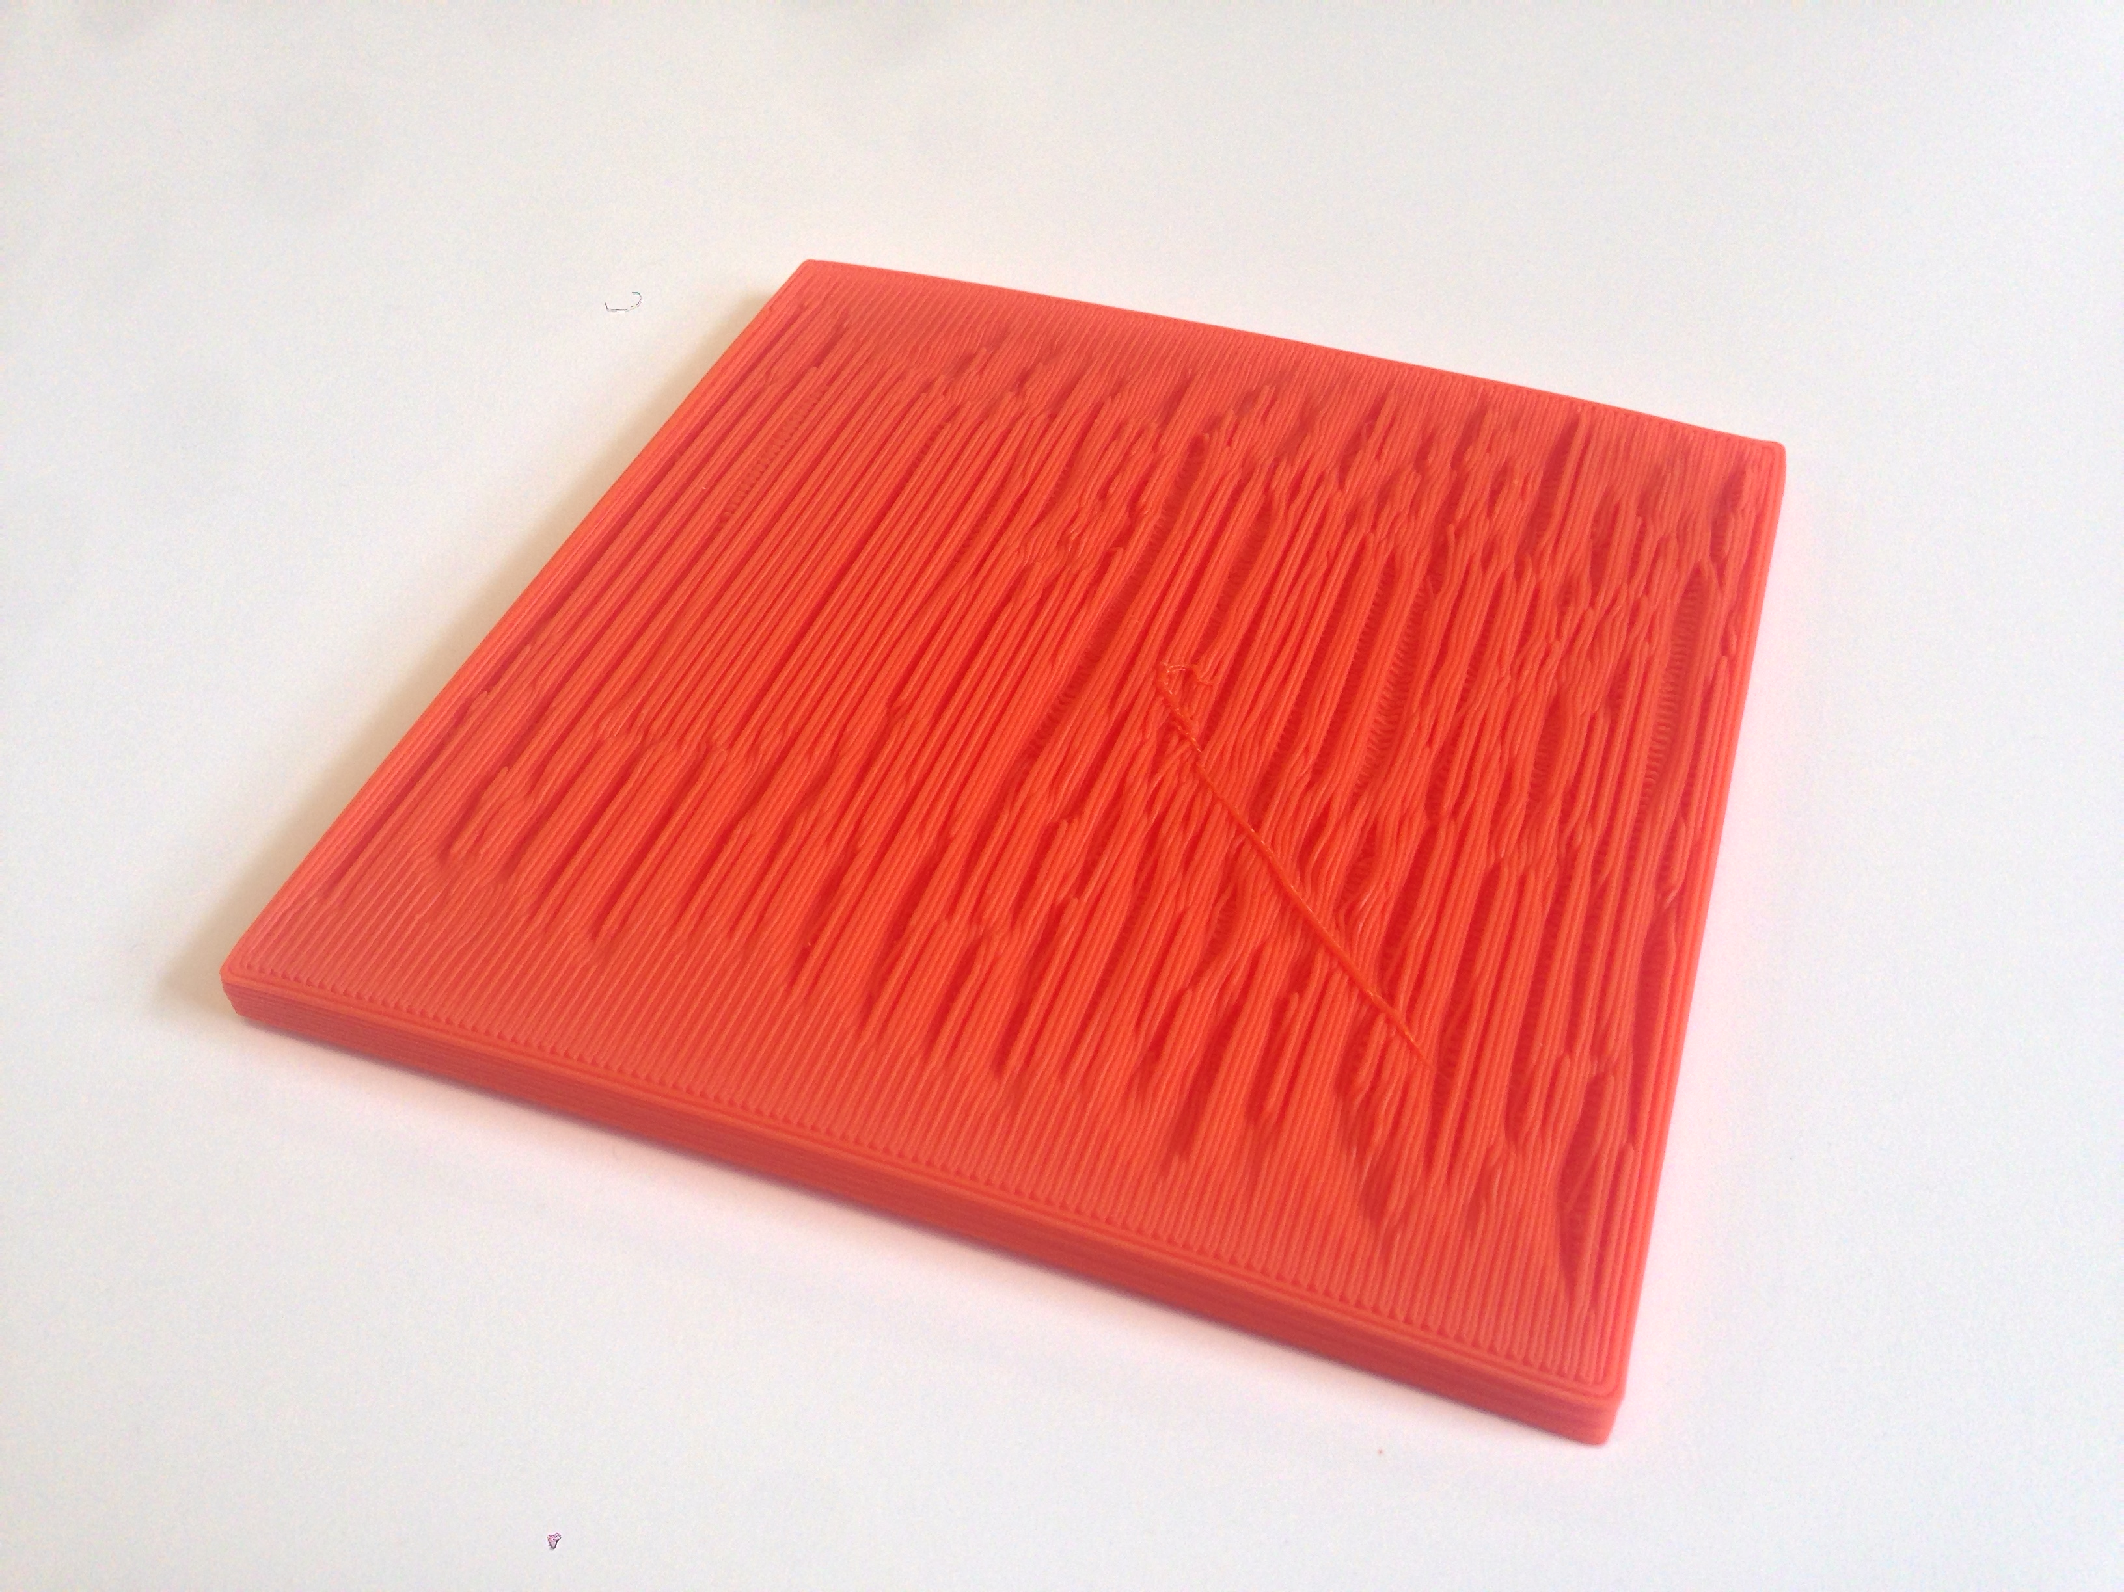
Print Defects: Warping
Notes:
Warping can also occur for each filament that is laid down next to other hot (not completely cooled) filaments. In this case, the individual filaments are warping up causing this rippling effect.

Slide 25
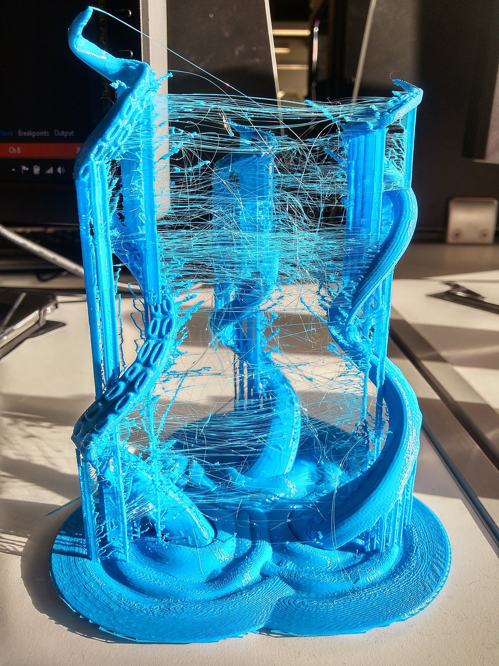
Print Defects: Stringing
[remix of Octopus Arm Toothbrush Holder (notcolinforreal) / CC BY-SA 3.0]
Notes:
Also related to heating is a defect that we call stringing. This is where we have excess, fine plastic strands that connect the print from one island/outline or pillar to the next within a single layer. More on this topic later as well.
Attribution:
http://www.thingiverse.com/thing:155396
http://www.thingiverse.com/notcolinforreal/about
Remix by http://www.thingiverse.com/seanocr/about
http://creativecommons.org/licenses/by-sa/3.0/

Slide 26
Print Defects: Over Extrusion
Notes:
This example is a little difficult to see, but here we have over extrusion where there’s too much plastic coming out of the nozzle, and it causes a rough, rippling surface.

Slide 27
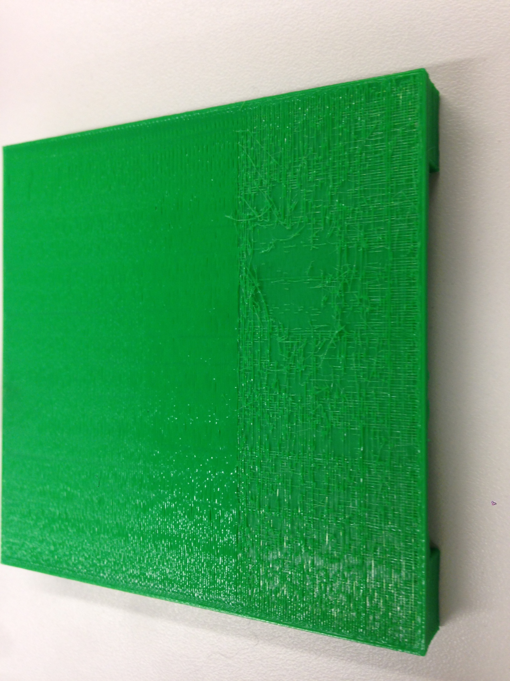
Print Defects: Under Extrusion
Notes:
The opposite of over extrusion is under extrusion, where we don’t have enough plastic coming out of the nozzle. And you can see that here as whispy bits of plastic on the surface or gaps on the surface of the print.

Slide 28
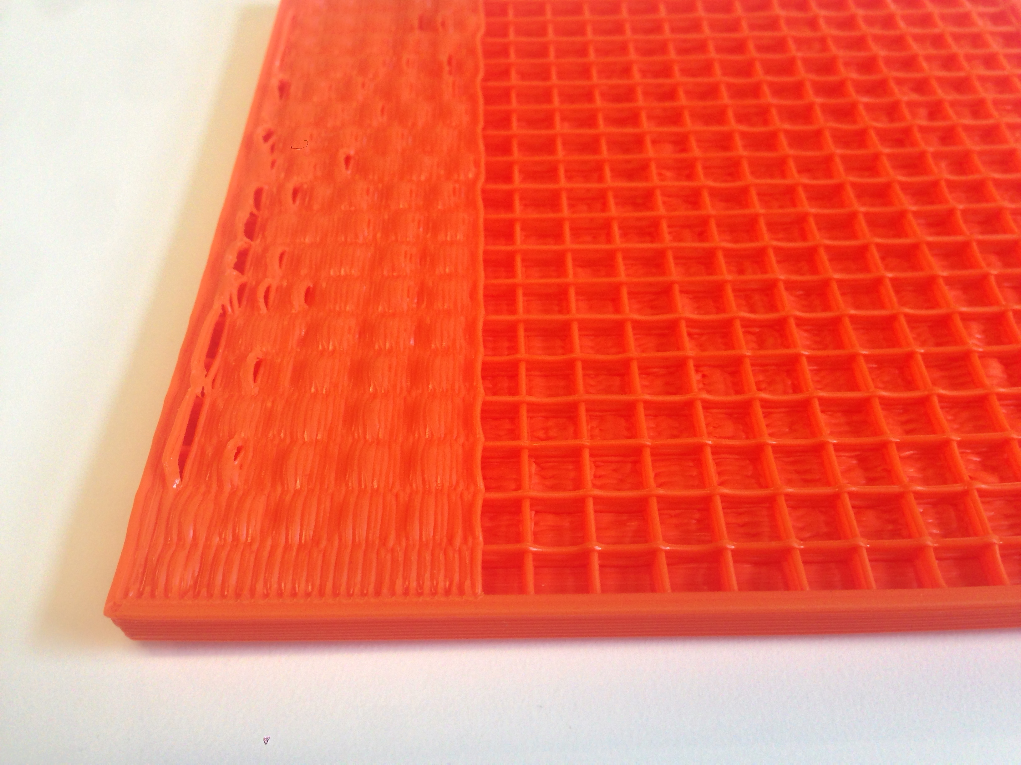
Print Defects: Solid over sparse
Notes:
When we print a solid surface, such as a roof, over sparse infill, there are many defects. The surface might ripple. There may be gaps. These defects actually force us to print several solid layers over the sparse infill to essentially cover up the defects until the final exposed surface has a nice, even finish. The number of solid layers required depends on the density and quality of the infill underneath.

Slide 29
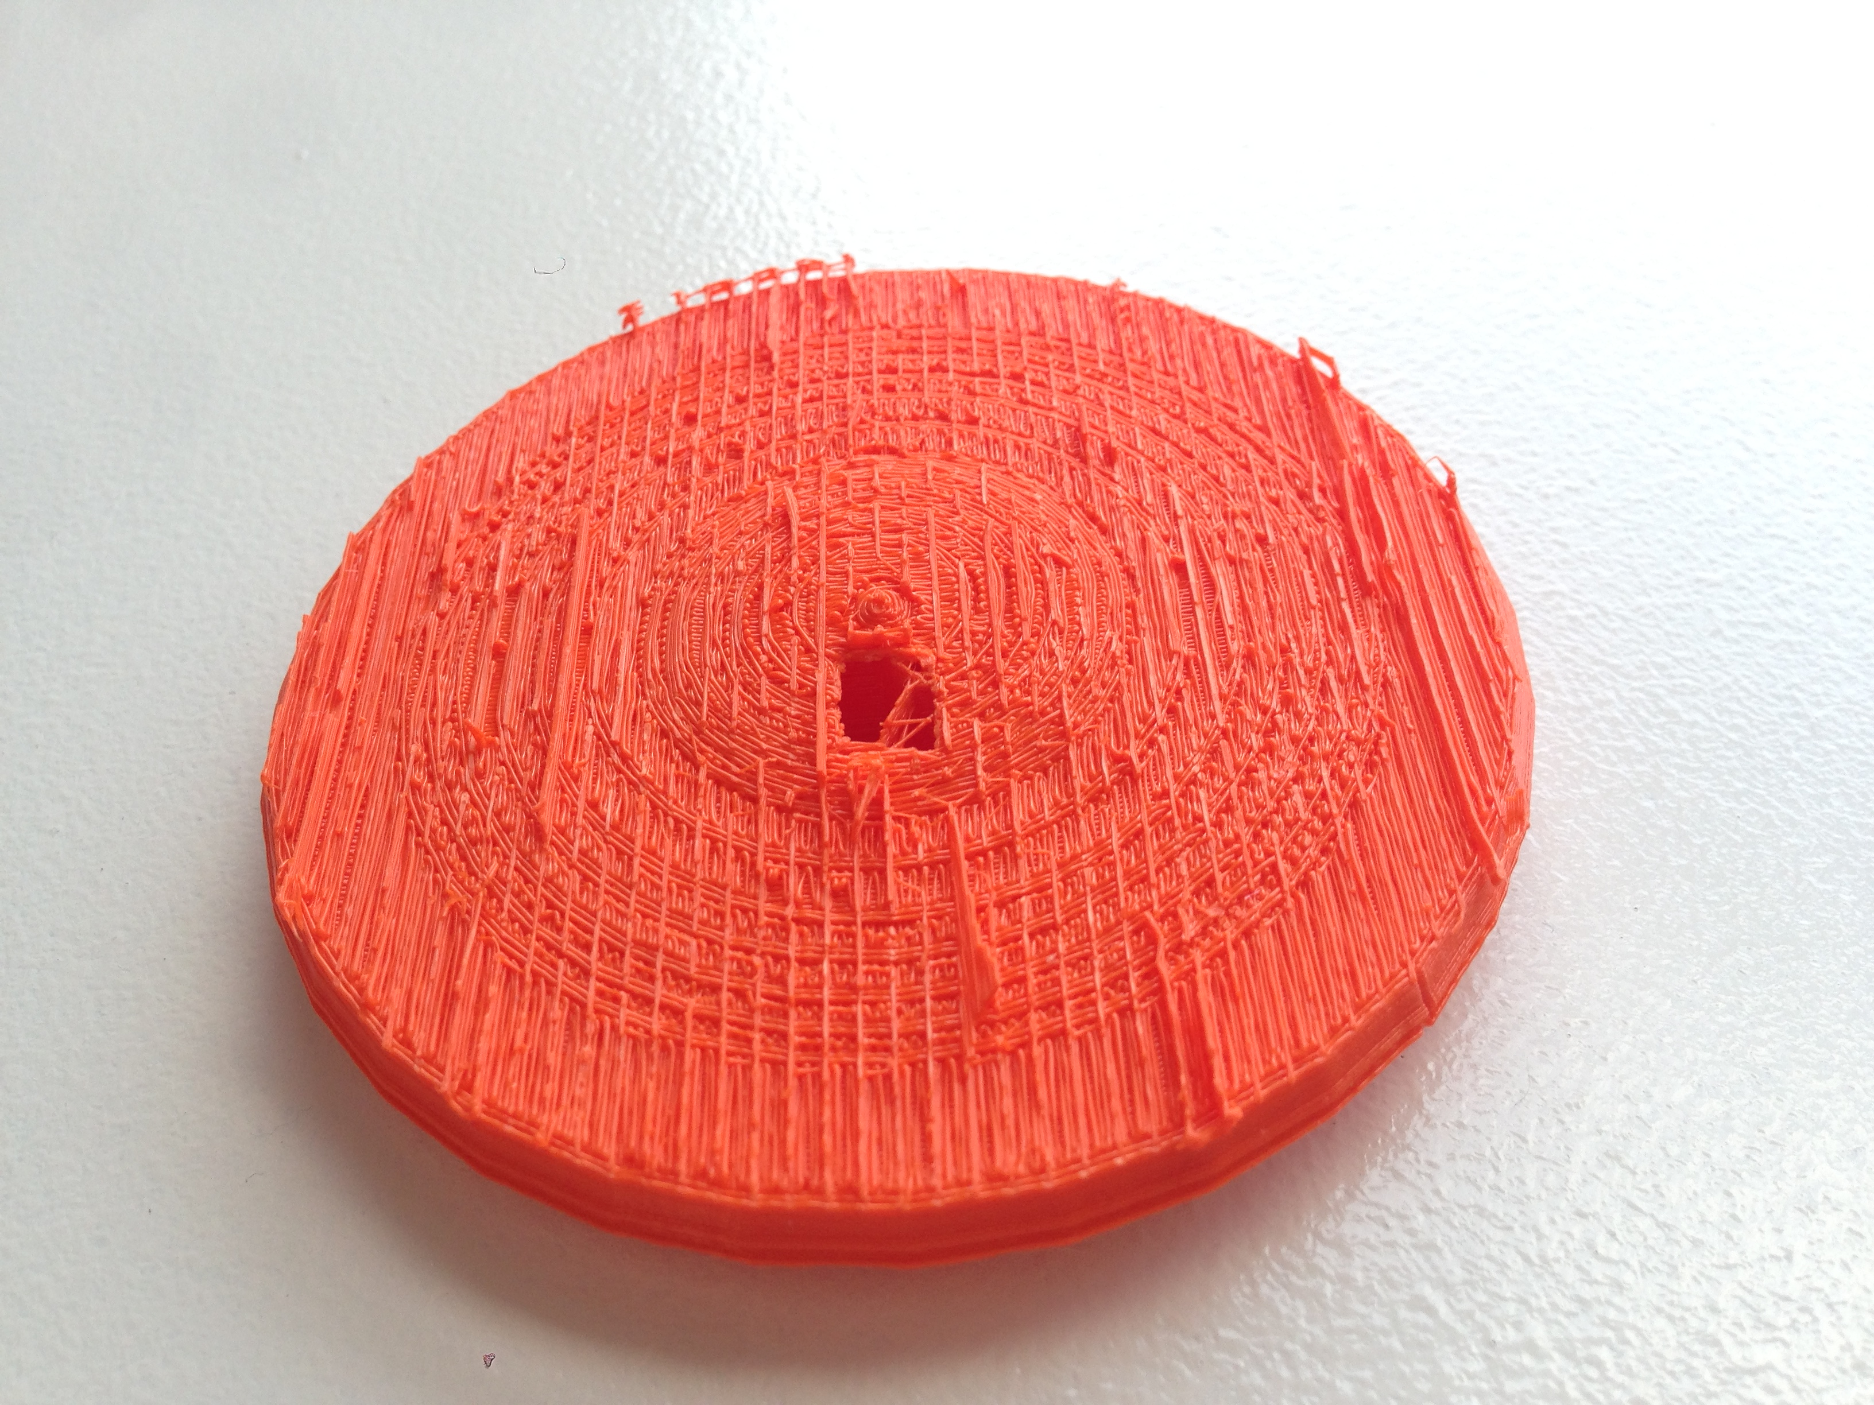
Print Defects: Stuck Supports
Notes:
A drawback of using supports underneath overhangs is that it can be difficult to remove. Remember the T print I showed earlier with the small artifacts underneath the arms of the T? This is an example where the supports were difficult to remove.
Another case of that is when the supports are deep inside of tunnels.

Slide 30
Print Defects: Supports needed
Notes:
This is the opposite problem where supports were needed but not used – on the David’s elbow, under the arms of the T, and on the upper right, we attempted to print the Stanford Bunny model upside down.

Slide 31
Material Properties and Mechanical Process
3D Printing with Plastic Filament
Notes:
Now that I’ve covered the anatomy of a 3D print and the potential defects, let’s look at the mechanical properties of a typical 3D printer and the material properties of plastic filament that are factors in creating those defects.
With this background, we can then describe the Software solutions that we to compensate for the realities of a mechanical system.

Slide 32
Extruder Mechanics
Stepper Motor
Filament
Pinwheel
Hot End
Heater
Nozzle
Notes:
Possibly the most important component in an FDM 3d printer is the extruder that takes in plastic filament and outputs a line of melted plastic. On the right is a diagram of a typical extruder.
Stepper motor drives a pinwheel which forces plastic filament down into the hot end where a heater melts the plastic.
Melted plastic is extruded through a nozzle of some diameter (Makerbot’s is 0.4mm).
References:
http://reprap.org/wiki/File:Extruder_lemio.svg
http://en.wikipedia.org/wiki/Plastics_extrusion

Slide 33
Amount of Plastic Extruded
Modeling volume of plastic through nozzle
Filament and nozzle diameters
Speed of extrusion
Pinwheel slip results in under extrusion
Modeling extruded filament profile
Notes:
Print quality is directly tied to the amount of plastic being extruded – Too little, and you have under-extrusion effects (brittle, thin infill). Over-extrude, and you get blobs. So, we try very hard to estimate the amount of plastic that is going through the nozzle.
Pinwheel slip: This is when the pinwheel that is extruding the filament slips on the filament. This typically occurs at higher speeds and results in underextrusion – less plastic is moving through nozzle than expected.
The filament coming in typically has a circular profile, but as it is melted and laid down next to an adjacent line of extruded filament it takes on a different profile – e.g., compressed cylinder, rectangle, square. How you model this profile can affect your estimation of the volume of plastic being extruded and again, affects print quality.

Slide 34
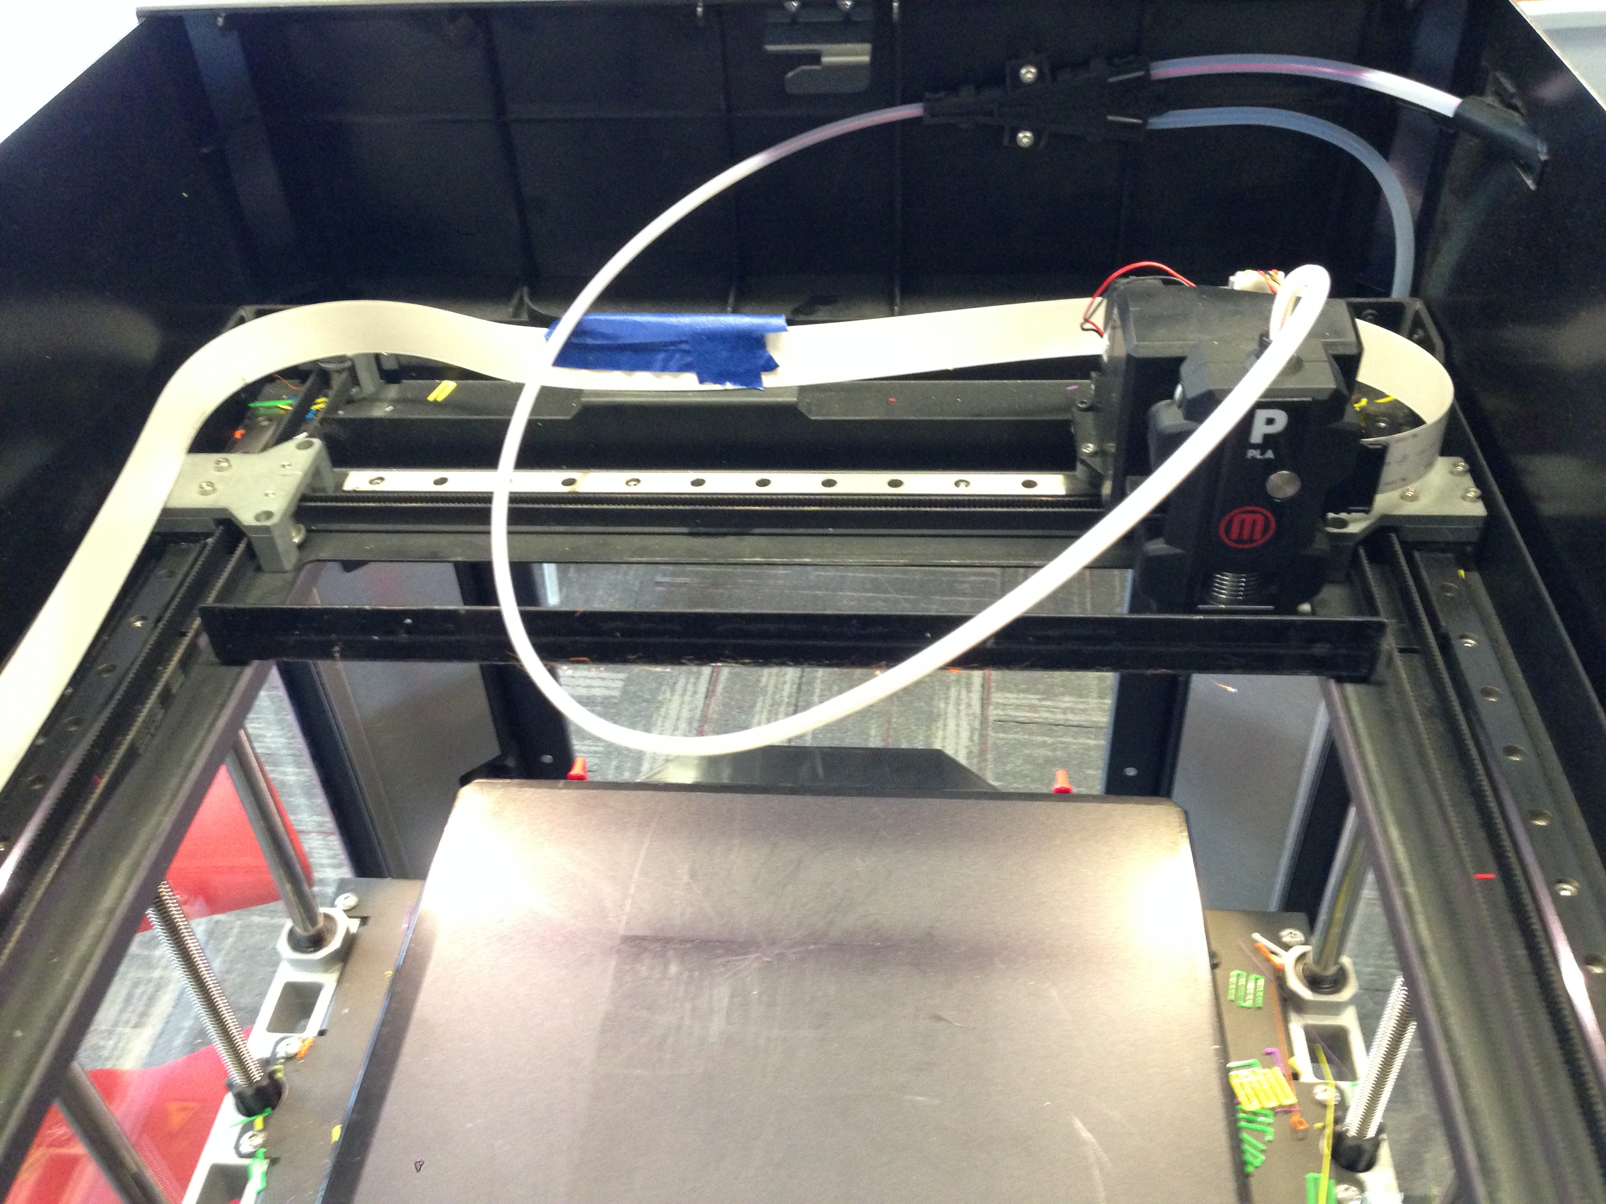
Printer Mechanics
H Gantry
Single belt
H configuration
Gantry racking
Backlash: loss of mechanical motion due to slack in the belt
Gantry
Belt
Extruder
block
Notes:
The extruder block is mounted on what’s called a gantry that enables it to move in the X-Y plane – left & right horizontally, and front to back. The extruder is again highlighted in green in the image.
Our 5th Generation printers (that is, the current Replicators, Mini, and Z18s on the market) have what’s called an H gantry owing to the belt configuration.
Gantry-related errors include racking and backlash which is the loss in mechanical motion due to slack in the belt.
Gantry racking is the divergence in Y as the toolhead is moved left to right and back in an H gantry.
Let’s look at each in more detail.
Note: Rep2, Rep2x are Cartesian gantry

Slide 35
H Gantry
Gantry
Belt
Extruder
block
Y
X
Notes:
Makerbot printers have an H gantry similar to this. Extruder block moves back and forth based on how this belt is moving.
As the belt rotates in 1 direction to move the extruder block there is a net torque about the X-axis – in this case, counter-clockwise. The yellow arrows illustrate the direction of belt movement and the net torque.

Slide 36
H Gantry
Gantry
Belt
Extruder
block
Y
X
Notes:
When the belt changes direction to move the extruder block in the reverse direction, the torque reverses.
As the net torque changes direction, the position of the extruder shifts in Y. This is called gantry racking, and results in a Figure 8 pattern of motion for the extruder block.

Slide 37
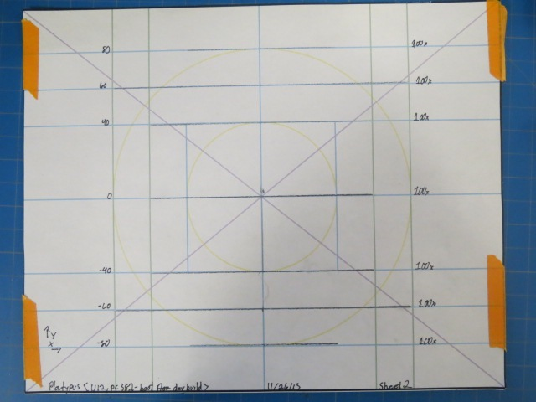
H Gantry Racking
Increased divergence in Y farther from the center
Pen Plot
Notes:
The Y-motion at the ends is on order of mm and is most apparent at the far ends of the Y axis. This plot is just an example where a pen has been mounted to the toolhead to track the path.
Racking more exaggerated farther from the center. So, printers with smaller build platforms such as the Replicator Mini will experience less racking.
We can’t really compensate for racking, but as long as it’s small enough, plastic adhesion can overcome adverse affects.

Slide 38
Backlash
Backlash occurs when there is a change in direction of printing
Notes:
As mentioned, backlash is the loss of mechanical motion due to slack in the belt, and has a dampening effect on motion control.
Here, we have a close-up of 2 gears, and the blue gear is moving to the left.

Slide 39
Backlash
Backlash occurs when there is a change in direction of printing
Backlash
Notes:
When it changes direction to the right, it must travel the distance indicated (the slack or backlash) before it makes contact with the grey gear again.

Slide 40
Backlash
Backlash occurs when there is a change in direction of printing

Slide 41
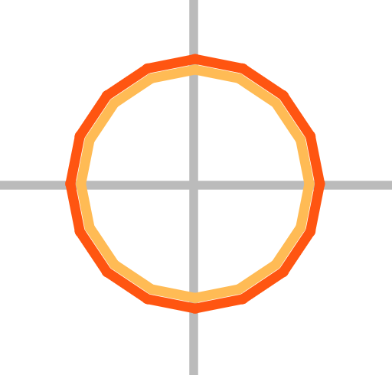
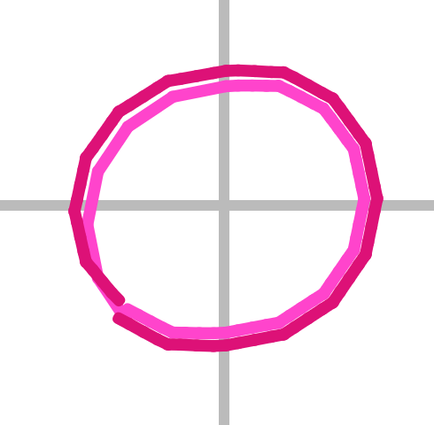
Backlash
No Backlash
Backlash
Notes:
This is a visualization of 1 layer of a cylinder print. The print has 2 shells as shown by the different colors, and on the left w/o backlash, the cross-section of the cylinder is a circle, as you would expect.
On the right, when there is backlash, the circle becomes more oval like, and the toolpath of the start and end of each shell does not even meet.

Slide 42
Backlash Compensation
Determine the amount of lost motion due to backlash
We recommend printing a 20 mm box and measuring its sides to see if it is < 20 mm
Add the motion back in gradually after the change in direction
Notes:
To compensate for backlash, we determine the amount of lost motion by printing a 20 mm cube and measuring its sides. Backlash typically results in smaller prints.
We then add back the lost motion gradually after the change in direction.
In Makerbot Desktop, users can set the following:
backlashX" / "backlashY” – mm loss in each direction
How quickly to compensate for this lost motion
References:
https://www.makerbot.com/support/new/04_Desktop/Knowledge_Base/Using_Custom_Slicing_Profiles/10-MakerBot_Slicer_settings:_Backlash_Compensation

Slide 43
Thermal Effects
Cooling required to reduce filament bonding
Allow small layers to cool
Fan settings
Chamber temperature settings
Heat reduces warping during printing
Notes:
Next are thermal effects.
We enforce cooling in a number of ways.
Tall, thin prints would collapse if we don’t allow its small layers to cool sufficiently. We slow down the printing of small layers to allow them to cool (within some minimum amount of time).
Our extruders also have a fan attached which we use for active cooling.
Fan usage: the fan is on most of the time, but off during travel moves, and runs at higher speeds during 1st layer.
Heated chamber only on the Z18 and a heated build plate on the Rep2x. Heated chamber is meant to reduce warping during printing. Heating is used sparingly, mostly adjusted settings for better rafts and reduce stringing.
References:
https://www.makerbot.com/support/new/04_Desktop/Knowledge_Base/Using_Custom_Slicing_Profiles/17-MakerBot_Slicer_settings:_Fan_controls

Slide 44
Thermal Expansion
Heat creeping up nozzle melting plastic
Visual artifacts
Stringing
Blobbing
Notes:
Thermal expansion inside nozzle - heat creeps up plastic inside the nozzle. This can cause:
Melted plastic to leak out of the nozzle even when we’re not extruding.
Blobbiness can occur as the volume of melted plastic is pushed out
Explain stringing here – thin, plastic strand connecting different parts of a print on the same layer. Stringing occurs between when we stop extruding and when we start extruding again.
To mitigate these problems:

Slide 45
Thermal Expansion
Heat creeping up nozzle melting plastic
Visual artifacts - Solutions
Stringing
Blobbing
Retraction
Chamber temperature
Turn off fan during non-extrusion moves
Account for oozing plastic
Wiping off trailing plastic
Notes:
First and foremost, retracting the filament at the end of an extrusion will reduce stringing.
Stringing can be reduced by tuning the temperature for printers with a heated chamber (Z18s). There will be more stringing with higher temperatures.
During non-extruding (travel) moves, we turn off the fan (which seems to draw out the molten plastic).
We can account for the molten plastic that is oozing out of the extruder.
And finally, some Slicers reduce stringing and blobs by wiping off excess plastic. One way to do this at the end of a print path is to move the extruder back over a traveled path. Simplify 3D does this. We effectively wipe off excess plastic for dual extrusion using Extrusion Guards which I’ll describe later.
Let me describe a few of these solutions in a little more detail.
------------------------------------------------------
Turning the fan off during long travel moves reduces stringing. Fan modulation is a way to avoid turning the fan on and off for EVERY travel move.
References:
https://www.makerbot.com/support/new/04_Desktop/Knowledge_Base/Using_Custom_Slicing_Profiles/17-MakerBot_Slicer_settings:_Fan_controls
https://www.makerbot.com/support/new/04_Desktop/Knowledge_Base/Using_Custom_Slicing_Profiles/MakerBot_Slicer_settings:_Exponential_deceleration

Slide 46
Retractions
Stepper Motor
Filament
Pinwheel
Hot End
Heater
Nozzle
Notes:
We retract the filament by reversing the direction of the pinwheel. This draws the filament back up into the nozzle head.
Retractions effectively attempt to cut of the molten plastic filament.

Slide 47
Retractions
Goal is to cleanly break off the filament at the end of an extrusion path
Problems:
Clogs and jams possible when extrusion begins again
Retracts and restarts are time consuming
Stringing still occurs
Notes:
In other words, when we turn start turning the pinwheel in the forward direction again, a clog might occur because some of the filament that was pull up into the nozzle head may have cooled making it difficult to push out again.
Retractions are time consuming, leading to longer print times. Reducing the number of retractions is one of the main ways to reduce print time overall.

Slide 48
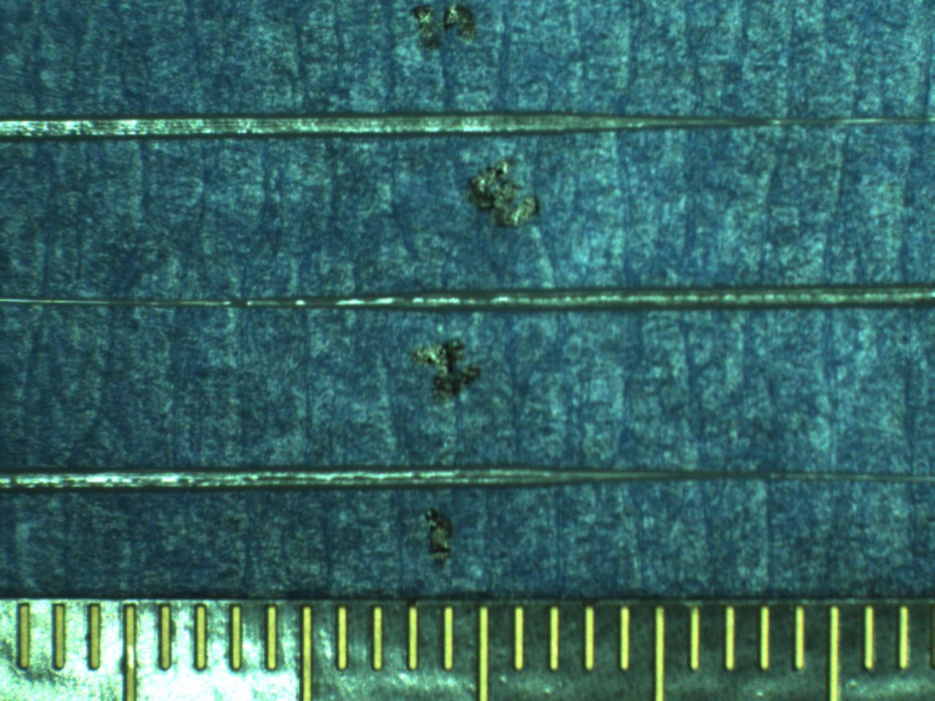
Account for Oozing Plastic
Decelerate near the end of a tool path to accommodate for oozing plastic
Trailing Ooze Profile
Notes:
Basic idea of exponential deceleration is to shut off the flow of plastic early, and decelerate while continuing to ooze plastic at the end of a path, thereby reducing stringing.
This image is a profile of the oozing or leaking plastic and shows an exponential decay.
From Makerbot Support pages:
“Melted plastic is a liquid, so when your extruder stops extruding, plastic will continue to ooze out of the nozzle for a short time at a decreasing rate. Exponential deceleration allows you to use that oozing plastic. First, it stops extrusion a little bit early, so that it can use the ooze to finish the line of extrusion. Then it slowly decelerates the extruder to correspond with the decreasing flow of plastic, so that extrusion width remains consistent.”
We profiled the trail of oozing plastic to determine the rate of deceleration.
References:
https://www.makerbot.com/support/new/04_Desktop/Knowledge_Base/Using_Custom_Slicing_Profiles/MakerBot_Slicer_settings:_Exponential_deceleration

Slide 49
Extrusion Guards
Problem: idle extruders continue to ooze plastic causing “dirty” prints and clogged nozzles
Solution: print Extrusion Guard wall before printing object with idle extruder
[Hilbert Cube (tbuser) / CC BY-SA 3.0]
[Traffic Cone (Dual Extrusion) (CocoNut) / CC BY-SA 3.0]
Patent pending
Notes:
A problem with Dual extrusion is that when one of the extruders is idle, it will continue to melt and ooze plastic.
The solution to this is what we call Extrusion Guards. Before an idle nozzle Is used to print the object, we use it to print a layer of the purge wall. Doing so expunges any blobs that have formed within the idle extruder and effectively wipes off excess plastic.
Extrusion Guards are printed in zigzag pattern to prevent collapse. The walls are located at the bounding box of the meshes, as opposed to following the surface, for faster print times.
Attributions:
http://www.thingiverse.com/thing:16343
http://www.thingiverse.com/tbuser/about
http://creativecommons.org/licenses/by-sa/3.0/
http://www.thingiverse.com/thing:21773
http://www.thingiverse.com/CocoNut/about
http://creativecommons.org/licenses/by-sa/3.0/

Slide 50
Thermal Expansion
Heat creeping up nozzle melting plastic
Visual artifacts - Solutions
Stringing
Blobbing
For dual material, use Extrusion Guards
For single, don’t stop printing!
Notes:
As for blobbing, it’s harder to predict and control. So for dual extrusion, use the Extrusion Guards, but for single material prints, just don’t stop printing because blobbing is most likely to occur when you start printing again after a stop.

