Slide 1
Toolpaths
3D Printing with Plastic Filament

Slide 2
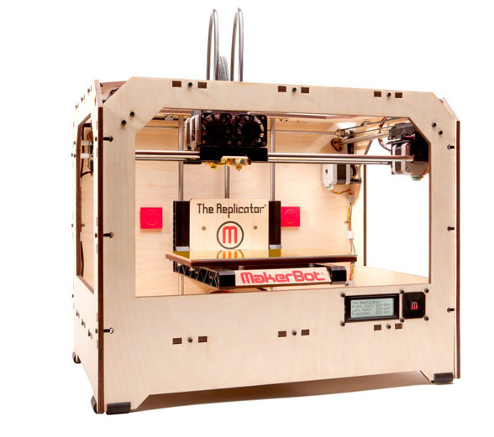
+E
-X
+X
+Z
Notes:
Filament printers, like most additive manufacturing processes, create the object layer after layer.
Therefore, a crucial operation is how to split, or slice, the object into a set of layers.

Slide 3
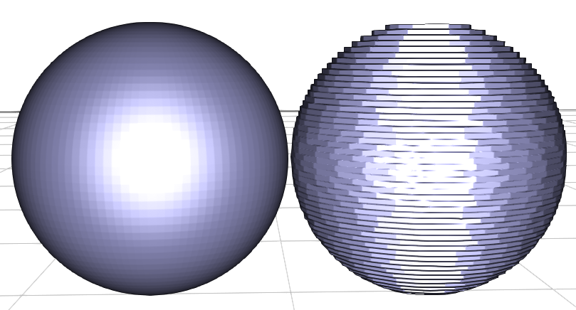
Slicing
Notes:
Here you can see on the left the real object (a finely tessellated sphere) and on the right what will actually get printed. It is obvious that the object we print is different from the initial one. In particular note the stair-stepping effect along the silhouette.
Using thinner slices will reduce this effect, but will require significantly more time. In fact, for the same object you can expect 0,1mm slices to take three times the time it takes to print with 0,3mm slices.

Slide 4
Uniform slicing
Fixed thickness (typically from 0,1 to 0,3 mm)
Z (up) axis
Notes:
The simplest way to divide a 3D model into slices is to do a uniform slicing, that is all slices have the same thickness and the object is regularly subdivided.

Slide 5
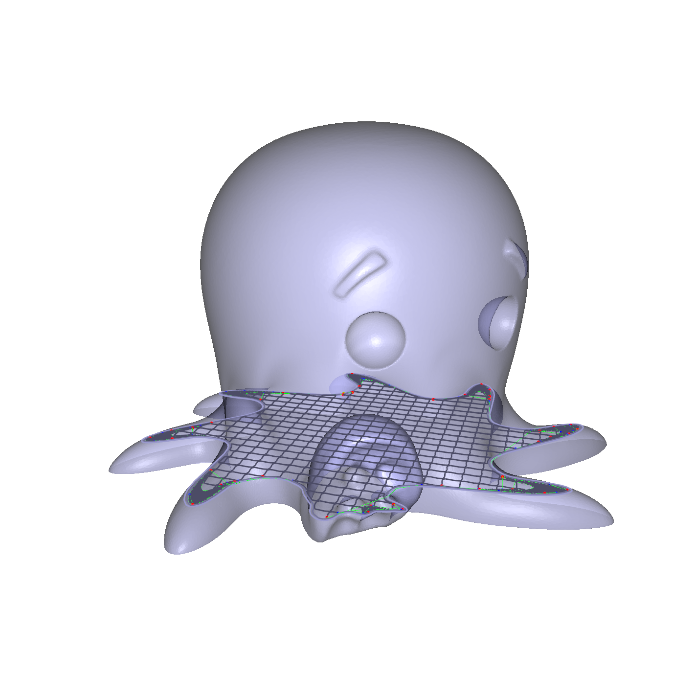
Slice plane
[Cute Octopus Says Hello (MakerBot) / CC BY 3.0]
Notes:
The right image shows what a single slice looks like. It corresponds to the intersection between the object and a plane. Here we show in white the inside and in black the outside. Most slicers will represent this as a polygon, and others will represent the slice as an image.
On the left side you can see the object and were the slice is located. You can also see the toolpaths, that is the paths along which plastic is deposited. We will detail toolpaths in the next part of the course.

Slide 6
Upon printing
extruder
Slice slab
Z (up) axis
Notes:
We have just seen that a slice is the intersection of a plane and the object. When printing, this plane will turn into a slab of plastic.

Slide 7
Volume error
Z (up) axis
Notes:
Here is what is printed. You can see that an error exists where we either push to much plastic (above) or not enough (below).

Slide 8
Minimizing volume error
Optimization
Minimize volume error?
Variables:
Object orientation!
Slice thicknesses
Notes:
The error depends on several variables. An important one is the orientation of the object! For a simple rectangle, the vertical orientation of course gives a perfect results, while any other will result in errors. Of course, on most complex objects this will be a tradeoff.
Please see the references on the website for papers optimizing the orientation automatically.
Another important variable is slice thickness. As we have already seen, making slices thinner improves the result – it reduces the error – however this requires significantly more print time.

Slide 9
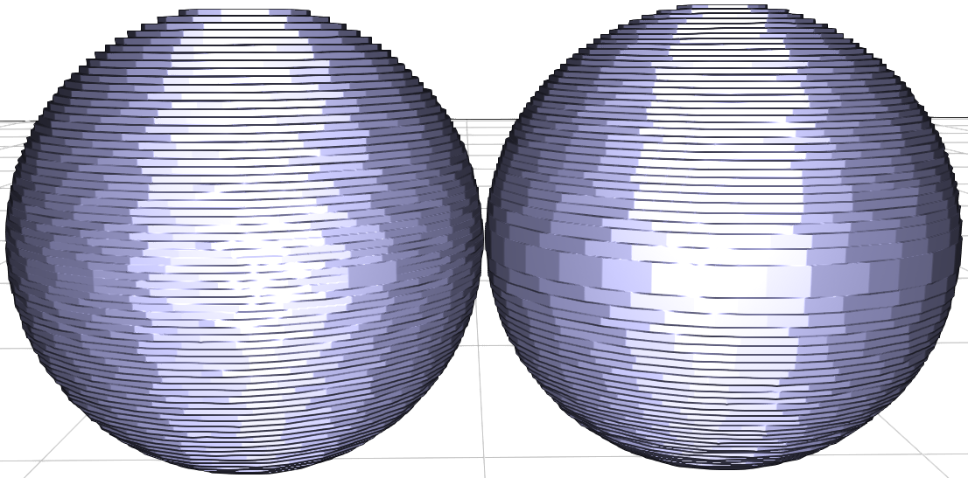
Adaptive slicing
Same number of slices
Notes:
Therefore a different approach has been investigated. The idea is that some parts of the object might produce less errors than others.
In ‘easy’ regions thick slices can be used, whereas smaller slices will be used in more difficult regions.

Slide 10
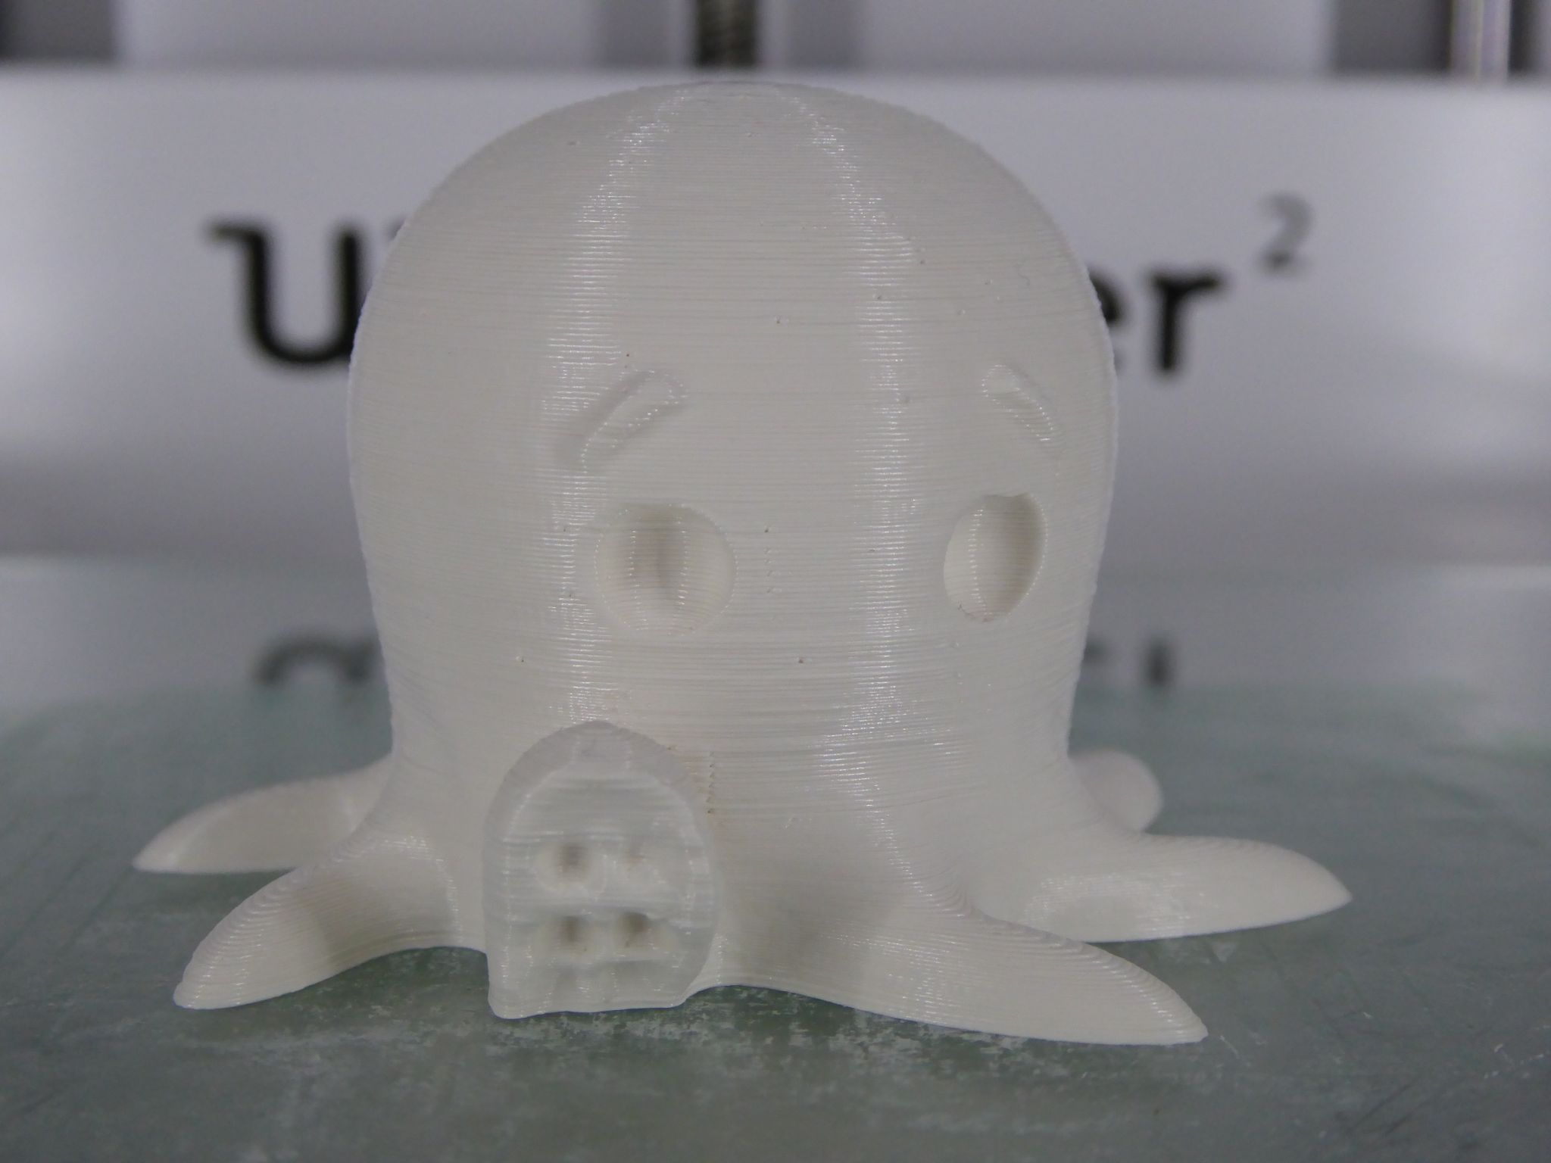
Adaptive slicing
[Cute Octopus Says Hello (MakerBot) / CC BY 3.0]
Notes:
Here is a printed example using adaptive slices.

Slide 11
Adaptive slicing
[Cute Octopus Says Hello (MakerBot) / CC BY 3.0]
Notes:
A close up reveals that thinner slices are used on the tentacles, where the surface becomes almost flat.

Slide 12
Adaptive slicing
Faster for same precision
Do not waste time in ‘simple’ regions
Not so easy to determine best strategy
See survey by [P.M. Pandey et. al. 2003]
Recent work: [Wang et. al. 2015] “Saliency preserving slicing”
Notes:
Adaptive slicing has clear advantages. However, it is not easy to determine the best strategy and to optimize for slice thicknesses. There are several considerations such as the precision, the volume error, but also aesthetics of the final part.
There is a lot of work in this area, but I wanted to point this survey by Pandey and colleagues, as well as recent work by Wang and colleagues regarding adaptive slicing. These are good entry points into the domain if you are interested.
[P.M. Pandey et. al. 2003]
http://web.iitd.ac.in/~pmpandey/RP_html_pdf/slice_review.pdf
[Wang et. al. 2015]
http://staff.ustc.edu.cn/~lgliu/Projects/2015_AdaptiveSlicing_3DPrinting/default.htm

Slide 13
Locally adaptive slicing
Slic3r : micro-layering
IceSL : nested slices
Notes:
A way of slicing that has been proposed in the past is to use thicker slices inside and fine slices outside.
The idea was described early in academia and nowadays a few slicers support this feature. Slic3r calls it micro-layering and IceSL nested slices. A difficulty in this approach is how to stitch correctly the inner and outer parts.

Slide 14
Toolpaths
[Cute Octopus Says Hello (MakerBot) / CC BY 3.0]
Notes:
Now that we have seen how to obtain a set of slices, let’s discuss how the basic toolpaths are obtained.

Slide 15
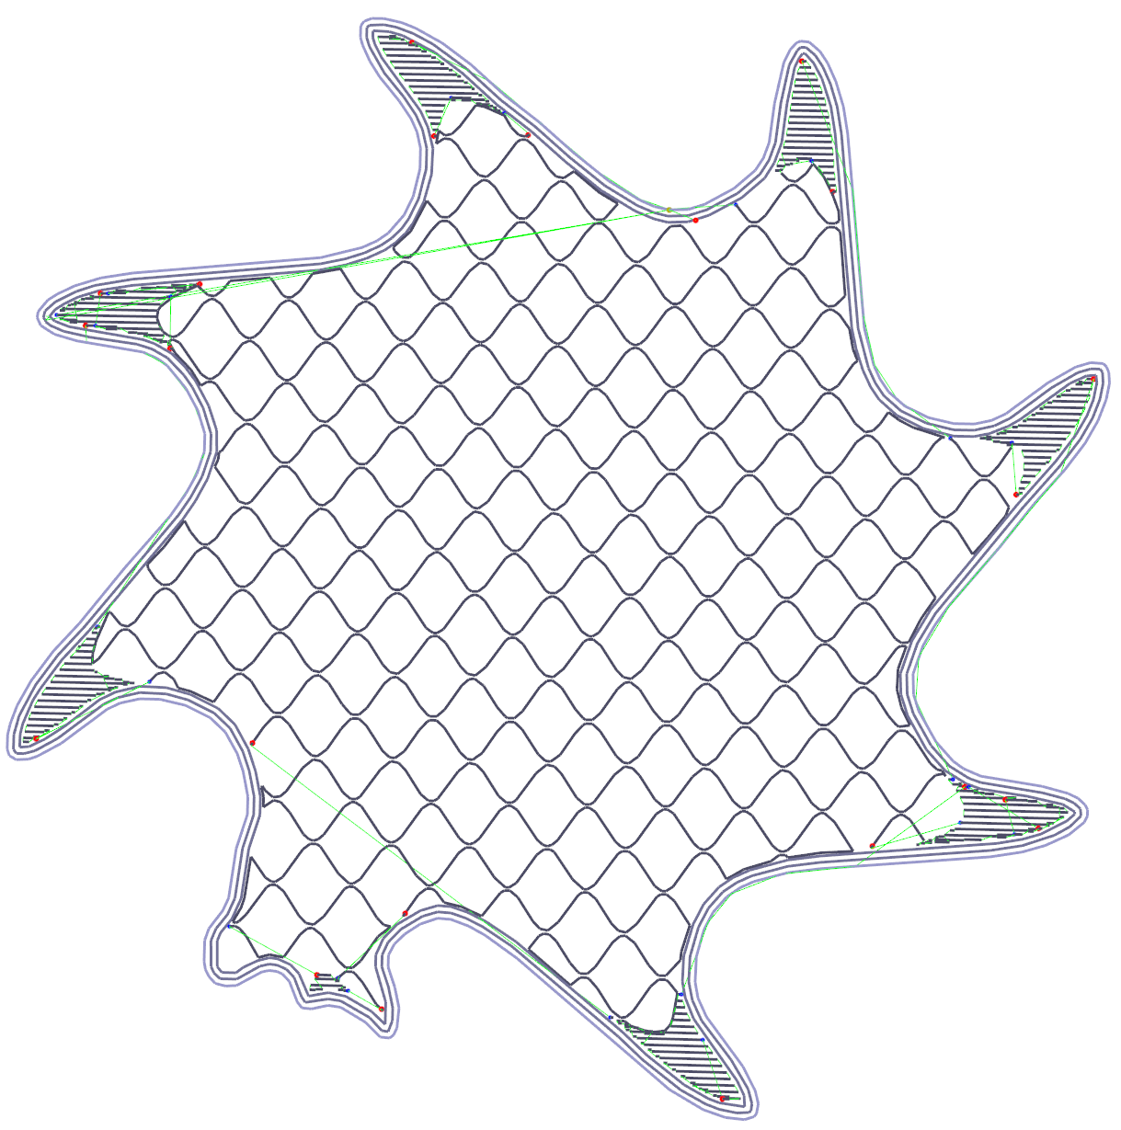
Shells
Infill
Perimeter
Cover
Notes:
First, let’s recall the naming conventions for the different paths. We have perimeters which are the visible part of the object, then shells which are contouring the object inside, and finally the infill paths which are filling the inside.

Slide 16
Erosion (morphological)
Structuring element
(nozzle exit hole)
Slice
Notes:
The mathematical tool we will use the most for producing toolpaths is erosion.
An erosion is done with respect to a structuring element. In our case this is a disk having the diameter of the exit hole of the nozzle.

Slide 17
Erosion (morphological)
Structuring element
(nozzle exit hole)
Erosion: All points where
structuring element is
entirely included
Notes:
Given a slice, shown on the right, the erosion of the slice by the element is defined as the points where the structuring element is fully included within the slice. Here, this is the green polygon.
There are good libraries to compute such operations on polygons, such as CGAL or Clipper (http://www.angusj.com/delphi/clipper.php).

Slide 18
Perimeter
Visible part of the filament
Object contouring
Erosion!
(top view)
Notes:
So, given a slice and a nozzle diameter, how do we extract the perimeter toolpath?
First, it is important to realize that when depositing plastic along a path, the track of plastic goes halfway on either sides of the path followed by the extruder, as shown left.
Therefore, we should not deposit plastic on the exact contour of the slice, otherwise the object will get too big by half the nozzle width!
Instead, we erode the slice by a disk having for diameter the nozzle width. The contour of the resulting polygon is the perimeter path.

Slide 19
Plastic flow
How much plastic to push?
Millimeters of filament (E axis)
FA
E axis
L
Nozzle diameter
Layer height
Filament diameter
Layer height x Nozzle diameter x L
Length to push =
FA

Slide 20
‘Thin features’
Disappears!!!
Notes:
Note that following this definition, thin features – part thinner than the nozzle – will disappear through erosion. We will come back to this later.

Slide 21
‘Thin features’
????
Notes:
But now, let’s come back to thin features. When we do the erosion, features below the nozzle width simply disappear.
Sometimes this is what you want, because these features are arguably below the minimum thickness and can be removed.

Slide 22
A possible approach
Skeleton
Notes:
But what if you still want these features? Then a possible approach is to extract the skeleton of the thin parts. This sounds easy, but it is not as skeleton can be difficult to compute.

Slide 23
A possible approach
Notes:
However, once you get the skeleton you can use it as an additional toolpath.

Slide 24
Arbitrary decision (user?)
Notes:
Whether this is a good idea or not is probably up to the user to decide!

Slide 25
Shells
Note the gaps
More of the same
Might become thin
Notes:
Once we have the perimeter, we are ready to extract a number of shells. We use erosion again.
Note how the inner part might become thin. The thin feature problem will unfortunately appear very often when trying to fill the inside.
Also note that we are leaving small gaps in sharp corners. One possible way to fill these is to push slightly more plastic than exactly required.

Slide 26
Infills
Top / bottom covers
Inside
Full infill (very robust, slow, lots of plastic)
Sparse infill (save plastic and time, less strong)
Notes:
Once we have perimeters and shells, we are ready for infilling.
There are two types of infill. The first is used on tops and bottoms. This infill produces covers such that the inside of the object is not visible through the ‘top’ of the slices.
The second type of infill is used inside the object. With opaque plastic this is completely hidden from view.

Slide 27
100% Infill
Notes:
In purple you can see a typical full infill. The idea is to produce a raster pattern covering the inside.
This seems easy enough, however …

Slide 28
100% Infill
???
Notes:
… some difficulties appear again due to thin gaps.

Slide 29
Flow control
Limited change of thickness
Might not adhere
100%
50%
25%
Notes:
One idea to fill-in these gaps is to play with plastic flow. By changing the flow the ‘thickness’ of the plastic track tends to become smaller.
However, under some threshold plastic will stop exiting the nozzle continuously, so this idea should not be pushed too far.

Slide 30
100% Infill
Notes:
Here is how a smaller plastic track can be used to fill-in the gap. Again this is just a straight segment, pushing less plastic than usual.

Slide 31
Speed
Faster!
Both axis work together: better acceleration
Notes:
As a side note, keep in mind that using angled segments can actually print faster since the acceleration of both axes is combined.

Slide 32
Sparse Infill
Simple approach
Notes:
Now let us discuss sparse infillings.
A simple idea is to skip one segment every N. Here, a 50% infill, keeping only half the infill segments.
The direction is typically alternated between X/Y every other layer to make the part slightly stronger.

Slide 33
Sparse Infill
Squish!
Notes:
Still, this type of infill will not produce strong prints, and the prints might be easily squished.

Slide 34
Sparse Infill
An improved variant:
Could be slow to print
Resonance
Notes:
Here is a much better infill pattern.

Slide 35
Sparse Infill
An improved variant:
Notes:
It would print faster if done this way,

Slide 36
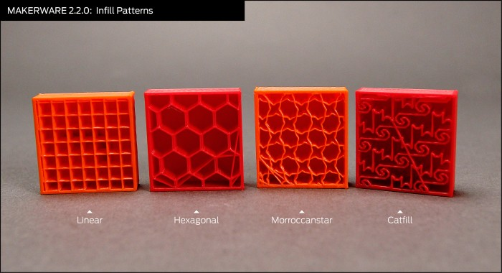
Many other variants
Notes:
There is a much larger variety of possible infill patterns, and a lot of slicer include exotic infillings. Here are some examples from Makerbot.

Slide 37
Improving sparse infill ?
Tradeoff between:
Strength vs Plastic consumption
Time and printability (favor straight, diagonal lines)
Recent works:
[Wang et al. 2013] “Cost effective printing”
[Lu et al. 2014] “Build to last”
Slic3r 3D honeycomb
Generates a 3D cellular pattern
Notes:
Of course a key question is what is the best infill? This is a tradeoff between print time, plastic use and part strength.

Slide 38
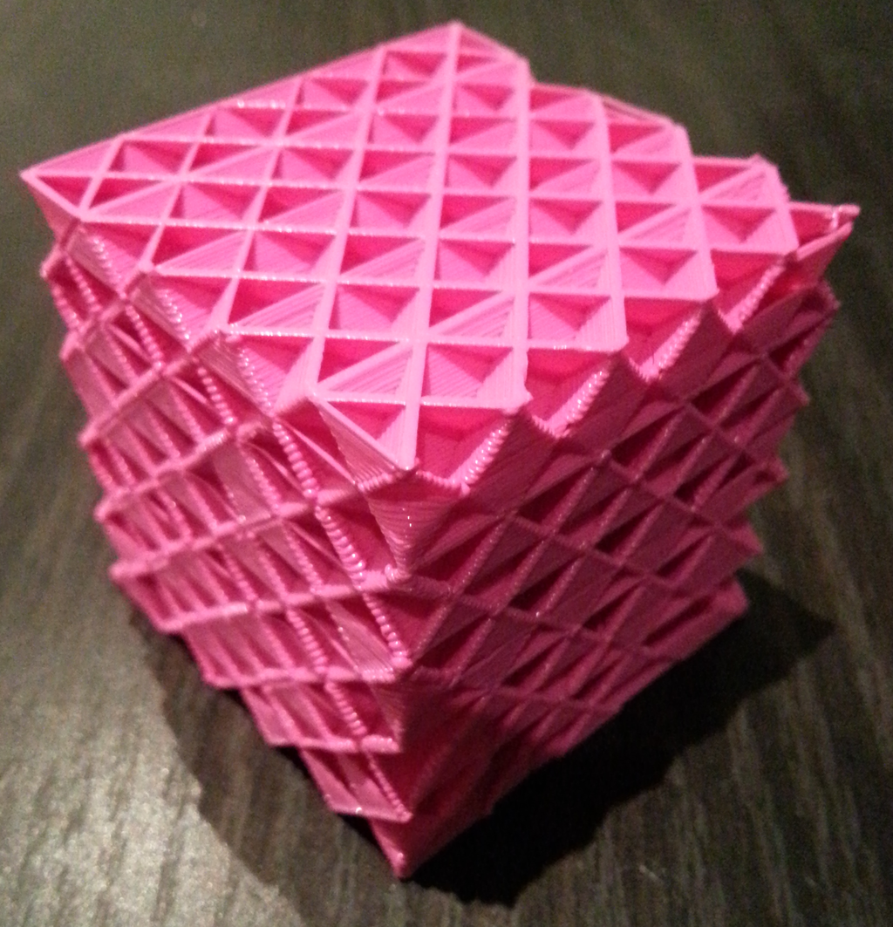
New 3D infills
Just released :-)
See http://sylefeb.blogspot.fr/
[3D infills, Sylvain Lefebvre, CC BY 4.0]
Notes:
Here you can see the latest infills we use in IceSL. They produce 3D cells for maximum strength, while being fast to print.

