Slide 1
Path Ordering
After generating toolpaths for the different parts of a print (shells, infill, supports, etc), a single, fully ordered toolpath must be generated
Path ordering heuristics are used that promote structural integrity and print quality, and reduce print time

Slide 2
Path Ordering Heuristics
Reducing print time
Start at point closest to the last
Contiguous regions of a given type will be printed completely before moving on to other regions
Print quality
Avoid crossing over exterior parts (roofs)
Structural integrity
Shells are printed first before infill
Adjacent shells are printed innermost to outermost
Holes are printed before outlines
Notes:
In terms of print quality, we care most about the outer shell because that is what you’ll see in the final print. Printing the inner shell first provides more stability for the outer shell.

Slide 3
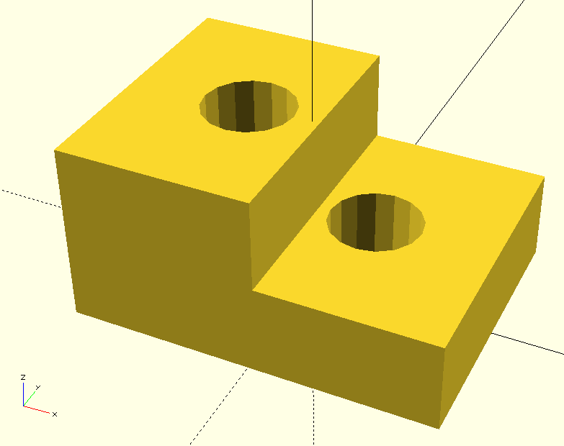
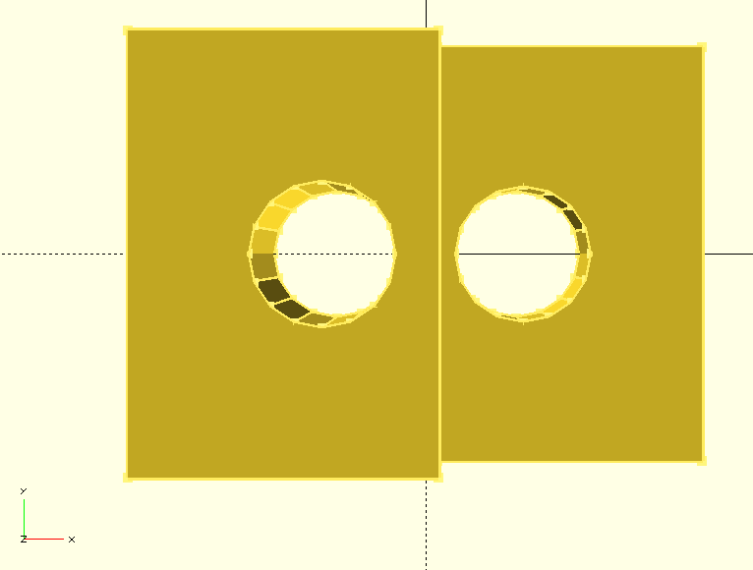
Path Ordering
Notes:
This is the example shape that will be used for shell ordering and infill generation.
Right: This view from the top shows that the holes go all the way through.

Slide 4
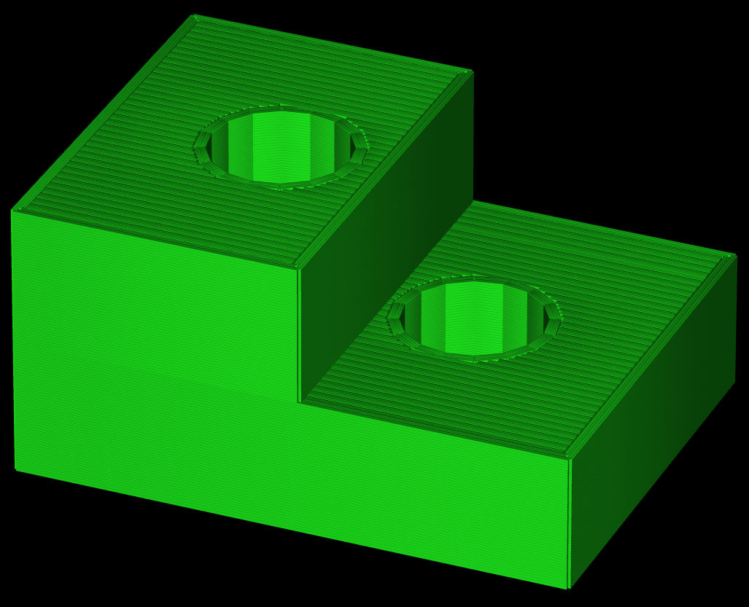
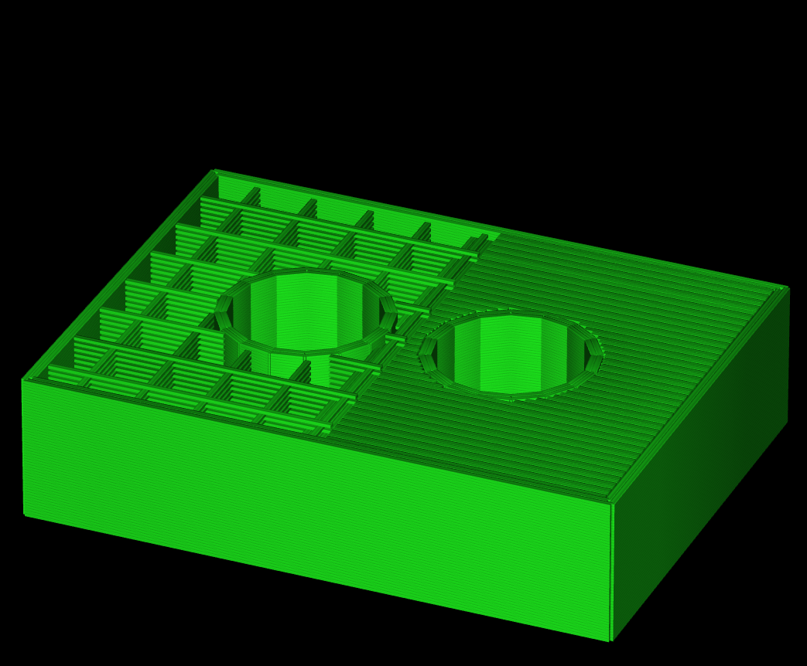
Path Ordering
Notes:
Left: This is the entire toolpath for the example object.
Right: Let's look at one layer near the top of the shorter right side.
We’ll focus on the order in which we print shells first, before moving to infill.

Slide 5
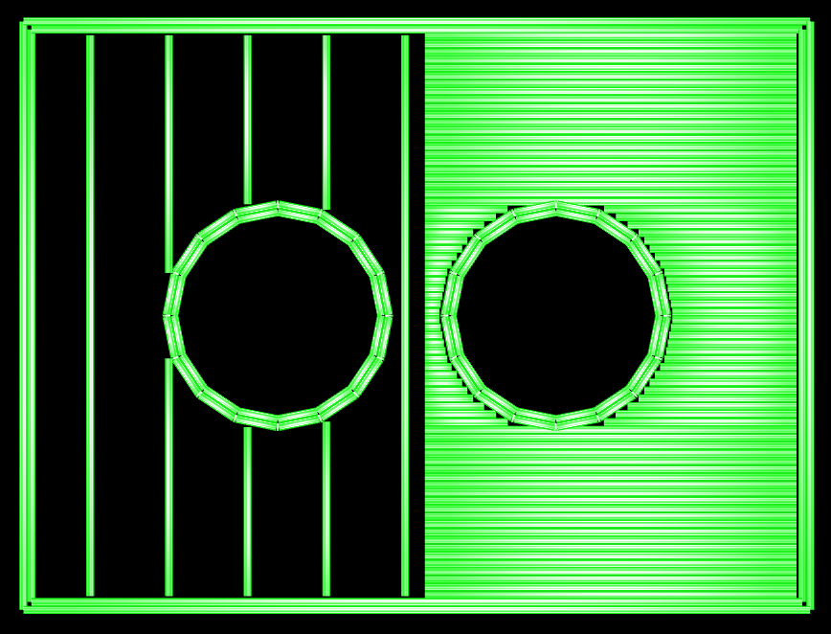
Path Ordering: Shells
Notes:
This shows the top-down view of the single layer that we will examine. The right side has solid fill to support the roof of that section. The left side does not have to support a roof for many layers, so it has sparse fill.
Here is a preview of the toolpath that is generated for this layer.
We print each island completely before moving onto the next. Within each island, we print all of the shells inner-most first, then all of the infill. Here the purple region represents the are where all of the infill will be placed.

Slide 6
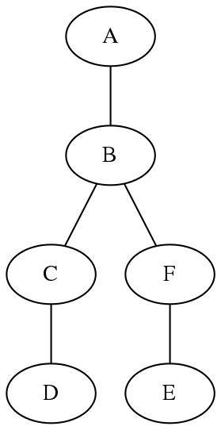
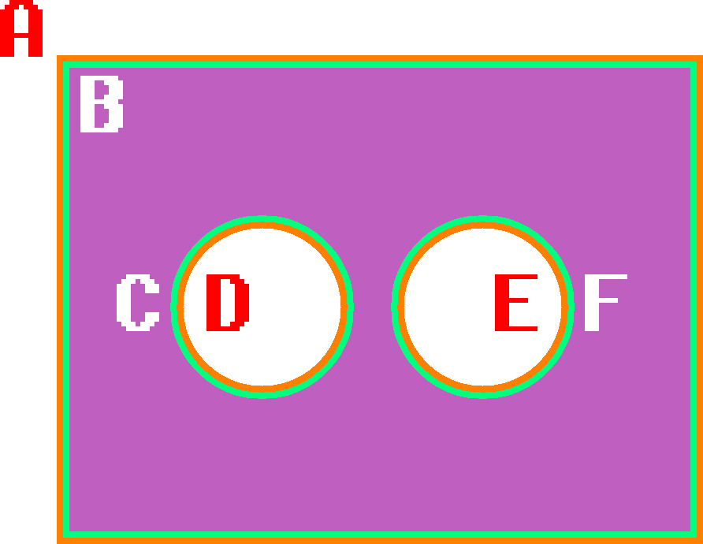
Path Ordering: Shells
Notes:
The shells are labeled A to F. Notice how A, D, and E are outer shells and B, C, F are inner shells. Shells are done inner to outer so that out-ward shells can attach the in-ward shells for more stability. This relative order matters only for shells that are in contact.
Here's how we satisfy this requirement.
Build a tree out of the loops that make up the shells. Loop X is a child of loop Y if X is inside Y using the even-odd test. Traverse this tree depth-first.
The only choices to be made:
To do a shell on the way down or on the way up?
In which order to traverse siblings?

Slide 7
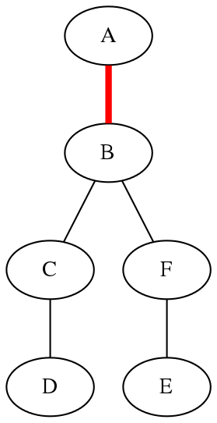
Path Ordering: Shells
Notes:
Start at the root. There is exactly one child. We want to do shells inner-most first. B is an inner shell and A is an outer shell. A has to be done in the way up.

Slide 8
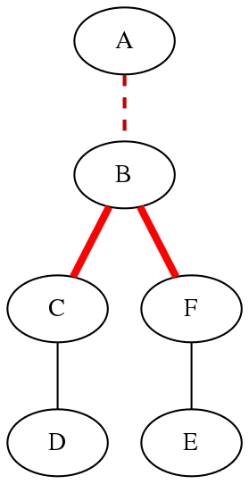
Path Ordering: Shells
Notes:
B has multiple children. How do we chose an order?

Slide 9
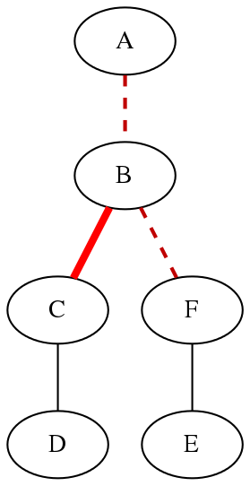
Path Ordering: Shells
Notes:
Which loop is closest to the previously printed point? This will be the last point of the previous layer or of another island. Assume for this example that C is closer.

Slide 10
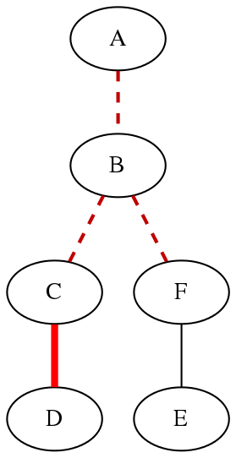
Path Ordering: Shells
Notes:
C is an inner shell and D is an outer shell. C has to be done on the way down.

Slide 11
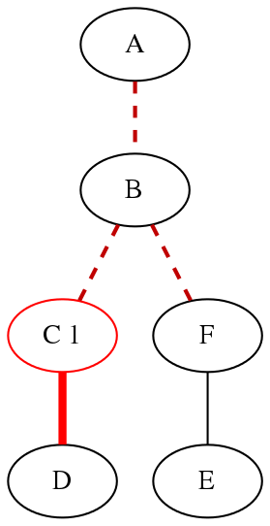
Path Ordering: Shells
Notes:
C is the first shell to be printed.

Slide 12
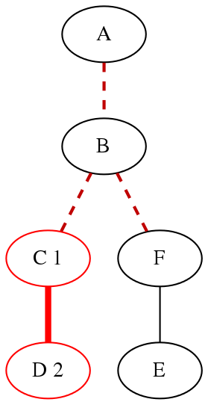
Path Ordering: Shells
Notes:
D has no children. Print it next.

Slide 13
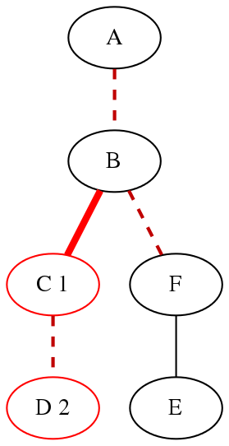
Path Ordering: Shells
Notes:
We continue the depth-first traversal...

Slide 14
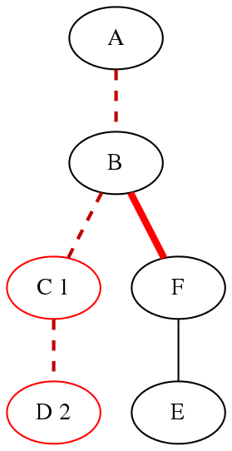
Path Ordering: Shells

Slide 15
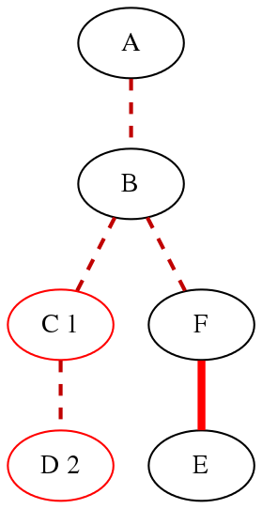
Path Ordering: Shells

Slide 16
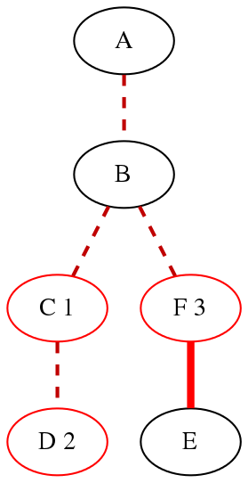
Path Ordering: Shells

Slide 17
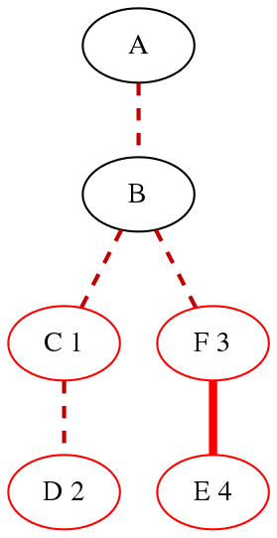
Path Ordering: Shells
Notes:
The same procedure is done for the other sub-tree.

Slide 18
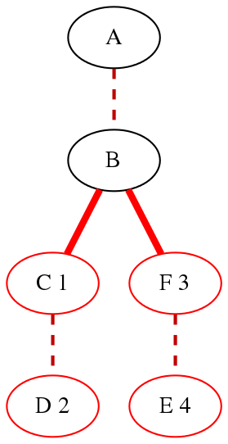
Path Ordering: Shells
Notes:
For any node, if we did not chose to print it on the way down, we print it on the way up, after all of its children have been traversed.

Slide 19
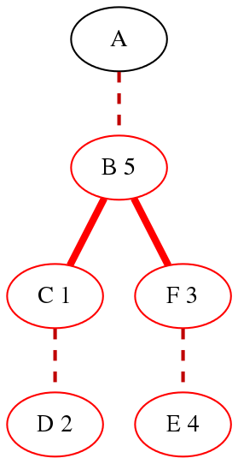
Path Ordering: Shells
Notes:
This means B is printed 5th, after C, D, F, and E.

Slide 20
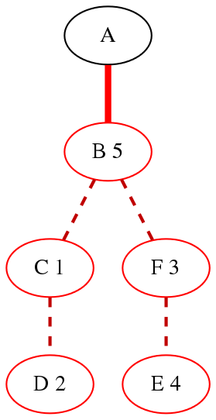
Path Ordering: Shells
Notes:
Finally...

Slide 21
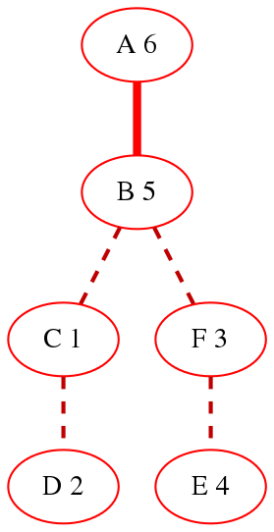
Path Ordering: Shells
Notes:
The outermost shell, A, is printed last.

Slide 22
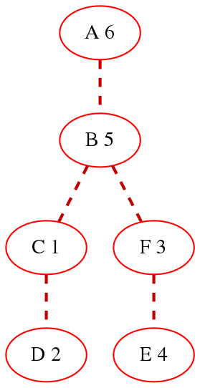
Path Ordering: Shells
Final order: C D F E B A
Notes:
Final order for printing:
C, D, F, E, B, A

Slide 23
Path Ordering: Infill
Notes:
Returning to the toolpath view of the single layer - the right side has solid fill to support the roof of that section. The left side does not have to support a roof for many layers, so it has sparse fill.
(Click) We will now focus on generating the paths for infill and connecting them optimally.
The pale green region on the right will be filled by solid fill, the pale blue one on the left by sparse fill. Notice the slight gap between these regions and the shells. The gap (purple outline) prevents the tips of the fill paths from overlapping too much with the shells and with each other. This will be shown on a later slide.

Slide 24
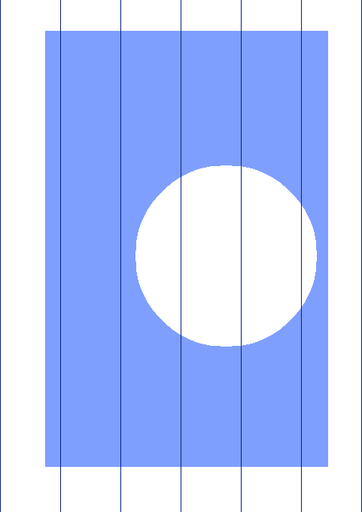
Path Ordering: Infill
Notes:
All infill starts as a simple repeating pattern.

Slide 25
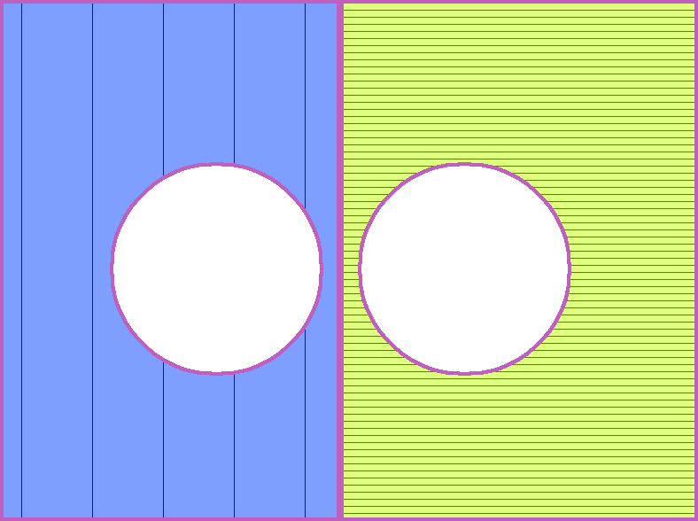
Path Ordering: Infill
Notes:
To get only the parts we want to print, we cut off anything that does not fall inside the region. A good analogy is cutting off extra wallpaper.

Slide 26
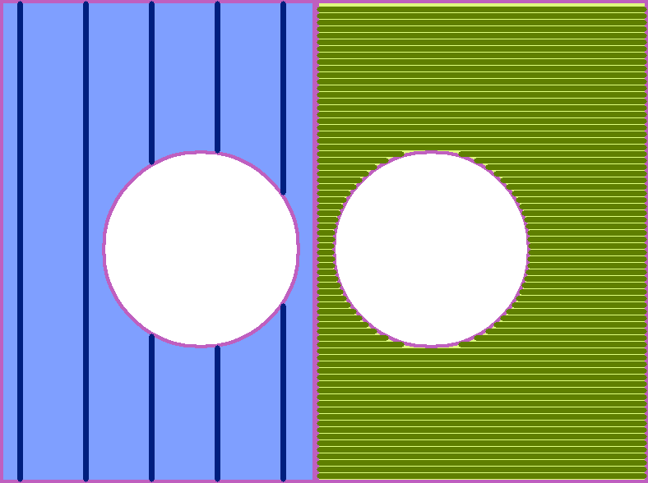
Path Ordering: Infill
Notes:
When printed, the lines will have real width. This includes their sides and ends. We adjust the gap between the fill regions and the shells to control the amount of overlap between the shells and the fill lines.

Slide 27
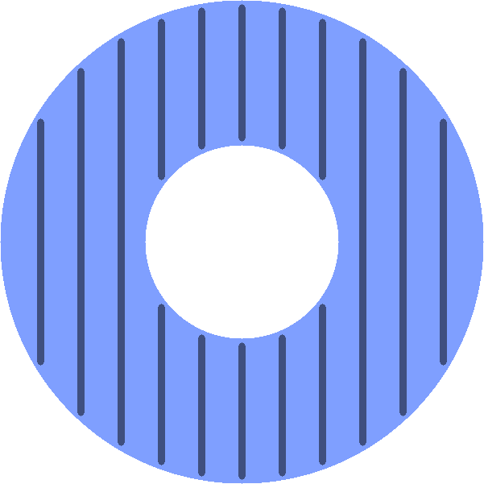
Path Ordering: Infill
Notes:
When the paths are generated, we know only where they will be printed, not in what order or direction. It is the job of path optimization to select an order that will be optimal for printing.
"Optimal" means different things for different kinds of paths. Let's consider the following example region and fill paths:

Slide 28
Path Ordering: Infill
Sparse infill supports the roof and provides rigidity, and is not visible in final print
Optimal rules for sparse infill should favor speed over print quality:
Minimize retraction
Pick the closest point
Notes:
On the next slide we will see what implications these rules have.

Slide 29
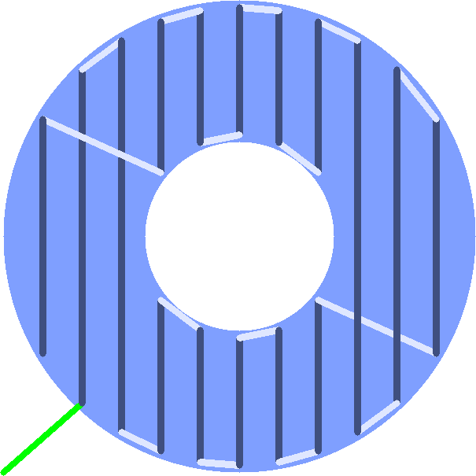
Path Ordering: Infill
Notes:
The starting point is on the bottom left. Green lines represent travel moves. These are moves where the printer retracts, moves quickly to the end point, then restarts. The lightly coloured lines represent connections. These are extra paths added by path optimization that were not in the input. They would be printed in exactly the same way as the sparse fill paths.

Slide 30
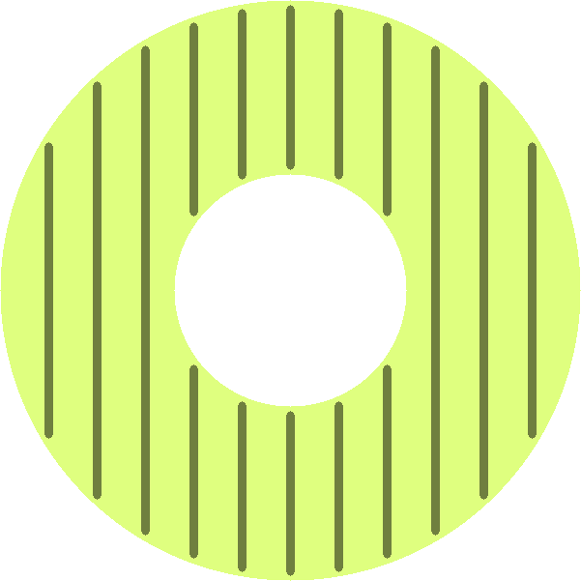
Path Ordering: Infill
Notes:
Let's see what would happen if these paths were printed as part of solid fill. Solid fill is the tightly packed lines that make up the exposed top and bottom of an object. Since these are visible, the rules are slightly different.

Slide 31
Path Ordering: Infill
Solid fill are the tightly packed lines that make up the exposed roofs and floors visible at the top and bottom of a print
We want to avoid extruding:
Between solid layers
Over exposed areas
Notes:
Extra filament between solid layers can cause a bump to propagate up to the surface of the object.

Slide 32
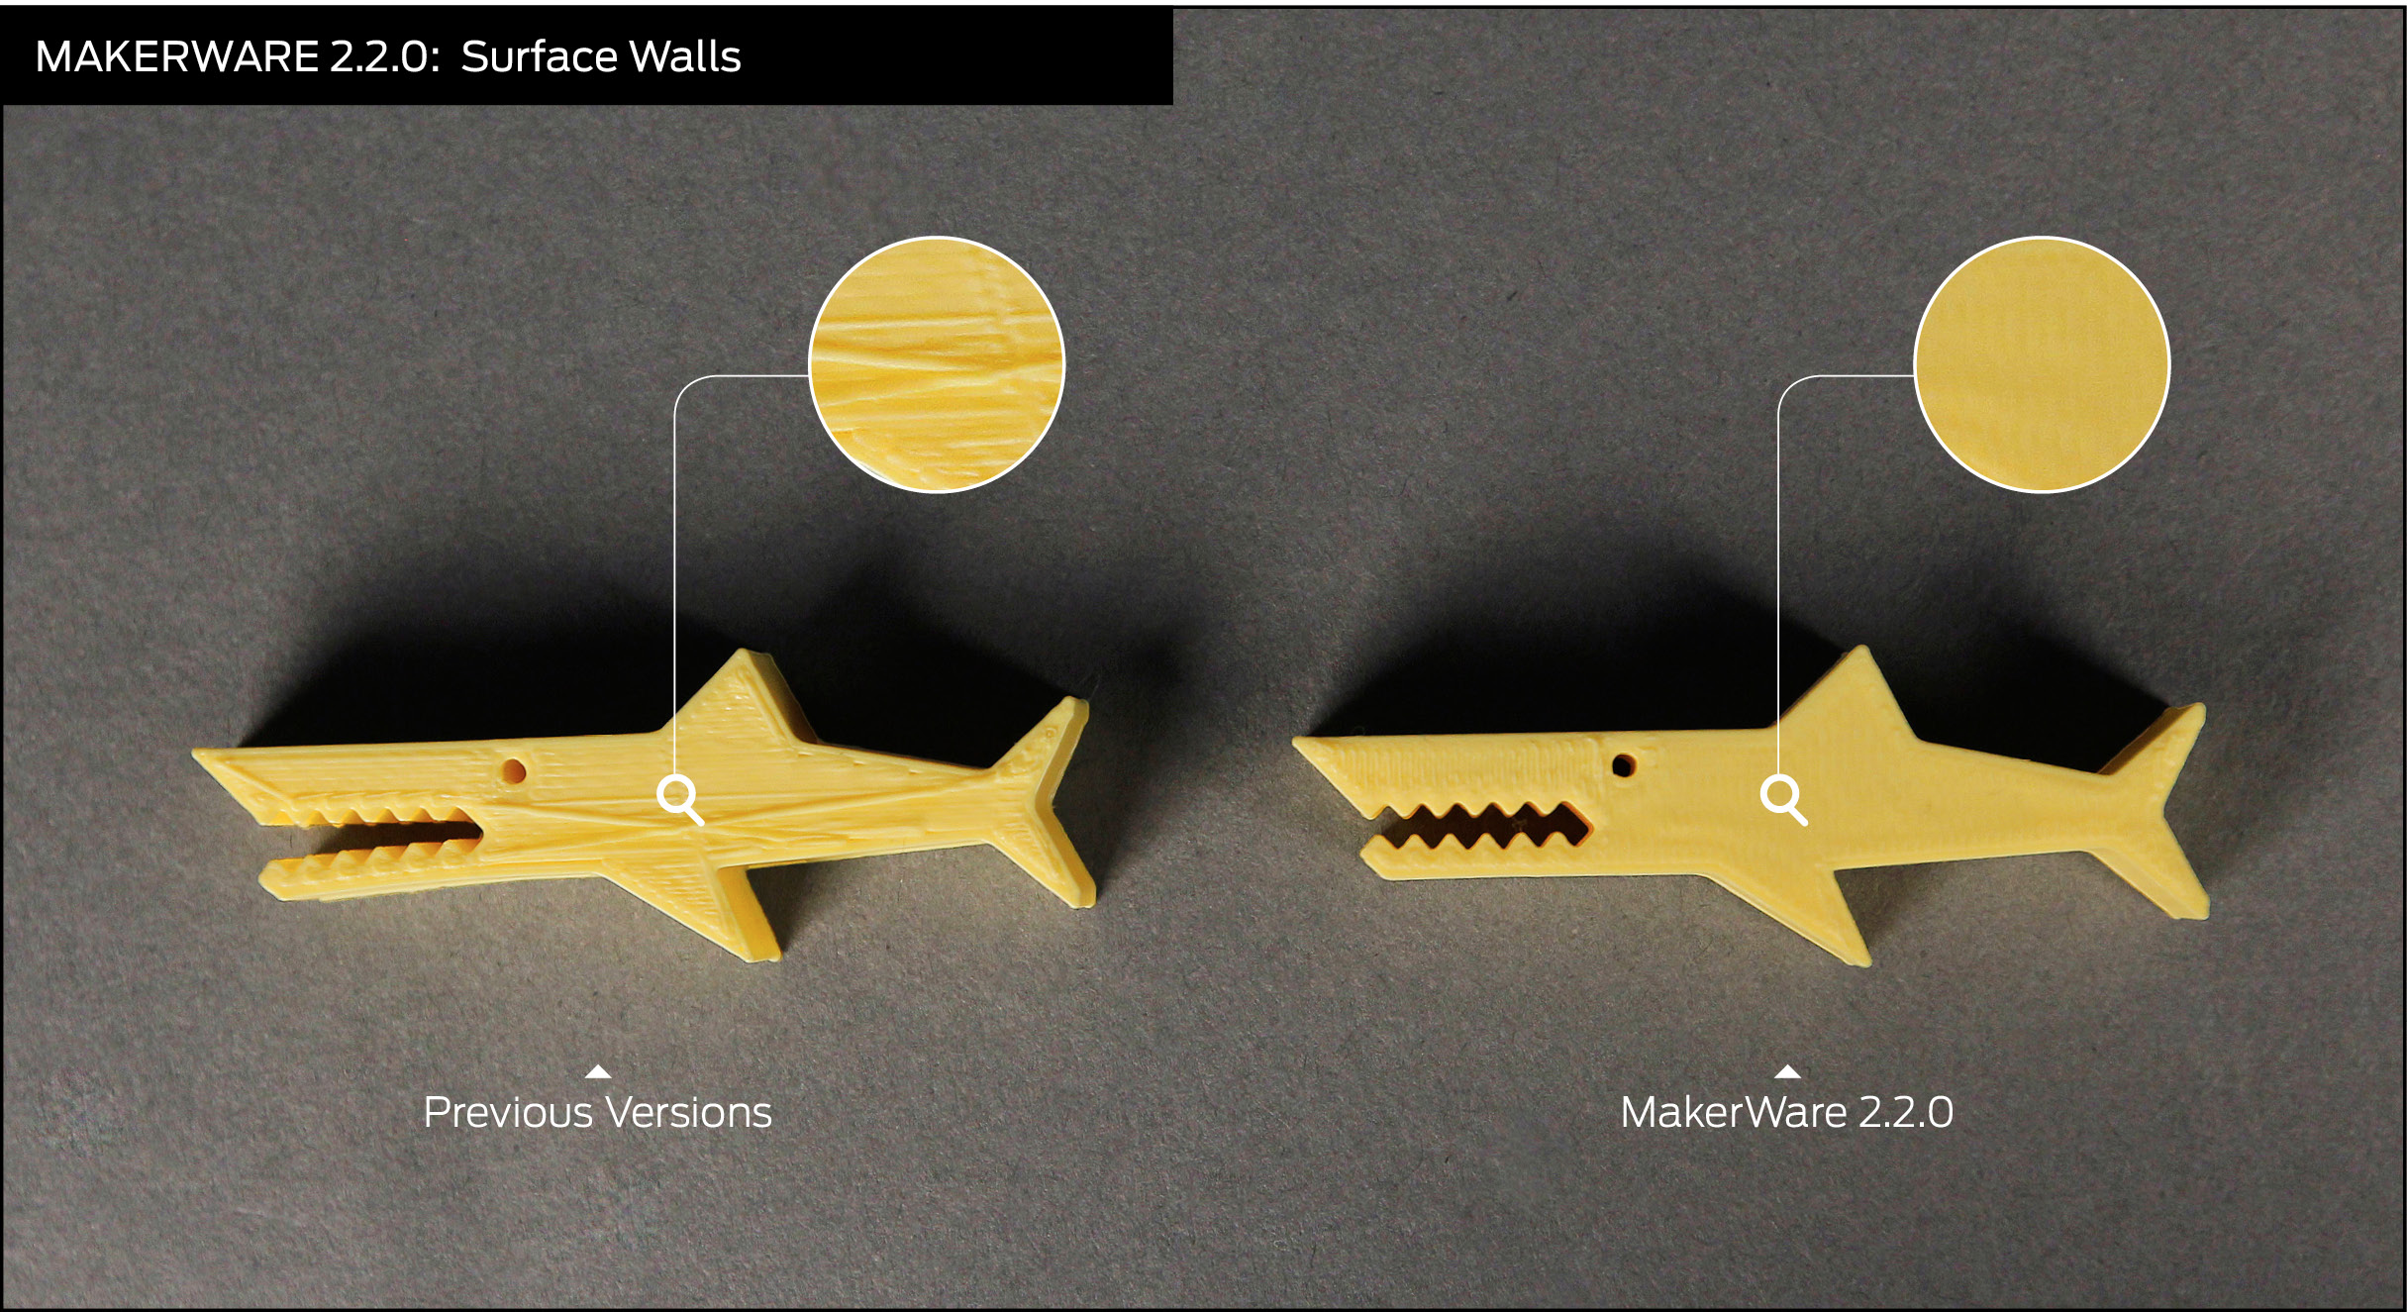
Path Ordering: Infill
Extruding over exposed areas
Notes:
Extra filament between solid layers can cause a bump to propagate up to the surface of the object.

Slide 33
Path Ordering: Infill
Optimal rules for solid fill should favor print quality over speed:
Avoid extruding over fill paths
Minimize retraction
Pick the closest point

Slide 34
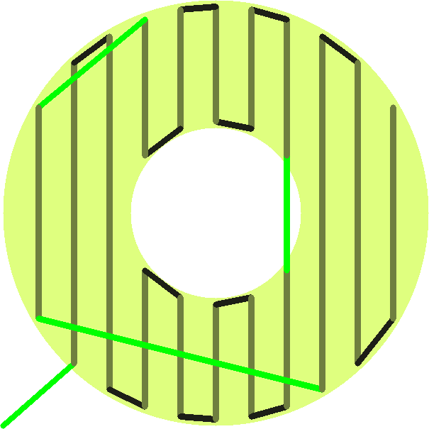
Path Ordering: Infill
Notes:
This is the result of applying the solid fill rules from the previous slide. The starting point is on the bottom left. Green lines represent travel moves (with retractions), dark lines represent connections.
Notice that additional travel moves (which mean additional retractions) have been added to avoid extruding over the solid fill paths.

Slide 35
Path Ordering: Infill
Fill path
Travel moves (with retraction)
Connections (extruding)
Notes:
Left: Sparse fill
Right: Solid fill
The starting point is on the bottom left. Green lines represent travel moves. These are moves where the printer retracts, moves quickly to the end point, then restarts. The lightly coloured lines represent connections. These are extra paths added by path optimization that were not in the input. They would be printed in exactly the same way as the sparse fill paths.
This is the result of applying the solid fill rules from the previous slide. The starting point is on the bottom left. Green lines represent travel moves (with retractions), dark lines represent connections.

Slide 36
Putting it All together
Notes:
Again, the animation of the toolpath

Slide 37
Factors Affecting Print time
3D Printing with Plastic Filament

Slide 38
Print Speed Heuristics
Shells, floors, and roofs are printed slowly for high quality
Infill and supports can be printed at higher speeds
Travel moves are typically at faster speeds than extrusion moves
Leaky moves avoid retraction
Notes:
Travel moves are non-extrusion moves that include a retraction. Retractions require a full stop.
Leaky moves are travel moves w/o retraction. The extruder will continue to ooze plastic, causing stringiness during the travel, but avoids a retraction which is time consuming due to the required full-stop and the time for retraction.
Reference:
https://www.makerbot.com/support/new/04_Desktop/Knowledge_Base/Using_Custom_Slicing_Profiles/03-MakerBot_Slicer_settings:_Travel_Movement
https://www.makerbot.com/support/new/04_Desktop/Knowledge_Base/Using_Custom_Slicing_Profiles/MakerBot_Slicer_settings:_Leaky_connections

Slide 39
Print Times
(Estimated hrs:mins:secs)
20mm Box | 00:13:29
Full Replicator Mini Build Volume (10cm x 10cm x 12.5cm) | 21:18:22
Full Replicator Build Volume (25cm x 20cm x 15cm) | 42:17:59
Full Z18 Build Volume (30cm x 30.5cm x 46cm) | 199:19:12
Notes:
Estimated print times with default settings.

Slide 40
Reducing Print TIme
Extrude at high speed for as much of the print as possible
Tool path optimization
Start a layer near the last
Reduce retractions – allow leaky moves
Speed up travel moves
Avoid sharp turns (e.g., in printing fill)
Jin et al. 2014
Thick infill and supports
Notes:
Toolpath optimization – e.g., by starting a layer near where the last layer finished, and avoid retractions (which also require a full-stop).
We can reduce retractions by, for example, not retracting when traveling over infill since we don’t care that we have extra plastic in the infill.
Avoiding sharp turns in printing reduces print time because the gantry and extruder does not have to slow down to make the turn. The sharper the turn, the more deceleration is required – e.g., 360 degree turn is the worst. Because we don’t really want to alter the model contours, the only place we can avoid sharp turns is in the fill pattern. So, for example, linear infill is much faster than hexagonal infill. In Jin et al.’s paper, they optimize the orientation of the fill pattern to reduce sharp turns.
Reference:
“Optimization of tool-path generation for material extrusion-based additive manufacturing technology”, Jin et al., Additive Manufacturing 1-4 (2014), pp32-47

Slide 41
100 Micron prints
Slow – dense tool path
Poor quality
100μ solid fill is brittle
100μ supports fall down
100μ bridges fail
Without rafts, build plate needs to be leveled within 100μ
Solution: Thick infill and supports
Notes:
So with the advent of 100 micron layers, came a series of problems related to both print speed and quality.
Solid fill at 100 microns is brittle, and takes many layers to seal over.
Support at 100 microns doesn’t stand up.
100 micron bridges don’t work well.
W/o rafts, 100 micron prints require build plate to be leveled to within 100 microns.
Our slicer architecture enabled us to break the uniform layer constraint. Uniform layer constraint is where all layers must be the same height, and in particular, all elements within a layer must be the same height. By breaking the uniform layer constraint, we can more quickly print infill and supports by making them thicker than the high resolution shells. Simplify3D also does this.

Slide 42
Thick Fill
Print infill, supports, and rafts at standard layer height (reduces print time)
More complex tool path optimization
Path dependencies:
Z height
Move platform down, not up
Extrusion guards
Minimum cooling time required between layers
Notes:
Infill, supports, and rafts do not need to be high resolution, so print them at standard layer height. But this leads to a more complex toolpath because now within a layer, you may have components that are off different heights.
Z height dependency: obviously, we want to print layers below before printing those that sit on top of them.
But more specifically, we want to always move the nozzle up and not down – we don’t want nozzle to hit any printed material
For dual material, need to account for extrusion guards
Minimum cooling time – minimum time spent on printing a layer. W/o this, very narrow tall things will not have time to cool between layers and they become unstable and collapse
These constraints become more complicated to implement when we have regions of variable layer height.

Slide 43
Build Plate Adhesion
3D Printing with Plastic Filament

Slide 44
Build Plate Adhesion
Ideally, build plate should be:
Level
Completely flat
Adhesive enough to keep print stable while printing
Not too adhesive such that removing a print is difficult or damages the print
Notes:
In reality, this is not the case.
We have a build plate that in some cases is not level and/or not flat. It is not adhesive enough to keep large or very small prints from separating from the build plate. Depending on how close the build plate is to the nozzle, the resulting print may be difficult to remove from the plate.

Slide 45
Build Plate Adhesion: Goals
Print should adhere well to build plate while printing
Print should be easy to remove when printing completes
Tolerant to build plates that are not flat and/or not level

Slide 46
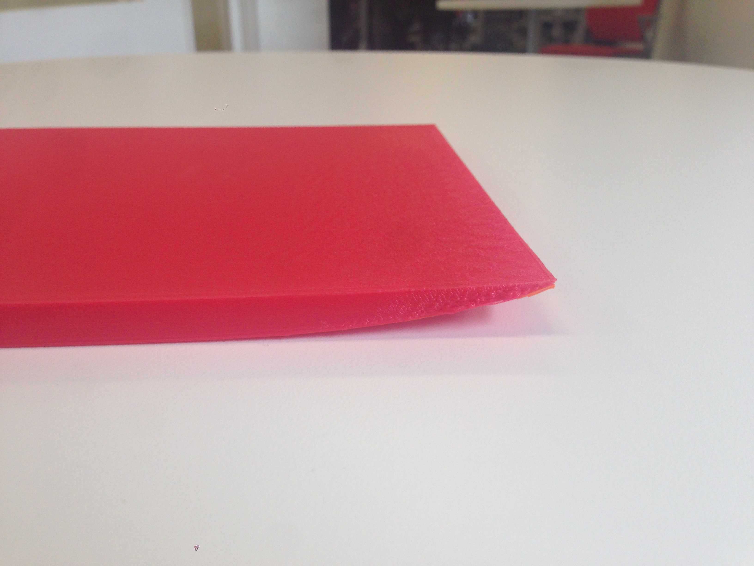
Build Plate Adhesion
Warping
Notes:
This is a defect that occurs when the object surface is not adhering enough to the build plate. Let’s take a look at what causes warping.

Slide 47
Build Plate Adhesion
Build Plate
Notes:
The goal of the first layer printed on top of the platform is to provide a stable and level base on which the rest of the model can be printed. Several phenomena counteract this goal.
This is a view from the side of the first layer being printed. The platform is represented in grey, the plastic in brown, and the nozzle in dark yellow.

Slide 48
Build Plate Adhesion
Build Plate
Notes:
For some time after the plastic is deposited, there exists a thermal gradient. The top portion (closer to the extruder nozzle) will be hotter than the bottom portion. As the top and bottom of the plastic cool at different rates, it will tend to "warp" off the platform.

Slide 49
Build Plate Adhesion
Build Plate
Notes:
One way to counteract this warping is to heat the platform. This reduces the thermal gradient, thus reducing the warping forces.

Slide 50
Build Plate Adhesion
Build Plate
Notes:
Another approach is to avoid printing long straight extrusions. Limiting the length of each segment limits the warping forces it experiences.

Slide 51
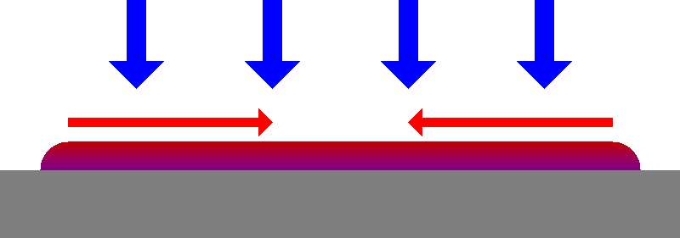
Build Plate Adhesion
Build Plate
Notes:
It is also possible to reduce the thermal gradient slightly by actively cooling the extruded filament. Most printers do this by using a fan attached to the extruder to blow surrounding air onto the extruded plastic.
The amount of cooling this can provide is limited by the amount of time an extrusion can spend within range of the fan.

Slide 52
Build Plate Adhesion
Z-homing: Process by which we determine the distance between the extruder and the build plate
Notes:
Another goal for the first layer printed on to the platform is to absorb inconsistencies in the platform surface. We accomplish this by printing very thick, widely spaced lines.
- When the platform is close to the nozzle, there is room for the plastic to spread sideways
- When the platform is far from the nozzle, there is enough plastic for a good bond to be made
This technique can compensate for inconsistent platform homing and platforms that are not flat or level within some amount.

Slide 53
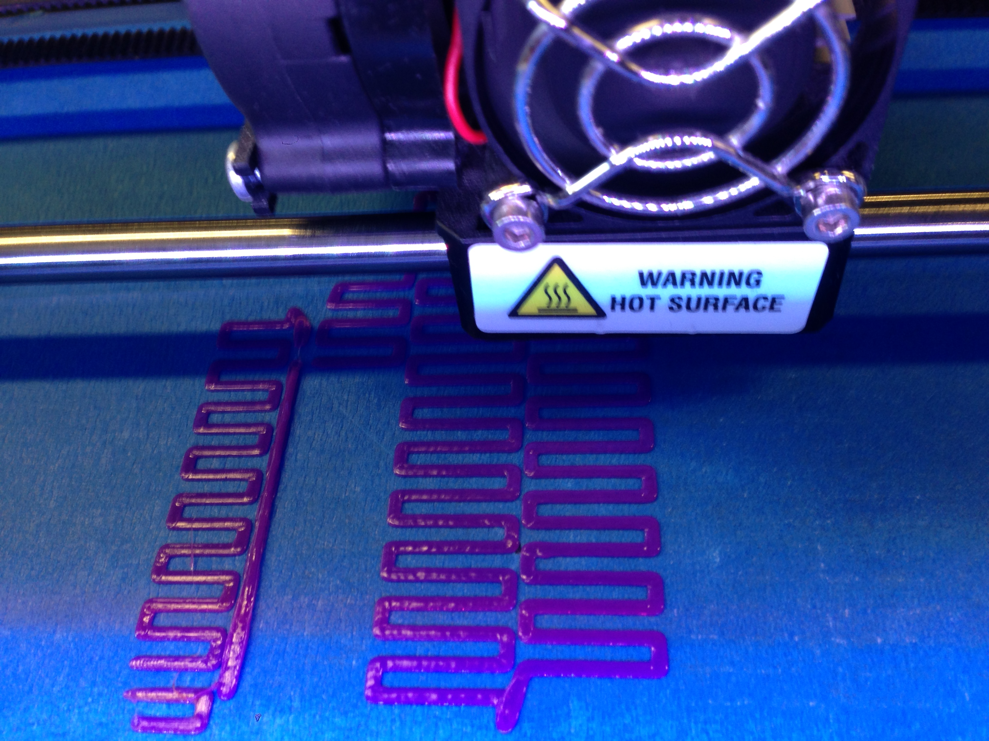
Concept To Practice: Rafts
First raft layer comprised of thick filaments for easy removal, and widely spaced with short runs to prevent warping
Notes:
Rafts were developed to solve warping on Rep2. As an added benefit, it helped with the Mini which has no leveling. It allowed us to have non-parallelism of the plate to within 1.6mm.
First, we have thick filaments with wide spacing for easy removal from build plate.
Reduce warping – no straight line longer than specified amount. This zigzag pattern are short runs.
Adhesion to object’s first layer prevents object itself from warping.

Slide 54
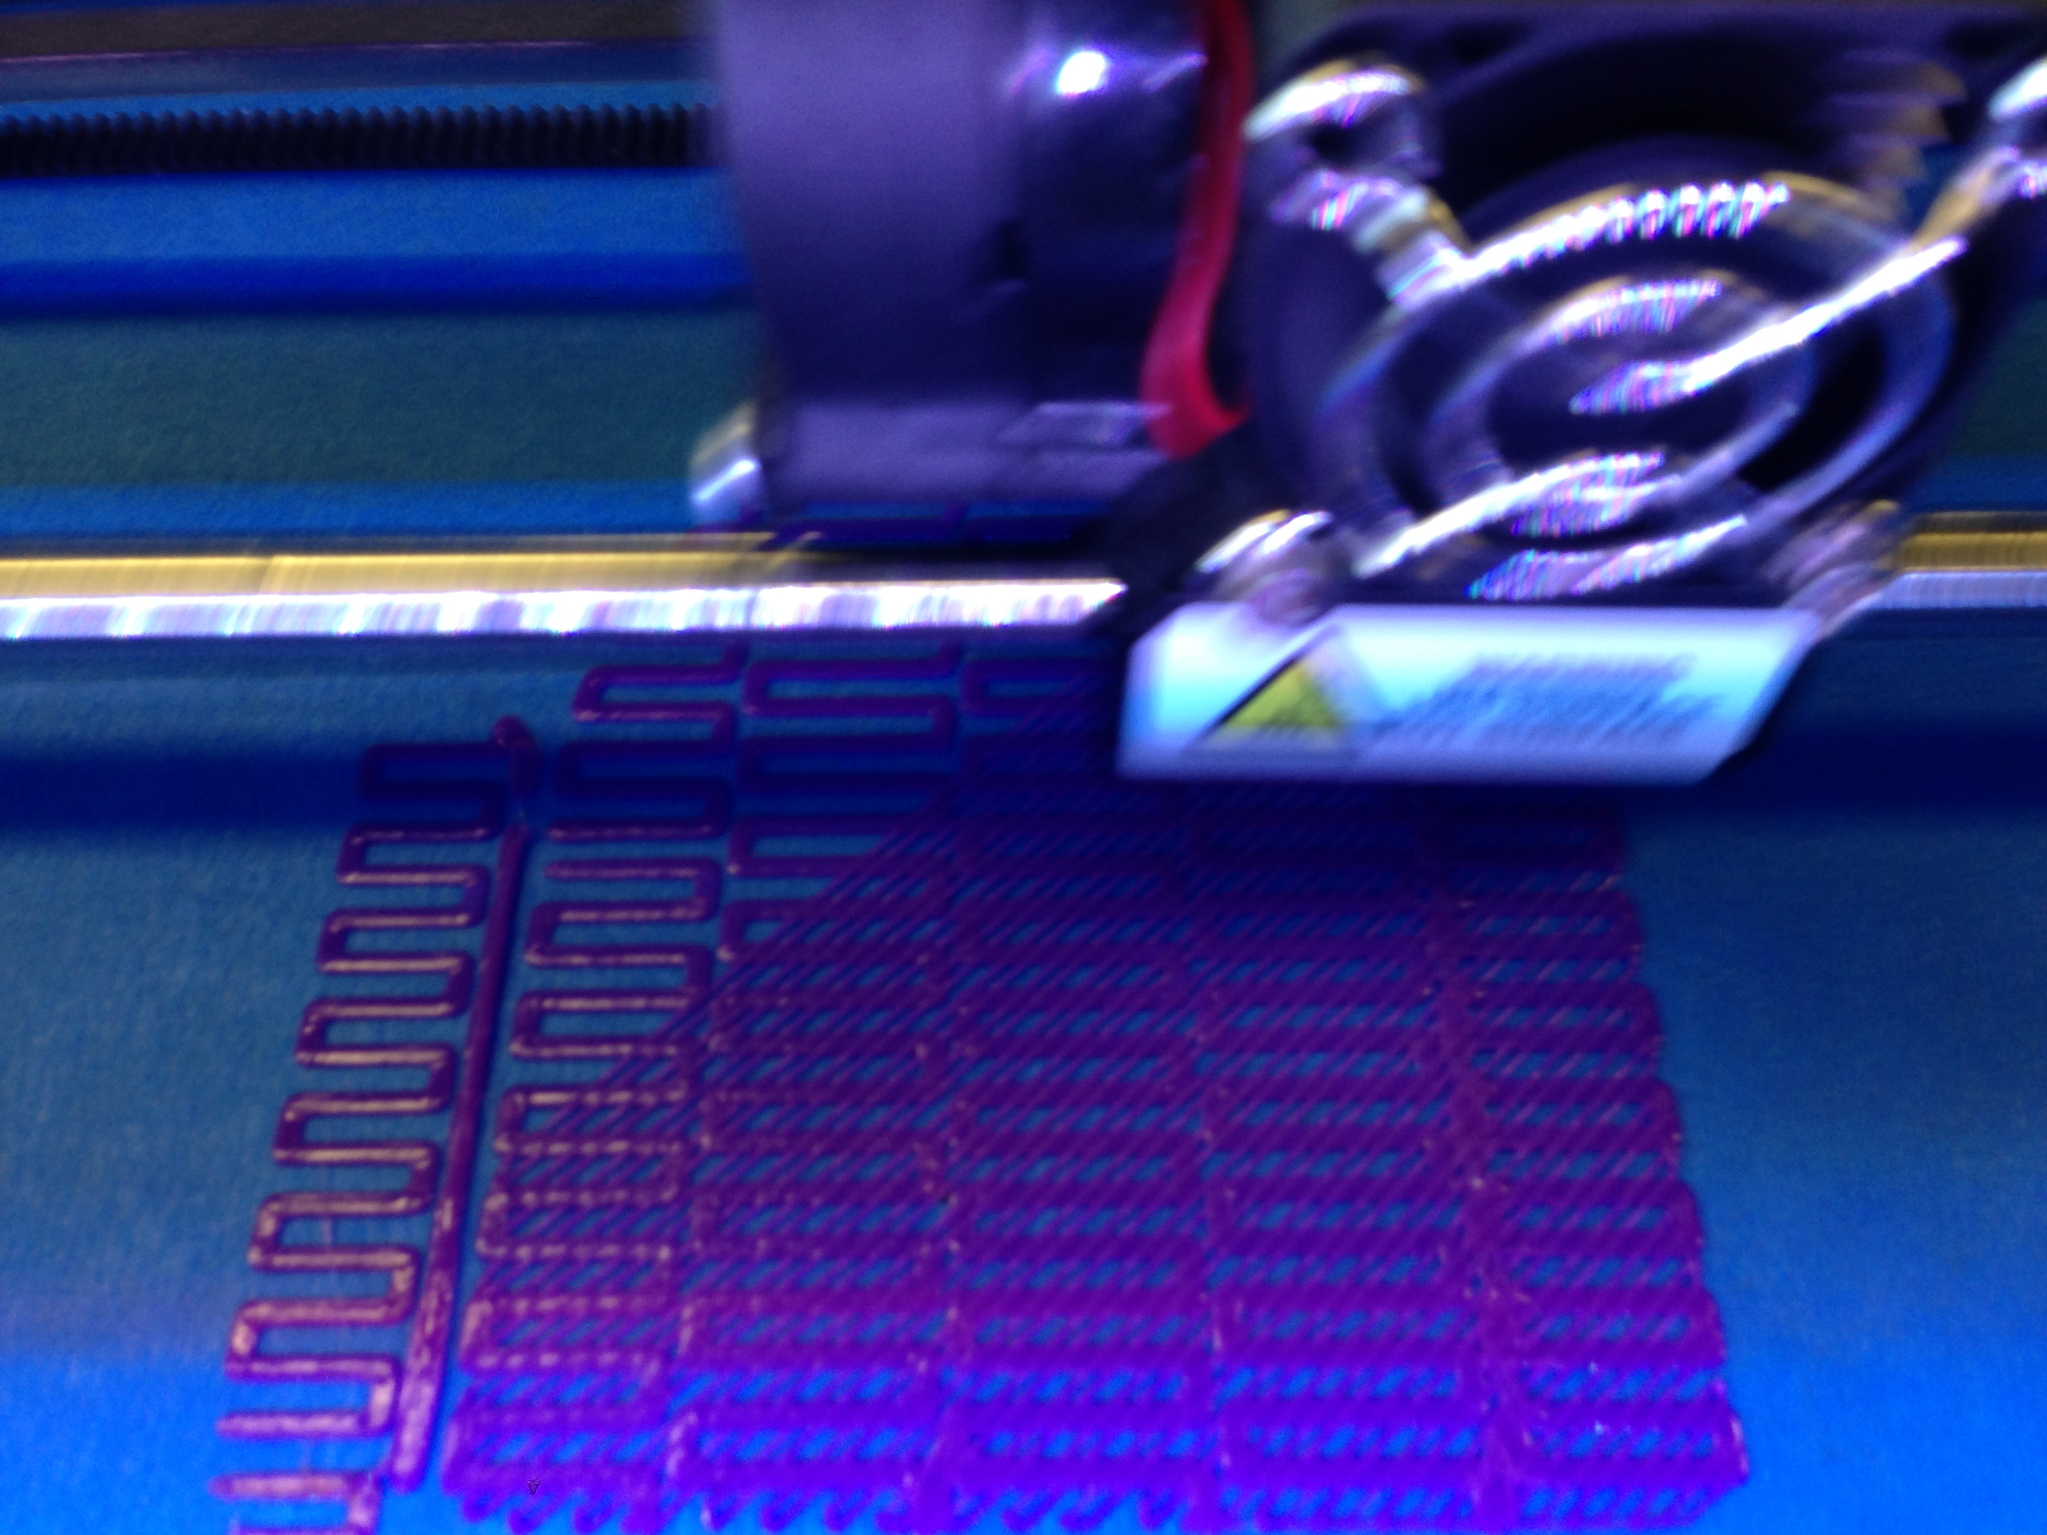
Concept To Practice: Rafts
2 sparse layers followed by 2 solid layers complete the raft
Notes:
Next the solid layers of the rafts are printed – typically 2 layers.

Slide 55
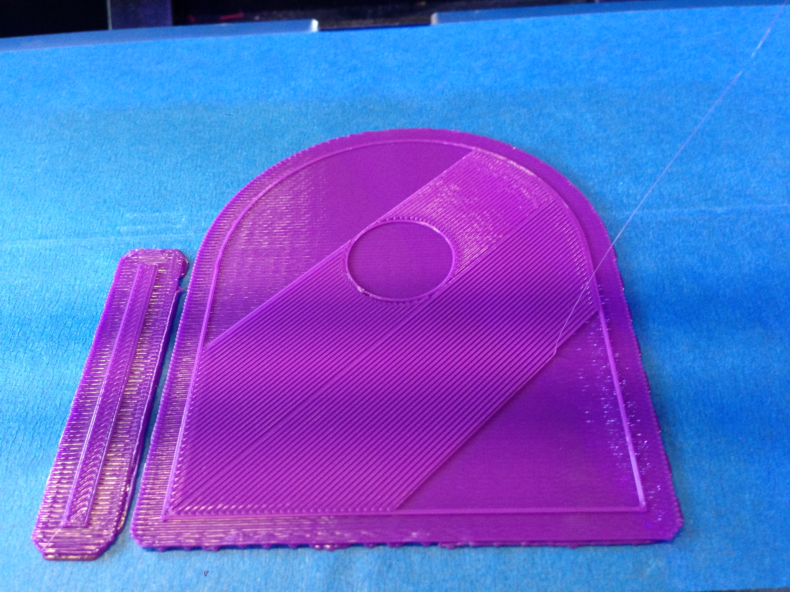
Concept To Practice: Rafts
First layer of object is extruded onto raft with additional cooling to reduce bonding between raft and object
Notes:
Finally, we start printing the object itself.
For an effective raft, the bonding between the raft and the object must be reduced such that there will be no scaring when the raft is removed from the object. But at the same time, there must be sufficient adhesion to ensure that the object itself does not warp. This bonding may be reduced by additional cooling time and by applying active cooling (fan) on the top surface of the raft.

Slide 56
Results
Printed with a Raft

Slide 57
Configurable Rafts
Raft layers
Base (zigzag)
Interface
Surface
Configurable settings for each
Number of layers
Density
Orientation
Thickness
Size and spacing of zigzag (base only)
Notes:
The base layer is for maximum adhesion and to avoid warping.
Interface layers are to absorb any defects not absorbed by the base – e.g., ripped pieces of tape, or if homing was too close.
Surface layers should create an even surface on which object first layer is extruded.
Reference:
https://www.makerbot.com/support/new/04_Desktop/Knowledge_Base/Using_Custom_Slicing_Profiles/13-MakerBot_Slicer_settings:_Rafts

