Slide 1
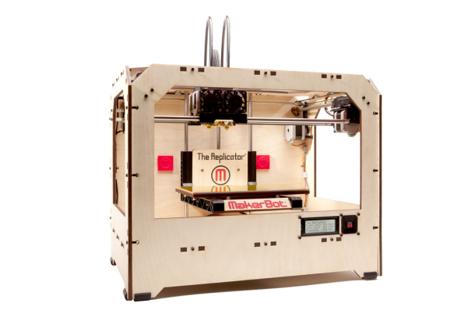
Dual extrusion for Multi-material
Notes:
In this part of the course we are going to focus on multi-material filament printers.
For instance, this printer, the Makerbot Replicator 1, features two different extruders.
Most of the ideas I present here originate from our 2014 publication ‘Clean Color’
http://webloria.loria.fr/~jhergel/cleanColor.pdf

Slide 2
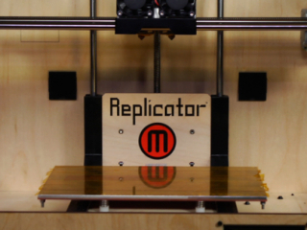
Dual extrusion
Carriage
Right Extruder
Left Extruder
Notes:
The extruders are mounted on a single carriage, and two different plastic filaments can be used on the same print.
You can use different colors, or different plastics such as rigid / soft materials.

Slide 3
Dual Color Print, Symbols
Carriage
Left Extruder
Right Extruder
Notes:
In this presentation we will use these symbols to represent the carriage and the extruders

Slide 4
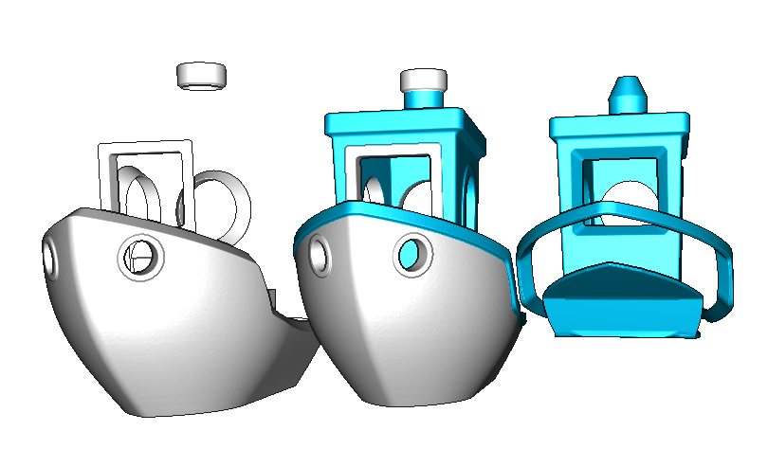
Slicer
Two meshes: toolpaths for each extruder
[#3DBenchy (Creative-Tools.com) / CC BY-ND 4.0]
Notes:
Let’s see how the slicer is going to deal with dual extrusion. We will be using IceSL in this case.

Slide 5
Slicer
Infills
Shells
Travel moves
Perimeters
[#3DBenchy (Creative-Tools.com) / CC BY-ND 4.0]
Notes:
The slicer will generate two sets of toolpaths in each slice, one for each material.
Of course there are challenges! For instance, the ordering and the way the carriage travels will be even more important than when printing with a single material.

Slide 6
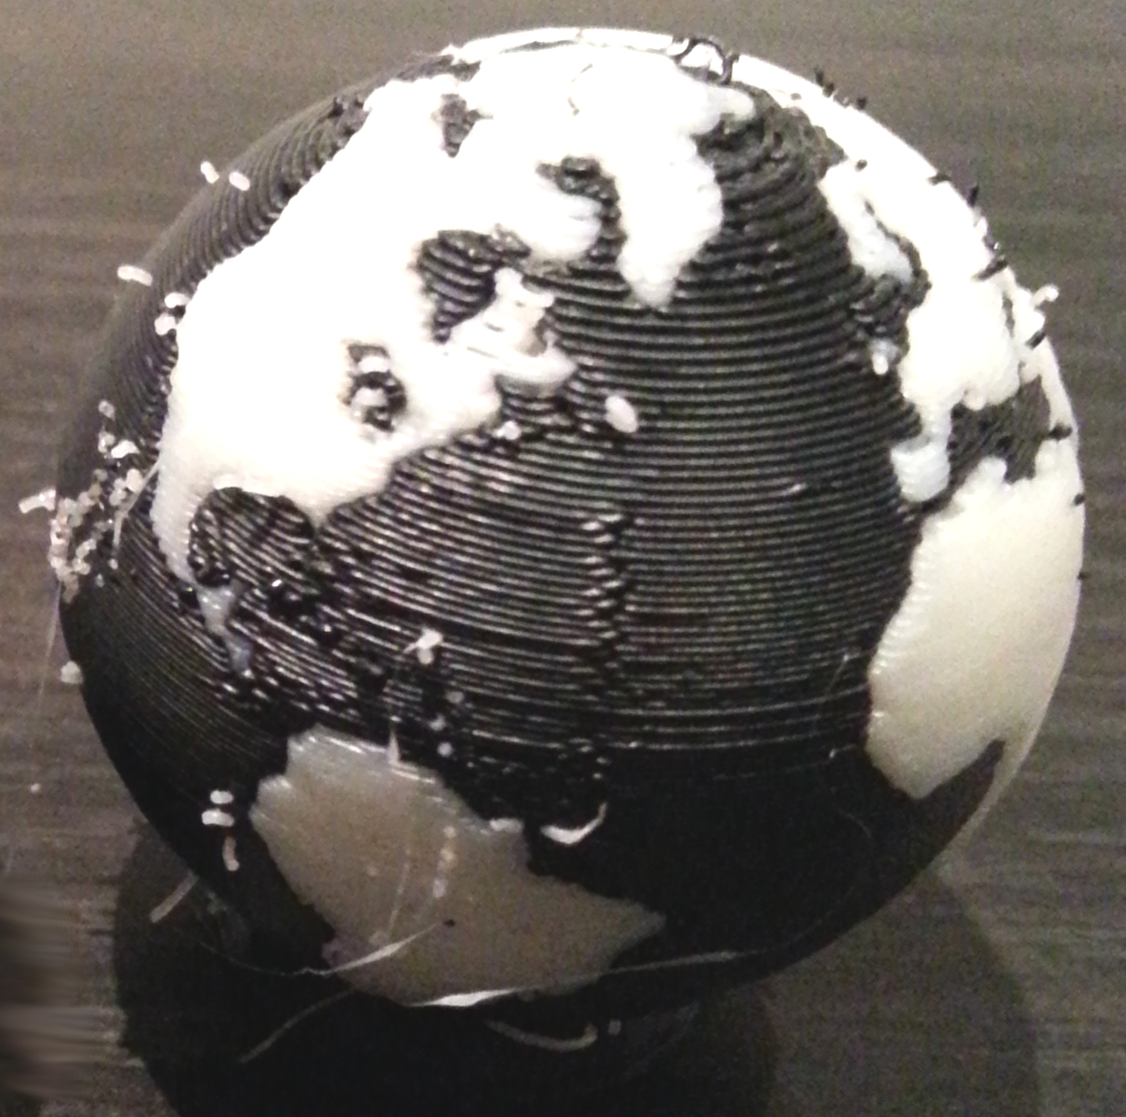
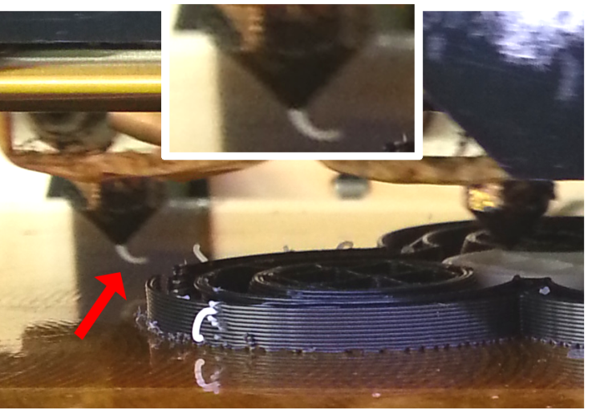
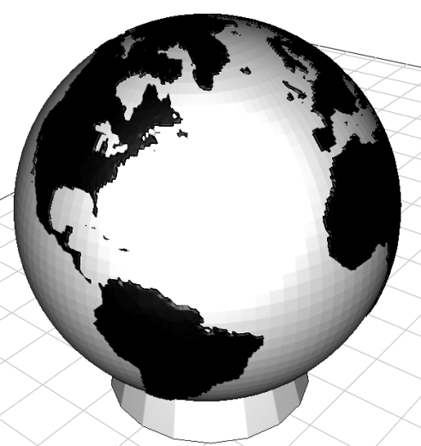
Defects
Oozing
[Two Color World (m6mafia) / GNU-GPL]
Notes:
Indeed, several defects can occur without special considerations.
The main issue is oozing, which we have already mentioned earlier. When an extruder stops printing, the melted plastic inside leaks out. In single material prints the effect is relatively limited. With dual printing, one extruder might be idle for several seconds, and oozing can be very significant.
Attribution:
http://www.thingiverse.com/thing:11660
http://www.thingiverse.com/m6mafia/about
http://www.gnu.org/licenses/gpl-2.0.html

Slide 7
Defects
Oozing
Zippers (single and dual)
[Two Color World (m6mafia) / GNU-GPL]
Notes:
Besides oozing, another defect that appears on both single and dual prints are zippers. These occur when the extruder stops printing a perimeter. Very careful calibration can limit these, but they can be seen on most printed parts.

Slide 8
Defects: Holes
[#3DBenchy (Creative-Tools.com) / CC BY-ND 4.0]
Notes:
One last issue are holes: these appear because the plastic that oozed from the extruder is now missing! So when the extruder restarts, the plastic is not deposited as expected.

Slide 9
Outline
Analysis
Oozing
Holes
Zippers
Improvements
Azimuth Optimization
Ooze Shield
Hiding Zippers
Results
Notes:
Let’s now have a closer look at the defects, before we explain what can be done in more details

Slide 10
Analysis: Oozing
Notes:
Here is a picture taken during a dual printing session, just to show how significant oozing can be.
Several millimeters of plastic are dangling from the extruder after only a few seconds.

Slide 11
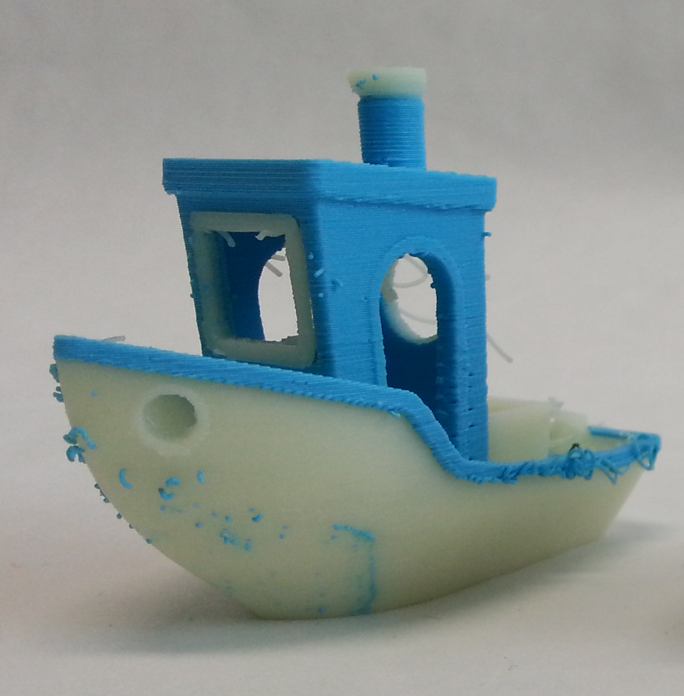
Analysis: Oozing
[#3DBenchy (Creative-Tools.com) / CC BY-ND 4.0]
Notes:
The result are all these little blobs of plastic that are deposited on the other color. These cannot be trivially cleared since the materials mix when they are fused together.

Slide 12
Analysis: Oozing
Case A
Case B
Case B
Notes:
There are in fact two distinct cases where oozing is problematic.

Slide 13
Analysis: Oozing
Case A
Case B
Case B
Notes:
The first case is during print moves, when one extruder (red) prints and the other (blue) crosses the just printed path. This leaves a blob of plastic. It is a difficult case because we cannot really change the way the carriage moves: it has to deposit plastic along the red path.

Slide 14
Analysis: Oozing
Case A
Case B
Case B
Notes:
A second case is during travel moves: here we cross the blue part to reach the red part, but the red extruder is likely to deposit plastic along the blue perimeter. The case is slightly easier, since we can change the way the carriage travels.

Slide 15
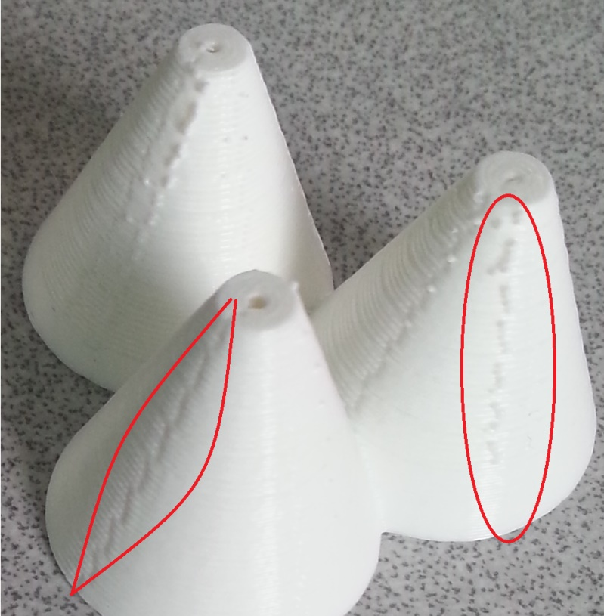
Analysis: Holes And Zippers
Holes
Consequence of Oozing
Zippers
When extruder starts
Notes:
We will further consider holes and zippers, and how to reduce their effect.

Slide 16
Reducing these issues
Ooze shields
Azimuth Optimization
Hiding zippers
Notes:
Ok, let’s have a closer look at what we can do to reduce such problems,

Slide 17
Ooze Shield
Catch ooze before extruder crosses the object
As close as possible from the object
Built layer by layer during the print
Notes:
The idea is similar to the oozing walls discussed earlier. We want to catch ooze before it reaches the surface. For this, we print a shield surrounding the shape. This shield will catch ooze just before the surface.

Slide 18
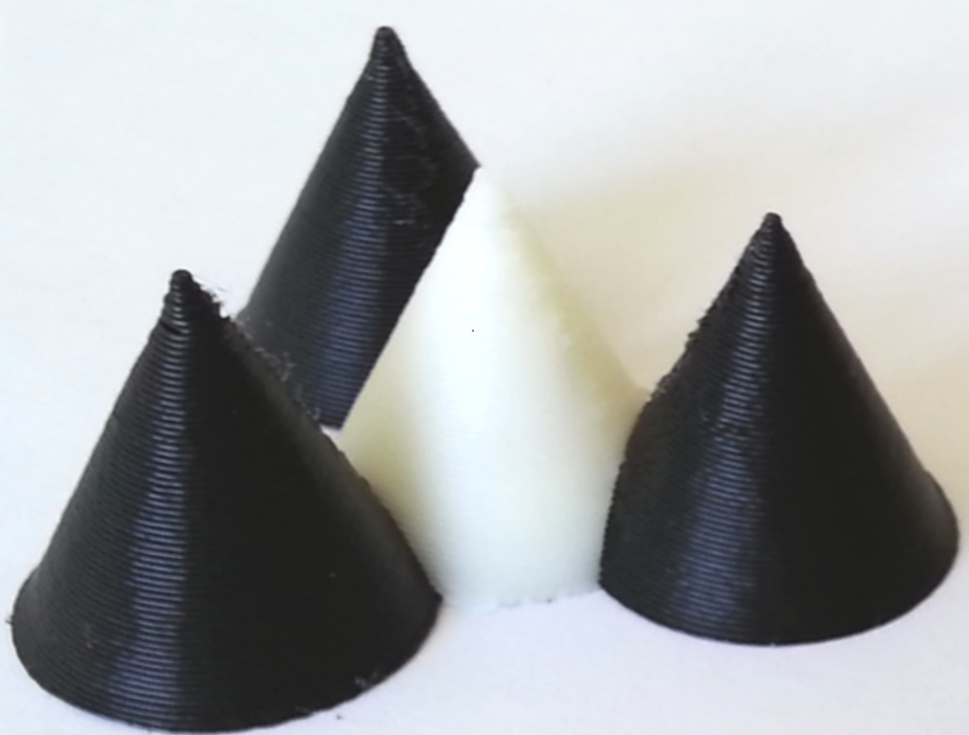
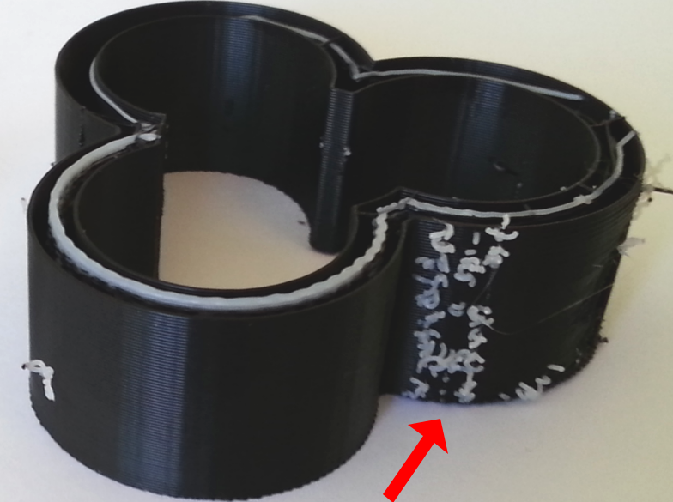
Vertical rampart
Wiped ooze
Notes:
Here you can see vertical walls protecting the print.

Slide 19
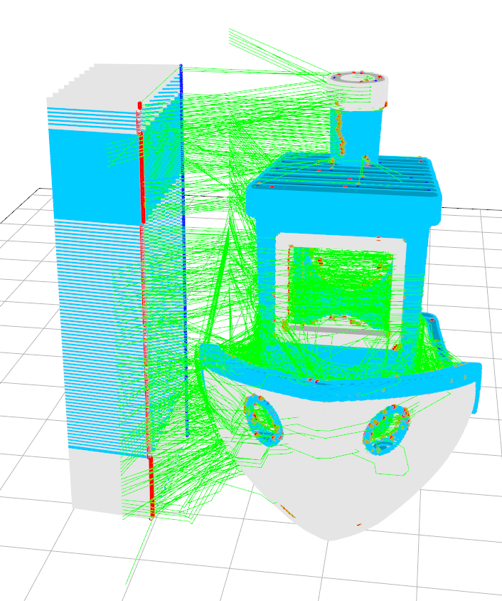
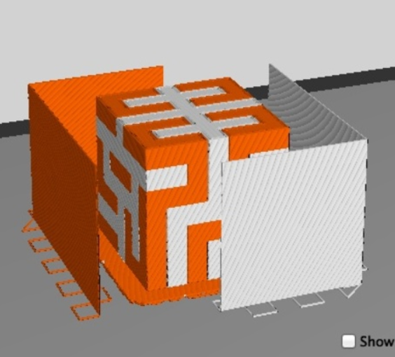
Wipe walls / towers
MakerBot extrusion guards
[HilbertCube (tbuser) / CC BY-SA 3.0]
IceSL prime tower
[#3DBenchy (Creative-Tools.com) / CC BY-ND 4.0]
Notes:
Here you can see other examples of shields or walls protecting a print.

Slide 20
Ooze shields
Cura / IceSL ooze shields
Learn more:
Tight printable enclosures for additive manufacturing
S. Hornus, S. Lefebvre, J. Dumas, F. Claux
[Twin Cats (Mankati3DPrinter) / CC BY-SA 3.0]
Notes:
There are more advanced shapes that can protect the print while staying close to the fabricated object.

Slide 21
Reducing these issues
Ooze shields
Azimuth Optimization
Hiding zippers
Notes:
Ok, let’s have a closer look at what we can do to reduce such problems,

Slide 22
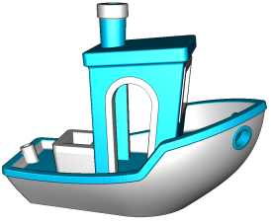
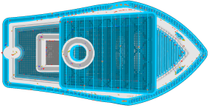
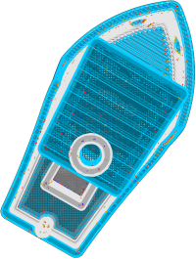
Azimuth Optimization
White crosses Blue
Printing With Left extruder
Notes:
We observed that a simple change of orientation – azimuth angle -- can greatly improve quality.
When the blue extruder prints, the red extruder will move for some time just above the blue region. This is the effect we want to minimize.

Slide 23
Azimuth Optimization
White head motion as blue head prints
Notes:
We can easily compute the region spanned by the red extruder when the blue prints.

Slide 24
Azimuth Optimization
Overlap
Notes:
Our goal is to minimize the overlap region.

Slide 25
Azimuth Optimization
No defect after optimization
Defects before rotation
Notes:
One simple way to do that is to change the orientation of the print!

Slide 26
Azimuth Optimization
Minimize overlap volume
Intersection computed by CSG
Fixed number of angles
Fast GPU Implementation
(4 seconds for 36 angles on #3DBenchy)
Notes:
Across all slices, this overlap region turns into a volume. We can compute this volume by fast boolean intersections between the object, and a translation of the object. As we will later see, our software is able to perform such operations very rapidly.

Slide 27
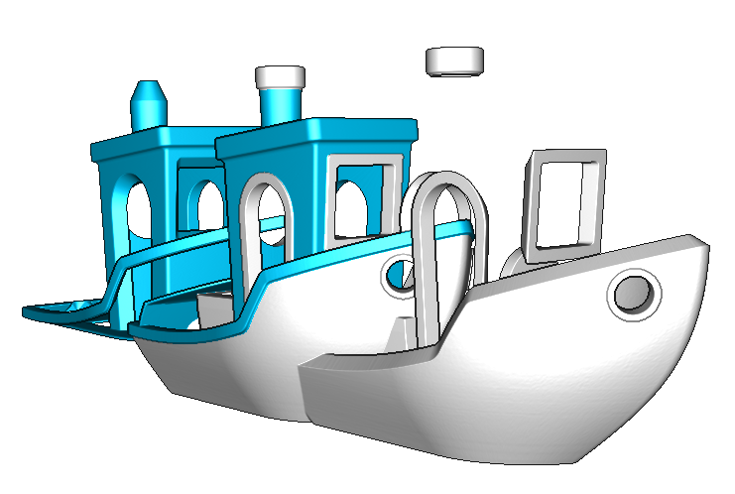
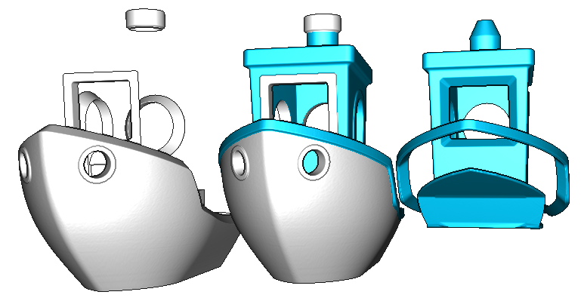
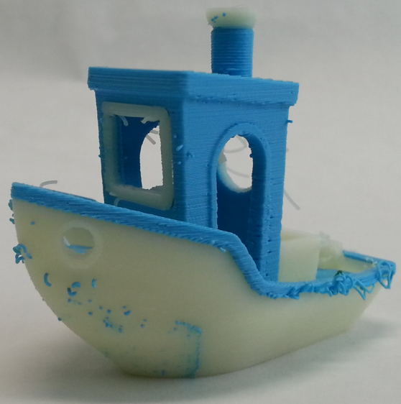
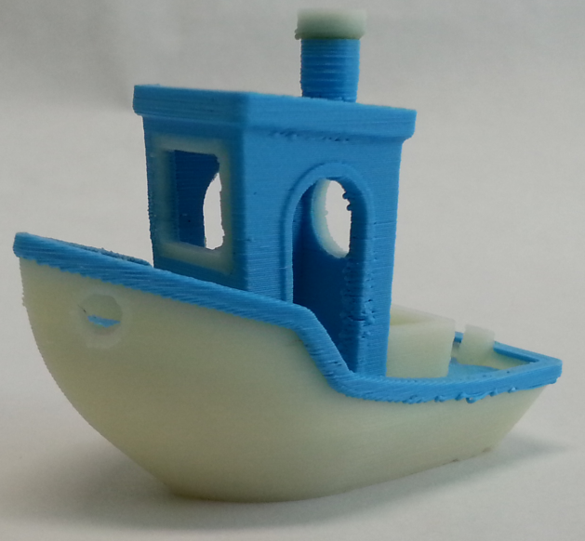
Azimuth Optimization
Without
With
No remaining overlap!
Overlap
[HilbertCube (tbuser) CC BY-SA 3.0]
Notes:
Here you can see on the left the overlap region in green before optimization, and after optimization. This alone greatly reduces the chance of oozing.

Slide 28
Reducing these issues
Ooze shields
Azimuth Optimization
Hiding zippers
Notes:
Ok, let’s have a closer look at what we can do to reduce such problems,

Slide 29
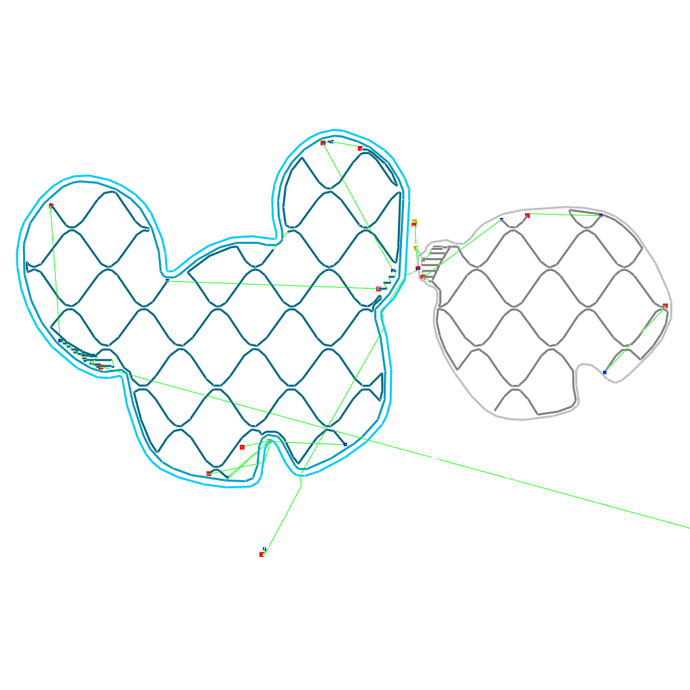
Zippers
Perimeters are cyclic
Position of start/end point is free
Change zipper locations
They can be hidden
[Twin Cats (Mankati3DPrinter) / CC BY-SA 3.0]
Notes:
Zippers mostly occur along perimeters, which are – in our software – always cycles.
Therefore we can freely choose the start/end point for printing a perimeter.
We can thus hope to hide the zippers in less visible regions of the print.

Slide 30
Zippers
Perimeters are cyclic
Position of start/end point is free
Change zipper locations
They can be hidden
Ambient Occlusion
[Twin Cats (Mankati3DPrinter) / CC BY-SA 3.0]
Notes:
Zippers mostly occur along perimeters, which are – in our software – always cycles.
Therefore we can freely choose the start/end point for printing a perimeter.
We can thus hope to hide the zippers in less visible regions of the print.

Slide 31
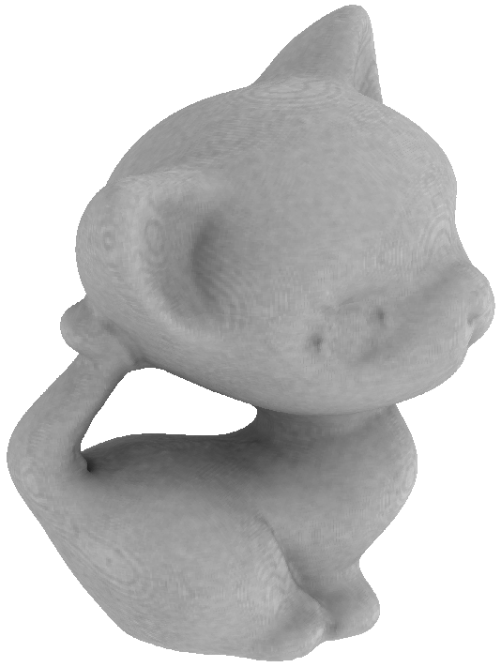
Zippers
Ambient Occlusion [Zhukov*98]
Used to enhance realism
of a render
Darker zones are less visible
Hide defects in occluded zones
[Kitten (MBCook) / CC BY-SA 3.0]
Notes:
This computes a map along the surface which is darker when it is less visible and brighter otherwise. This correspond to how many viewpoints can actually see each surface points. We can compute this quickly on modern GPUs.

Slide 32
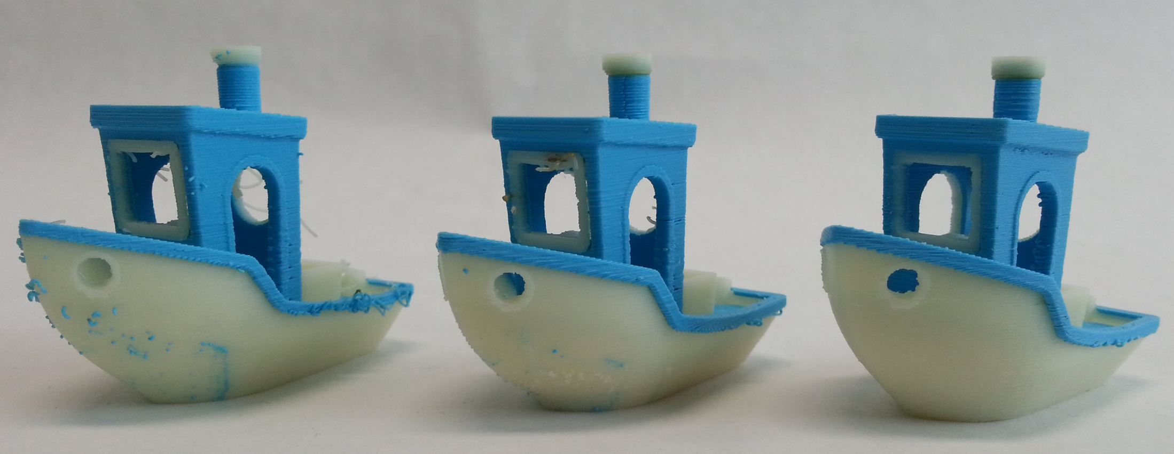
Results
[#3DBenchy (Creative-Tools.com) / CC BY-ND 4.0]
Naive
Shield
Azimuth + Shield + Travel
Notes:
Here are some results, note the significant improvement. These objects have not been cleaned in any way.

Slide 33
Results
[Jillian's Rose (Bob_East) / CC BY-SA 3.0]
Naive
Shield
Azimuth + Shield + Travel
Notes:
A comparison using the various ingredients.
Attribution:
http://www.thingiverse.com/thing:26417
http://www.thingiverse.com/Bob_East/about
http://creativecommons.org/licenses/by-nc-sa/3.0/

Slide 34
Earth
[Two Color World (m6mafia) / GNU-GPL]
Notes:
The earth model was quite bad.

Slide 35
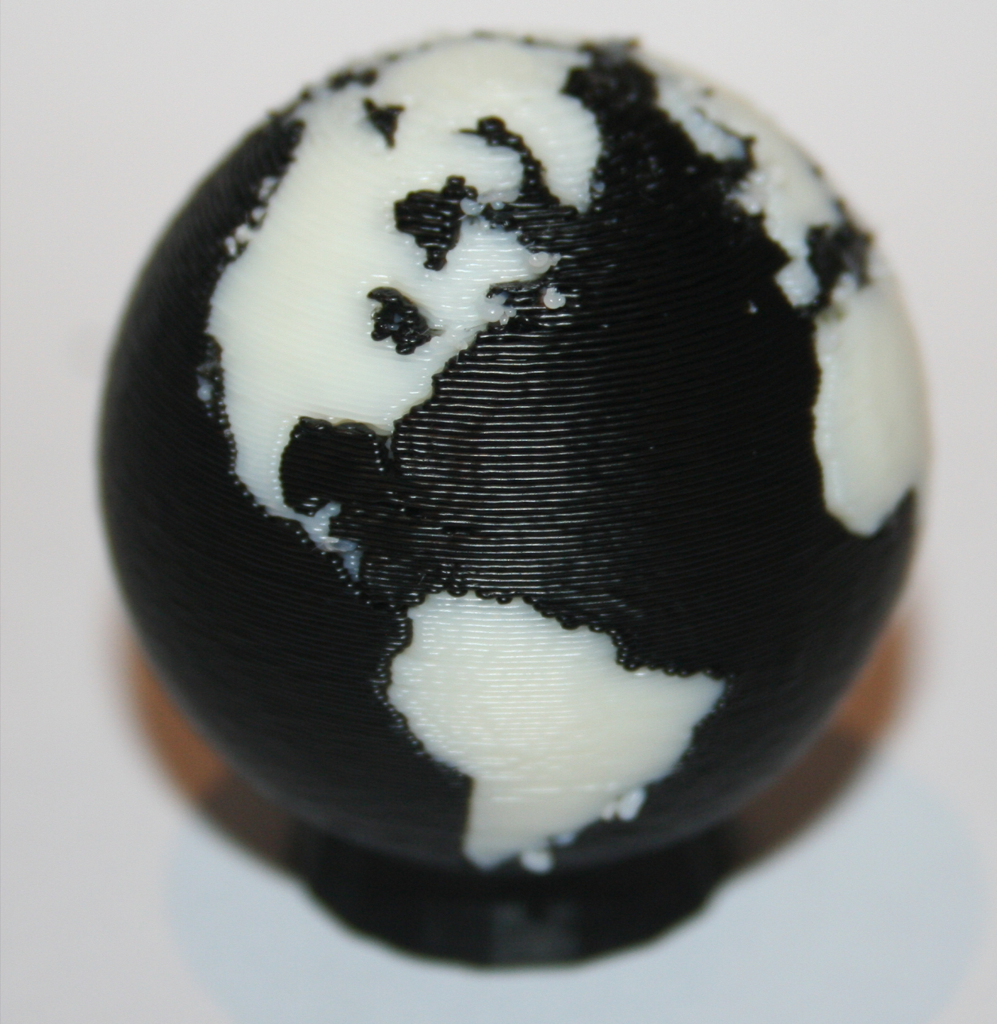
Results: Earth
[Two Color World (m6mafia) / GNU-GPL]
Notes:
Here is our result.

Slide 36
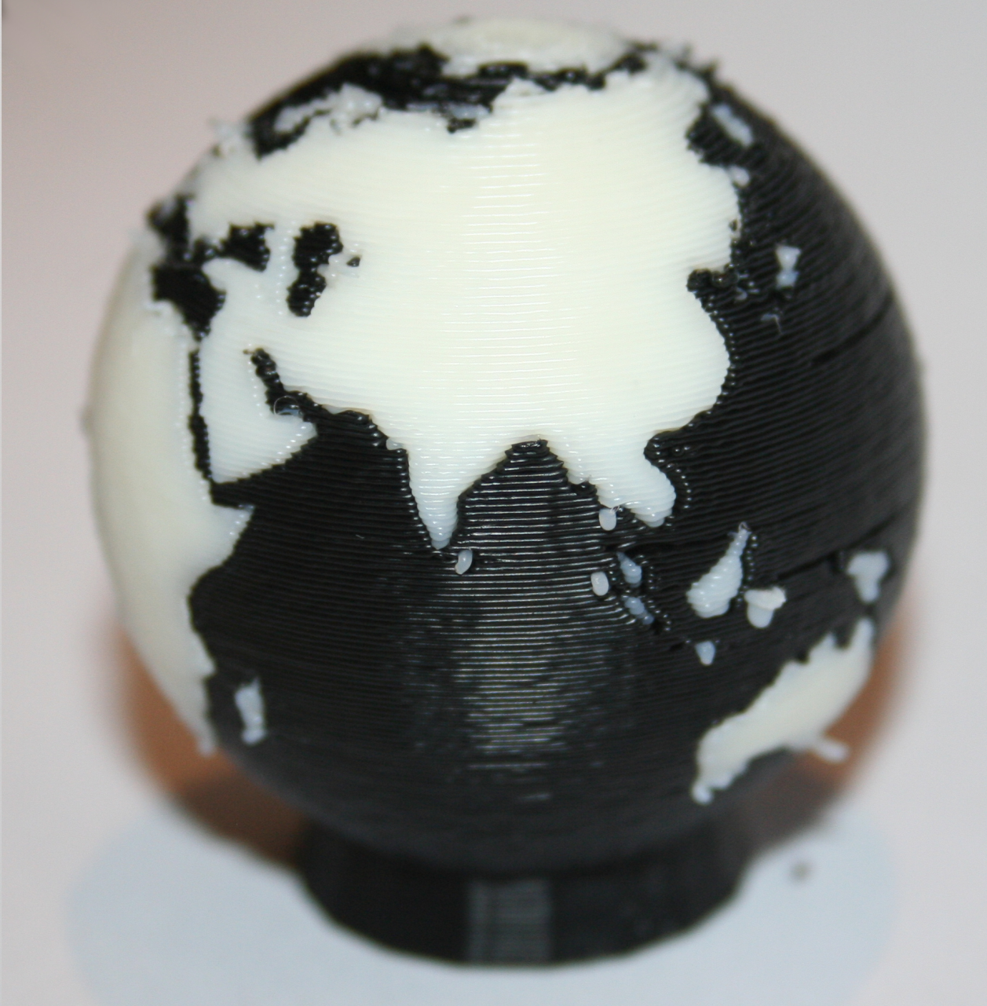
Results: Earth
[Two Color World (m6mafia) / GNU-GPL]
Notes:
Another view.

Slide 37
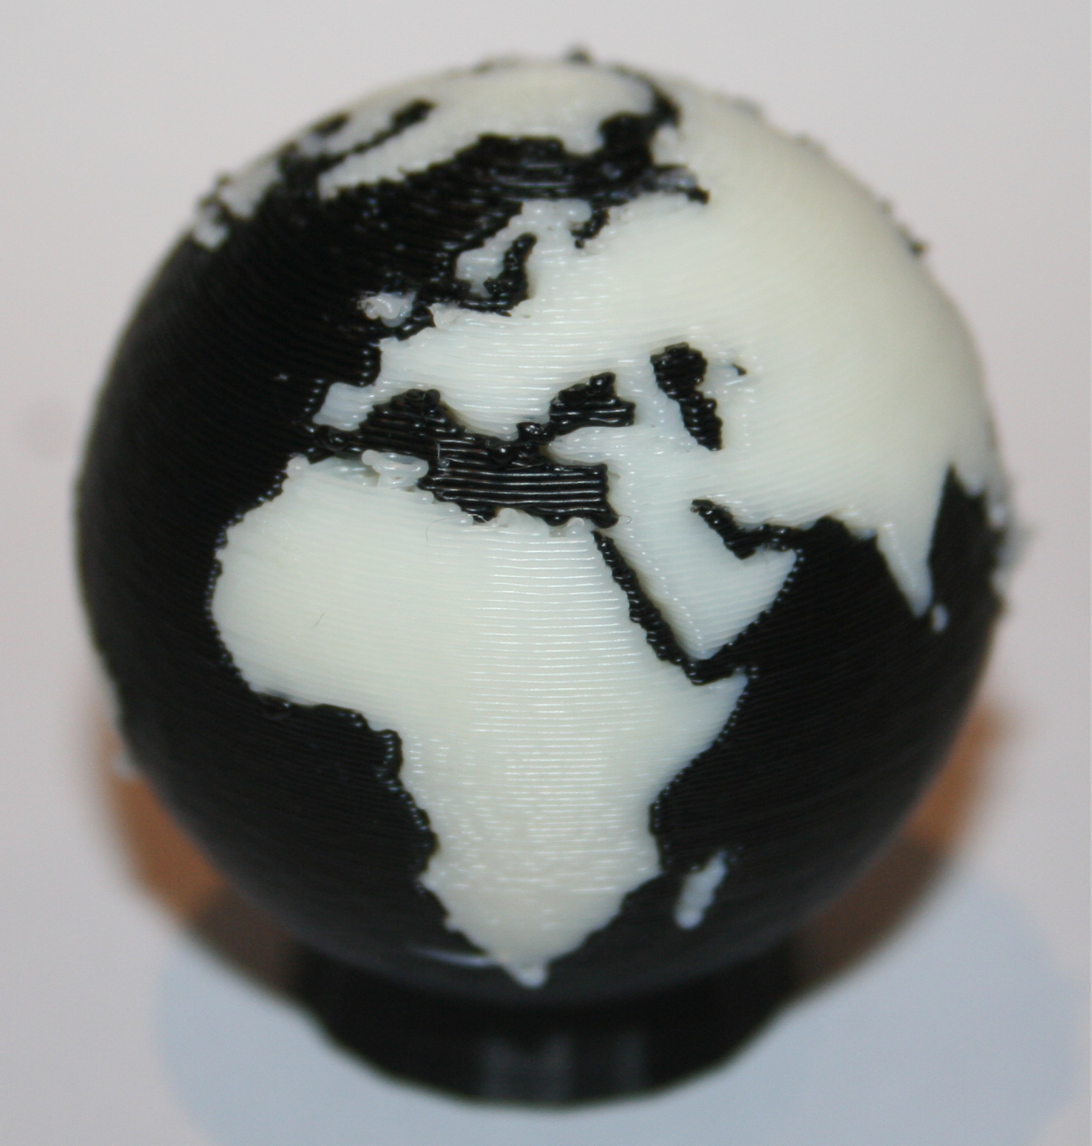
Results: Earth
[Two Color World (m6mafia) / GNU-GPL]
Notes:
And another view.

Slide 38
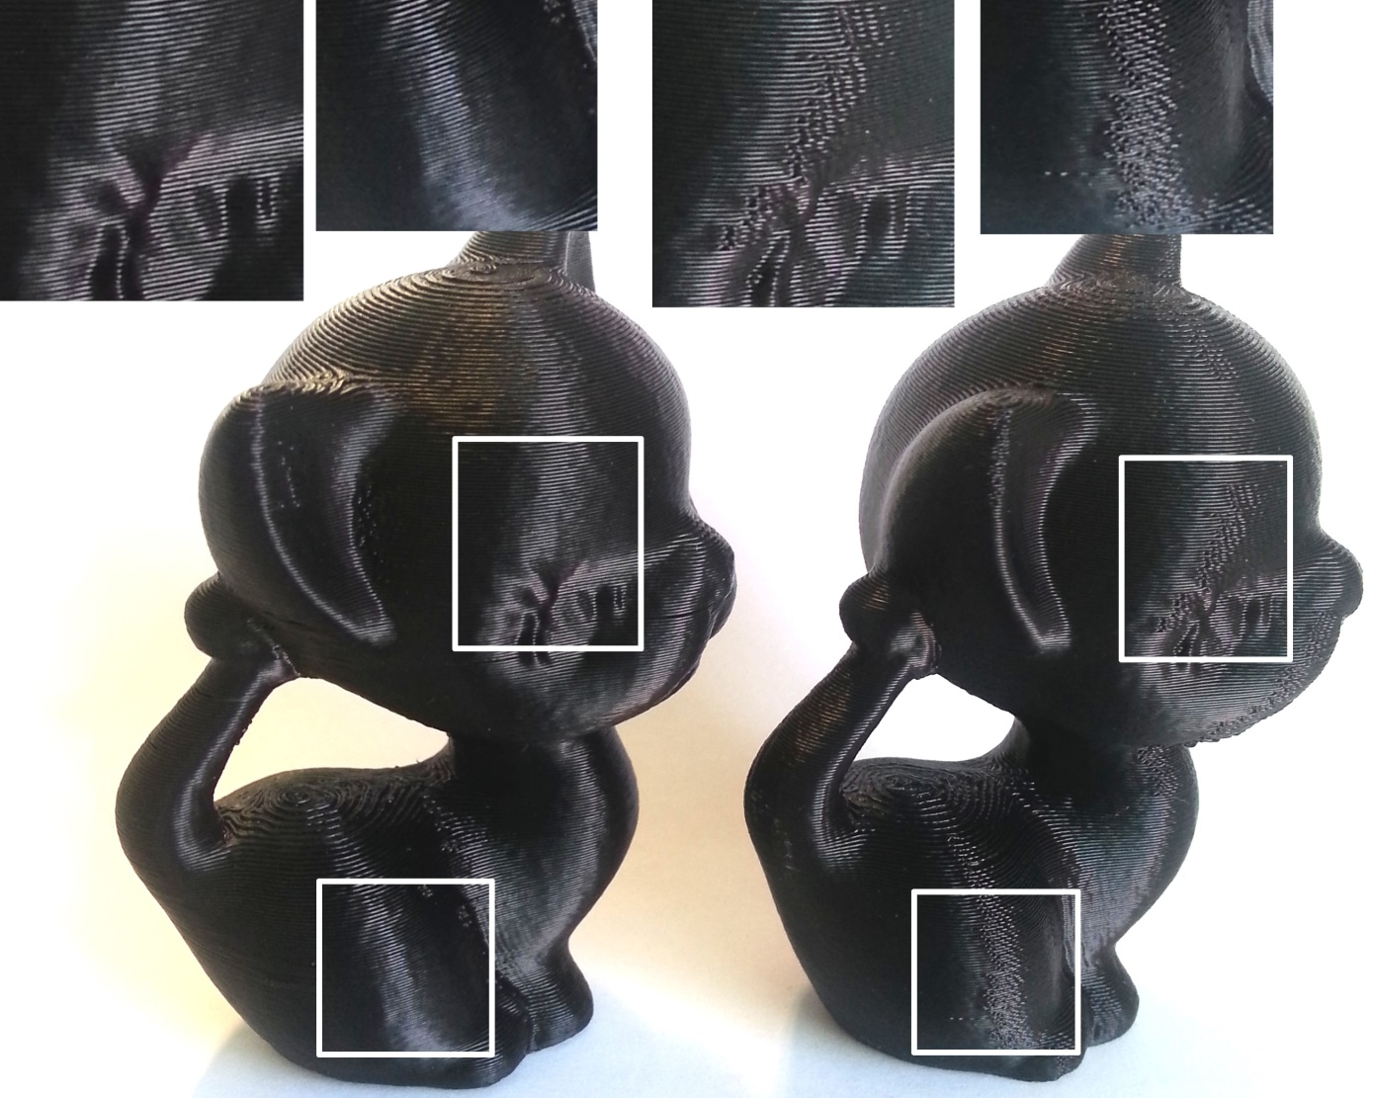
Zippers
With Our Technique
Without
[Kitten (MBCook) / CC BY-SA 3.0]
Notes:
Our approach also removes most zippers – in fact they are not removed but hidden from view. This greatly improves the finish of shiny surfaces.

Slide 39
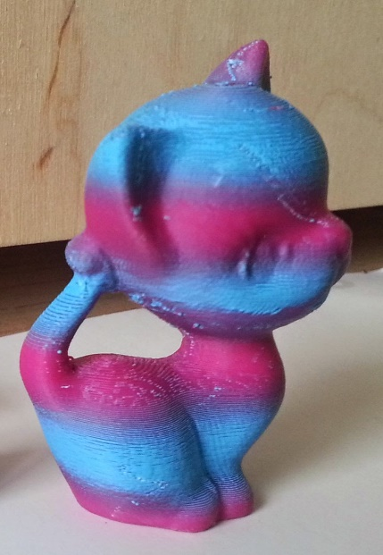
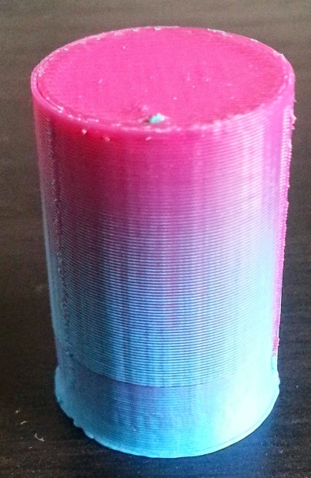
Dual versus mixing
Mixing is possible!
Dithering style
Layering style
Dual-Color Mixing for Fused Deposition Modeling Printers
[Reiner et al, 2014]
Print and picture by S. Lefebvre
Notes:
So far we only looked at printing one color or the other. There are ways to mix the two colors!
Reiner and colleagues presented a very interesting approach were dithering is used to bring one color visually in front of the other.
https://cg.ivd.kit.edu/publications/2014/DCM/DualColorMixing.pdf
We also experimented with a mixed layering approach, were the plastic flow is modified to deposit each layer twice, in proportions such that the total amount of plastic matches what’s normally required. By carefully calibrating the printer color gradients can be obtained, as shown here.

