Slide 1
Modeling for Filament-Based 3D Printing
3:45pm – 5pm

Slide 2
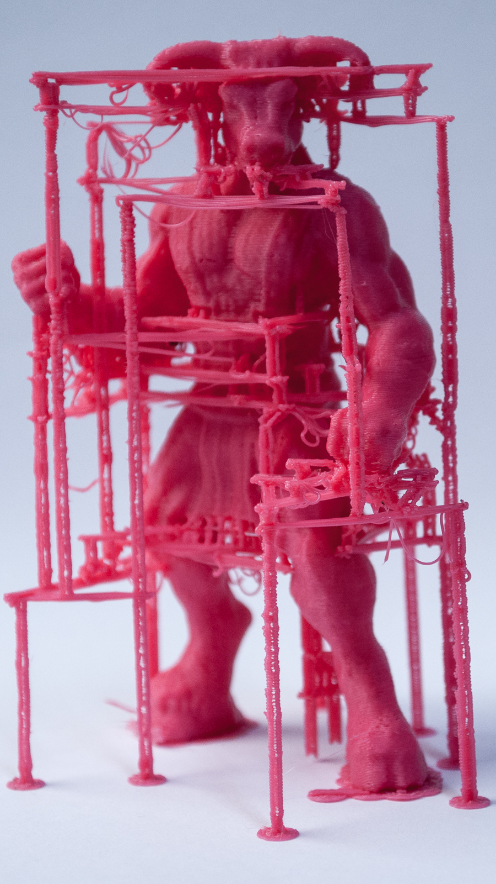
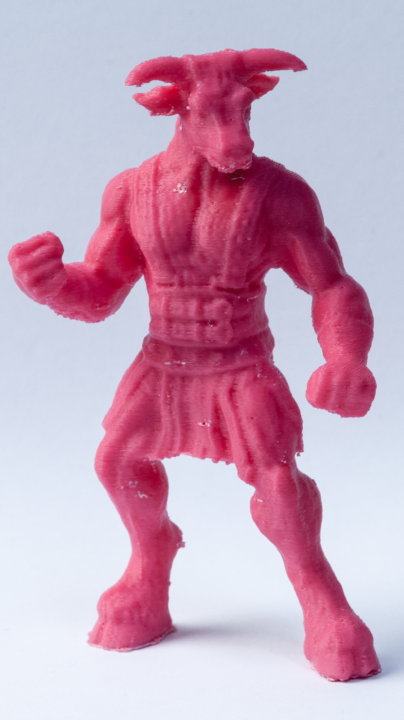
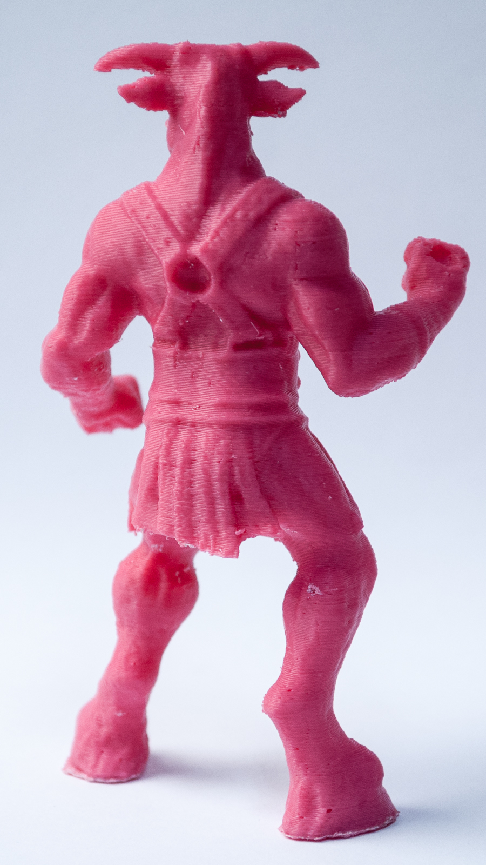
Overhangs and Supports
[Minotaur (ajolivette) / CC BY-SA 3.0]
Modeling for Filament-Based 3D Printing
Notes:
Attribution:
http://www.thingiverse.com/thing:46646
http://www.thingiverse.com/ajolivette/about
http://creativecommons.org/licenses/by-sa/3.0/

Slide 3
Overhangs
[Laurana 50k (jmil) / CC BY-SA 3.0]
Layers extending beyond layers below will fall down
Notes:
Overhangs are parts of the model where the layer above extends well beyond the layers below, and gravity will cause the printed plastic to droop down, like printing over air.
Attribution:
http://www.thingiverse.com/thing:1978
http://www.thingiverse.com/jmil/about
http://creativecommons.org/licenses/by-sa/3.0/

Slide 4
Supports
[Laurana 50k (jmil) / CC BY-SA 3.0]
Layers extending beyond layers below will fall down
They need to be Supported
Notes:
Overhangs need to be supported so that we are not printing over air.
Attribution:
http://www.thingiverse.com/thing:1978
http://www.thingiverse.com/jmil/about
http://creativecommons.org/licenses/by-sa/3.0/

Slide 5
Supports
0
20
30
45
60
70
[Laurana 50k (jmil) / CC BY-SA 3.0]
MB default: Supports are printed for all angles > 68 degrees from vertical
Notes:
However, if the overhang is small enough, then it will not droop down, and we do not need to support such overhangs. This is typically determined by the angle formed between the overhang and the closest point in the layer below. Our default is to leave all angles < 68 degrees from vertical unsupported.
The yellow regions are where supports must be generated. The Makerbot Slicer uses filament-based supports instead of generating supporting meshes. Filament-based supports are printed like infill with no shells.
References:
https://www.makerbot.com/support/new/04_Desktop/Knowledge_Base/Using_Custom_Slicing_Profiles/15-MakerBot_Slicer_settings:_Support
Attribution:
http://www.thingiverse.com/thing:1978
http://www.thingiverse.com/jmil/about
http://creativecommons.org/licenses/by-sa/3.0/

Slide 6
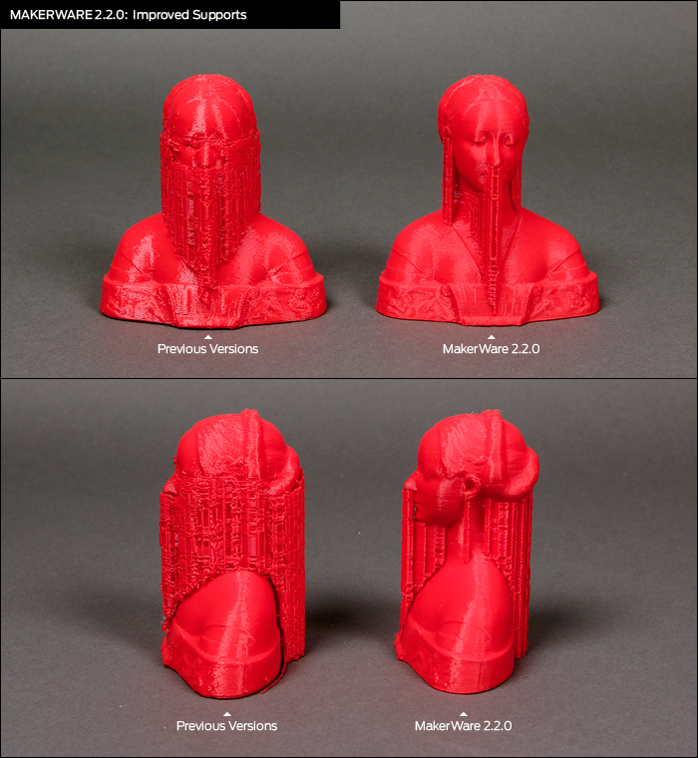
Filament-Based Supports
Notes:
This example shows a change in version 2.2.0 last fall where we significantly reduced the amount of support we printed.
In previous versions, we did not account for angle.
References:
http://www.makerbot.com/blog/2013/06/12/makerware-2-2-0-preview/

Slide 7
Filament-Based Supports
Factors to consider
Angle at which supports begin
Support pattern
Density
Space between model and supports
Models are printed from the bottom-up, but support generation needs to account for floors in slices above
Notes:
Pattern often affects removability
Denser supports will support more of the floor, but uses more plastic, takes longer to print, and may be more difficult to remove.
Space between model and supports:
- More space makes it easier to remove supports, but will mean that less of the floors above will be supported which could result in a drooping floor.
References:
https://www.makerbot.com/support/new/04_Desktop/Knowledge_Base/Using_Custom_Slicing_Profiles/15-MakerBot_Slicer_settings:_Support

Slide 8
Filament-Based Supports
Infill
Supports
Supports
Notes:
Reviewing a previous example – as you can see, supports and infill are not that much different. They differ in their density and pattern.

Slide 9
Filament-Based Supports: +/-
Pros (+)
Simpler toolpaths – no shells
Faster to print
Cons (-)
Problems with supporting small areas
Considers only local stability, not global
Uses more plastic than tree-like supports
Notes:
Pros:
Unlike many other slicers, ours does not model supports as a mesh. Instead, supports are just filaments loosely laid down – this makes the toolpath simpler (no shells and fewer retractions).
The object surface is also more uniformly supported, unlike cone-based supports where the contact is a point.
----------------------
Cons:
For small areas:
Resulting supports are small, unstable pillars
Support filament is often hard to remove from small areas

Slide 10
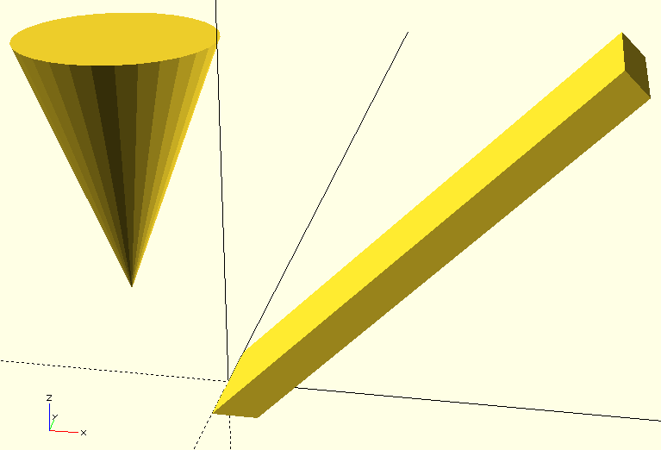
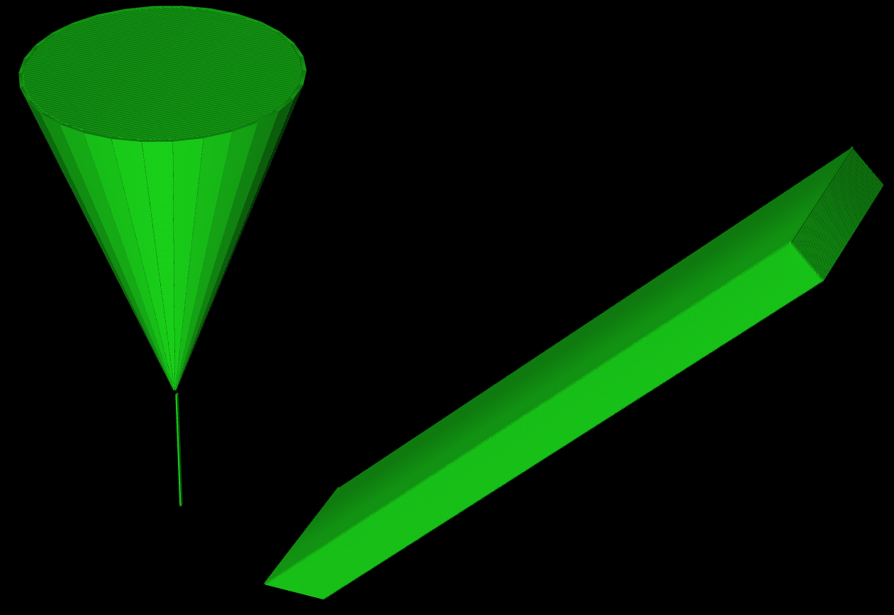
Global Instability
Notes:
Left: The downward pointing cone is elevated above the platform. The rectangular shape is tilted at 45 degrees.
Right: Only the tip of the cone is supported. The box does not get any support. Both of these things happen because our support algorithm only looks at a few layers at a time, rather than the entire model.

Slide 11
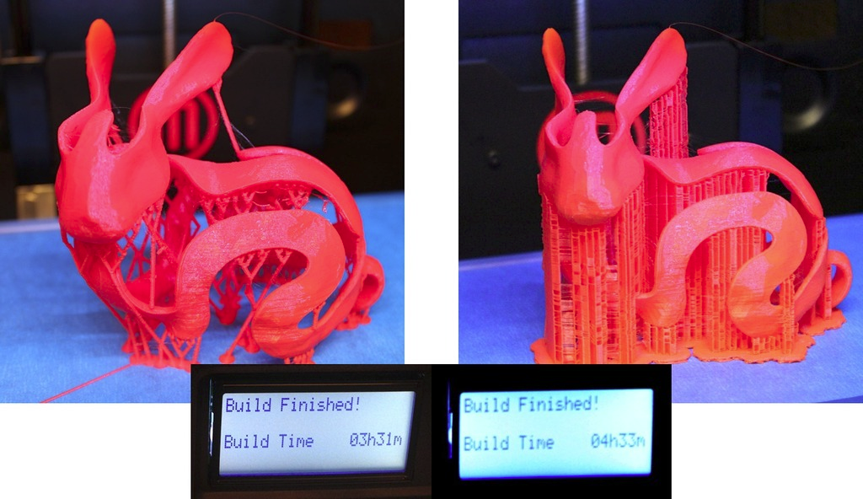
Supports: MeshMixer
[Bunny Peel with meshmixer Support (meshmixer) / CC BY-SA 3.0]
Filament-based supports can result in longer print times and more plastic usage, but avoid narrow, unstable support columns
Notes:
Filament-based supports may use more plastic and take longer to print than alternative approaches, such as MeshMixer and INRIA’s scaffolds. One concern with these narrow column-based supports is that they will tend to fall over during printing. Printing a lot of small islands is also time consuming and involves a lot of retractions.
Neither filament-based, nor mesh-based, is perfect. Each has benefits and disadvantages.
References:
“Clever Support: Efficient Support Structure Generation for Digital Fabrication”, Juraj Vanek, Jorge A. G. Galicia, Bedrich Benes, Computer Graphics Forum 33(5): 117-125 (2014)
Attribution:
http://www.thingiverse.com/thing:131054
http://www.thingiverse.com/meshmixer/about
http://creativecommons.org/licenses/by-sa/3.0/

Slide 12
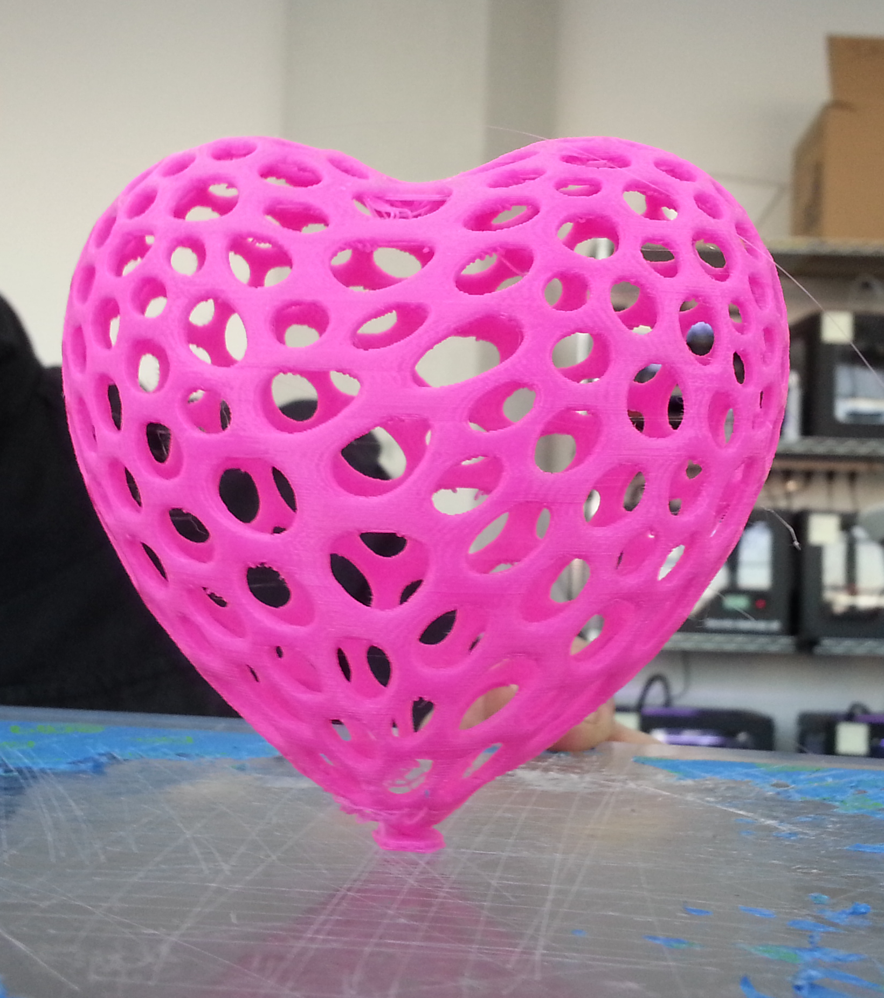
Minimizing Supports
[Print by Stephen Detsch, MakerBot]
Modeling for Filament-Based 3D Printing
Notes:
It is possible to construct a model that prints completely unsupported, exploiting the angle at which gravity is overcome by adhesion and the contraction of plastic.

Slide 13
Bridging
[Bridges test model, MakerBot]
Omit supports under bridges
Notes:
Another way to reduce supports is to print bridges. These are areas of the surface that sit over open air, but are short enough and are surrounded by parts of the shell which can be used to anchor a bridge. The bottom of the object is shown in this example.
Sometimes fails – can be due to temperature and contraction properties of plastic.

Slide 14
Bridging
Anchors: where bridges attach to islands of the layer below
Span direction: given a bridgeable floor area, in which direction should bridges extend?
Maximum length of bridges

Slide 15
Bridge Anchors
Location: where should anchors intersect shells?
Size of anchoring islands
Islands in yellow with grey shells
Anchors in blue with a bridge in between
Notes:
The start and end of bridges are typically on the shell. The location of anchors and making room for them on the shells are required.
Anchoring island must be wide and deep enough to support a bridge
A successfully bridged extrusion is anchored at both ends. An anchor is the portion of the layer below that is adjacent to the region to be bridged.

Slide 16
Bridge Anchors
Location: where should anchors intersect shells?
Size of anchoring islands
Islands in yellow with grey shells
Anchors in blue with a bridge in between
Notes:
Anchors must have sufficient depth for the extrusions of the bridge to attach

Slide 17
Bridge Anchors
Location: where should anchors intersect shells?
Size of anchoring islands
Islands in yellow with grey shells
Anchors in blue with a bridge in between
Notes:
Islands that are too small can’t support bridges

Slide 18
Bridge Span Direction
Goal
Maximize anchored extrusions
Affected By
Shape of the region to bridge
Size, shape, and arrangement of anchors
Notes:
In other words, we want to maximize good bridges that don’t collapse. For a given, potentially bridgeable, region, different directions of the bridge span will result in different areas being bridged, and we essentially want to maximize that area while ensuring that the bridge doesn’t collapse.
The start and end of bridges are typically on the shell. Programmatically computing the location and making room for bridge anchors on the shell(s) is what is required to implement bridges.
Anchoring island must be wide and deep enough to support a bridge

Slide 19
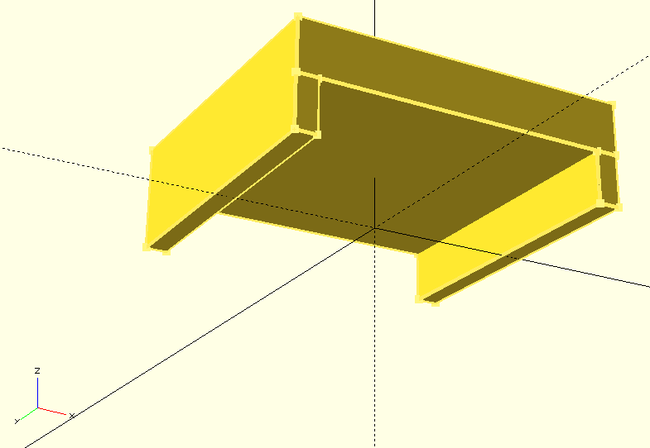
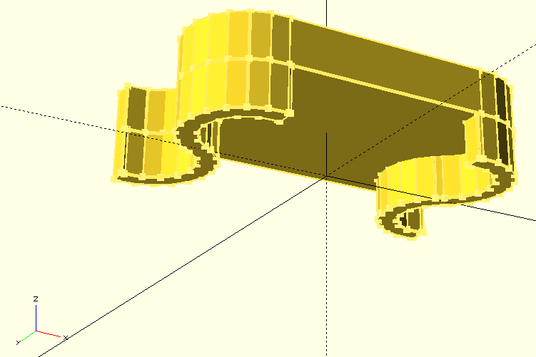
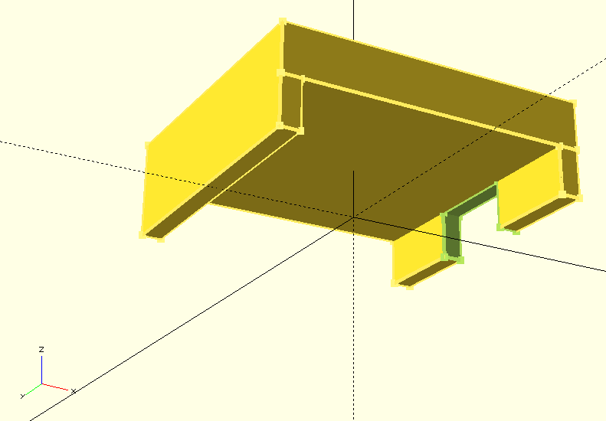
Bridge Span Direction
A
B
C
Notes:
Top:
A) A simple example of bridging – two straight aligned anchors
B) A slightly more complex case of bridging. Here, the anchors are S shaped
C) In this case, the bridge would be supported by three anchor regions.
Bottom:
These are top-down views of the model as seen by the bridging algorithm. Anchors are marked in red and the region to be bridged is marked in green.
A) In this case, bridge filaments would be aligned horizontally.
B) Like in the previous example, the bridge filaments would be aligned horizontally. Notice that the portion of the region that is considered anchored has a paler green color. The part of the region near the top of the image is not considered to be anchored sufficiently.
C) As in the previous examples, the filaments would be arranged horizontally. Notice that the center of the region is not anchored. The horizontal direction is chosen because it maximizes anchored extrusions. Any other direction would result in a greater unanchored area.
Dark green is where the bridge would not support itself.

Slide 20
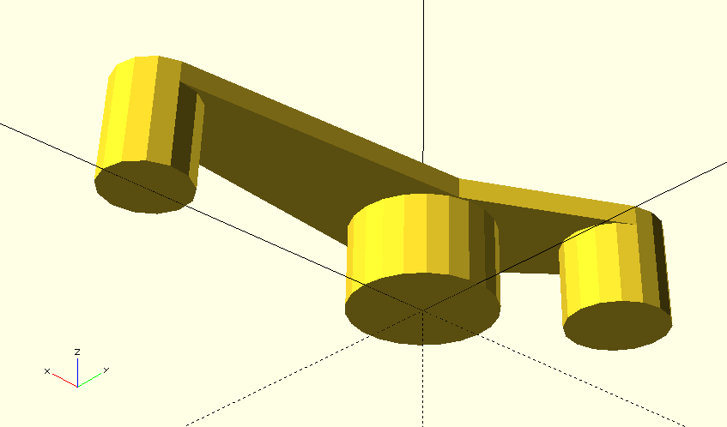
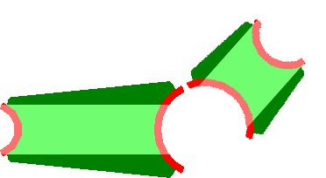
Bridge Span Direction
Notes:
Top:
More complicated bridging example – exposed floor regions that are larger than bridgeable area.
Bottom:
Resulting bridges in light green. Darker green areas are exposed floor regions that will need to be supported.

Slide 21
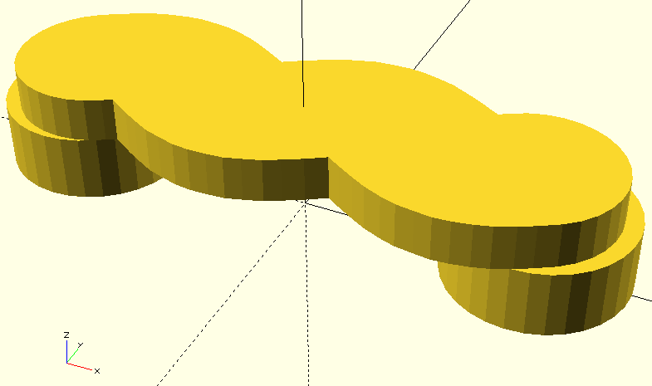
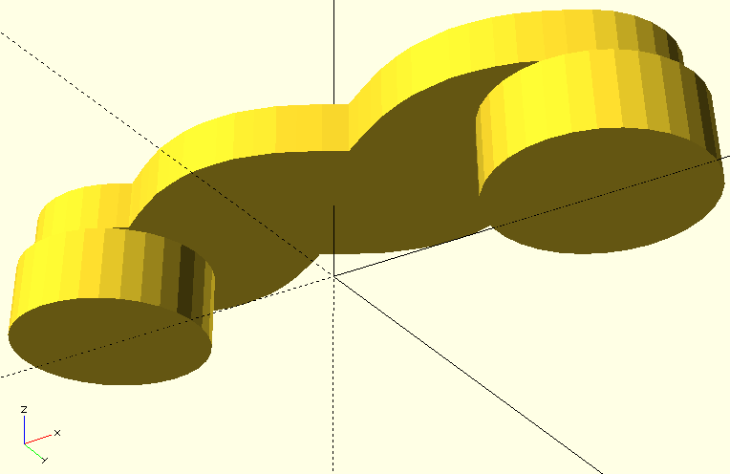
Putting it All together
Notes:
This is the model used to demonstrate bridge anchor detection.

Slide 22
Putting it All together
Notes:
Magenta: Pillars
Green: We wish to print another region above it with the magenta

Slide 23
Putting it All together
Notes:
To bridge the region, we must first determine where it can be anchored. This is done by comparing its shape to the shape of the region below it.

Slide 24
Putting it All together
Notes:
First, the region below is subtracted from the current region to determine which portion is exposed and should be bridged. This is coloured dark blue/green/navy (am I colour-blind?).
The exposed region is then outset/offset/dilated by a fixed distance. Portions of this dilated region that are not contained by the original exposed region but are contained by both the original current region and the region below will make up the anchors. They are coloured light blue.

Slide 25
Putting it All together
Notes:
This is the result of the previously described operations as seen by the bridging algorithm. Anchors are coloured red and the region to be bridged is coloured green.

Slide 26
Putting it All together
Notes:
,The filaments would be arranged horizontally. Notice that the sides of the region are not anchored. The horizontal direction is chosen because it maximizes anchored extrusions. Any other direction would result in a greater unanchored area.

Slide 27
Minimizing Supports
Decompose object into parts requiring no supports
Hu et al. 2014
Optimize orientation to minimize the support volume
Discrete optimization
Alexander et al. 1998, Vanek et al. 2014
Genetic algorithms
Danjou & Köhler 2009, Thrimurthulu et al. 2004, Canellidis et al. 2006
Orthogonal and Gaussian frameworks
Hildebrand et al. 2013, Hu et al. 2015
Notes:
When bridging can’t be used, there are other ways to avoid or minimize supports. One is to decompose an object into convex parts requiring no supports.
Another is to minimize the support volume by changing the orientation at which the object is printed. Several optimization approaches exist including discrete, genetic, and closed-from solutions using a Gaussian framework, for example.

