Slide 1
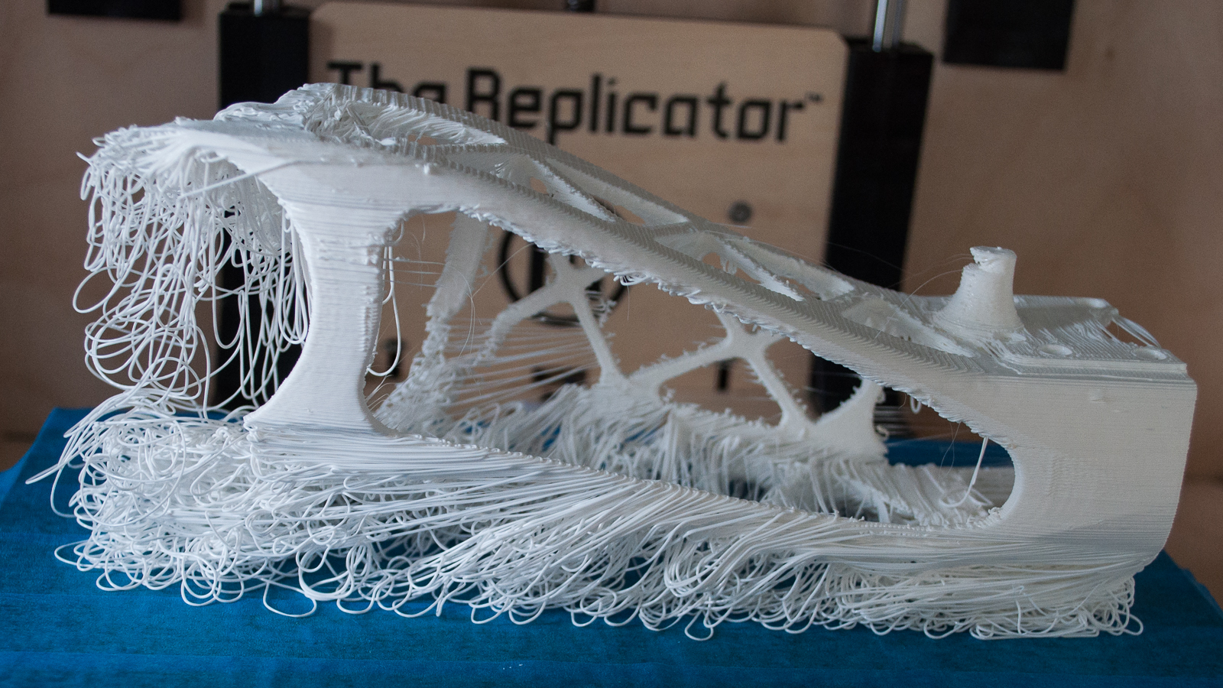
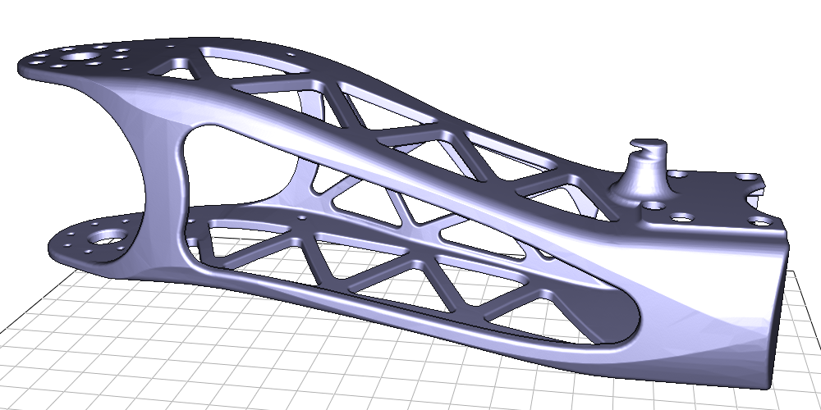
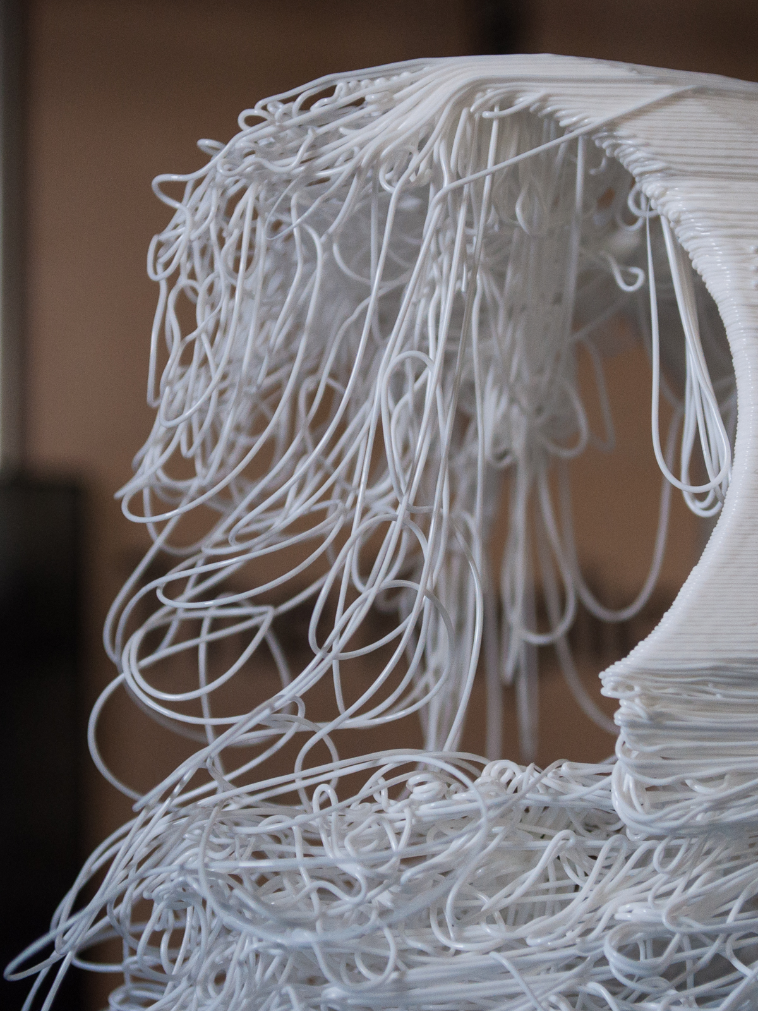
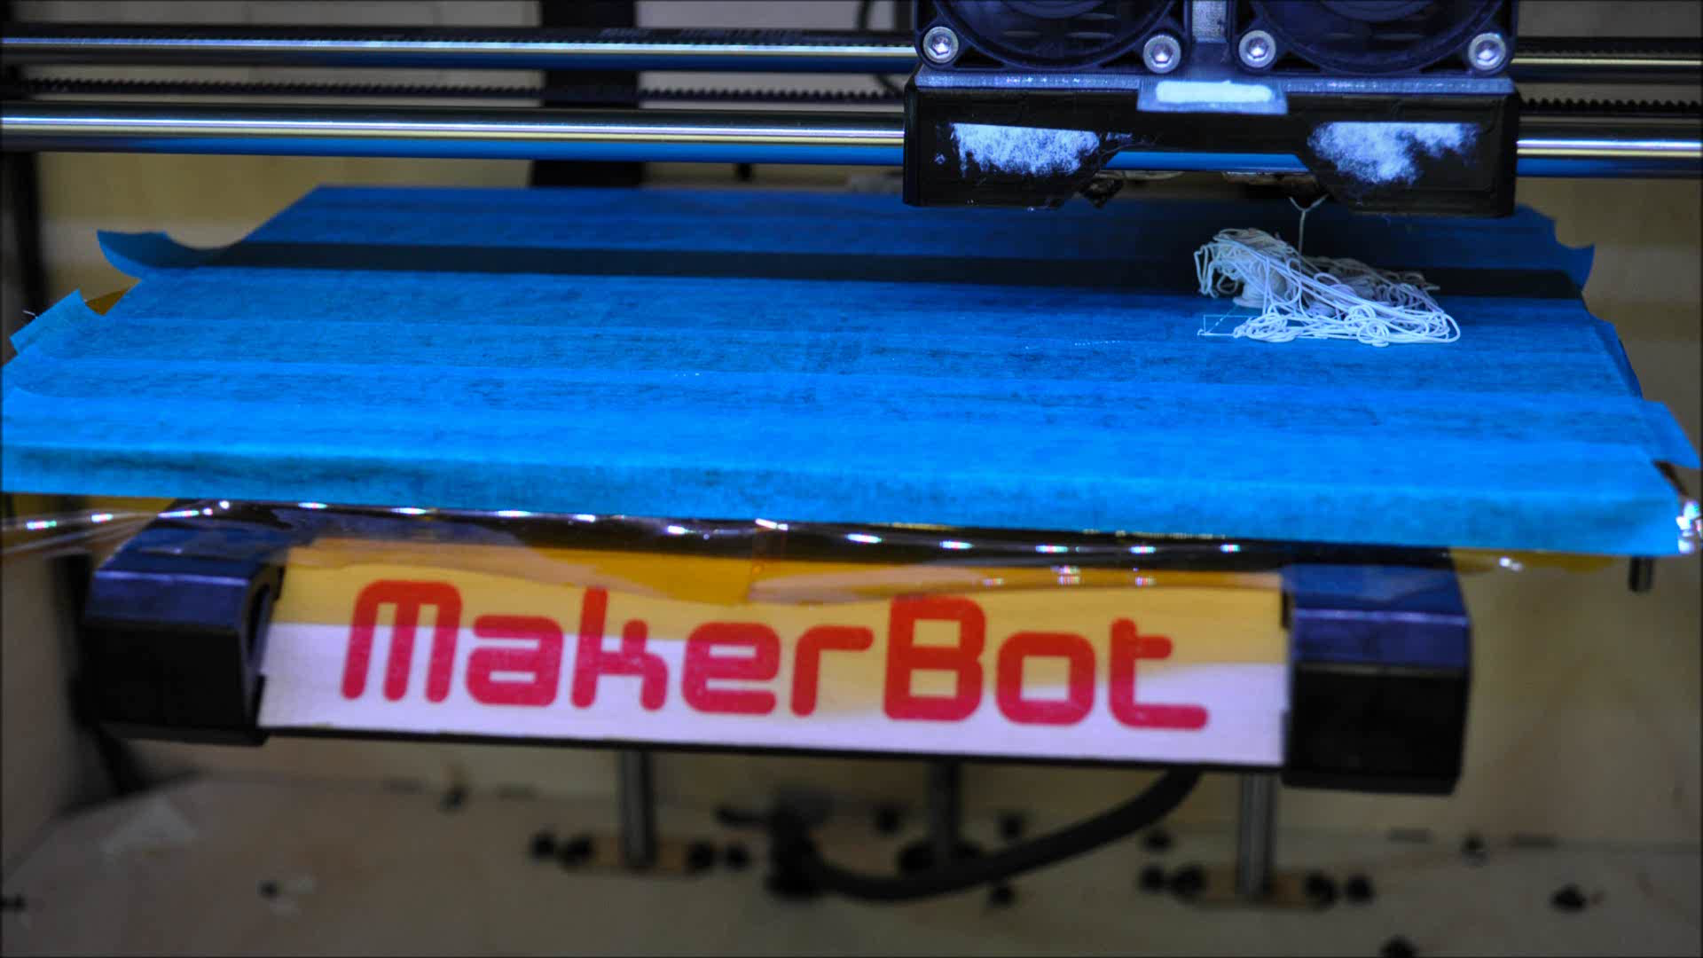
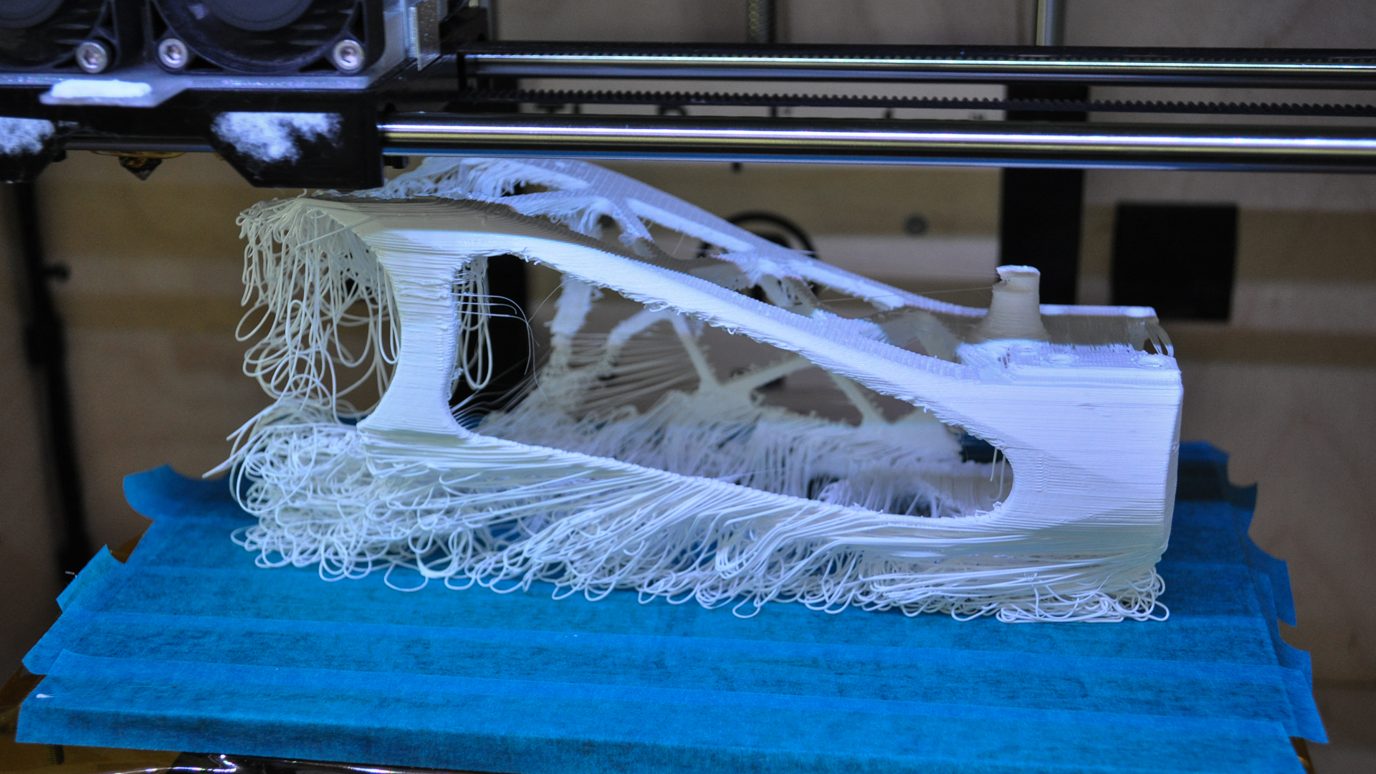
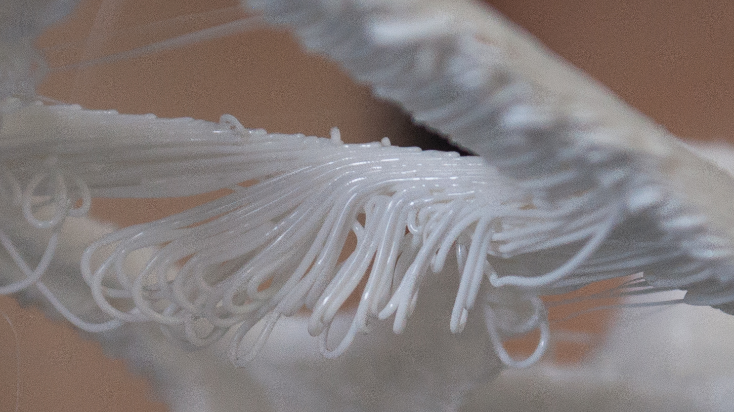
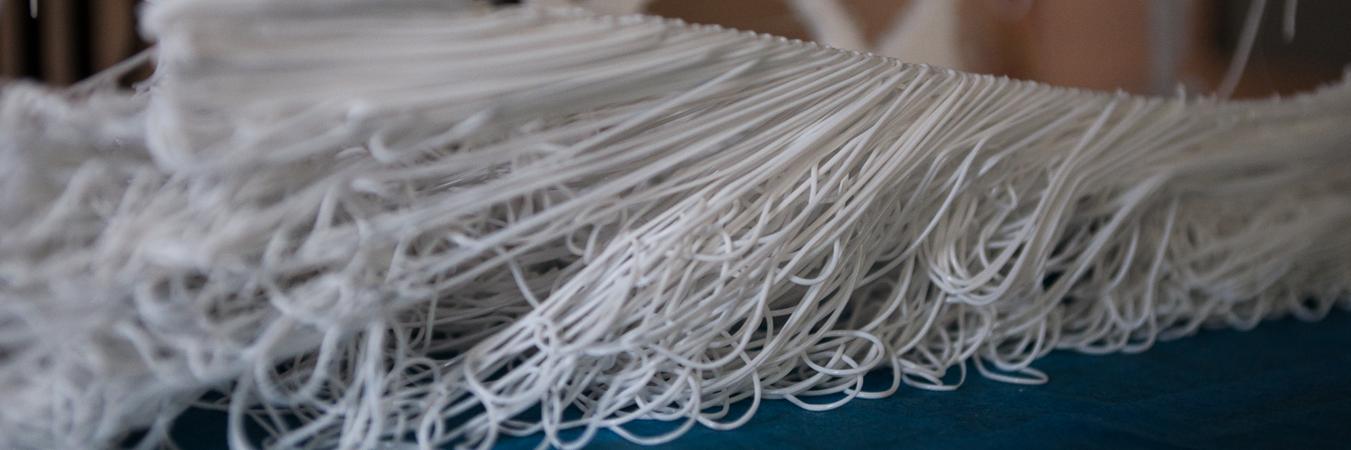
Support is required

Slide 2
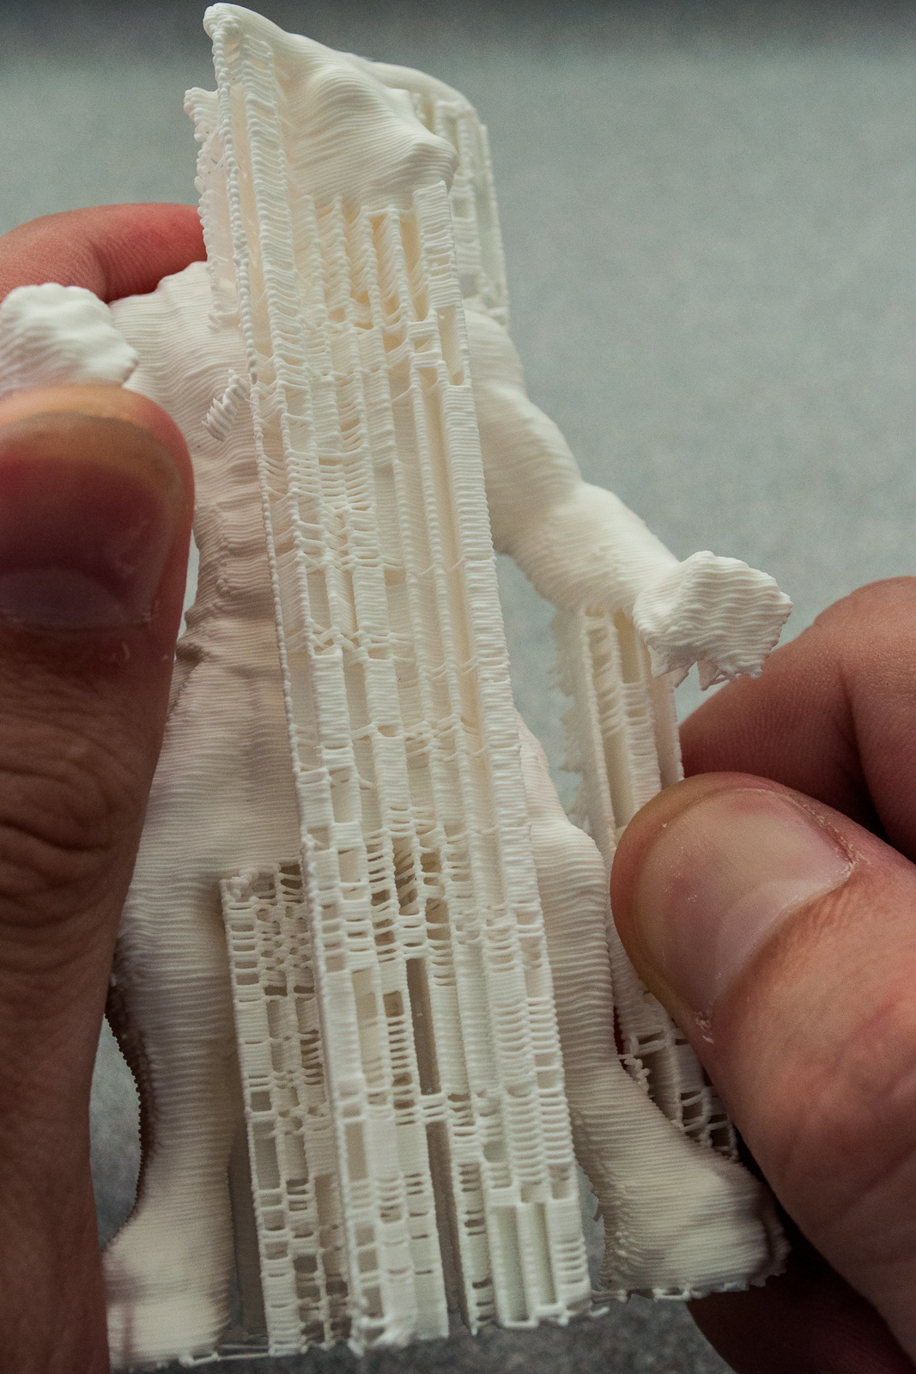
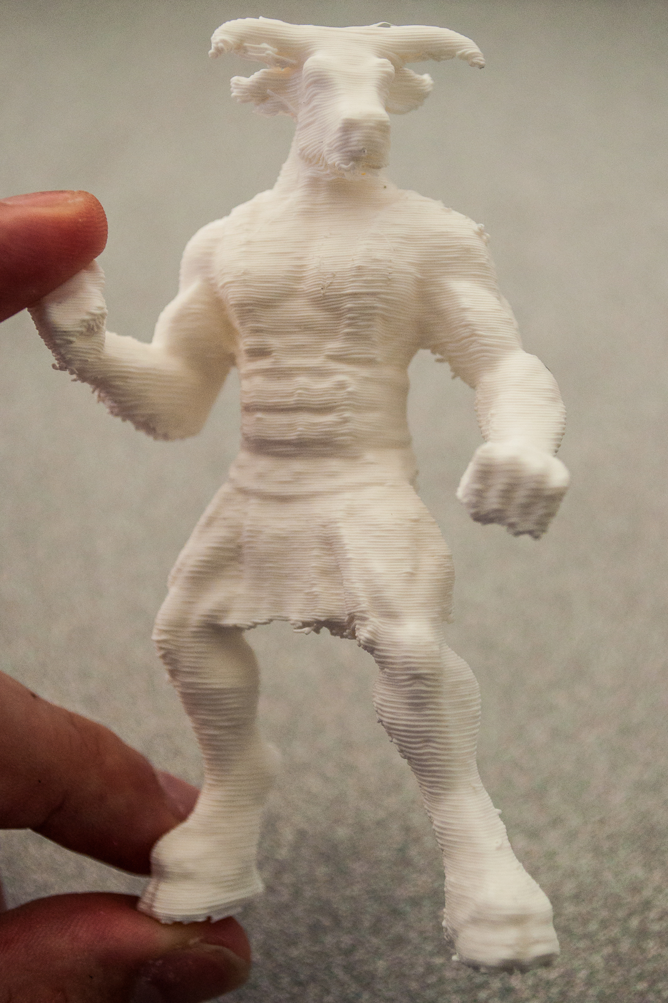
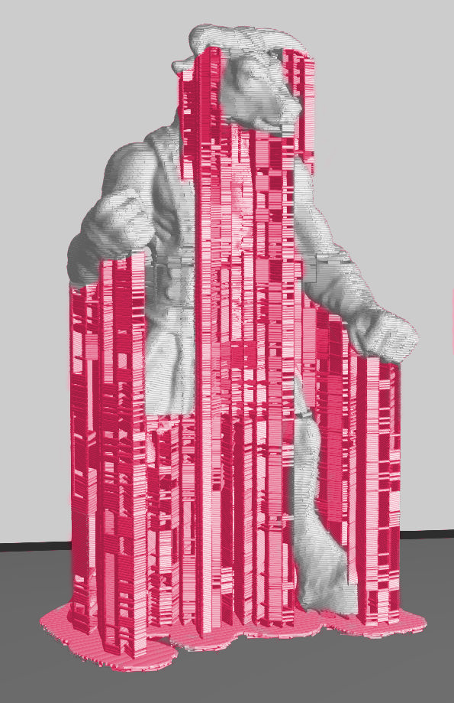
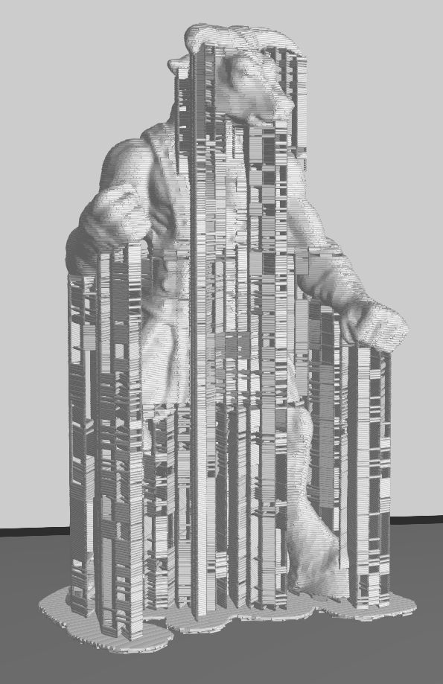
Typical Approach
Downward extrusion
  Reliable
  High material usage
  Difficult to remove
[Minotaur (ajolivette) / CC BY-SA 3.0]

Slide 3
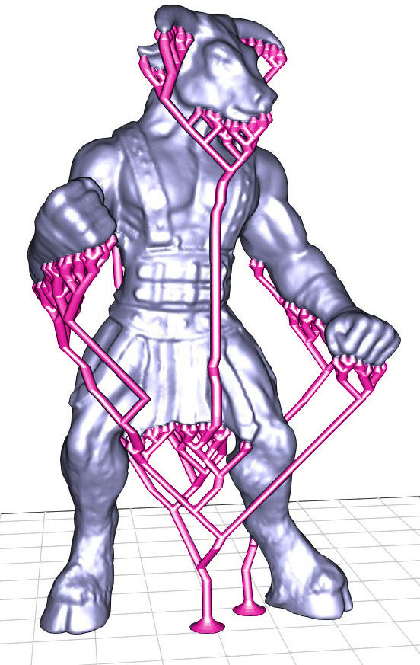
Recent Work
Tree supports [MeshMixer, Vanek et al.]
  Low material usage
  Imbalanced structure
  Requires manual tuning

Slide 4
Trees – Pros and Cons
Support/length ratio
Sensitive to torque

Slide 5
Think With Bridges
Support/length ratio
Resistant to torque

Slide 6
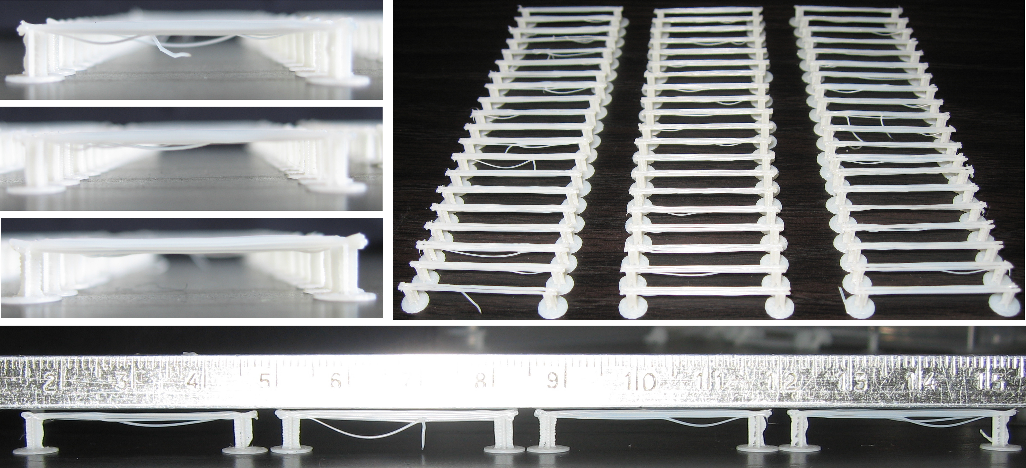
Printing Bridges

Slide 7
Material usage
Competitive to trees
…Up to a certain height

Slide 8
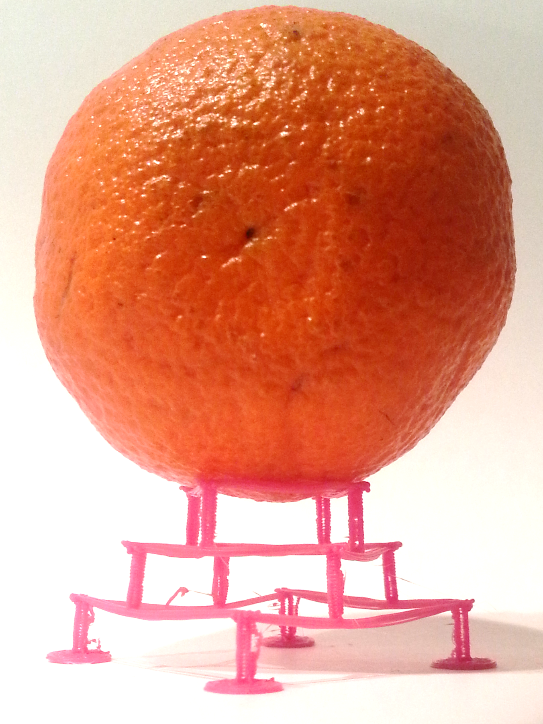
~50g
0.5g

Slide 9
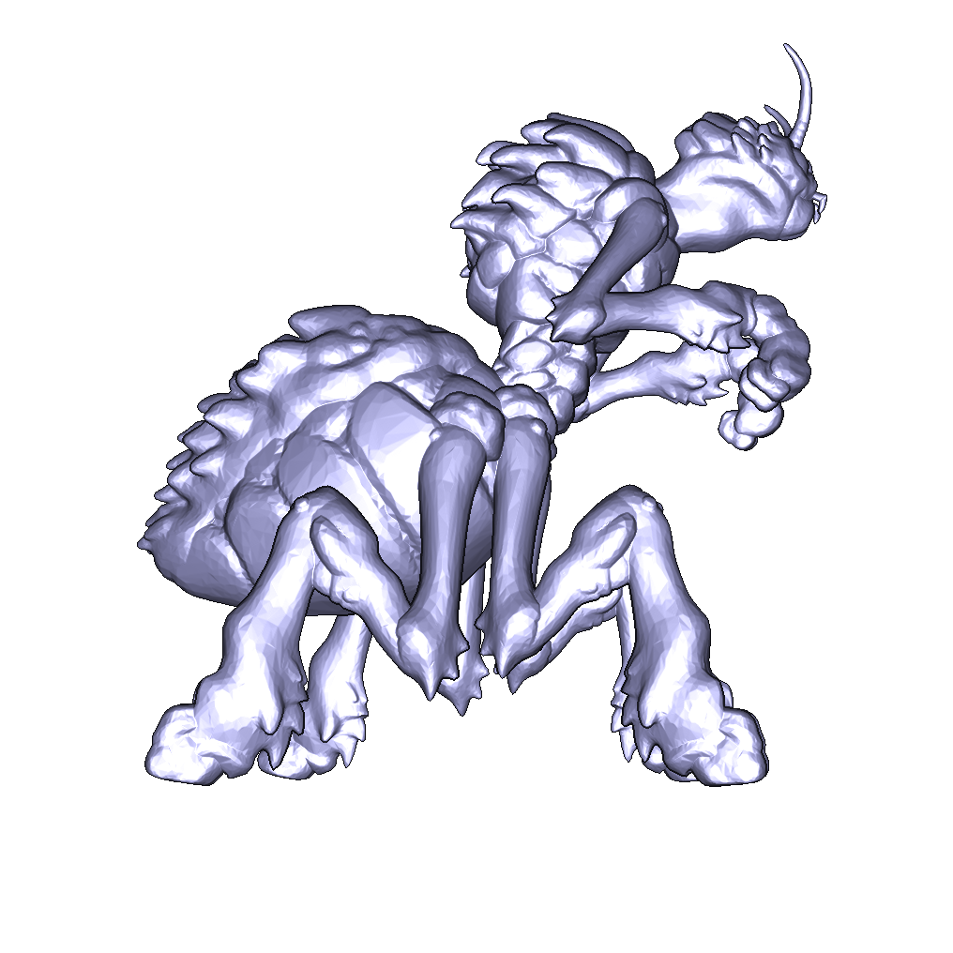
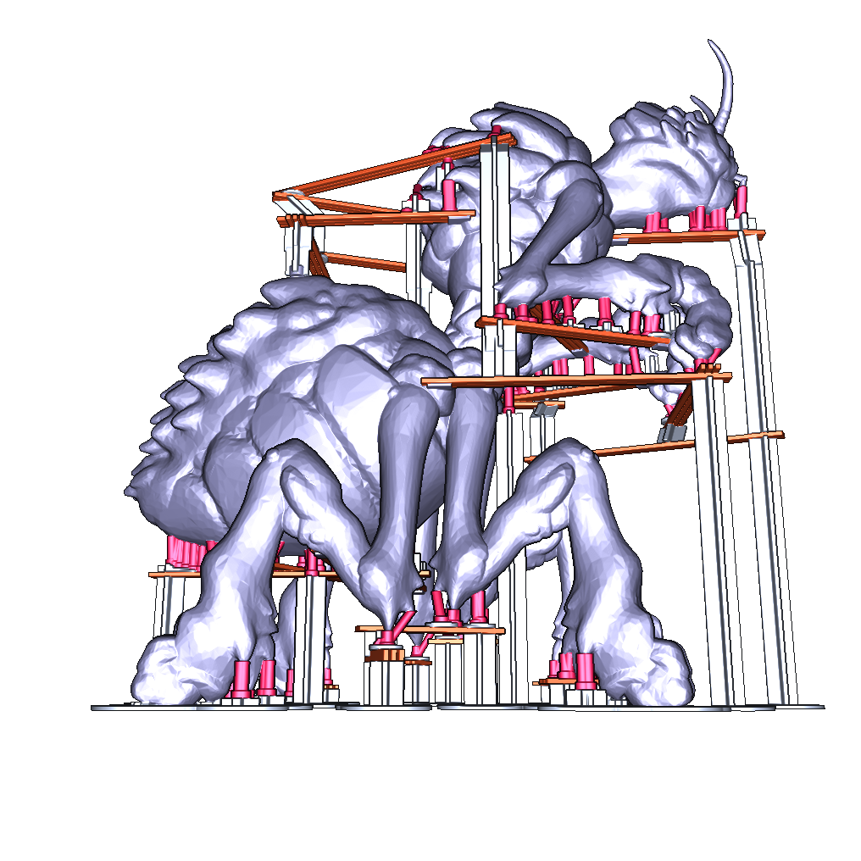
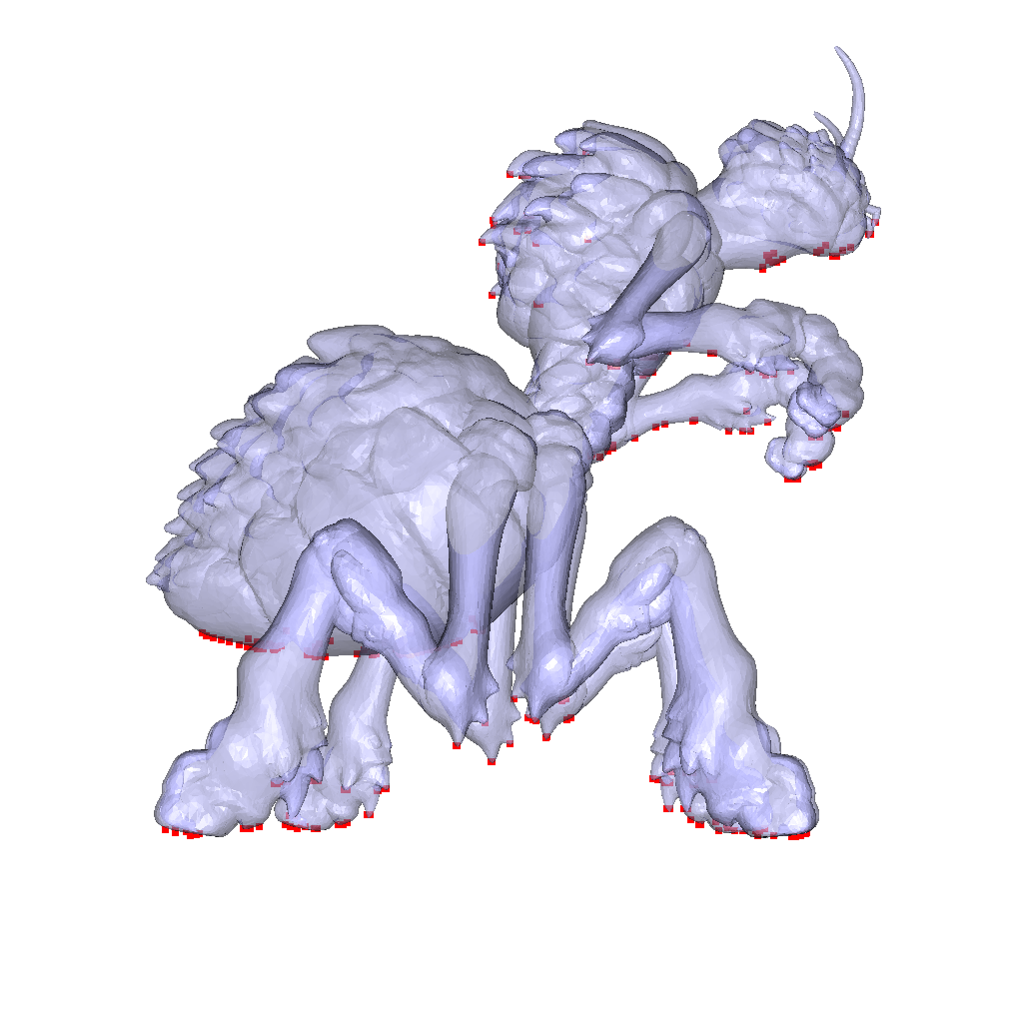
Method Overview
Overhang detection
Bridge synthesis
[Broodling (dutchmodul) / CC BY-SA 3.0]

Slide 10
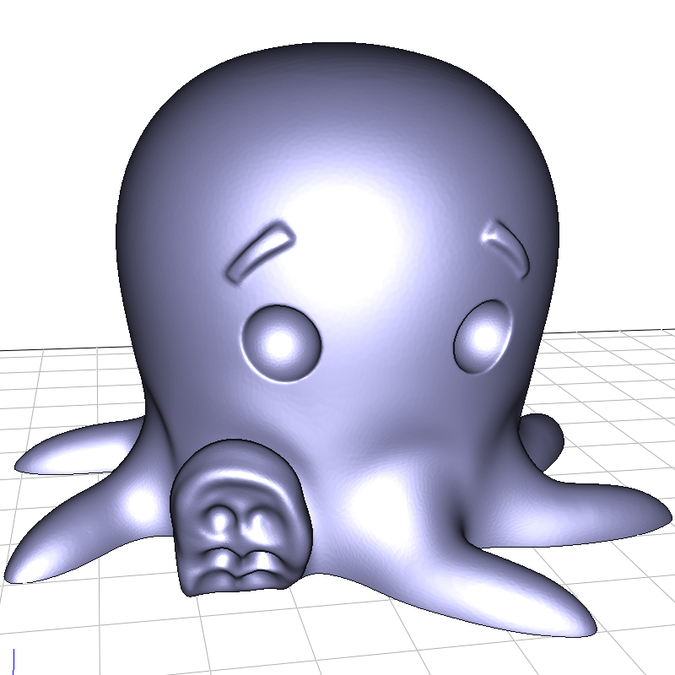
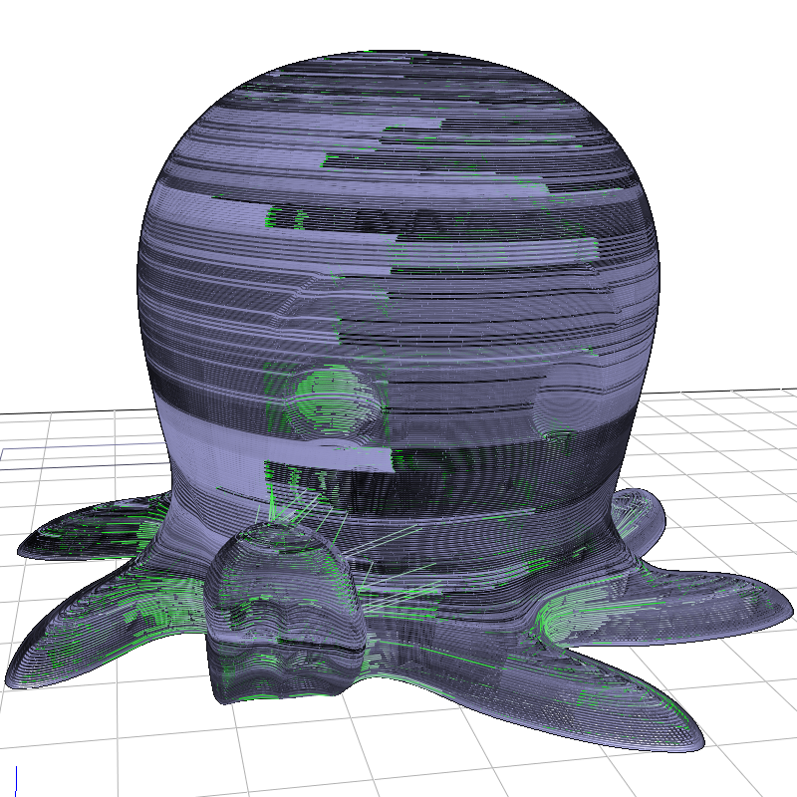
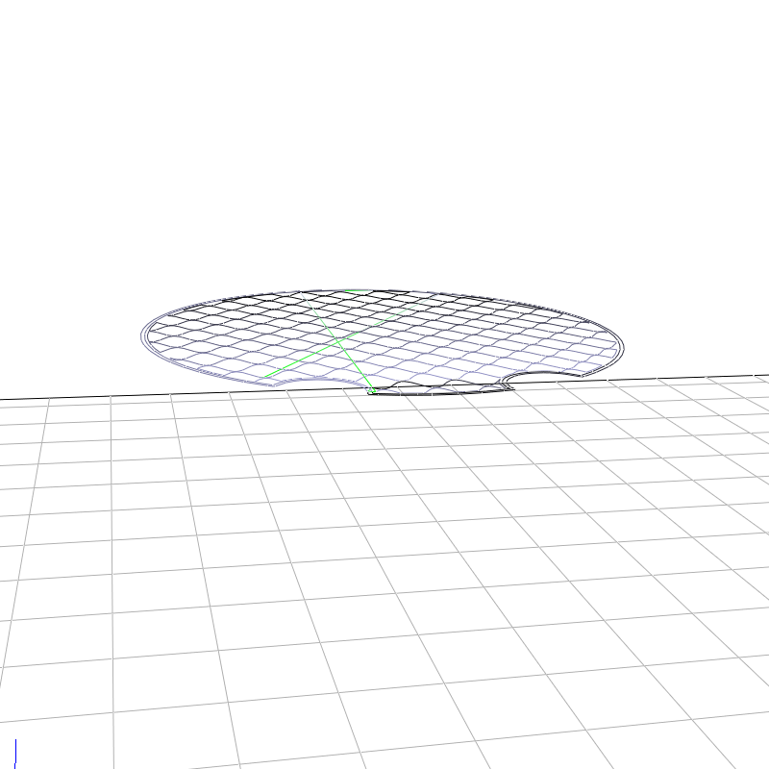
Overhang Detection
Input: 3D Model + Slices + Paths
[Cute Octopus Says Hello (MakerBot) / CC BY 3.0]

Slide 11
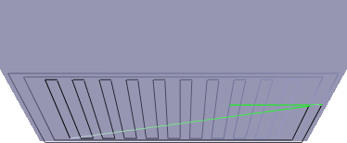

Overhang Detection
Use print paths
Uniform sampling
  Need Support ? Y / N
Simplify wrt print order

Slide 12
Scaffolding: Problem Statement
In - Required Points
Out - Valid Scaffolding
a
b
→ Global constraint

Slide 13
Goal: Minimal Length Scaffolding

Slide 14
Our Approach
Finding a global optimum is not easy
Sweep algorithm enumerating opportunities

Slide 15
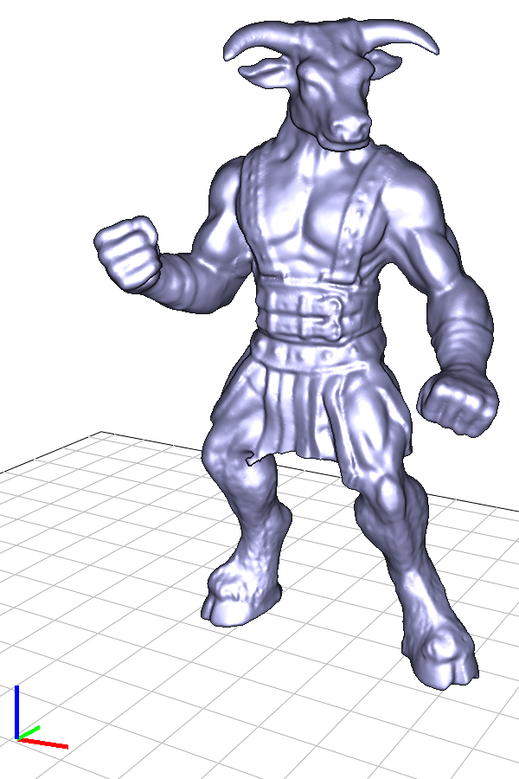
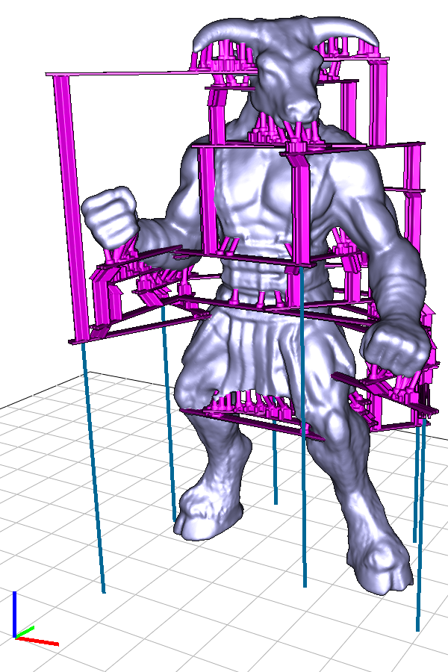
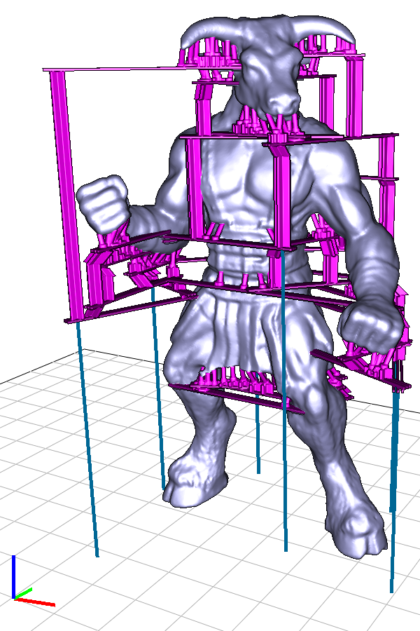
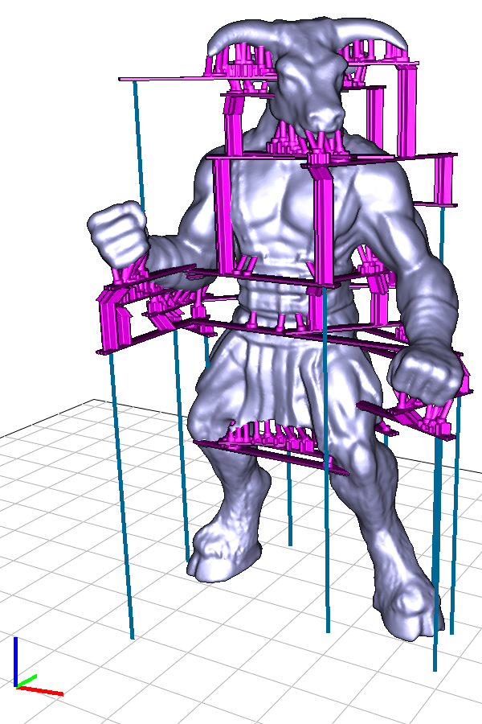
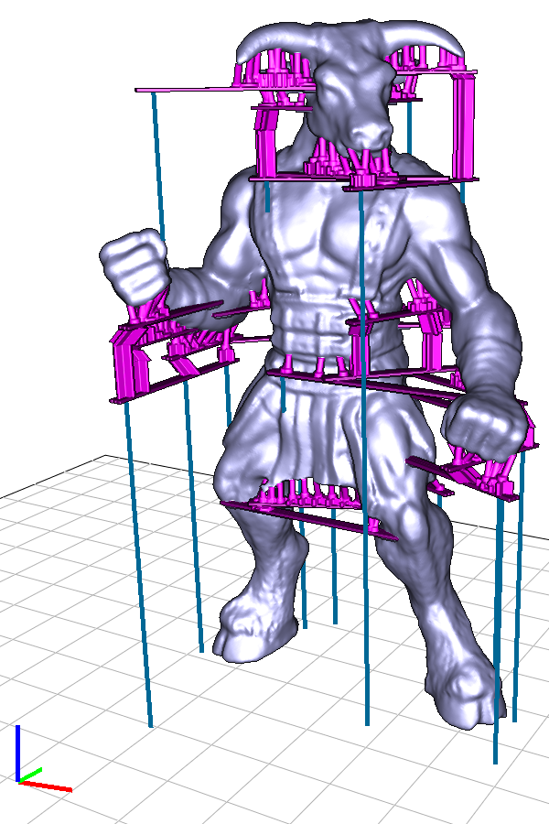
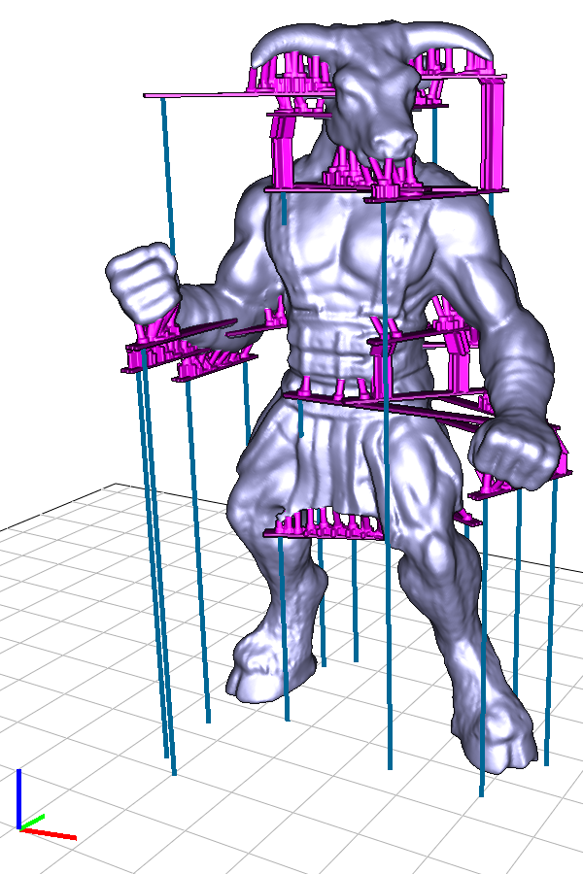
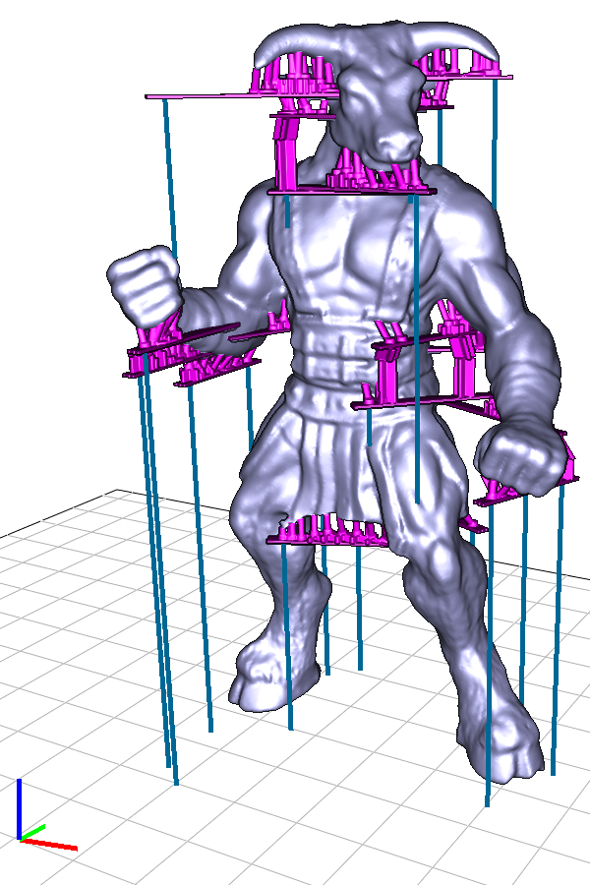
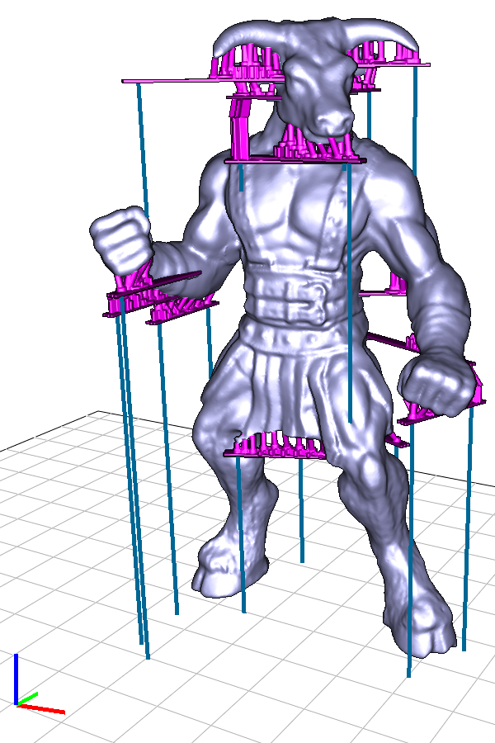
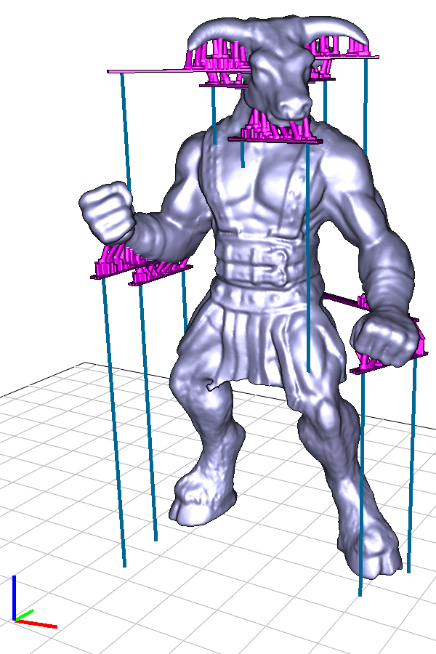
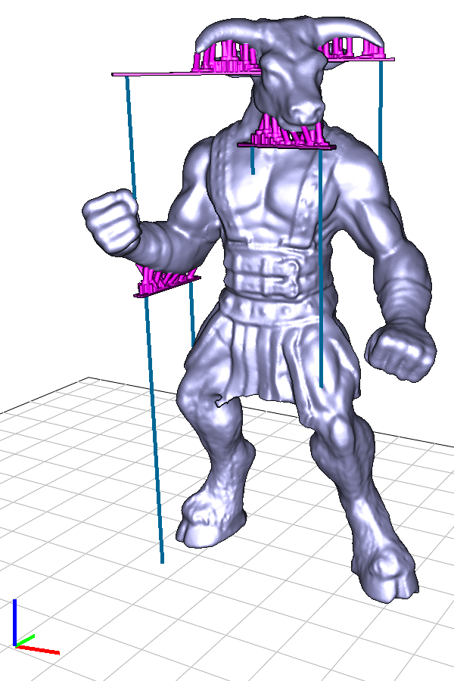
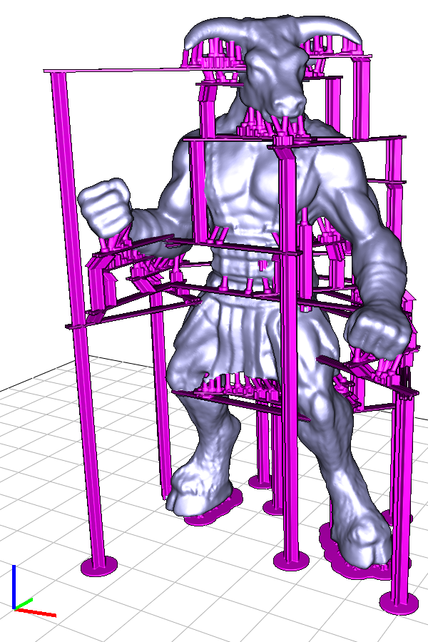
Bridge Synthesis
[Minotaur (ajolivette) / CC BY-SA 3.0]

Slide 16
Stability?

Slide 17
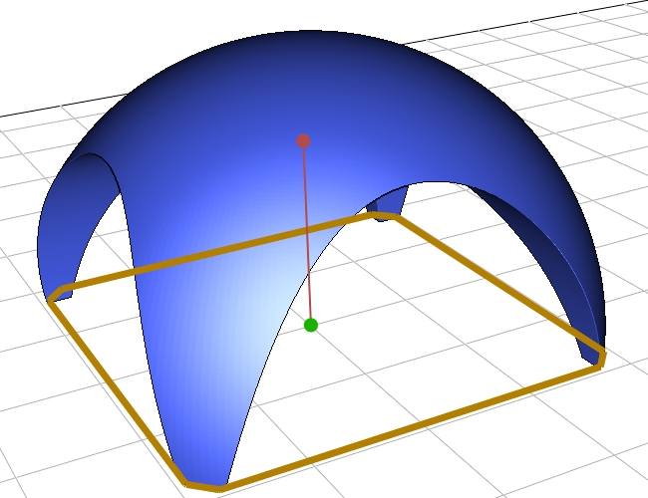
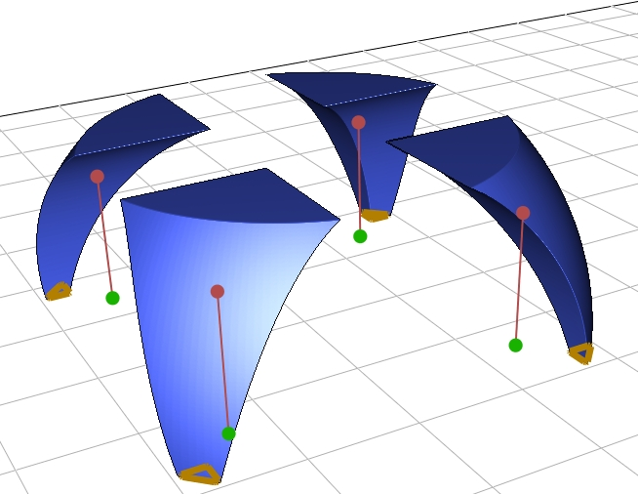
Stability?

Slide 18
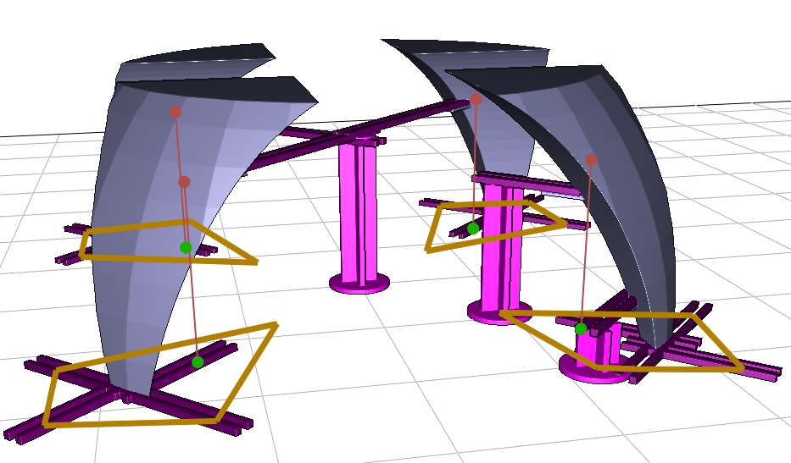
Stability Enhancement

Slide 19
Sweep bottom up
CoM
OK
BoS

Slide 20
Sweep bottom up
NOT OK
BoS

Slide 21
Sweep bottom up
BoS

Slide 22
Sweep bottom up
BoS

Slide 23
How to fix it?
NOT OK
BoS

Slide 24
How to fix it?
Pillar
BoS

Slide 25
How to fix it?
Artificial required
point
Property of bridges:
Center of mass always in base of support!

Slide 26
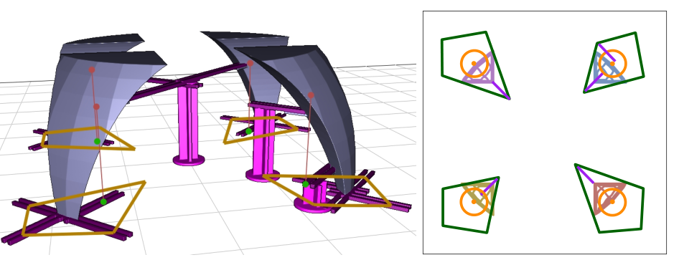
Detection

Slide 27
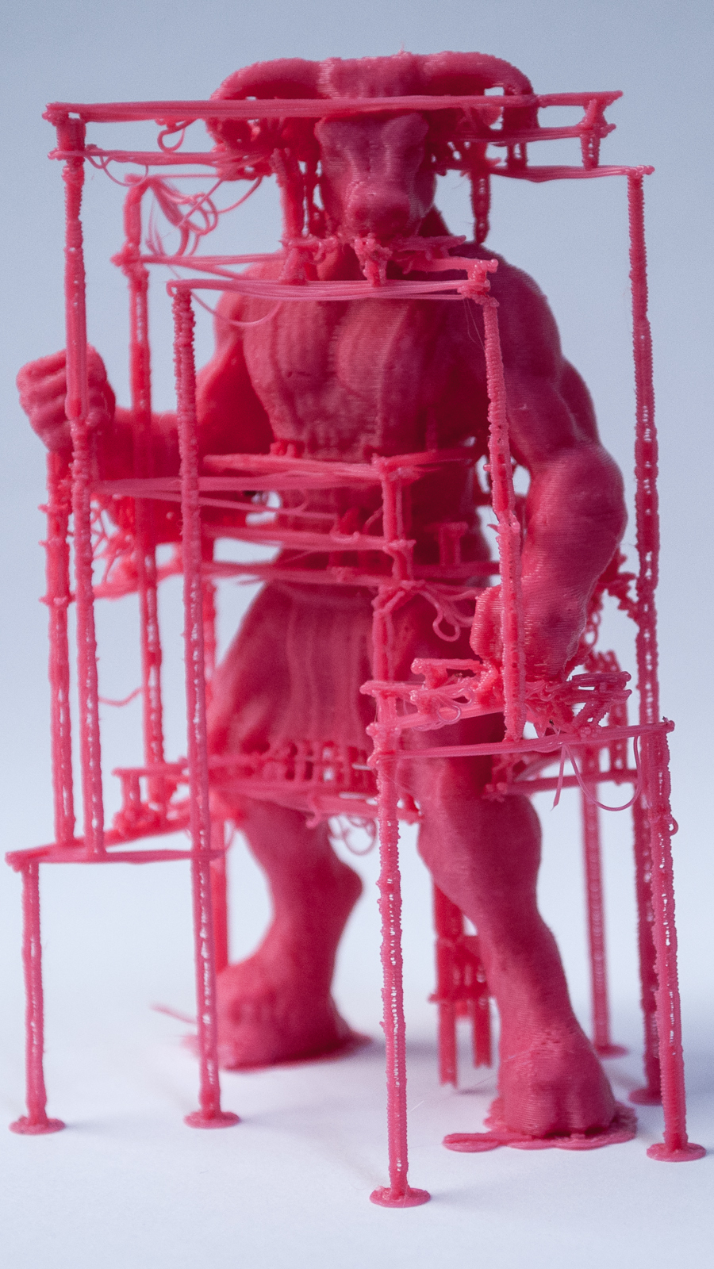
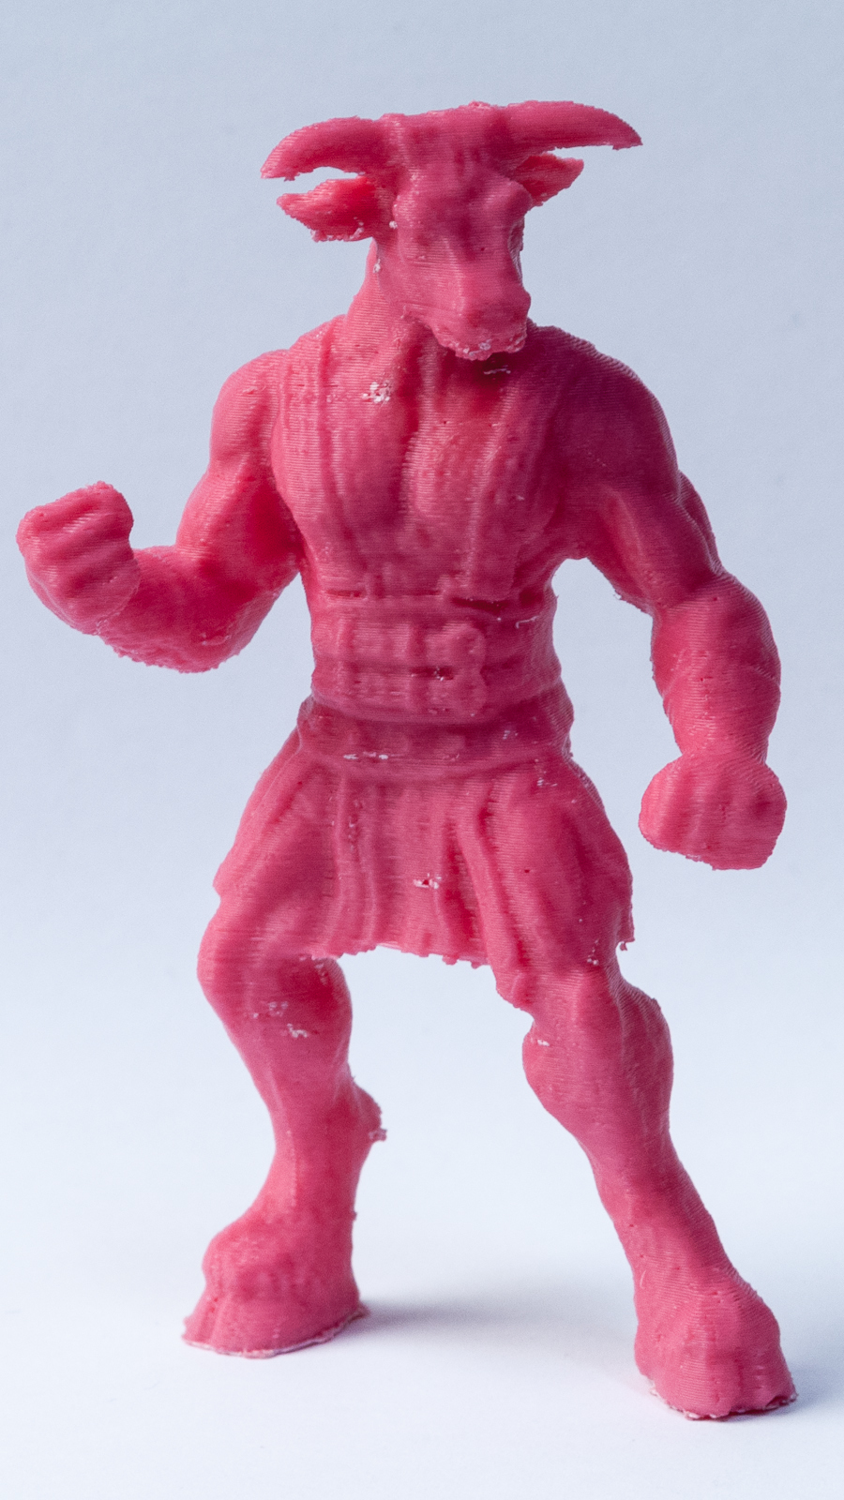
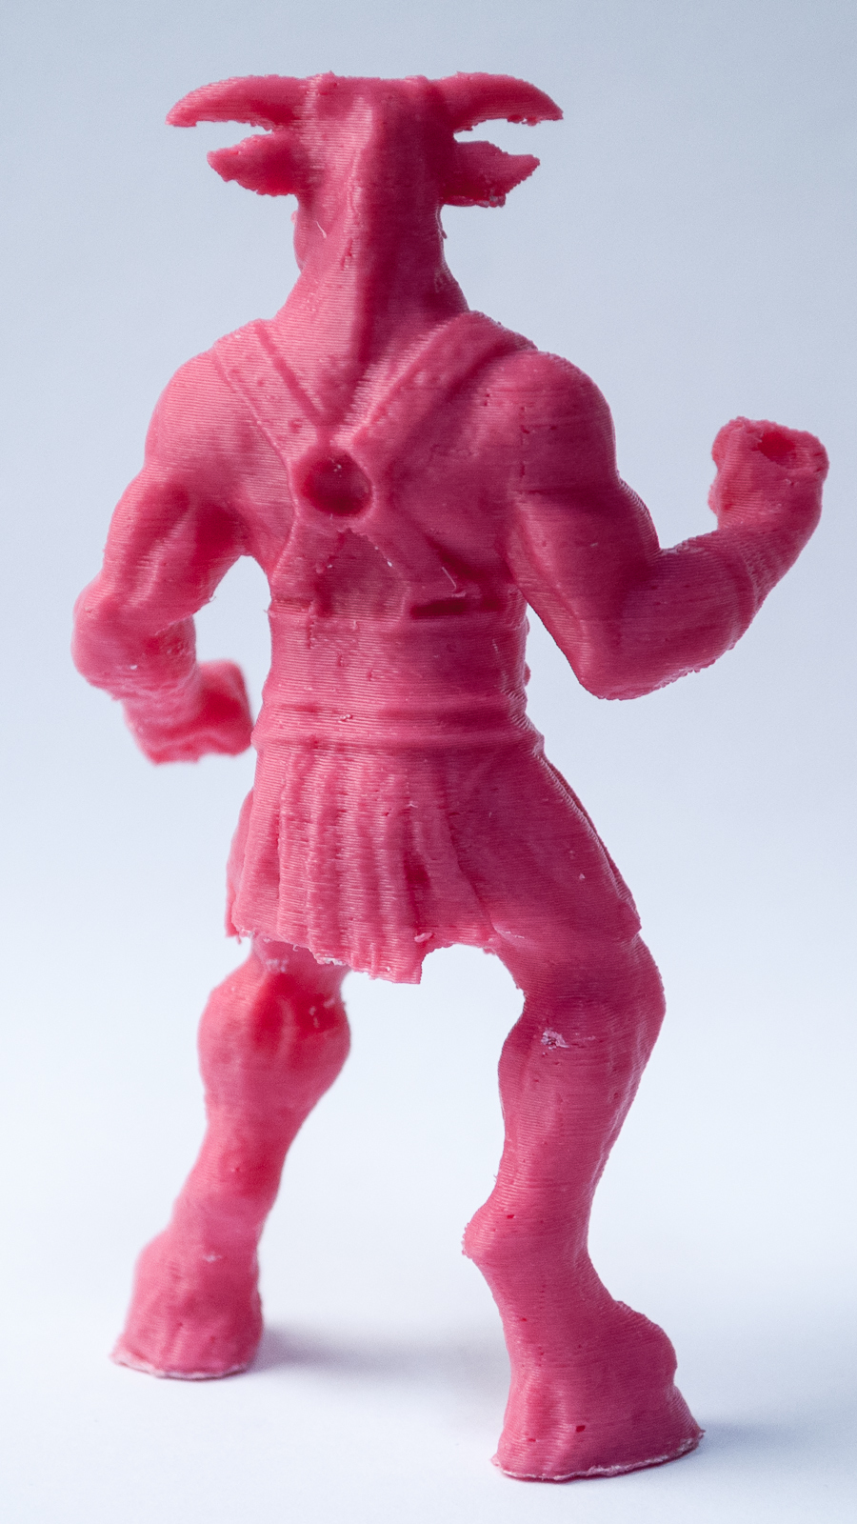
Results – Minotaur (Ours)
10 cm
[Minotaur (ajolivette) / CC BY-SA 3.0]

Slide 28
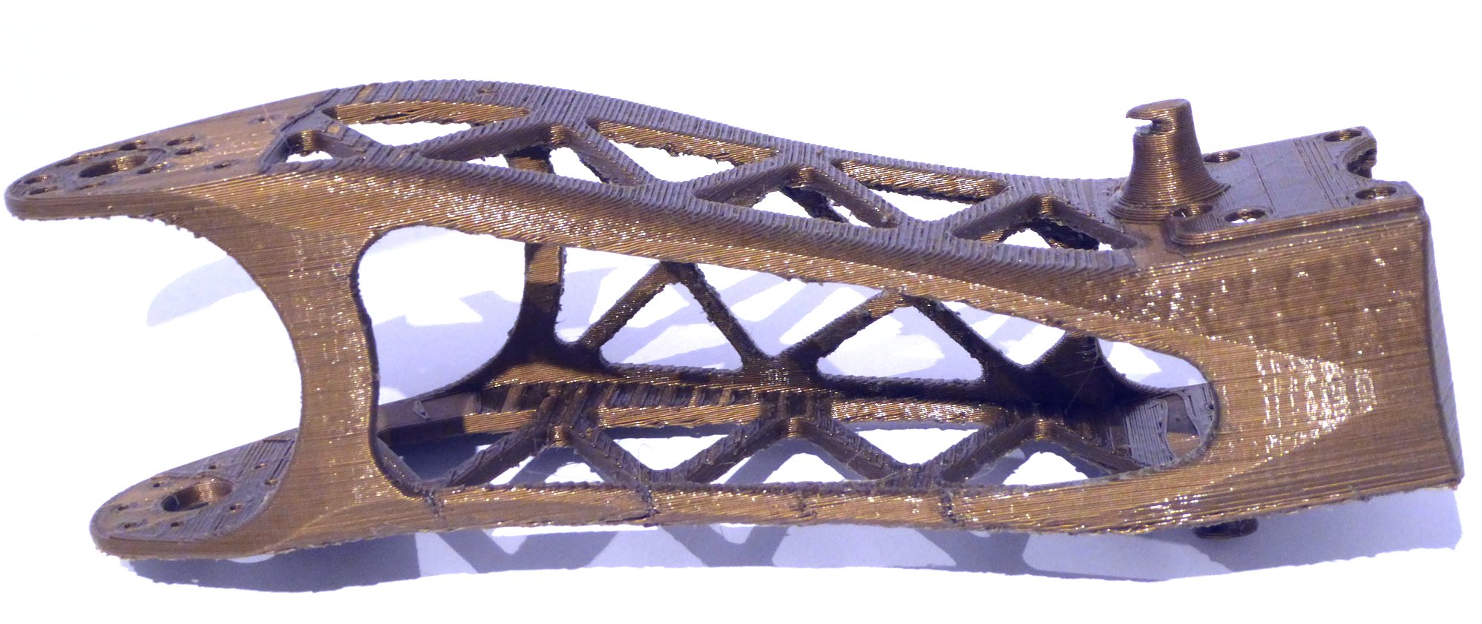
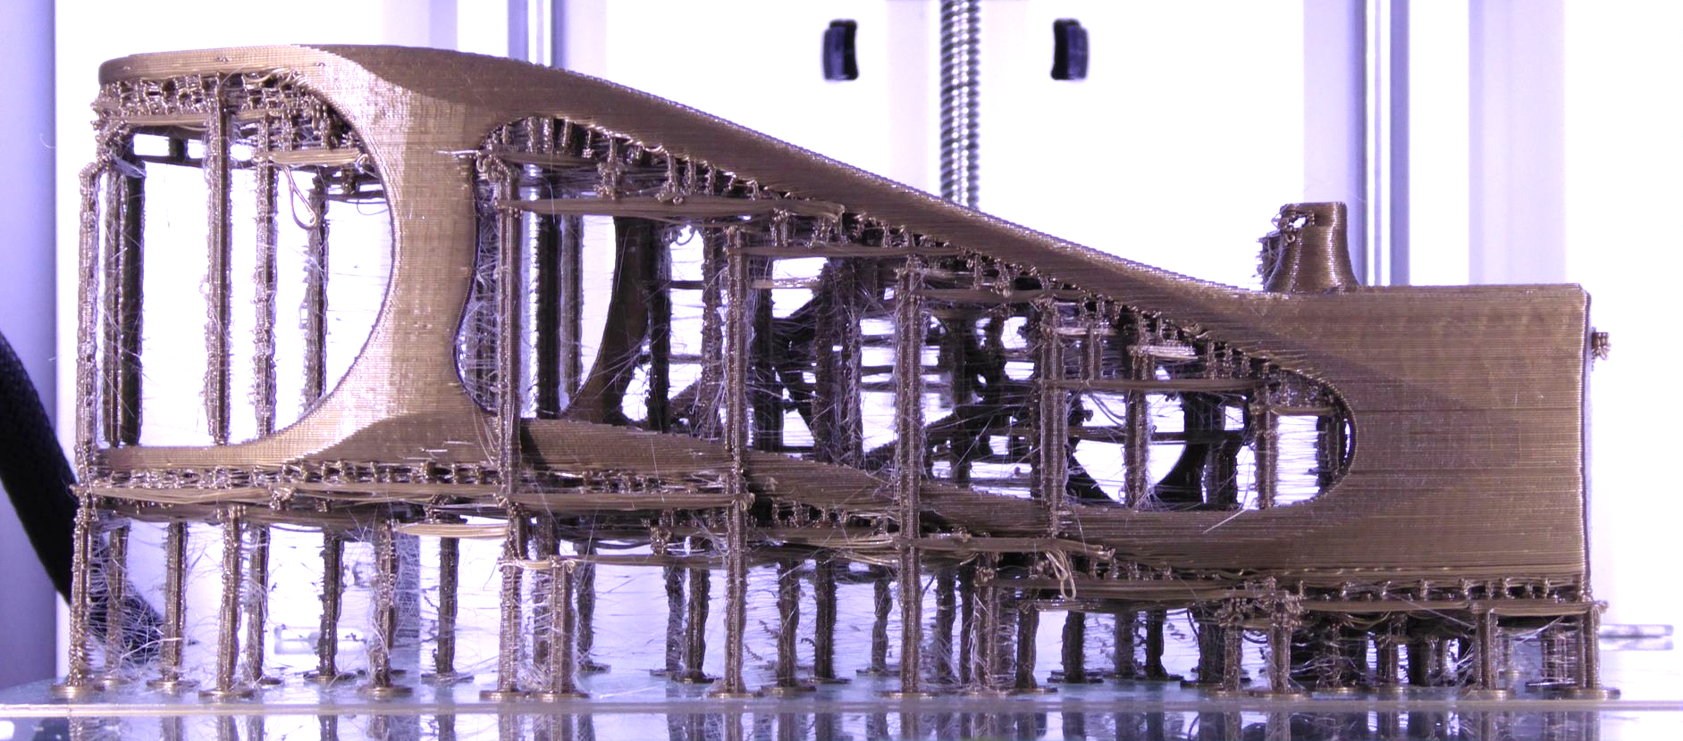
Results
–
Poppy
Model: poppy project (INRIA Bordeaux)
8 cm

Slide 29
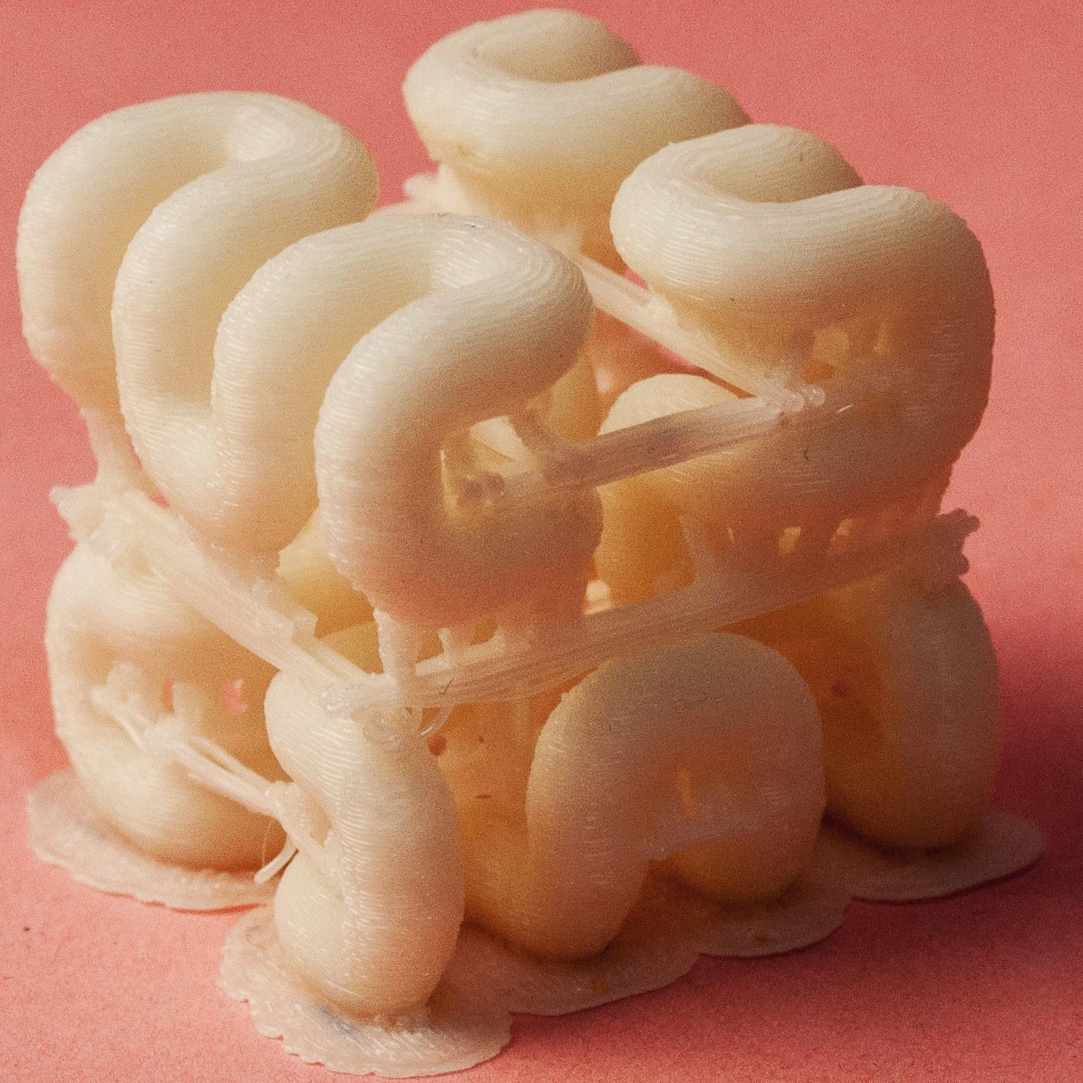
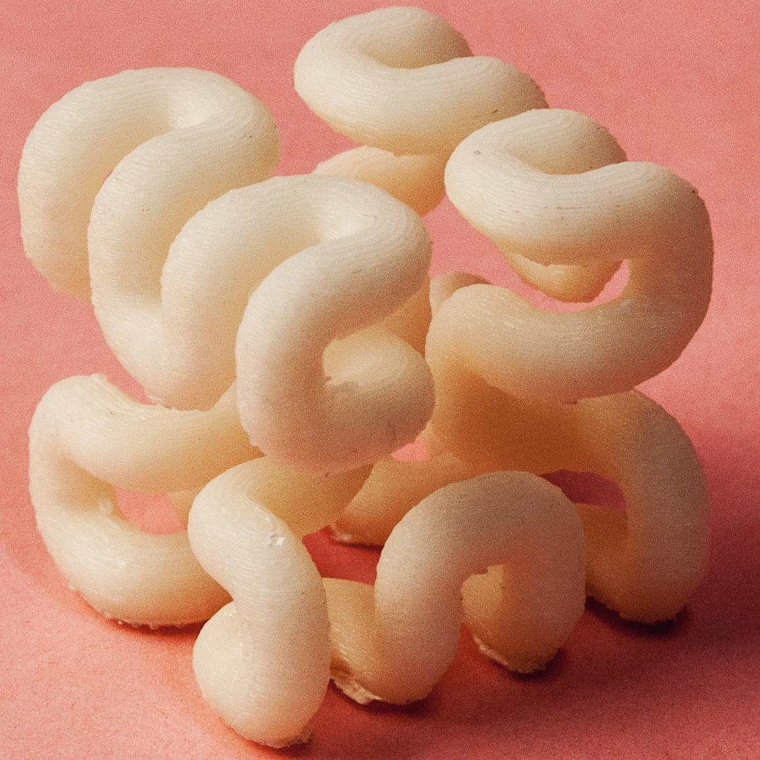
Results – Hilbert Cube
3 cm
[Hilbert Cube (tbuser) / CC BY-SA 3.0]

Slide 30
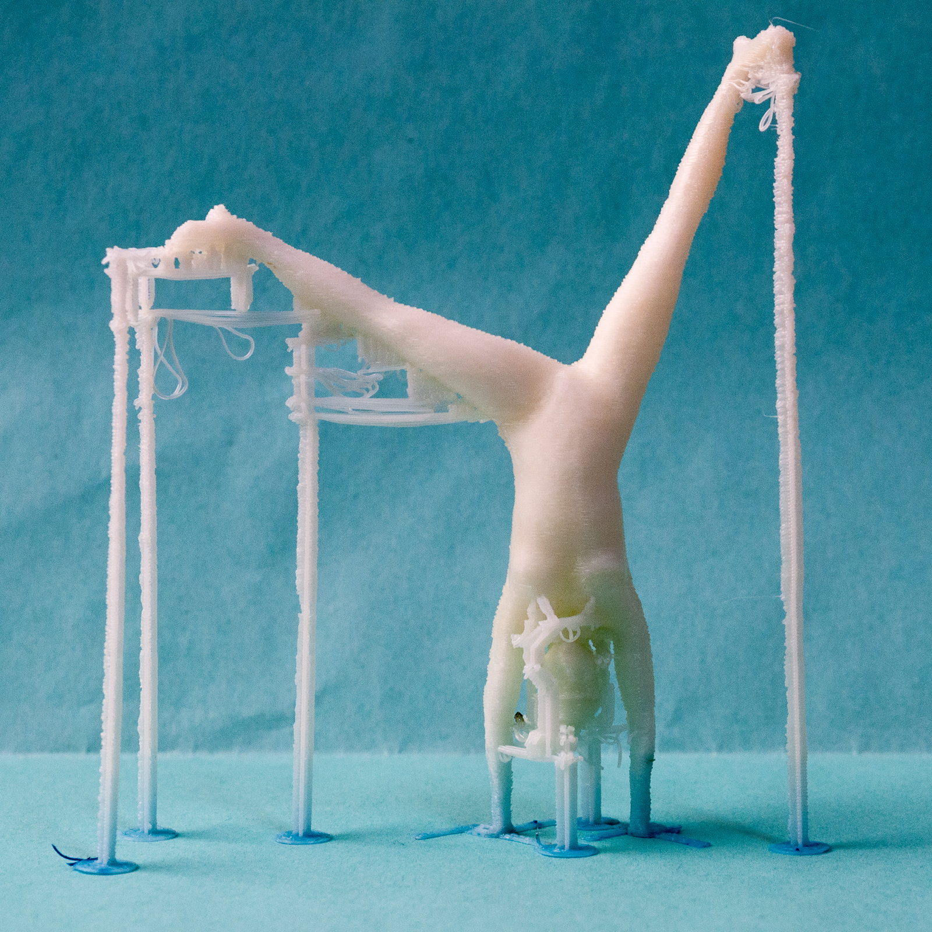
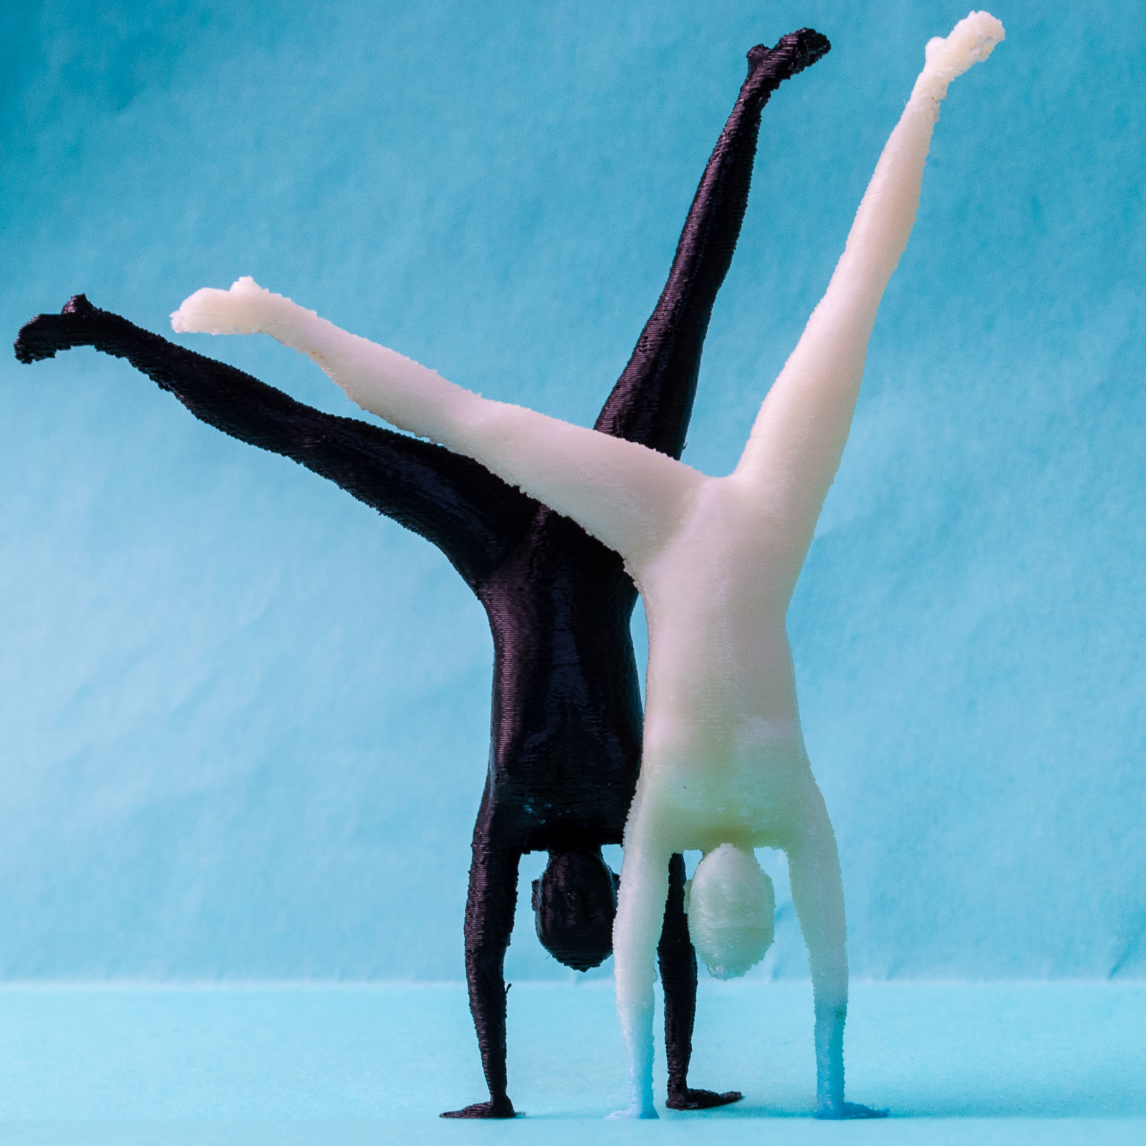
Results – Gymnast
10 cm
http://www.123dapp.com/123C-3D-Model/Female-Gymnastics-Cartwheel/711240

Slide 31
Print time
In principle less plastic = faster
Travel might increase, but travel is fast
Main issue: Acceleration on small connectors

