Slide 1
Integrating Solid Modeling with Slicing
Frédéric Claux and Sylvain Lefebvre
Notes:
We now present how to make a neat CSG modeling and slicing engine using GPUs

Slide 2
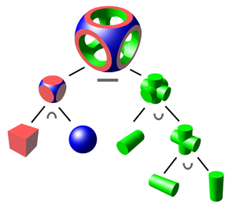
Constructive Solid Geometry
Modeling operations between solids
http://en.wikipedia.org/wiki/Constructive_solid_geometry
Notes:
One popular way of modeling objects is to use Constructive Solid Geometry, or CSG. CSG assembles solids using union, intersection and difference operators into a tree. You can make complex solids with complex trees. It is relatively intuitive, even for beginners. For instance, the difference operator is handy to remove matter from an existing object, such as when holes need to be created off, say, a solid bar. Primitives can be of any kind, including complex meshes.

Slide 3
[Doggie (TrevM) / CC BY-SA 3.0]
Notes:
Here is the doggie model taken from thingiverse and part its source code.

Slide 4
Made by a 13 years old
long = 100
r = scale(long,30,2) * translate(0,0,0.5) * box(1)
intersize = long/11
pos = -long/2+intersize
spacing = 2
for i=1,10 do
c = translate(pos, 0, 0 ) * cylinder( (1+i)/2, 2 )
r = difference( r, c )
pos = pos + (i+1)/2 + spacing + (i+2)/2
end
cn = rotate(90,Y) * translate(0,0,-long/2) * cone(5/2,18/2,long)
emit( intersection(r,cn) )
Notes:
Writing scripts might seems hard, but here is an example made by a 13 years old after some basic explanations.

Slide 5
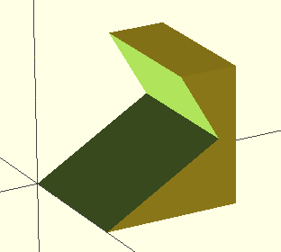
OpenSCAD
difference() {
cube([10,10,10]);
translate([-2.5,0,0]) rotate([30,0,0]) cube([15,10,10]);
}
Notes:
OpenSCAD for instance, a simple yet popular modeling application used in the 3D printing community, uses CSG trees. This is an example model, with its example CSG tree source code.

Slide 6
CSG
difference() {
cube([10,10,10]);
translate([-2.5,0,0]) rotate([30,0,0]) cube([15,10,10]);
}
STL
Printer
Lefebvre & Claux, 2015
Notes:
OpenSCAD, like other software applications, evaluates the CSG tree and turns it into a mesh, which it then gives to the slicer/printer.

Slide 7
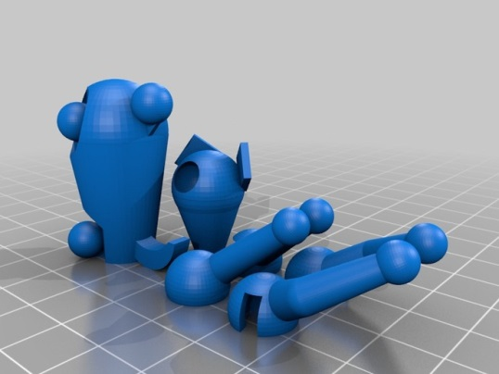
CSG
difference() {
cube([10,10,10]);
translate([-2.5,0,0]) rotate([30,0,0]) cube([15,10,10]);
}
STL
Printer
Lefebvre & Claux, 2015
Notes:
To produce the STL mesh file, ready to be printed, OpenSCAD transforms each CSG tree primitive into a mesh and then applies the CSG operators with these primitives, from the bottom up and in a recursive fashion up the tree.

Slide 8
CSG
difference() {
cube([10,10,10]);
translate([-2.5,0,0]) rotate([30,0,0]) cube([15,10,10]);
}
STL
OpenSCAD
9 minutes
Printer
Lefebvre & Claux, 2015
Notes:
It takes 9 minutes to generate the final geometry.

Slide 9
CSG
difference() {
cube([10,10,10]);
translate([-2.5,0,0]) rotate([30,0,0]) cube([15,10,10]);
}
A few seconds
Printer
Lefebvre & Claux, 2015
Notes:
It would be better to produce a printer-understandable Gcode file right from the input tree without having to generate a mesh first. This would considerably simplify the printing process, as generating the mesh is an obvious bottleneck.

Slide 10
Problems
CSG with meshes is difficult (numerical issues)
Slicers need well formed meshes
OpenSCAD produces high quality meshes
Relies on CGAL
Very powerful, but computationally intensive
Number of triangles quickly increases
Surface details, finely tessellated geometries
Notes:
CSG operations on meshes are very difficult. Many algorithms exist and a lot of them indeed have numerical issues. OpenSCAD relies on CGAL to do the CSG operations. CGAL is reliable but is very calculation intensive. The number of triangles can quickly grow, which tends to make calculations slower and slower as CSG operators are being evaluated throughout the tree.

Slide 11
Problems
How to work with non-mesh primitives?
Sphere + Perlin noise
Notes:
Another problem with this approach is : what happens when you want to deal with non-mesh primitives (like implicits for instance)?
You can’t, unless you convert the primitive into a mesh first, which is complex and takes a long time.

Slide 12
[Broodling (Dutchmogul) / CC BY SA 3.0]
Notes:
Let us show you a video of an engine which demonstrates how the CSG can be evaluated in real-time, for rendering and interactive modeling purposes, using a different approach.
Any type of primitives

Slide 13
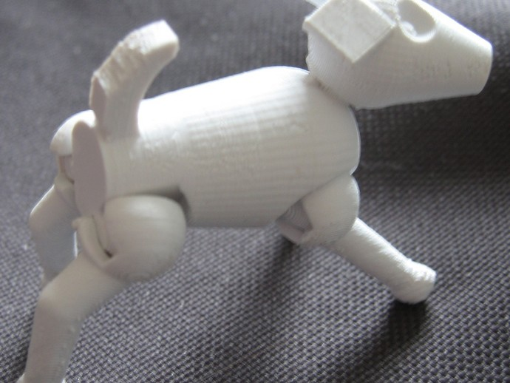
Comparison
CSG + slicing
0.25mm height, 25% infill, no shell
IceSL
OpenSCAD + Kisslicer
CSG: 9 minutes
Slicer: 10 seconds
CSG+slicer: 31 seconds
Notes:
IceSL does not need to create a mesh for printing, and directly visualizes the CSG tree during interactive editing. As you see in the previous video, CSG can be performed in real-time for rendering. The current slide gives some figures about slicing performance.

Slide 14
Observation about CSG
Same result!
Compute CSG before slicing
Compute CSG after slicing
Notes:
Let’s take a look at what makes this possible.
Slicing the result of the CSG model, or evaluating the CSG after generating object slices produces the same result.

Slide 15
Direct CSG slicing
Perform CSG in the slices
Instead of entire model [RepRap Host]
-
=
Notes:
Since slices are composed of 2D primtives, the CSG is considerably simpler to do within a slice with 2D primitives, than with full 3D meshes.

Slide 16
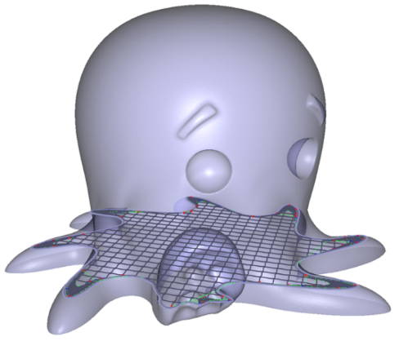
Main approaches for slicing
Vector based:
Intersect slice plane – mesh: 2D polygon outline
Offset 2D polyline
Ex: Makerbot Slicer
Raster based:
Render mesh onto slice plane as an image
Extract contours
Ex: RepRap Host
Direct slicing from raster [Zeng et al. 2011]
[Cute Octopus Says Hello (MakerBot) / CC BY 3.0]
Notes:
Generating object slices can be done in two ways. One way is to generate vector geometry from the intersection between planes and the object and then to create offsetted polylines for contours from this geometry Another way is to somehow render objects « onto slice planes » and then extract the rasterized slices contours. We’ll see later how we can do that.

Slide 17
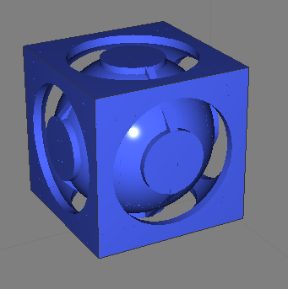
Raster-based
Slice = image
White pixel = inside ; black = outside
Problem: Raster is heavy
Millions of pixels per slice
Slice #95
Notes:
One thing to keep in mind when we do this is that each slice requires a lot of memory, as the raster will typically be the size of the object, and have the resolution of the printer. That’s a lot of pixels.

Slide 18
GPU
Graphics processors are perfect for this
Designed for parallel processing of pixels
Notes:
GPUs are ideal for this purpose, because they are primarily meant to produce raster images from 3D objects.

Slide 19
Raster slices
Only at slicing time
At printing resolution
Transient, disposable
Temporary data only
Used as input for tool path generation
Geometry always under its original form
No intermediate meshes!
Notes:
When you talk raster-bases slicing, a raster representation is only generated at slicing time, for each slice, at printing resolution. The generated rasters are temporary data generated using the original model, prior to the tool path generation phase, producing the final G-Code file.
Geometry never leaves its original form.
Let’s look at how raster slices are generated with the GPU.

Slide 20
Raster representation
A-buffer [Carpenter 1984]: Sorted fragments per pixel
Dexel-buffer [Van Hook 1986]: Sorted in/out events
Y
Z
Notes:
We first create an orthogonal transformation and set up rasterization to work in a bottom-up or top-down fashion (Z axis)
We render all the primitives into an A-Buffer, which records all rasterized fragments in depth order for each pixel.
Let’s say now we want the CSG difference between the sphere and the cube – we can easily identify the intervals which of these intervals are solid, that is, which belong to the sphere and not to the cube.
These intervals are called dexels.

Slide 21
Slice extraction
Z
Y
Notes:
To extract a slice at a given Z coordinate, we evaluate the CSG at a any given X,Y coordinate on this slice. We get the raster slice that way.

Slide 22
A-buffer
Fast construction techniques
Per-pixel Linked Lists [Crassin 2010]
HA-buffer [Lefebvre et al. 2013]
Single pass, integrated within OpenGL (simple)
Notes:
The construction of the A-Buffer can be fully integrated into the pipeline of the graphics API (eg. OpenGL or DirectX).
We have methods to do lock-free sorted insertions for the fragments.

Slide 23
Algorithm for slicing
Z
Setup view from bed
Build A-buffer
For each slice
Extract image
Build tool path (see paper)
Y
Notes:
Slicing is just a matter of building an A-Buffer once for all, and then to extract slices at various levels out of this A-Buffer. The actual tools paths can then be generated for each raster image.

Slide 24
Algorithm for rendering
Setup view from eye
Build A-buffer
For each pixel
Find first intersection
Y
Z
Same algorithm for slicing and rendering
Notes:
For interactive rendering, an A-Buffer is generated for each view. The CSG is evaluated in a front-to-back fashion and stops at the frontmost visible fragment at each pixel location, which is then shaded and rendered.
Note that we have the same algorithm for rendering and slicing.

Slide 25
Other benefits
Analytical primitives
If you can draw it, we can slice it
Proxy (triangles)
Ray
Pixel
Analytical intersection
with sphere
Notes:
Any kind of solid primitive becomes printable using this method, as long as we have rasterization code for it. Analytical primitives can be raytraced through some proxy geometry like a convex hull or just a quad primitive.

Slide 26
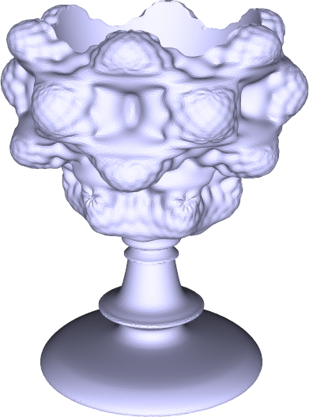
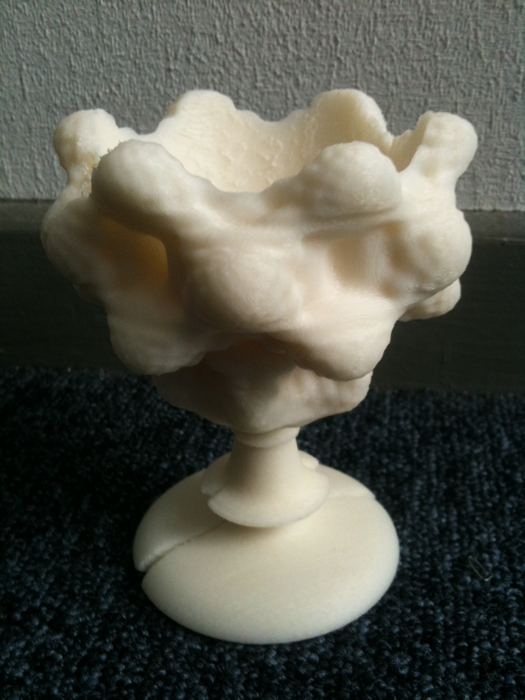
Other benefits
Mixing primitive types is easy and reliable
Mandelbulb-cup = STL cup holder + (Mandelbulb implicit – sphere)
Notes:
Mixing primitive types is straightforward and CSG can work seamlessly with them.
Here is an example of a complex cup generated with a mesh and an implicit primitive.

Slide 27
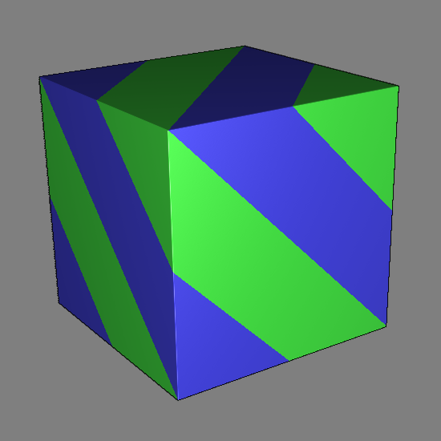
Other benefits
Multi-material support
Material ID in pixels
Model
Slice
Notes:
Because we work in a discretized fashion, on a pixel basis, with raster slices, we can easily provide a way to the script writer to modify the material to be used at any X,Y,Z position anywhere in the model. This is useful for multi-material prints.

Slide 28
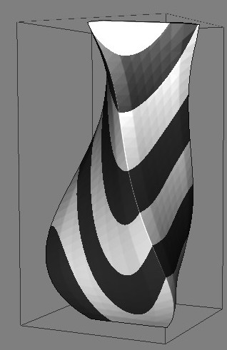
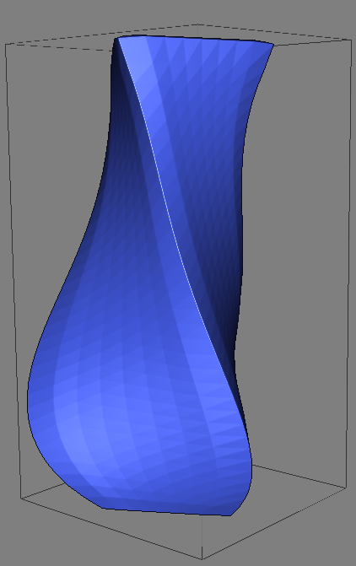
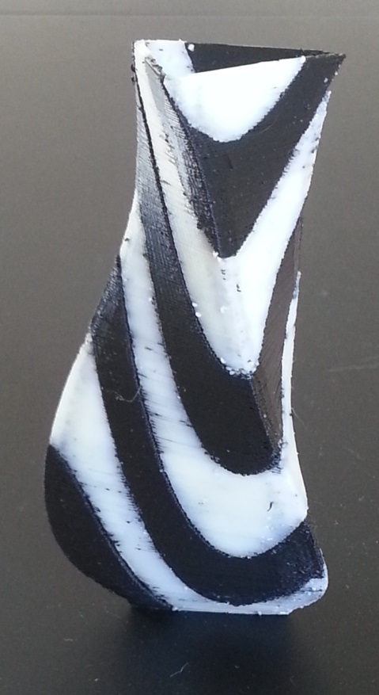
Slice shaders
Lefebvre & Claux, 2015
int material(vec3 p,int groups)
{
if (groups > 0) {
int g = int(p.z*6.0+1.2*sin(p.y*5.0)+0.7*cos(p.x*3.0));
if ( (g % 2) == 0 ) {
return 0;
} else {
return 1;
}
}
return -1;
}
[yet another vase (joo) / CC BY-SA 3.0]
Print and picture by S. Lefebvre
Procedural Texture [Perlin 1985]
Cost = code only
applied to slice (implicit)
Notes:
We can define the concept of ‘slice shaders’.
A bit like fragment shaders work with surfaces, slice shaders work with solids.
A slice shader receives an incoming ‘p’ position in world coordinates - the code can alter which material should be deposited at that location in the solid, or -1 if no material should be deposited at all. Tool path generation will take the output of the slice shader for each slice.

Slide 29
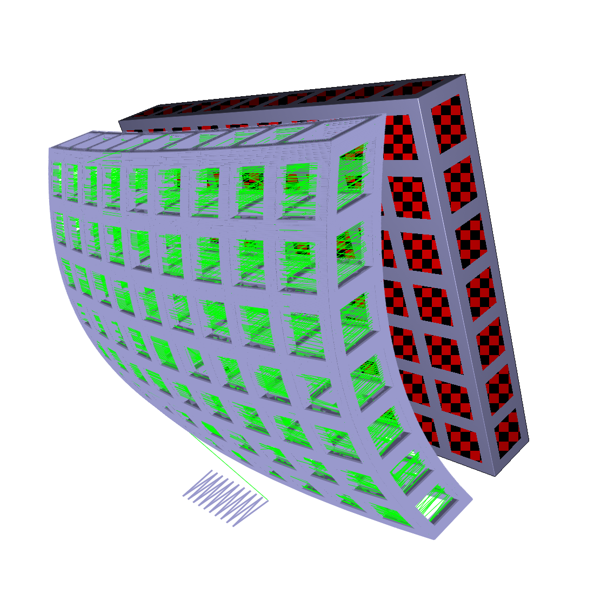
Slice based modeling
Lefebvre & Claux, 2015
Warp shaders
vec2 warp(vec3 p)
{
vec2 d = 0.2 * vec2( 0.0, cos((p.z-0.5)*2.0)
+ 0.5 * cos((p.x-0.5)*2.0) );
return p.xy + d;
}
Notes:
Warp shaders are available to procedurally alter slice geometry. Slice and warp shaders can be combined as is the case on this slide. A warp shader is used to twist the solid, and a slice shader is used to hollow cubical parts out of it.
As you can see we leverage GLSL all the way down, for both the rasterization and printing pipeline.

Slide 30
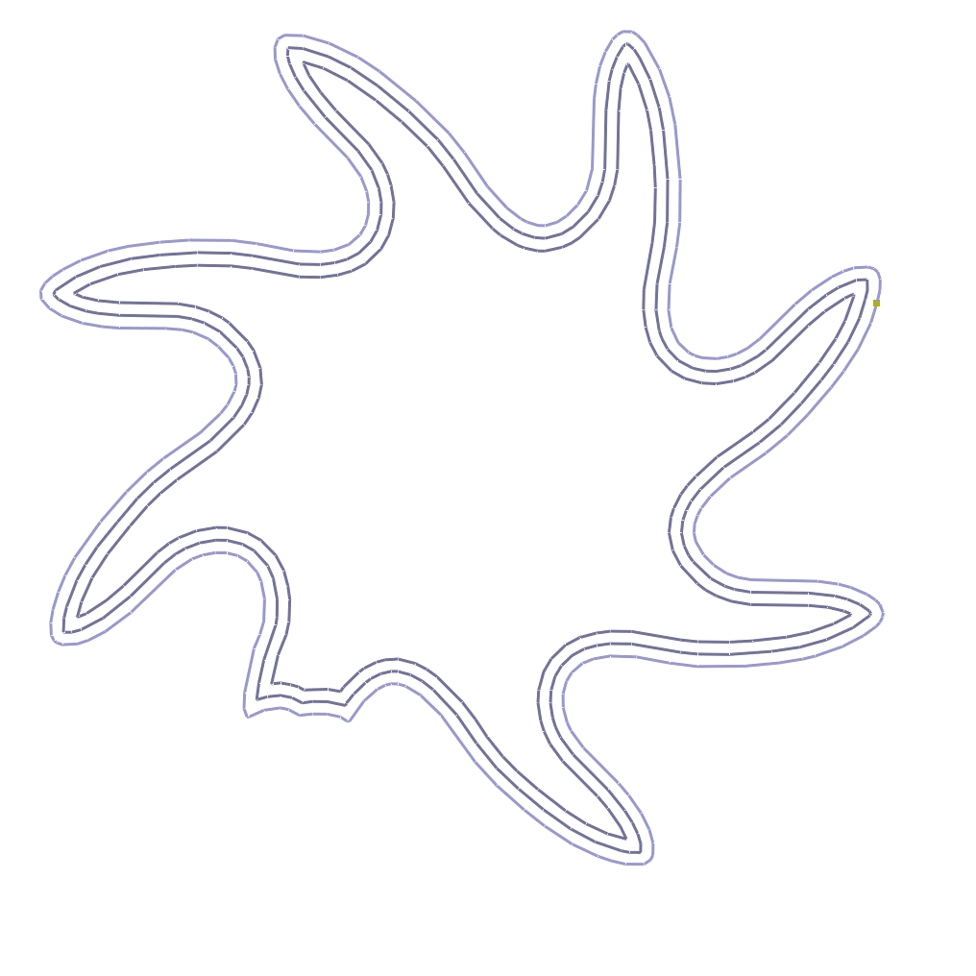
Other benefits
Image-based path extraction
Morphological erosion
Notes:
There are other benefits in using raster images for slices.
Image-based morphological erosion algorithms can be used to calculate tool paths.

Slide 31
Modeling with the dexels
Notes:
So far we described what we can do with raster slices.
Now, it is possible to leverage the A-.uffer/dexel representation to perform interesting modeling operations, especially those of interest in the context of fabrication,

Slide 32
Modeling with the dexels
Example: morphological operations
Applications for 3D printing include:
Molds and hollowing
Removing small features
Notes:
For instance creating molds or hollows or removing small undesired features. These operations have one thing in common : they are based on 3D morphological operators.

Slide 33
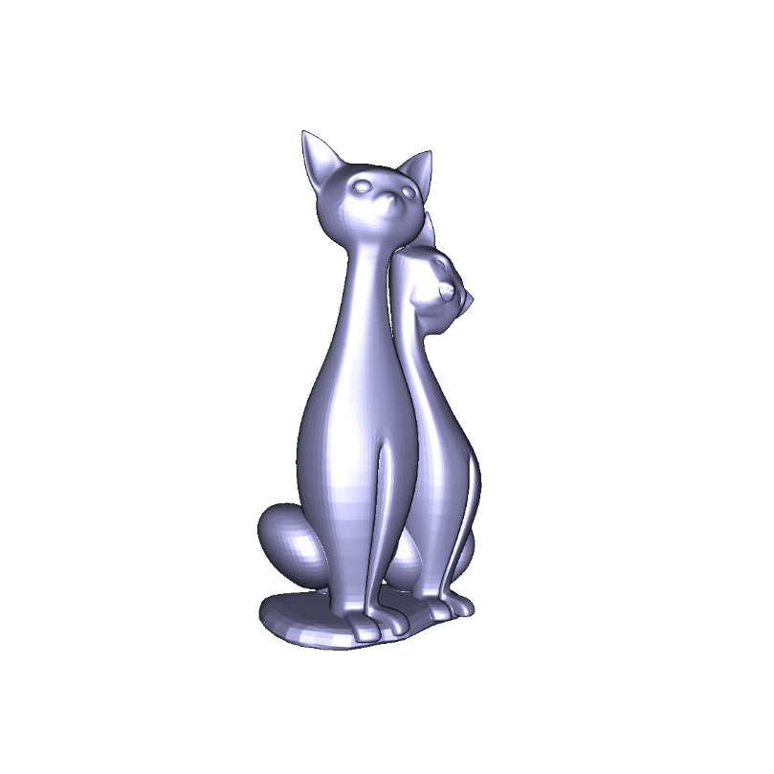
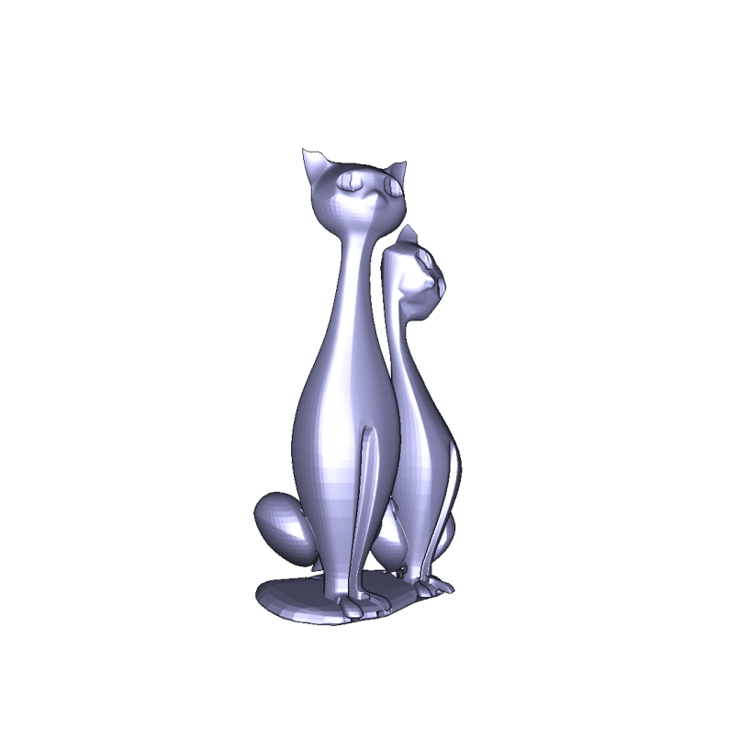
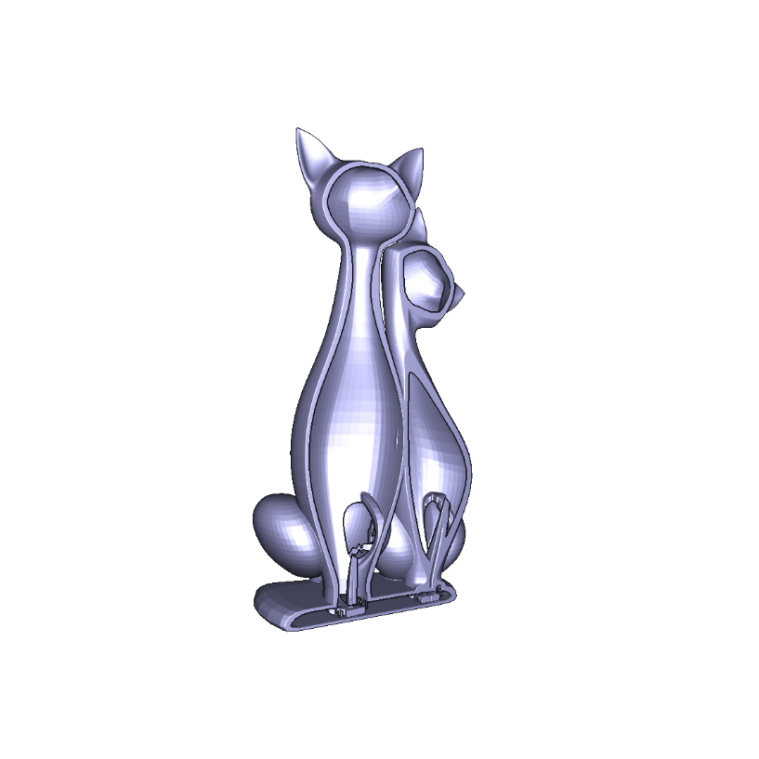
Example: hollowing
Hollowing uses CSG with a self eroded model
Hollowed model faster and cheaper to print
Molds use a dilated model
=
Cats Eroded cats Hollowed cats
(cross-section)
[Twin Cats (Mankati3DPrinter) / CC BY-SA 3.0]

Slide 34
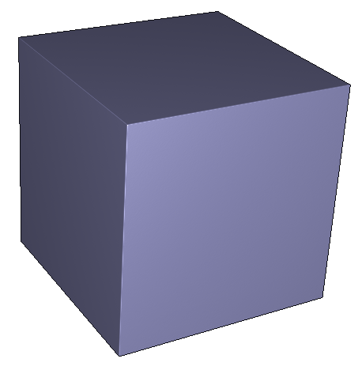
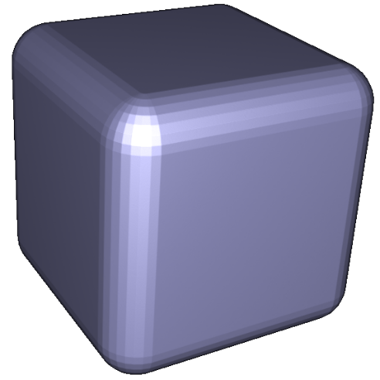
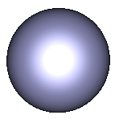
Morphological operations
Dilation Minkowski sum of model with a ball
Erosion Similar, uses complements
=
Notes:
A dilation between two solids is the Minkowski sum between these solids. Take all the balls at every possible surface position over the blue solid, and union them together into the blue solid. You get a dilation.
Erosion is defined similarly using complements.

Slide 35
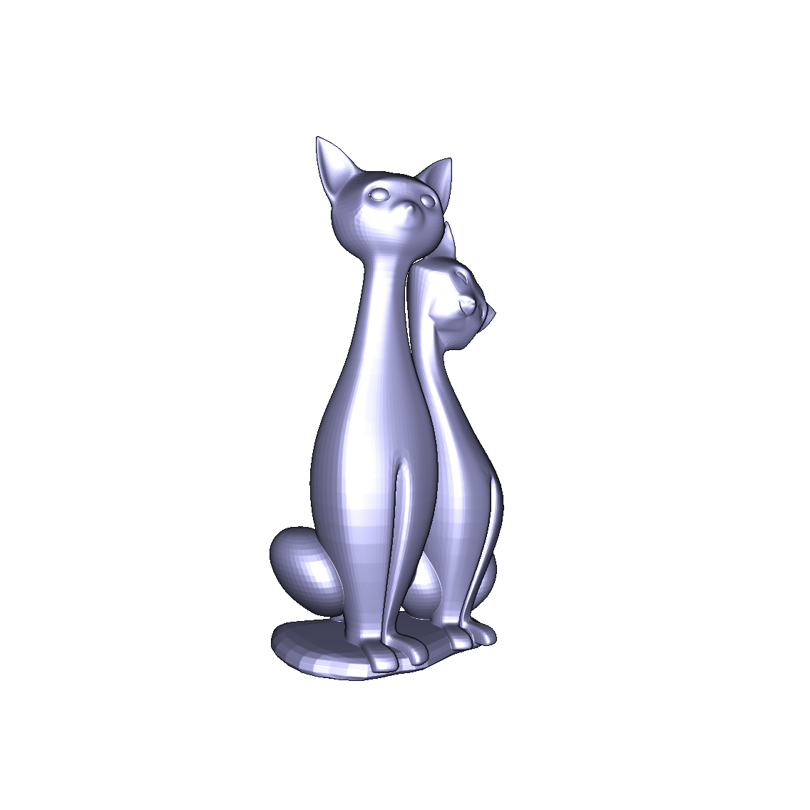
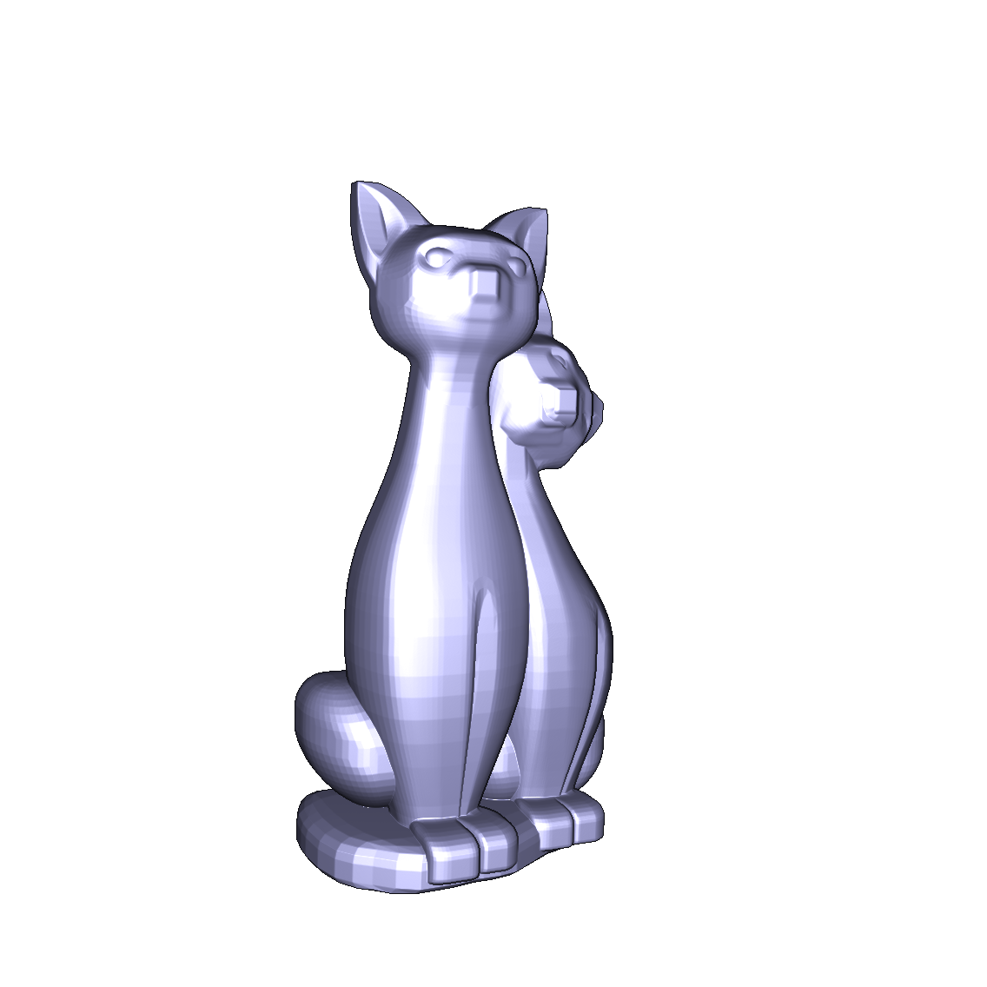
Morphological operations
Using an exact ball is difficult
Approximation OK for most applications
Notes:
It is possible to use an approximation of a ball instead of a real ball to approximate the dilation or erosion. It’s no big deal for hollowing.
A special type of solid, a zonotope, is ideal for this approximation.

Slide 36
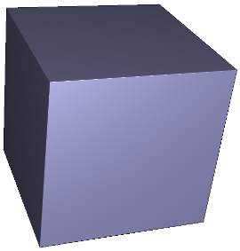
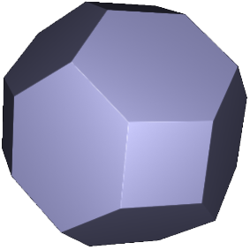
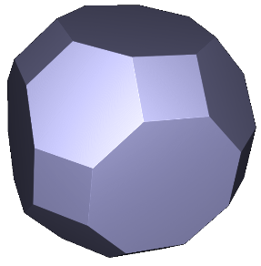
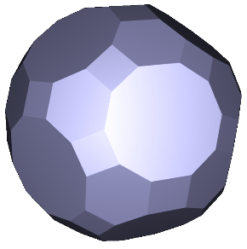
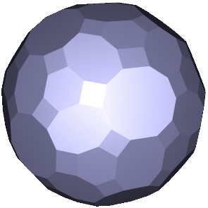
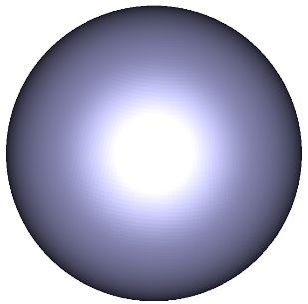
Morphological operations
Use zonotope as approximating solid [Martinez et al. 2015]
…
Notes:
A zonotope is a solid that can approximate a ball with more or less precision and is very simple to build.

Slide 37
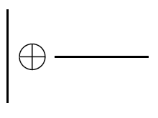
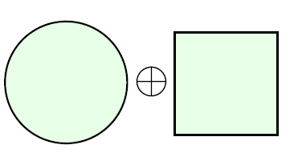
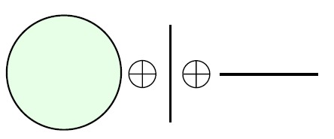
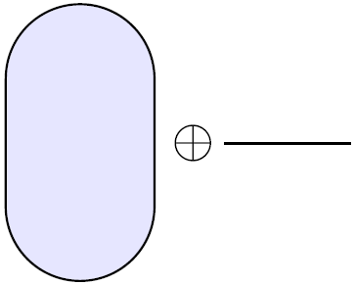
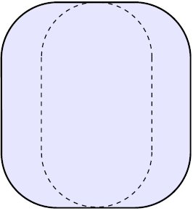
Morphology with zonotopes
Zonotope = Minkowski sum of line segments
Offsetting with zonotope = successive offsetting with these line segments
=
=
=
=
Notes:
Zonotopes are themselves Minkowski sums of line segments.
Successively offsetting a solid with a zonotope’s line segments gives the Minkowski sum between this solid and the zonotope.

Slide 38
Zonotopes
Number of segments:
…
3 7 9 15 21
Notes:
The more complex the zonotope, the more precise the morphological operation.
As you can see, a zonotope with 21 segments approximates relatively well a topological ball, especially if we use small offsets.

Slide 39
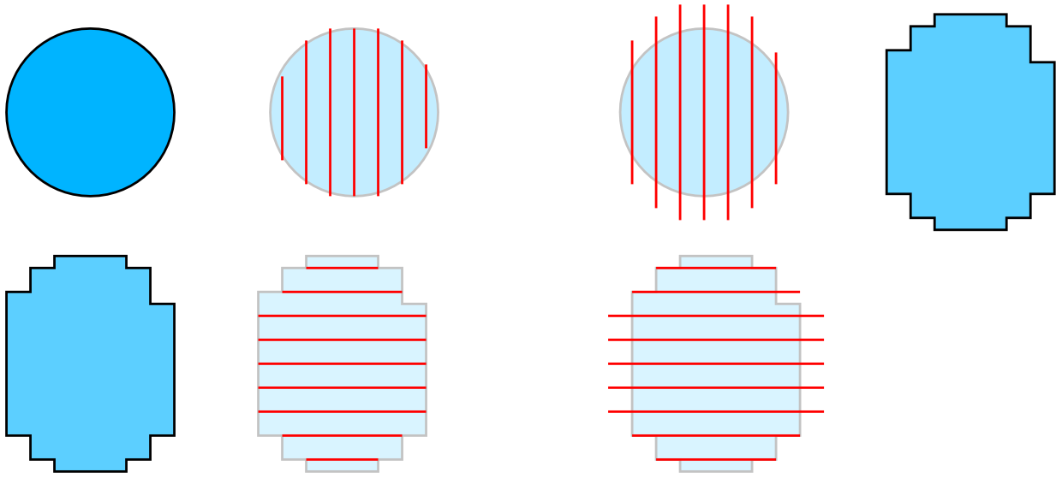
Dexel based offsetting
Input model
Dexelization
Dilation
Dexel-to-solid
Step 1
=
Step 2
=
Notes:
Offsetting becomes just a matter of, for each zonotope line segment,
Generating a dexel structure using the direction of the line segment
Dilating or eroding the dexels (see next slide)
Transforming the resulting dexels back into a solid representation
do this for every line segment

Slide 40
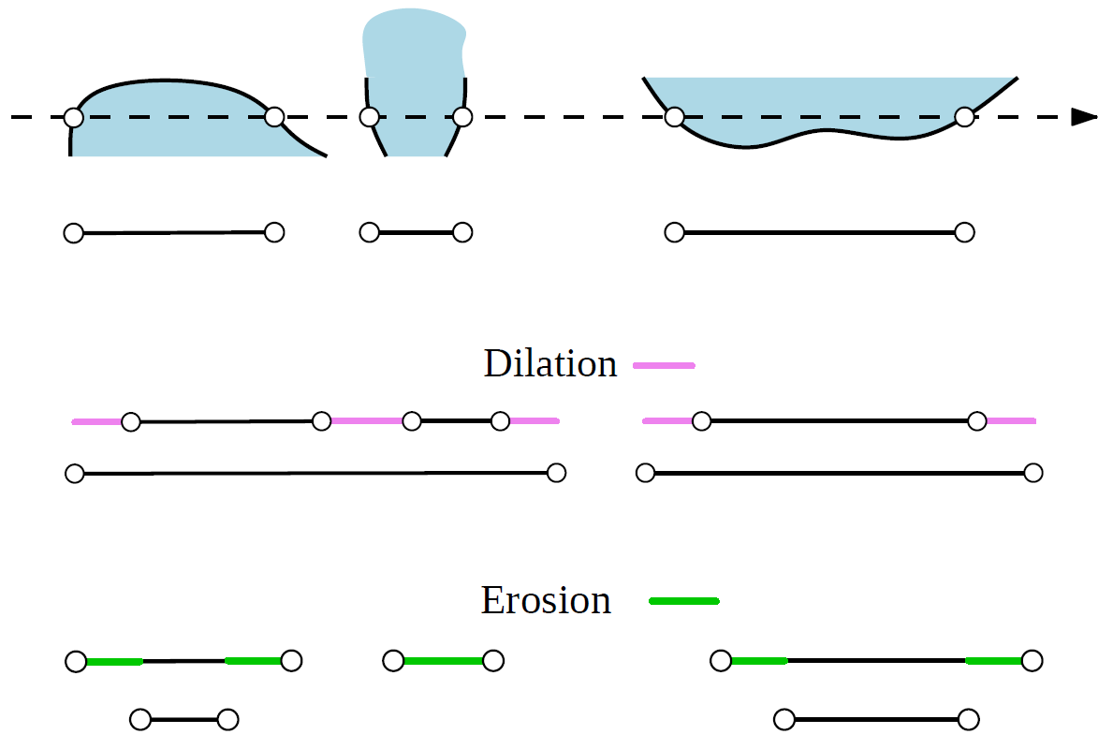
Dexel based offsetting
Notes:
Dilation or erosion is straightforward and efficiently done on GPUs between the dexels

Slide 41
Dexel based offsetting
Input model
Dexelization
Dilation
Dexel-to-solid
Step 1
=
Re-rasterization?
Step 2
=
Notes:
We need to transform offsetted dexels back into a solid, inbetween segment each offsetting step, so that we can re-rasterize the solid into the A-buffer.

Slide 42
Rasterizing dexel-to-solids
Generates many fragments
Notes:
If we naïvely convert all individual solids into parallelepipeds, that’s going to work but the rasterization is going to generate way too many fragments.

Slide 43
Dexel-to-solid
Dexel-to-solid conversion uses hierarchy of parallelepipeds to reduce fragment count
Notes:
We avoid generating too many fragments by using a hierarchical extraction method. This alleviates GPU memory occupation and improves performance.

Slide 44
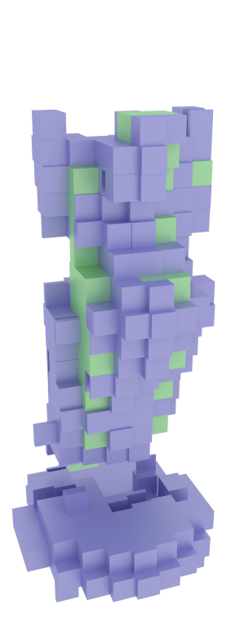
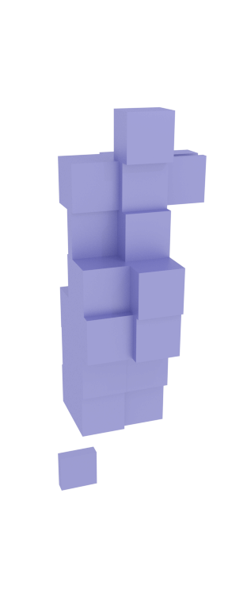
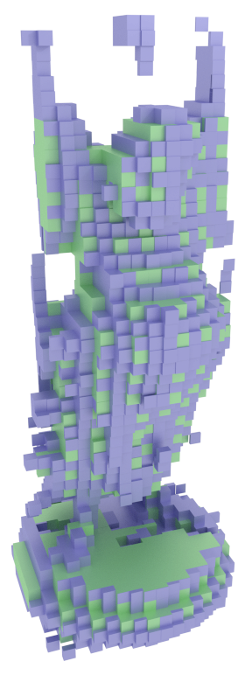
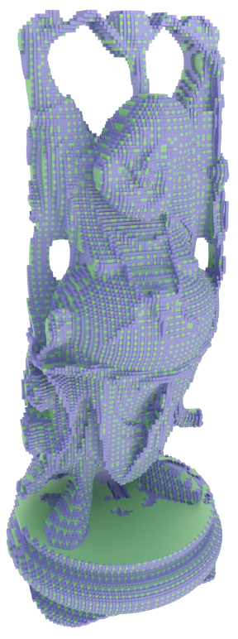
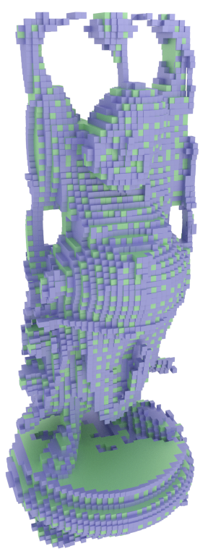
Dexel-to-solid
Model: Stanford University Computer Graphics Laboratory
Notes:
We can see here the various boxes extraction, at all resolutions.

Slide 45
More morpho modeling
Model: Stanford University Computer Graphics Laboratory
Notes:
Morphological operations can also be used for other purposes. Here they’re used to detect small features and highlight them.

Slide 46
Offsetting

Slide 47
Solid modeling for controlling fabrication
Notes:
I am now going to introduce how fabrication considerations can be integrated into the modeling scripts.

Slide 48
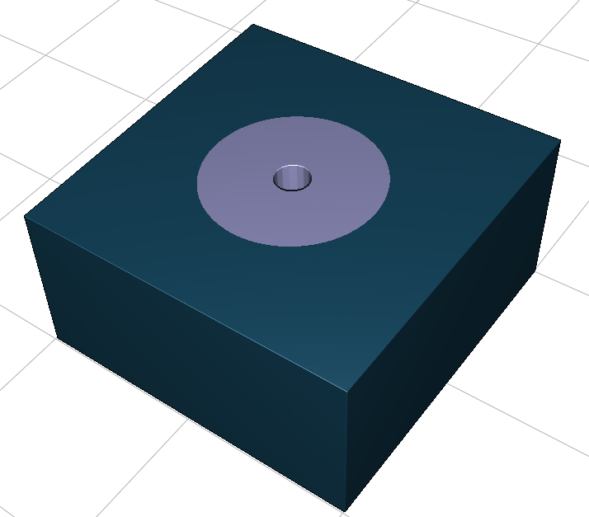
Solid modeling for controlling fabrication
Filled (strong)
Low density
Notes:
You may want to design an object like this box and make a hole in it, that receives a screw.
The central part of the object should be reinforced so that screwing in doesn’t break the object apart. What you want is higher material density around the screw (just around, you don’t want to waste printing time).

Slide 49
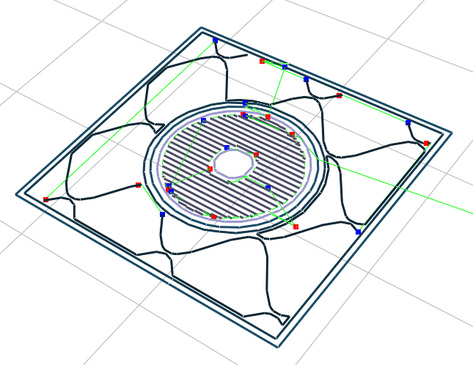
Solid modeling for controlling fabrication
Filled (strong)
Low density
Notes:
We’ve seen how shells, infills and covers work previously, when comes printing time.
Once printed, the material deposited on one layer will look like this.

Slide 50
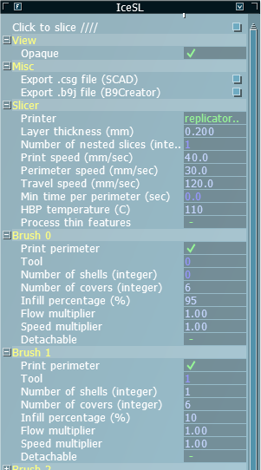
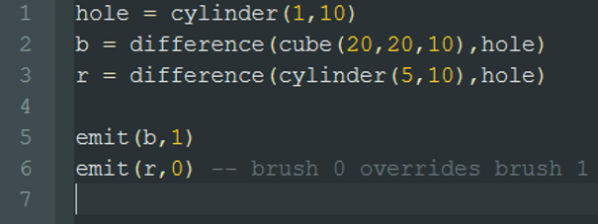
Brushes
0
1
Lefebvre & Claux, 2015
Notes:
Printing parameters are defined through objects called ‘brushes’. Brushes are useful when it comes to controlling material density.
Here, you can define a brush with high infill percentage for object parts known to undergo high mechanical stress once printed and used.
When you emit a primitive in a CSG script, you can also emit the brush number with which it should be printed.
The lowest brush number takes precedence when overlaps occur.

Slide 51
Limitations of this approach
Number of fragments
GPU memory is limited
Rendering performance (on screen)
# primitives, # fragments per pixel
Memory per slice
0,05 mm/pixel
400x400 XY max size (max render target : 8192^2)
In general 3D printed parts are relatively small (for now!)
Notes:
I explained how to design a CSG modeling and slicing engine based on rasterization. The approach has some limitations.
As the size of the final object and the number of primitives increase, the fragments are going to eventually use up all the available GPU memory, which might be limited.
Also, the visualization performance gets lower and lower as the number of fragments increases.
There is a slicing limitation whereby with current hardware the maximum viewport / render target sizes are about 8000x8000. This limits the object size to be about 400x400 mm (dimension over the platter).
3D printed parts are usually small fortunately.

Slide 52
Test it!
IceSL is available there:
http://shapeforge.loria.fr/
Requirements:
OpenGL 4.2 support
Extension API
Third-party high-level modeling languages
Available: OpenSCAD file support
Comments and suggestions welcome
https://groups.google.com/forum/#!forum/icesl
Notes:
IceSL has many features, and is available for free!
We provide a Windows version with an installer. Contact us for a Linux version.
All you need is an OpenGL 4.2 compliant GPU, regardless of the brand type.

