Slide 1
Practical 3D Frame Field Generation
Nicolas Ray
Dmitry Sokolov
Bruno Lévy

Slide 2
Table of content
Introduction
2D case
Classic approach
Function representation: same algorithm
3D case
conclusion

Slide 3
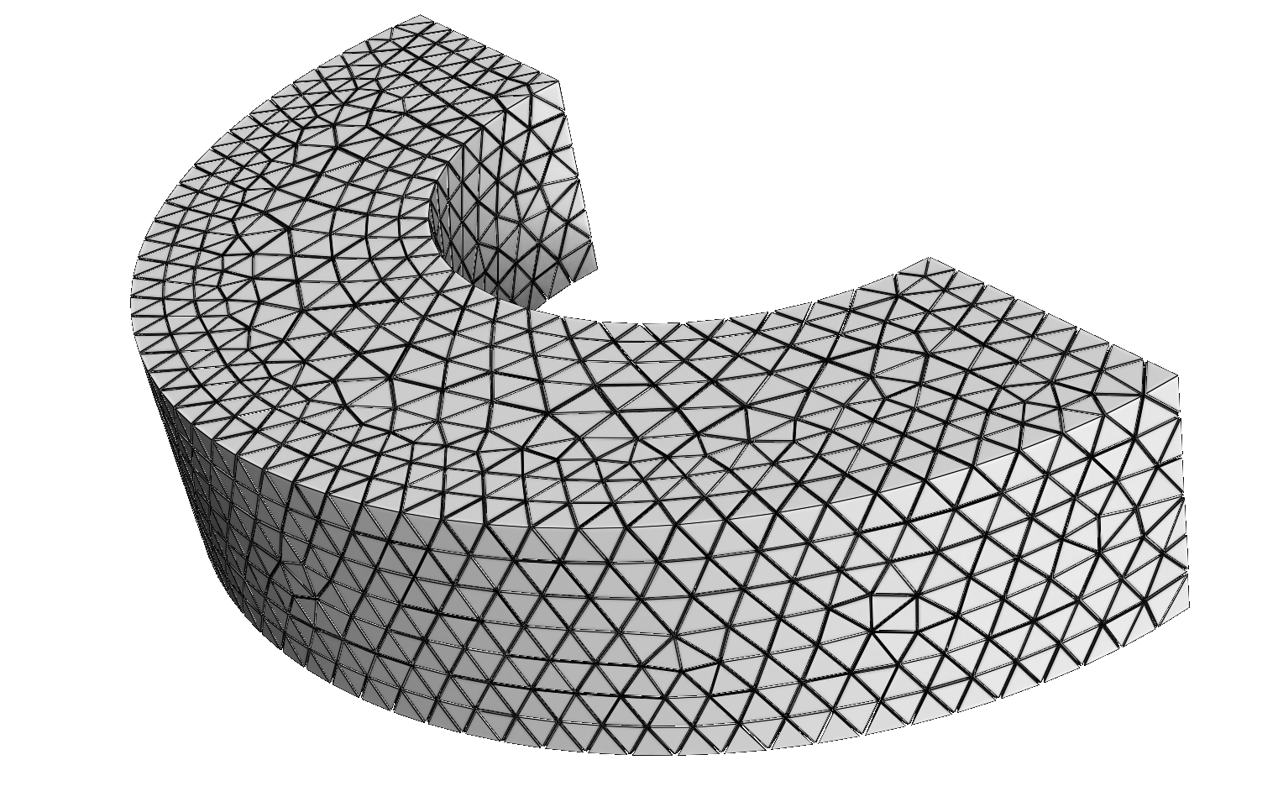
Introduction
What is a frame field ?

Slide 4
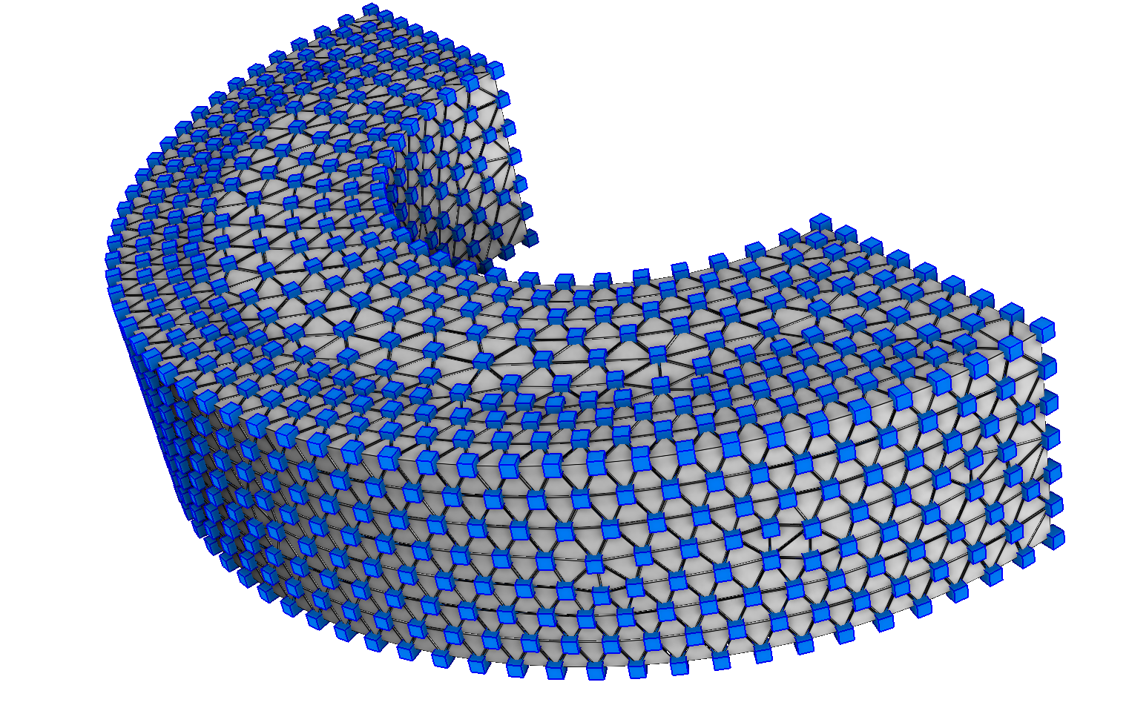
Introduction
What is a frame field ?
The orientation of each cube

Slide 5
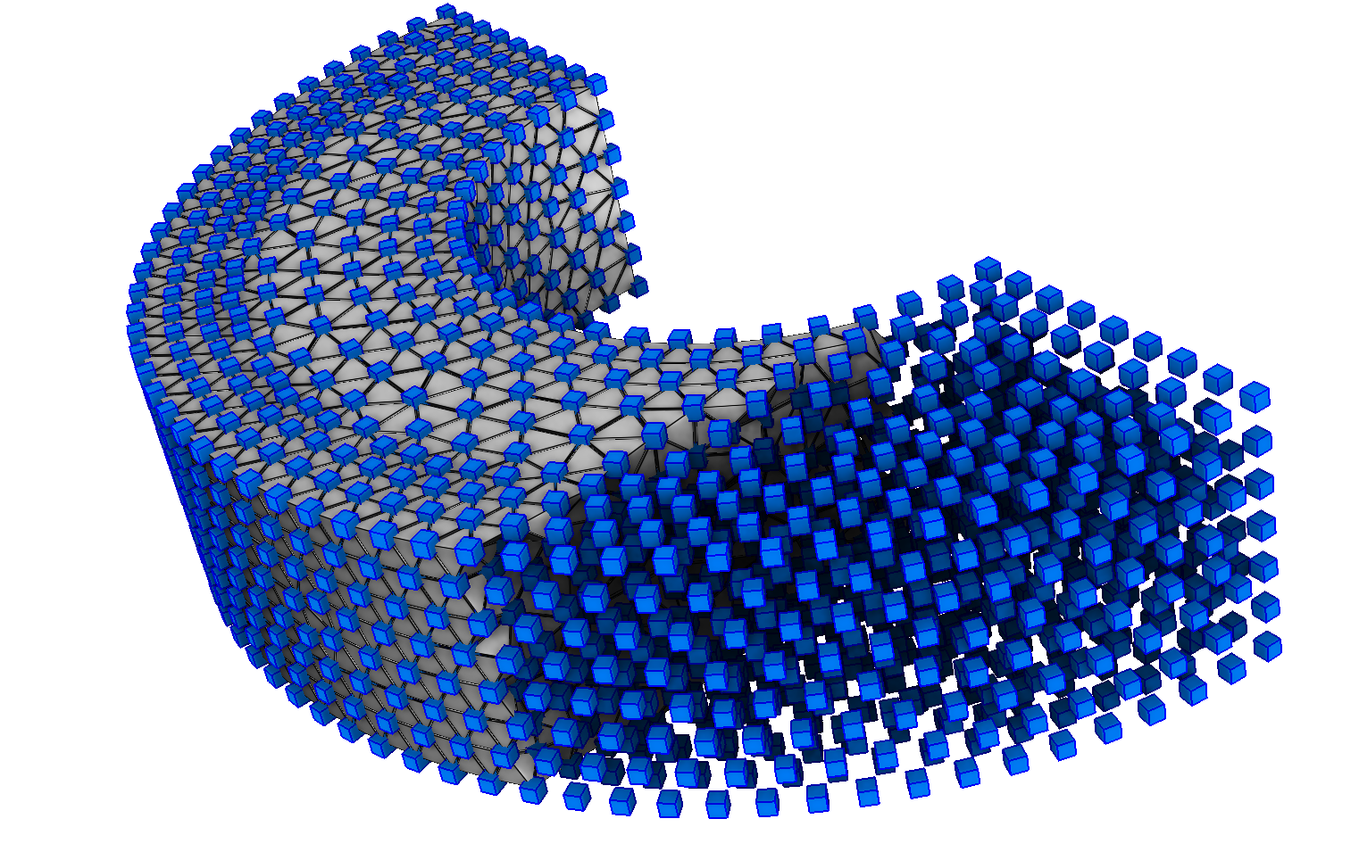
Introduction
What is a frame field ?
The orientation of each cube

Slide 6
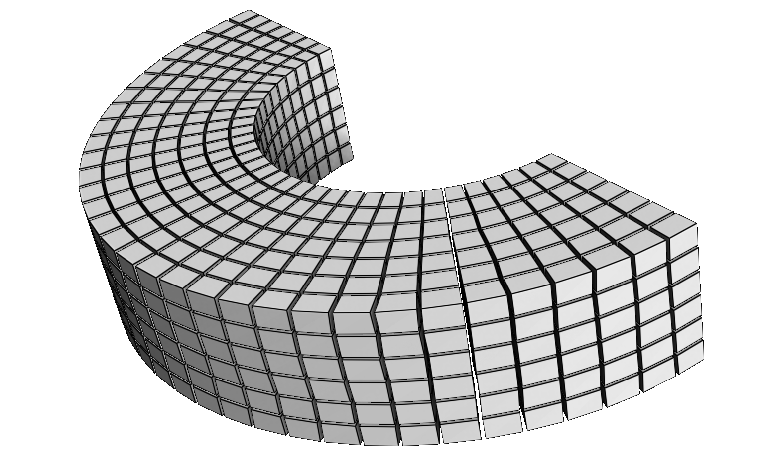
Introduction
Why?
Hexahedra orientation
Cubecover
[Nieser et al. 2011]

Slide 7
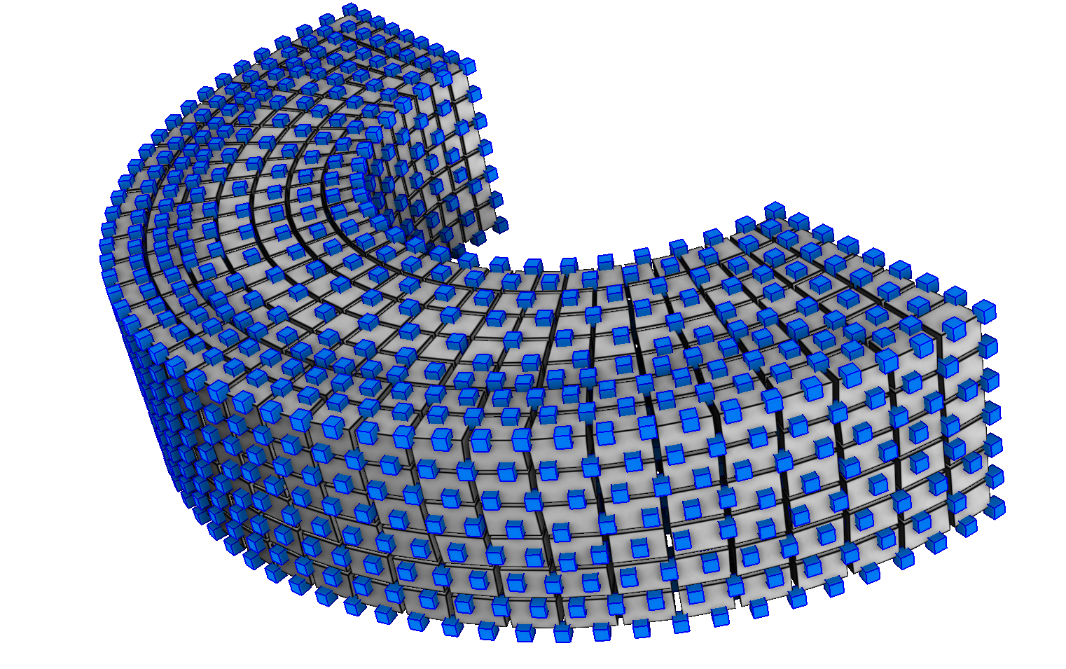
Introduction
What is a good frame field ?

Slide 8
Introduction
What is a good frame field ?
Aligned with boundary
smooth

Slide 9
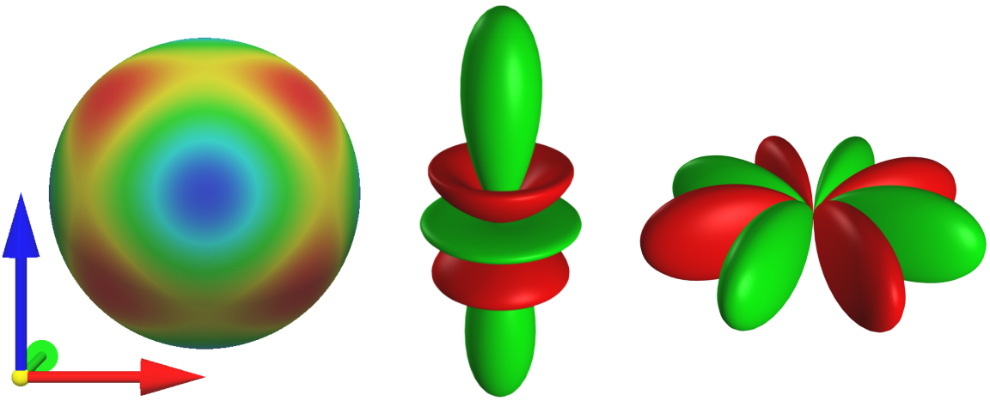
Introduction
Any solution ? [Huang et al. 2011], [Li et al. 2012]
Frames are represented by SH
Smoothness is optimized by LBFGS

Slide 10
Introduction
Contribution: increase speed & quality:
sampling on vertices (ease changing topology)
init. with valid boundary (topo is almost solved)

Slide 11
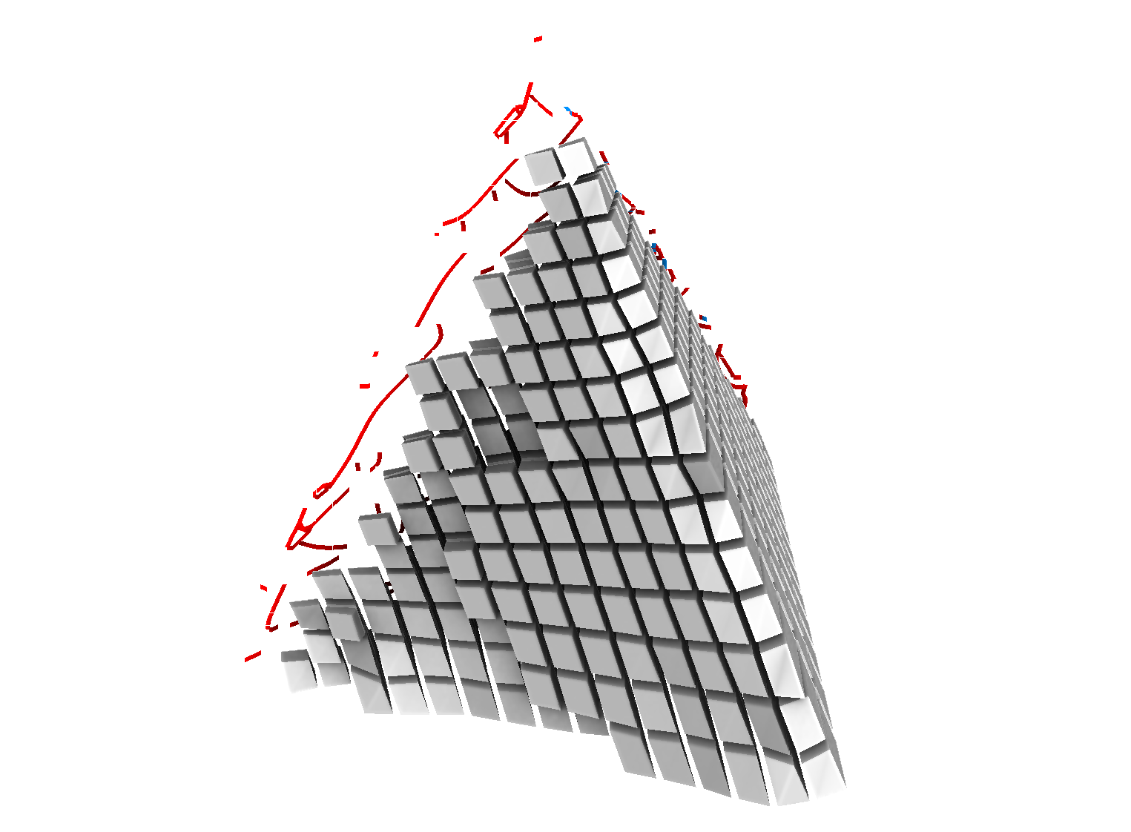
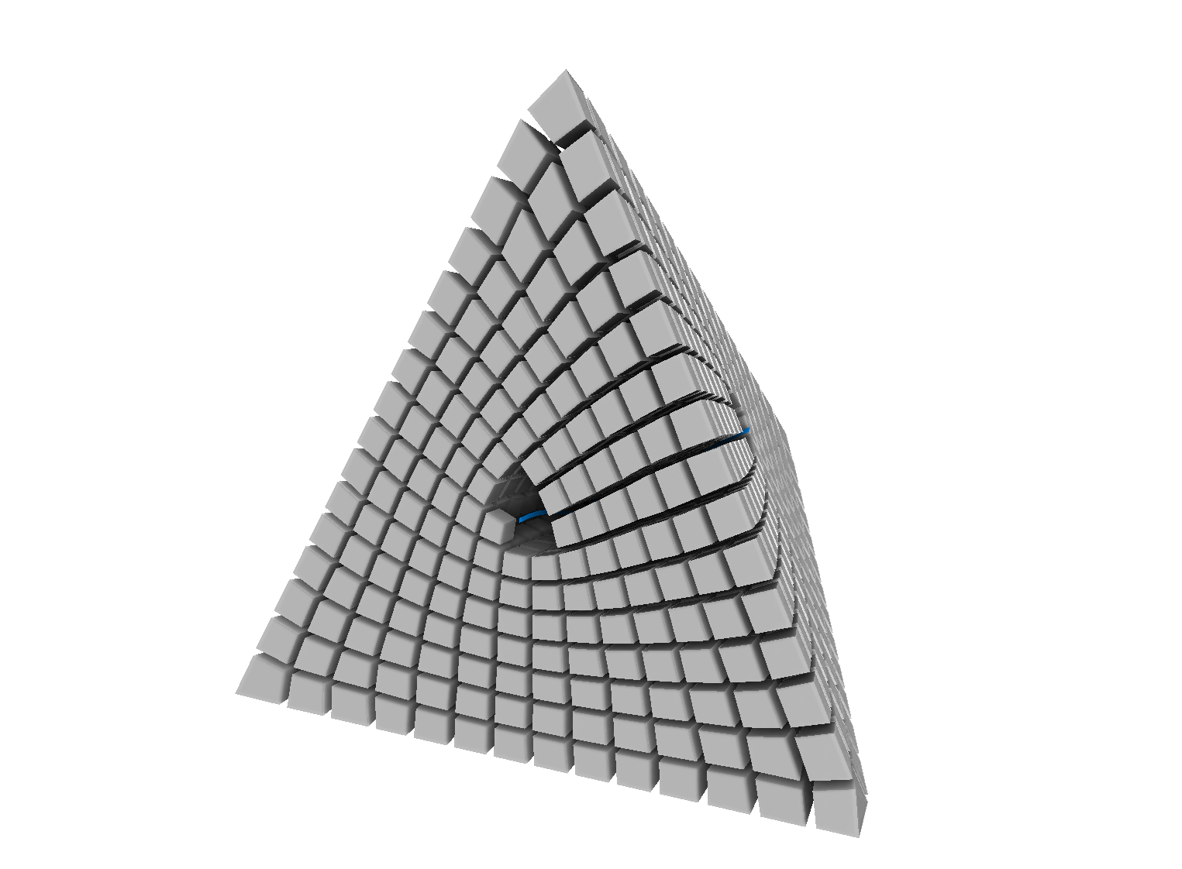
Introduction
Results:
Less failure cases

Slide 12
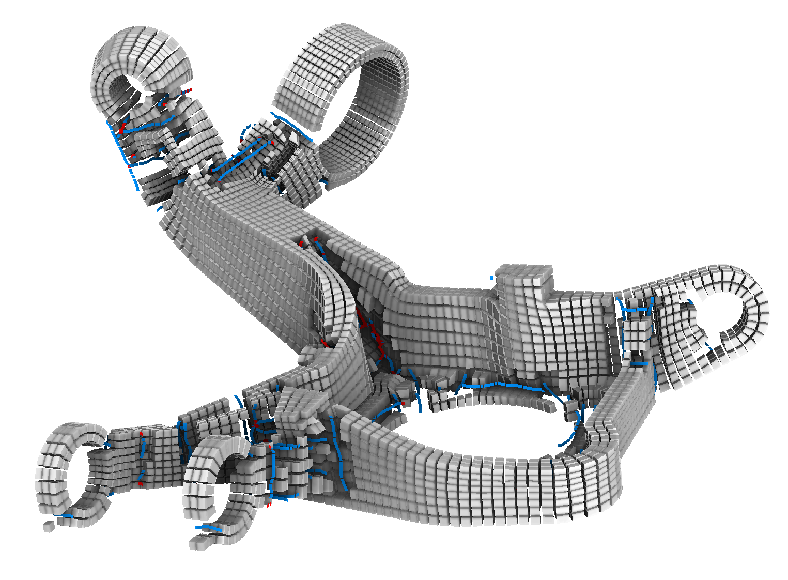
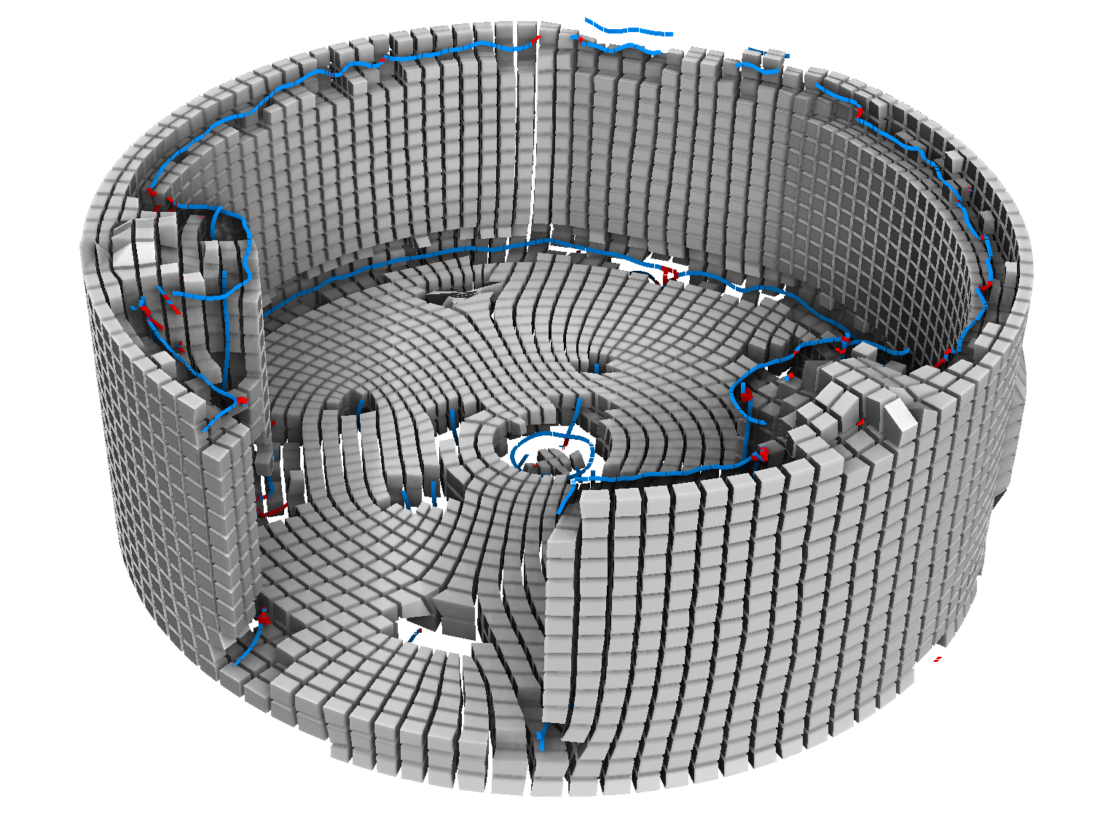
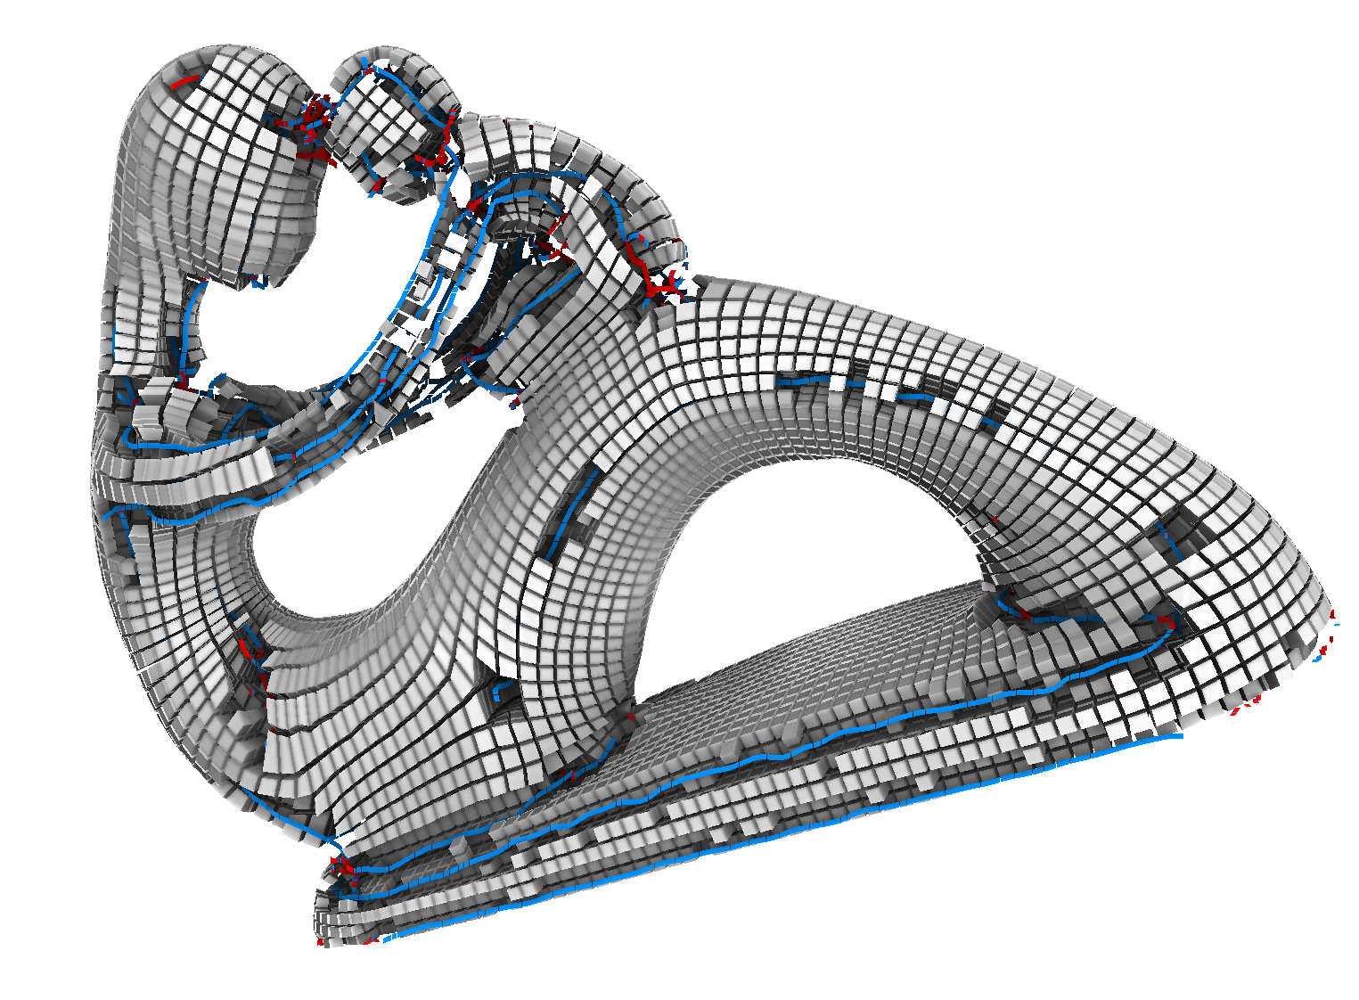
Introduction
Results:
Less failure cases
Initialization often suffice

Slide 13
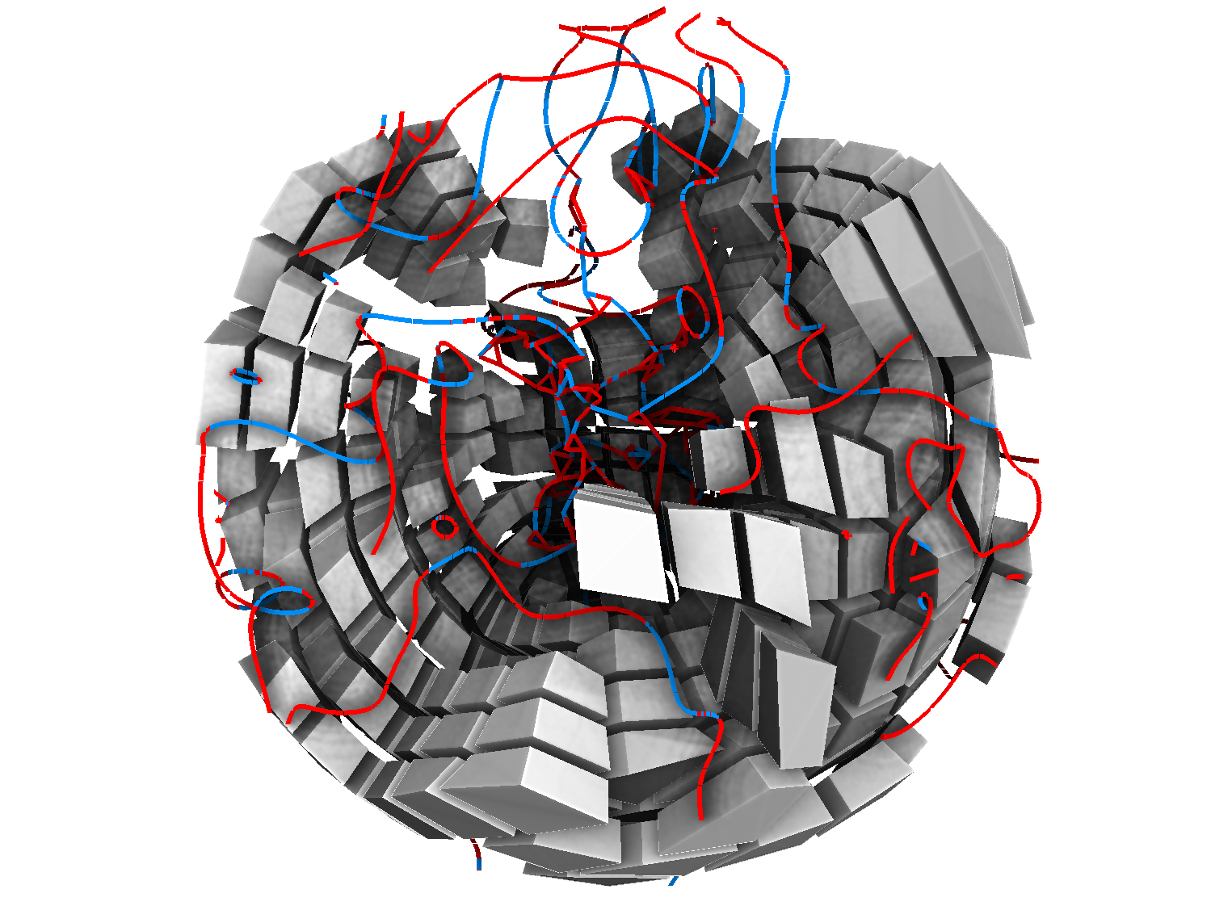
Introduction
Results:
Less failure cases
Initialization often suffice
Not always ☹

Slide 14
Table of content
Introduction
2D case
Classic approach
Function representation: same algorithm
3D case
conclusion

Slide 15
2D case: Classic approach
What is classic approach?
Object is a triangulated surface
Field is sampled on vertices
Manipulate frames by representation vectors [NRoSY, DFD, Knöppel 2013]

Slide 16
2D case: Classic approach
Optimization problem:
Minimize a difference between samples subject to boundary conditions

Slide 17
2D case: Classic approach
Vector field
Unit vector fields
Frame fields
Optimization problem:
Minimize a difference between samples subject to boundary conditions

Slide 18
2D case: Classic approach
Vector field
Unit vector fields
Frame fields
vector field
x₂
Optimization problem:
Minimize a difference between samples subject to boundary conditions
x₁
x₀
x₃
x₄
x₅
x₆

Slide 19
2D case: Classic approach
Vector field
Unit vector fields
Frame fields
vector field
(x₁-x₀)²
x₂
Optimization problem:
Minimize a difference between samples subject to boundary conditions
x₁
x₀
x₃
x₄
x₅
x₆

Slide 20
2D case: Classic approach
Vector field
Unit vector fields
Frame fields
vector field
Min Σ|x_{i}-x_{j}|²
x₁
x₂
Optimization problem:
Minimize a difference between samples subject to boundary conditions
x₀
x₃
x₄
x₅
x₆

Slide 21
2D case: Classic approach
Vector field
Unit vector fields
Frame fields

Slide 22
2D case: Classic approach
Vector field
Unit vector fields
Frame fields

Slide 23
2D case: Classic approach
Vector field
Unit vector fields
Frame fields
singularity

Slide 24
2D case: Classic approach
Vector field
Unit vector fields
Frame fields

Slide 25
2D case: Classic approach
Vector field
Unit vector fields
Frame fields
?
Optimization:
min Σ|x_{i}-x_{j}|² (sweet)

Slide 26
2D case: Classic approach
Vector field
Unit vector fields
Frame fields
!
Optimization:
min Σ|x_{i}-x_{j}|² (sweet)
with |x_{i}|²=1 (very hard)

Slide 27
2D case: Classic approach
Vector field
Unit vector fields
Frame fields
solution mechanism

Slide 28
2D case: Classic approach
Vector field
Unit vector fields
Frame fields
solution mechanism
Vector field
Relax unit norm

Slide 29
2D case: Classic approach
Vector field
Unit vector fields
Frame fields
solution mechanism
Vector field
solve
Relax unit norm

Slide 30
2D case: Classic approach
Vector field
Unit vector fields
Frame fields
solution mechanism
Vector field
solve
Normalize,
LBFGS
Relax unit norm

Slide 31
2D case: Classic approach
Vector field
Unit vector fields
Frame fields
solution mechanism
Vector field
solve
Normalize,
LBFGS
Relax unit norm

Slide 32
2D case: Classic approach
Vector field
Unit vector fields
Frame fields

Slide 33
2D case: Classic approach
Vector field
Unit vector fields
Frame fields

Slide 34
2D case: Classic approach
Vector field
Unit vector fields
Frame fields
θ
Let’s divide θ by 4
θ/4

Slide 35
2D case: Classic approach
Vector field
Unit vector fields
Frame fields
θ
Let’s divide θ by 4
θ/4

Slide 36
2D case: Classic approach
Vector field
Unit vector fields
Frame fields
θ
Let’s divide θ by 4
θ/4

Slide 37
2D case: Classic approach
Vector field
Unit vector fields
Frame fields
solution mechanism

Slide 38
2D case: Classic approach
Vector field
Unit vector fields
Frame fields
solution mechanism
Vector field
θ←4 θ

Slide 39
2D case: Classic approach
Vector field
Unit vector fields
Frame fields
solution mechanism
Vector field
solve
θ←4 θ

Slide 40
2D case: Classic approach
Vector field
Unit vector fields
Frame fields
solution mechanism
Vector field
Normalize, LBFGS
solve
θ←4 θ

Slide 41
2D case: Classic approach
Vector field
Unit vector fields
Frame fields
solution mechanism
Vector field
Normalize, LBFGS
solve
θ ← θ/4
θ←4 θ

Slide 42
2D case: Classic approach
Summary
In 2D, unit vector fields ⬄ frame fields (θ⬄4θ)
Unfortunaltely, it does not extend to 3D
Now, let’s see an alternative interpretation

Slide 43
Table of content
Introduction
2D case
Classic approach
Function representation: same algorithm
3D case
conclusion

Slide 44
2D case: functional formulation
Idea: replace cross by…
something with same symmetry

Slide 45
2D case: functional formulation
This object is perfect because:

Slide 46
2D case: functional formulation
This object is perfect because:
simple analytic expression
F(α) = cos(4α)
α

Slide 47
2D case: functional formulation
This object is perfect because:
simple analytic expression
easy to rotate by θ
F(α) = cos(4(α-θ))
α
θ

Slide 48
2D case: functional formulation
This object is perfect because:
simple analytic expression
easy to rotate by θ
F(α) = cos(4(α-θ))
α
θ
F(α) = cos(4(α-θ))

Slide 49
2D case: functional formulation
This object is perfect because:
simple analytic expression
easy to rotate by θ
F(α) = cos(4(α-θ))
α
θ
F(α) = cos(4(α-θ))
= cos(4θ)sin(4α) + sin(-4θ)cos(4α)

Slide 50
2D case: functional formulation
This object is perfect because:
simple analytic expression
easy to rotate by θ
F(α) = cos(4(α-θ))
α
θ
F(α) = cos(4(α-θ))
= cos(4θ)sin(4α) + sin(-4θ)cos(4α)
= a sin(4α) + b cos(4α)

Slide 51
2D case: functional formulation
This object is perfect because:
simple analytic expression
easy to rotate by θ
F is represented by (a,b)
F(α) = cos(4(α-θ))
α
θ
F(α) = cos(4(α-θ))
= cos(4θ)sin(4α) + sin(-4θ)cos(4α)
= a sin(4α) + b cos(4α)

Slide 52
2D case: functional formulation
With a²+b²=1
This object is perfect because:
simple analytic expression
easy to rotate by θ
F is represented by (a,b)
F(α) = cos(4(α-θ))
α
θ
F(α) = cos(4(α-θ))
= cos(4θ)sin(4α) + sin(-4θ)cos(4α)
= a sin(4α) + b cos(4α)

Slide 53
2D case: functional formulation
With a²+b²=1
This object is perfect because:
simple analytic expression
easy to rotate by θ
F is represented by (a,b)
F(α) = cos(4(α-θ))
α
θ
F(α) = cos(4(α-θ))
= cos(4θ)sin(4α) + sin(-4θ)cos(4α)
(a,b)=cos(4θ),sin(-4θ)…
= a sin(4α) + b cos(4α)

Slide 54
2D case: functional formulation
With a²+b²=1
This object is perfect because:
simple analytic expression
easy to rotate by θ
F is represented by (a,b)
F(α) = cos(4(α-θ))
α
θ
F(α) = cos(4(α-θ))
= cos(4θ)sin(4α) + sin(-4θ)cos(4α)
(a,b)=cos(4θ),sin(-4θ)…
= a sin(4α) + b cos(4α)
b
θ
4θ
a

Slide 55
2D case: functional formulation
With a²+b²=1
This object is perfect because:
simple analytic expression
easy to rotate by θ
F is represented by (a,b)
The difference

Slide 56
2D case: functional formulation
With a²+b²=1
This object is perfect because:
simple analytic expression
easy to rotate by θ
F is represented by (a,b)
The difference
can be
$\int_{\text{α}=0}^{π/2}{\text{(}\text{F}\text{0}\text{(}\text{α}\text{)− }\text{F}\text{1}\text{(}\text{α}\text{)}\text{)}\text{2}}$

Slide 57
2D case: functional formulation
With a²+b²=1
This object is perfect because:
simple analytic expression
easy to rotate by θ
F is represented by (a,b)
The difference
can be
$\int_{\text{α}=0}^{π/2}{\text{(}\text{F}\text{0}\text{(}\text{α}\text{)− }\text{F}\text{1}\text{(}\text{α}\text{)}\text{)}\text{2}}$
sin(4θ),cos(4θ)
are orthogonal

Slide 58
2D case: functional formulation
With a²+b²=1
This object is perfect because:
simple analytic expression
easy to rotate by θ
F is represented by (a,b)
The difference is a L2 norm
can be
$\int_{\text{α}=0}^{π/2}{\text{(}\text{F}\text{0}\text{(}\text{α}\text{)− }\text{F}\text{1}\text{(}\text{α}\text{)}\text{)}\text{2}}$
$≈$|(a₀,b₀)- (a₁,b₁)|²
sin(4θ),cos(4θ)
are orthogonal

Slide 59
2D case: functional formulation
With a²+b²=1
This object is perfect because:
simple analytic expression
easy to rotate by θ
F is represented by (a,b) = cos(4θ),-sin(4θ)
The difference is a L2 norm
We retreived the classic 2D formulation !!

Slide 60
2D case: summary
We represent
frames as functions
functions as vector in a function basis
frame difference as norm of vector difference

Slide 61
2D case: summary
The solution mecanism is
Vector field
Normalize, LBFGS
solve

Slide 62
Table of content
Introduction
2D case
Classic approach
Function representation: same algorithm
3D case
conclusion

Slide 63
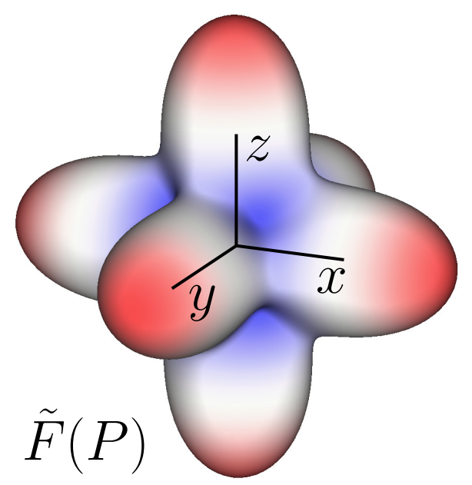
3D case: extend 2D approach
Frames are functions
harmonic functions
on the circle
A spherical harmonic
function
F(α) = cos(4α)
3D
α

Slide 64
3D case: extend 2D approach
Functions as vectors
Coefficients in the basis
sin(4α)
cos(4α)
9 coefficients in spherical harmonic basis (band 4)
3D

Slide 65
3D case: extend 2D approach
Constraint
a²+b²=1
No scale, just rotation
no extravagance (6d)
only rotations (3d)
3D
Rest frame
$$\sqrt{5/12}$$
$$\sqrt{7/12}$$
Rest frame
rotate

Slide 66
3D case: extend 2D approach
Difference between frames
L2 norm in coefficients space
sin(4θ),cos(4θ)
are orthogonal
SH4 are orthogonal
3D

Slide 67
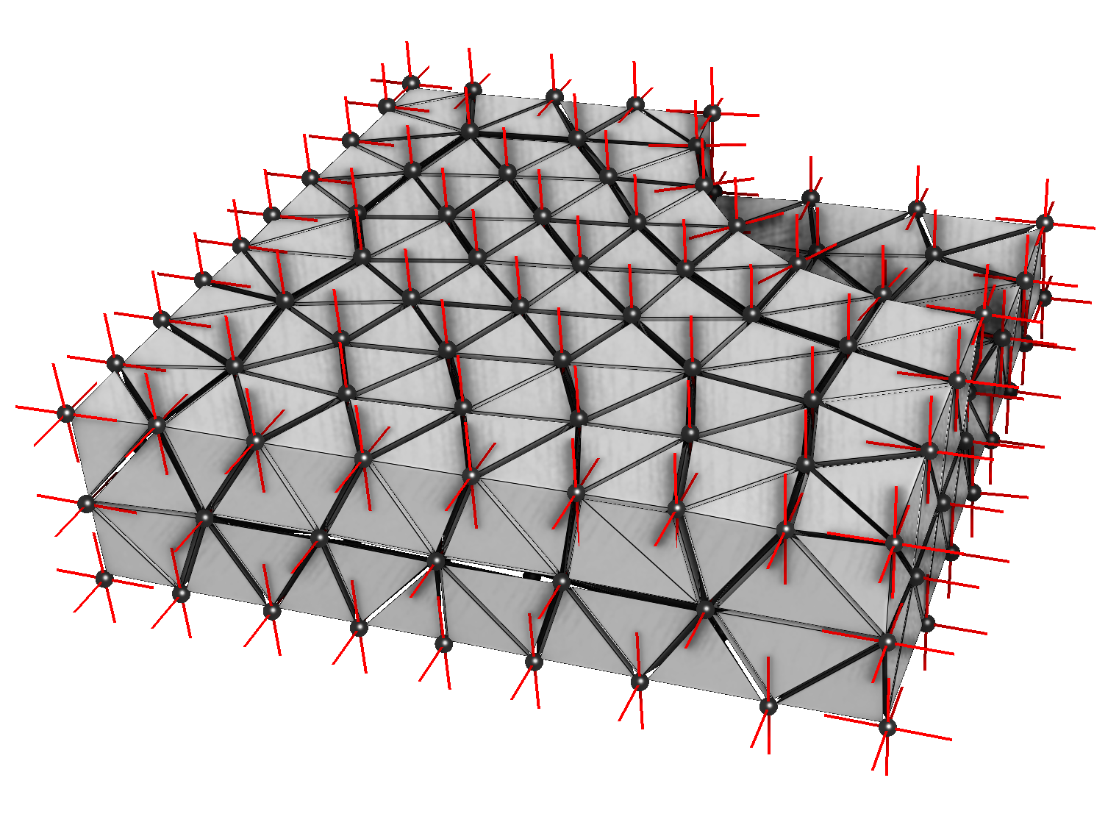
3D case: extend 2D approach
Solution mechanism

Slide 68
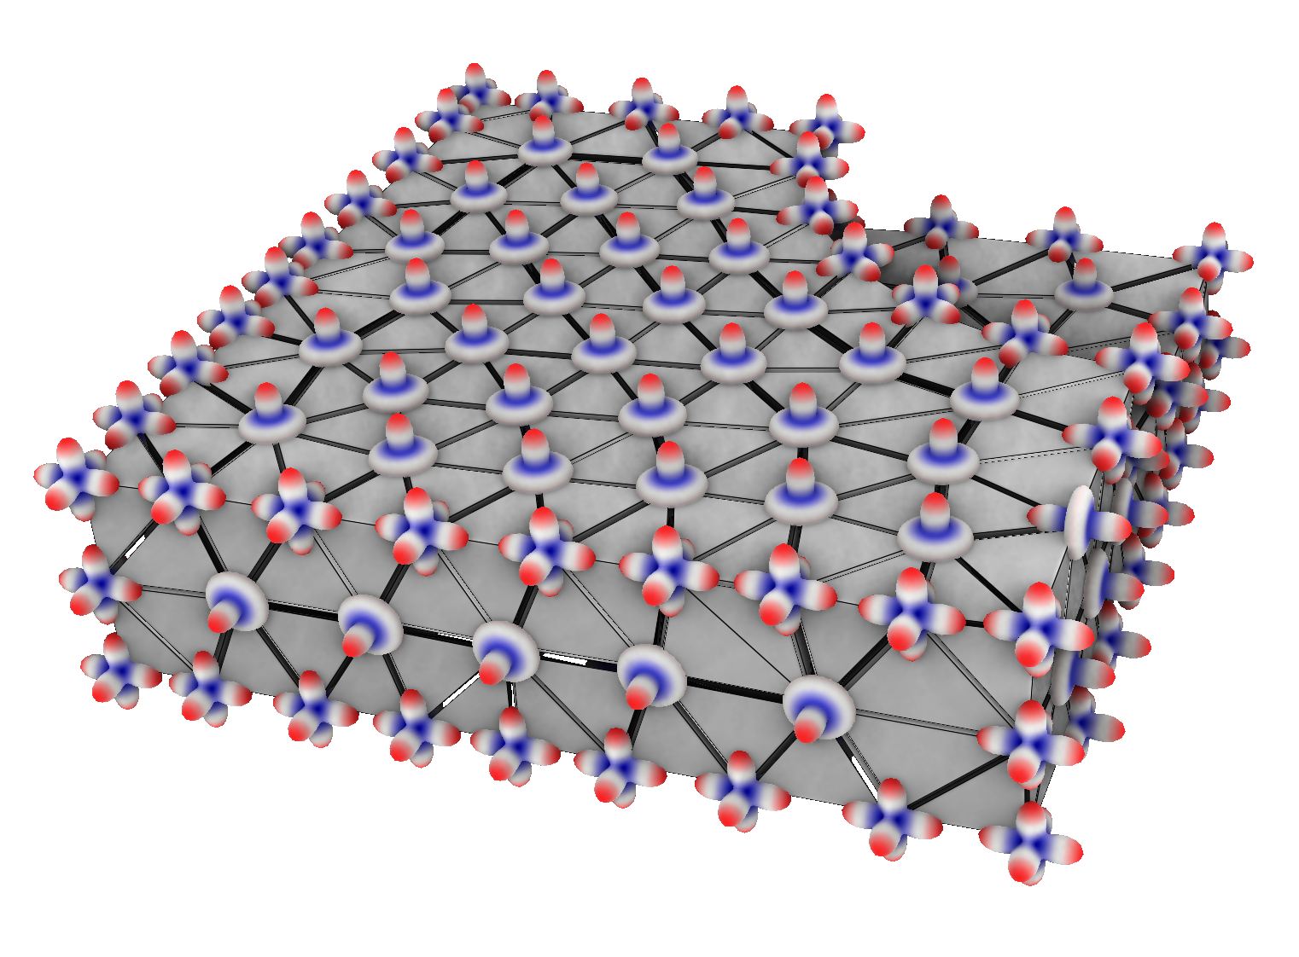
3D case: extend 2D approach
Solution mechanism
9D Vector field

Slide 69
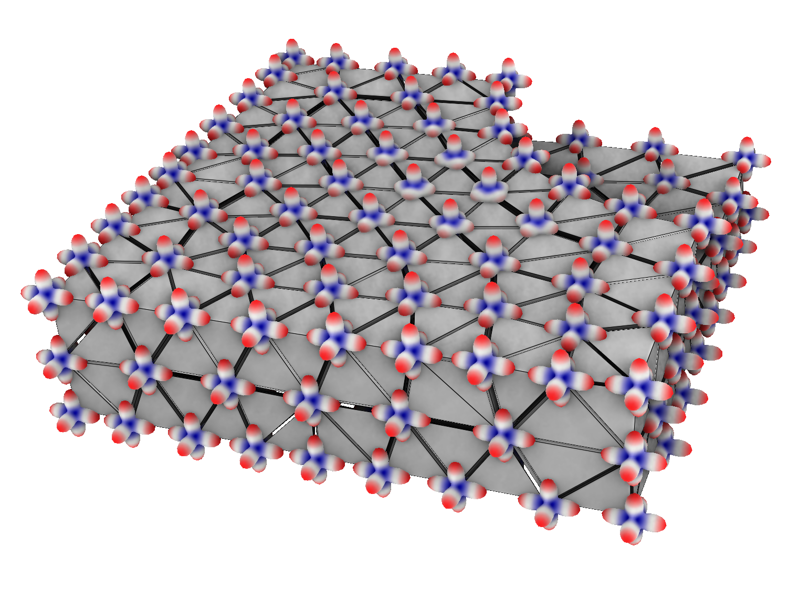
3D case: extend 2D approach
Solution mechanism
9D Vector field
solve

Slide 70
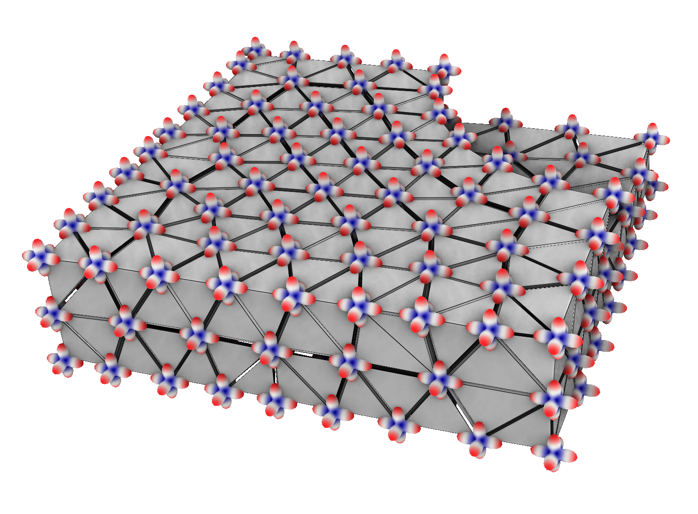
3D case: extend 2D approach
Solution mechanism
9D Vector field
Make valid, LBFGS
solve

Slide 71
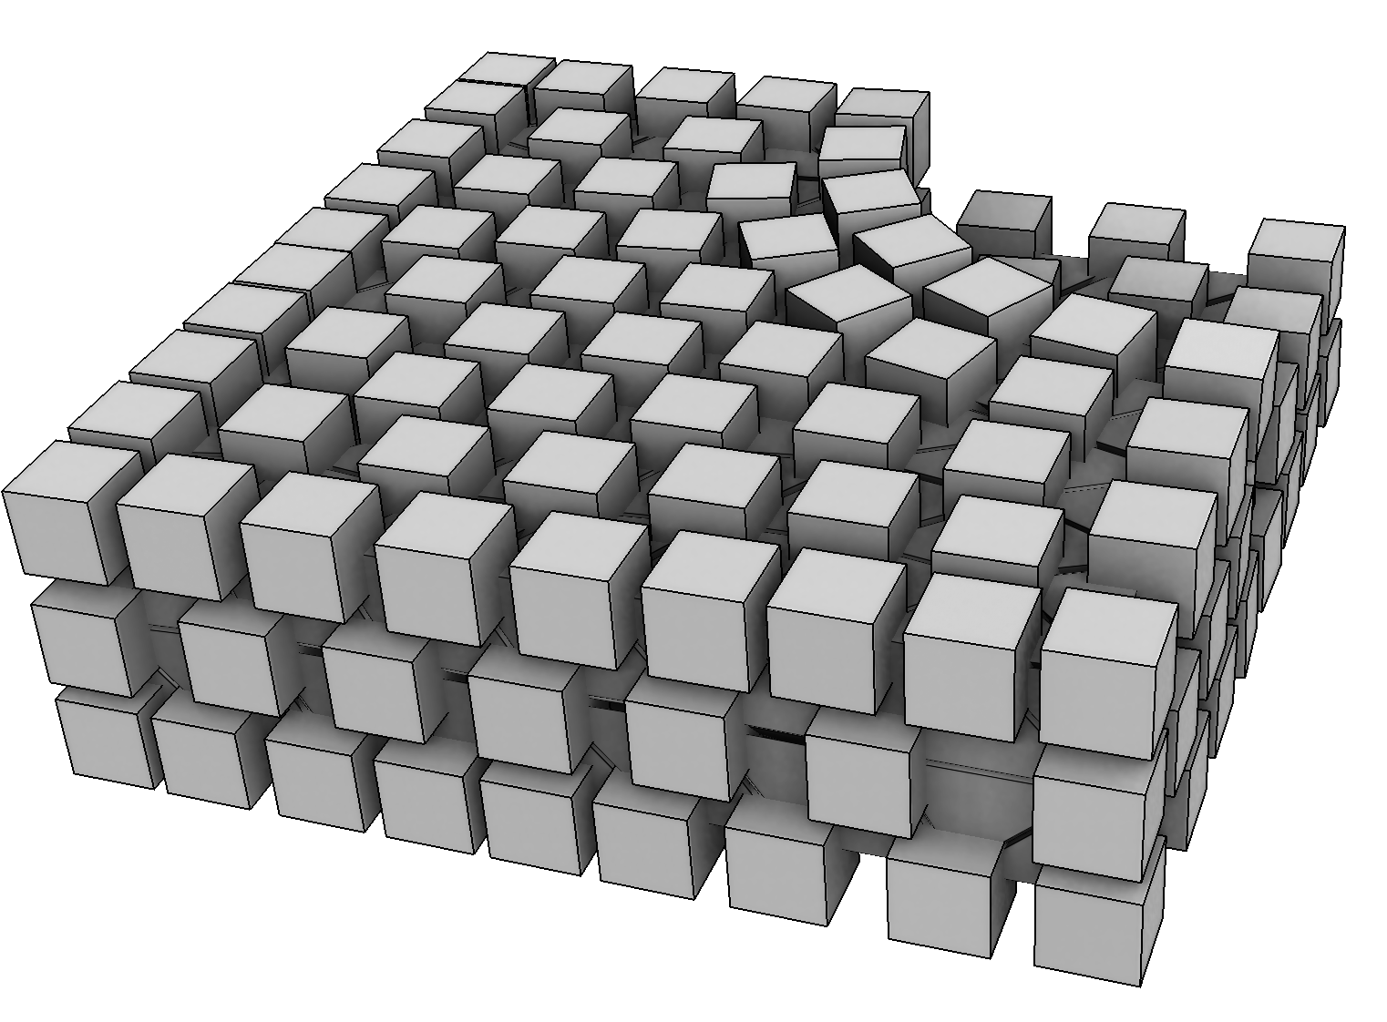
3D case: extend 2D approach
Solution mechanism
9D Vector field
Make valid, LBFGS
solve

Slide 72
3D case: extend 2D approach
Solution mechanism
9D Vector field
Make valid, LBFGS
solve
Lock only one vector

Slide 73
3D case: extend 2D approach
Solution mechanism
Projection onto valid frames
9D Vector field
Make valid, LBFGS
solve
Lock only one vector

Slide 74
3D case: boundary condition
Boundary frame are represented by:
a 2D frame (2D representation vector)
the normal (constant)
We can do 2D FF with our 3D solver

Slide 75
3D case: project onto valid frame
Steepest descent algorithm:
find the rotation R (Euler’s angles)
That minimizes |R(rest frame)- input frame|

Slide 76
conclusion
SH representation [Huang et al 2011] is
very efficient,
a generalization of 2D classic solutions.
Our contributions
improve speed and quality
non linear optimizations may be skipped

Slide 77
Thank you for your attention
ray@inria.fr
Sokolov@loria.fr
levy@inria.fr

