Slide 1
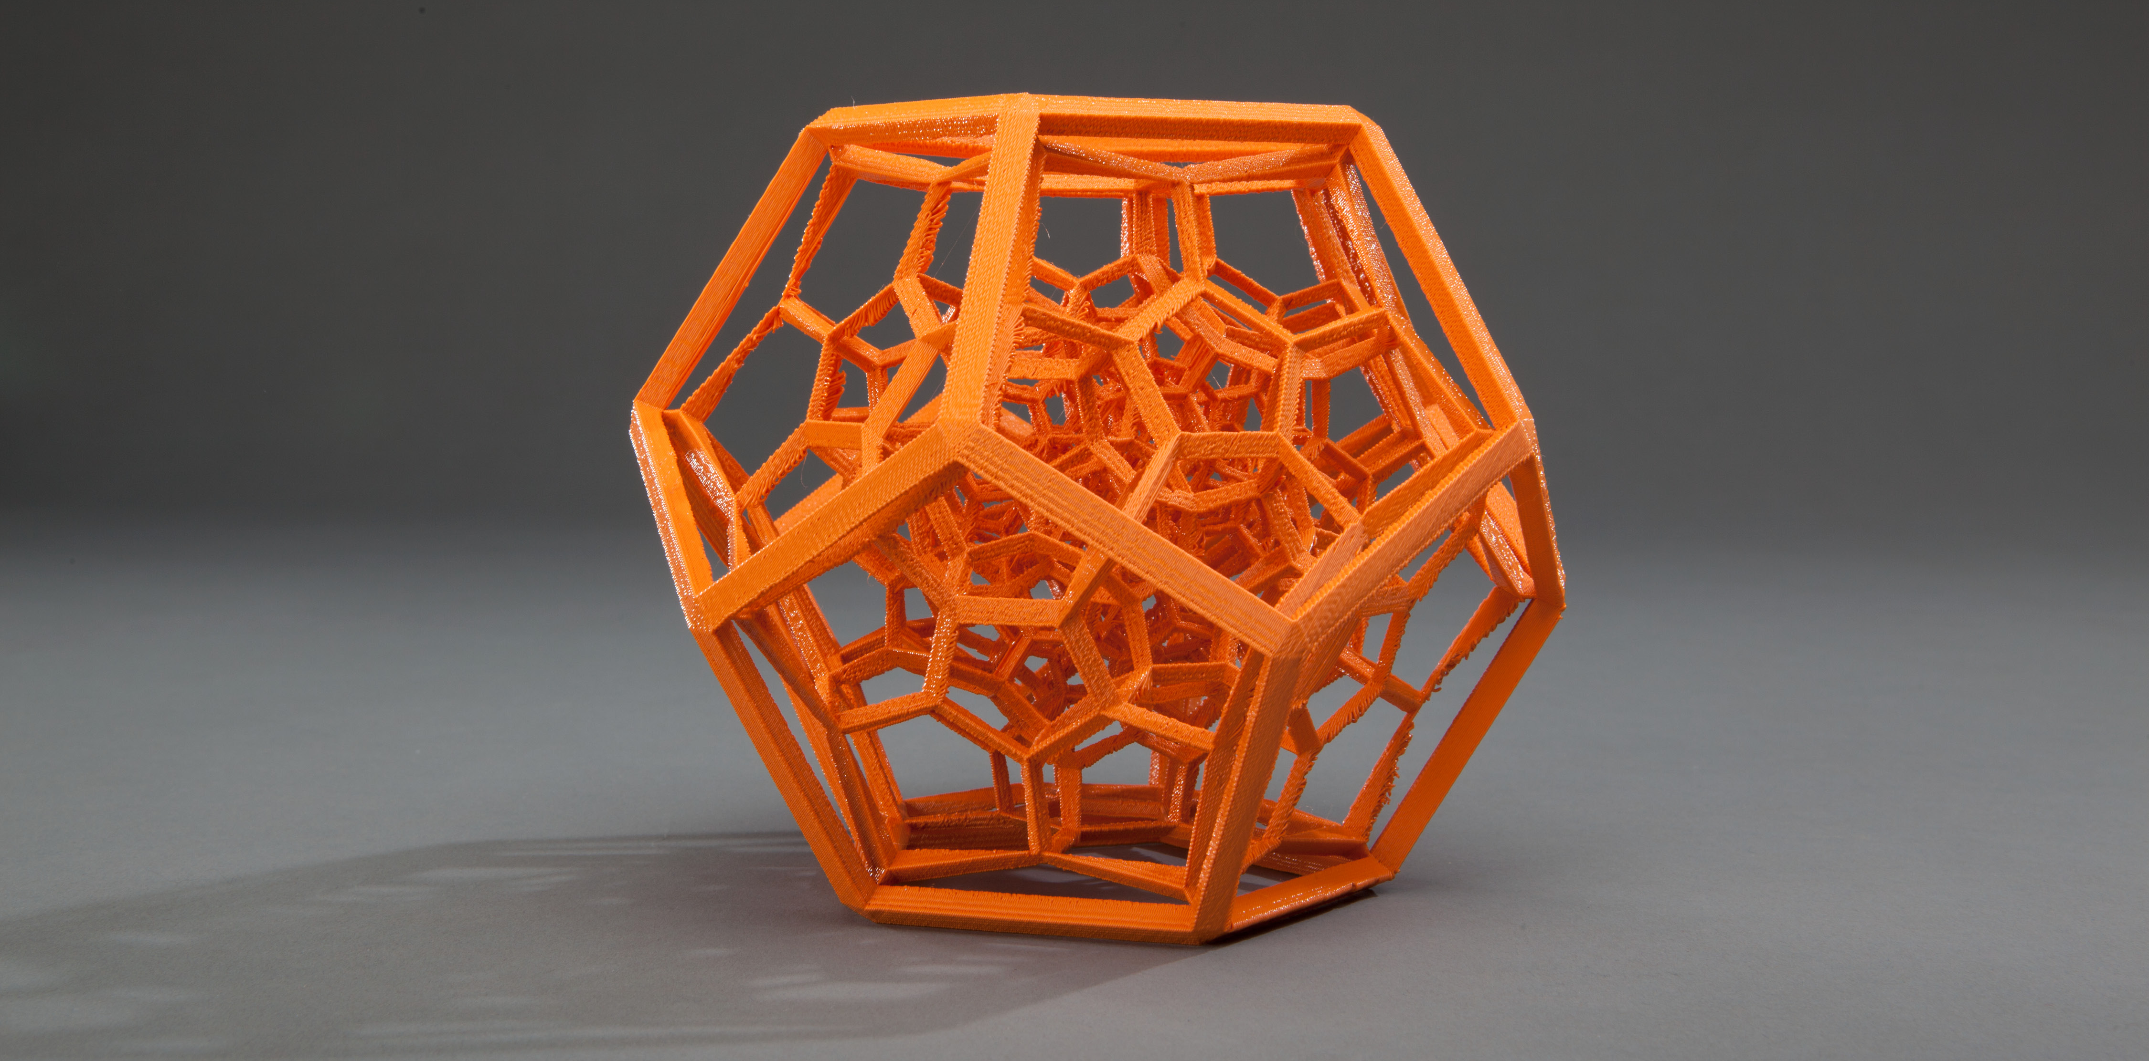
Large Meshes, Large Volumes
Modeling for Filament-Based 3D Printing
Notes:
In the final session of this course, we will discuss how to handle large meshes and large print volumes.

Slide 2
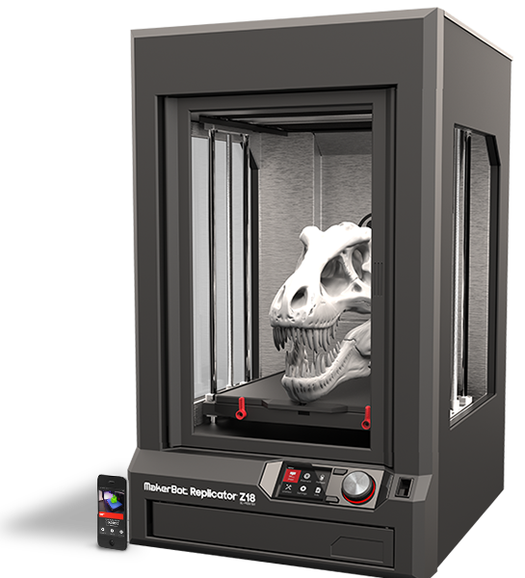
Mesh > Main Memory
High-resolution models (e.g., scan data)
Out-of-core mesh processing & slicing
Out-of-core file management
Notes:
Most people in Computer Graphics are familiar with the large mesh problem, and this is where a mesh has too many vertices and faces, such that it doesn’t fit into main memory. Scanning technology and 3D sculpting applications will often generate such meshes.
How do we handle large models that don’t fit into main memory – e.g., 28 million polygons on Lucy model?
We use outside of main memory or out-of-core algorithms for mesh processing and slicing.
In particular by slicing in an out-of-core fashion, we would be able to generate a toolpath in a layer-by-layer fashion that looks only at local layers, as opposed to loading the entire mesh into memory.
Using out-of-core approaches means that we must first convert a standard mesh file, such as an STL file into a proprietary out-of-core file format, and this conversion must also be in an out-of-core manner.

Slide 3
Mesh > Main Memory
Out-of-core processing required:
Model loading and slicing
Simplification (for display)
Analysis and repair
Approaches
Isenburg & Gumhold 2003
Lindstrom 2003
Liu et al. 2003
Notes:
There are several well-known out-of-core algorithms for simplification and visualization which we can adopt for this purpose. The complete list of references is at our website.
References:
http://www.cs.unc.edu/~isenburg/oocc/
https://computing.llnl.gov/vis/images/pdf/I3D03_Lindstrom.pdf
http://link.springer.com/article/10.1007%2Fs00371-003-0222-2

Slide 4
Z18: Tool path > Main Memory
Example: slice a cube at full build volume, 100 microns, standard 10% infill
Solution: stream data through stages
Memory usage reduced from 6 GB to 300 MB
Software architecture considerations:
Easy to create new stages and define dependencies
Most inter-stage dependencies known at compile time
Dynamically link stages based on print properties
Notes:
So we have a solution for meshes that don’t fit into main memory. This is the problem that most people are familiar with.
But, what about the problem of having a dense toolpath that doesn’t fit into main memory. This is the case we encountered when generating a toolpath for the full Z18 build volume.
Example: tool path we get is very dense.
Solution: Stream the data through stages. Toolpath generator has to be streaming. The amount of data in memory at any time is dynamically sized based on a window of data. We can restrict the size of the window so that it fits within main memory.
Most stage inter-dependencies are known at compile time, so that we get static connections, and and the compiler can optimize the code.
So what does this architecture look like?
Reference:
Similar streaming architecture for Polyjet-style printers (Objet Connex 500) “OpenFab: A Programmable Pipeline for Multi-Material Fabrication”, Vidimce et al., SIGGRAPH 2013
The stages and data stream in OpenFab are quite different, however.

Slide 5
Streaming Architecture
Solid Sparse Bridges Supports
Slicer
Rafts
Contours
Region Generators
Path Planner
Print Command Generator
Shells Interiors Floors Roofs Supports
Region Fillers
Toolpath
Notes:
These stages are typical in many slicers.
Slicer - First stage is the actual slicing of the 3D geometry to obtain 2D outlines of the object being printed.
Region Generators – Next the outlines go through a series of region generators. These generators construct regions such as where the interiors are where we’ll print infill, solid floors, solid roofs and where supports will need to be printed. In order to determine where supports are needed, the model is essentially sliced from top down. For example, outlines from above that are larger than outllines below means that supports will be needed in the top layer that is exposed.
Filler - Once the regions have been determined, the filler stage then fills out these regions with solid or sparse infill, with bridge fill, or with supports. At this time extrusion guards are also added, and rafts generated under the object and supported areas. At the end of this stage, we now have specified all tool paths to be printed, but they are not strictly ordered – the only real ordering we have right now is the bottom up, layer to layer, ordering. But within a layer, all the paths are unordered.
Path Planner – All the unordered paths comprising the fill for each layer are then processed by Path Planner which generates a toolpath according to a set of strict rules, plus some heuristics:
Fill paths or connected into a single path as much as possible
Shells are printed before infill.
Adjacent shells are printed innermost to outermost
Start at point closest to last when going form layer to layer
Avoid crossing over exterior parts of the print (e.g., roofs and exposed areas)
Command Generator – coming out of Path Planner the toolpath is just a list of coordinates telling us where to extrude. The Command Generator then adds speed, temperature, and fan adjustments, and then outputs these commands into a toolpath file (like gcode, or in our case a json toolpath).

Slide 6
Slicer API
For more information:
Email to quynh.dinh@makerbot.com
Please include Slicer API on subject line
MakerBot Toolpather Team
Notes:
Finally, I’d like to put a plug in for our Slicer API which is in development. The Slicer API will enable you to focus on developing modeling and CAD tools, and leave the Slicing software to us. It’ll enable you to directly link to our Slicer and output a toolpath file (the .makerbot file) which our printers read and will then print. It has a very simple interface and just requires the modeling software to provide outlines of the model for each layer.
Focus on the model creation software and then generate a file that can be printed on MB printers using our Slicer API.
I’d also like to say that we will be releasing some exciting features in Makerbot Desktop version 3.8 that will improve upon both supports and infill. So please stay tuned.

Slide 7
Acknowledgements
Developers:
Filipp Gelman
Andrey Patrov
Gregory Studer
Michael Zappitello
Lead:
H. Quynh Dinh
Print Quality Maven:
Rebecca Levitan
Former Member & Architect:
Joseph Sadusk
MakerBot Toolpather Team
Notes:
I’d like to acknowledge current and former members of Makerbot’s slicer team whose work has been presented here.

Slide 8
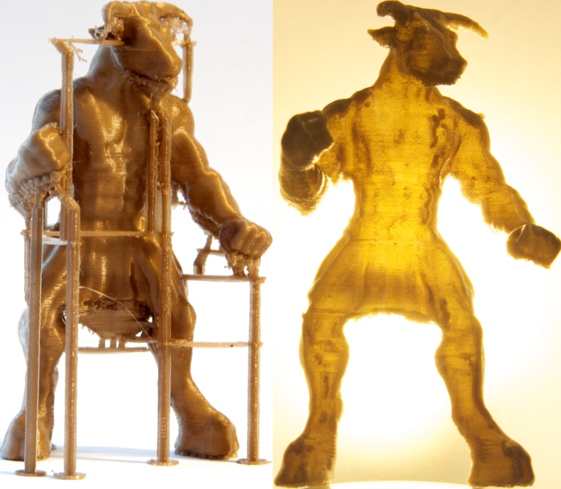
Acknowledgements
Other IceSL contributors
Jean Hergel (PhD student)
Jérémie Dumas (PhD student)
Jonas Martinez (postdoc)
Samuel Hornus (researcher)
Guillaume Devoille (intern)
Our early adopters!
ERC ShapeForge Stg-2012-307877
Région Lorraine

Slide 9
Open Challenges
5pm – 5:15pm
Notes:
Filipp will cover many of the specific Software solutions. I’m going to conclude this talk with an overview of the Software architecture of MakerBot’s toolpather.
We had a recent overhaul of the Slicer when our latest generation of printers came out, and specifically, we needed to handle the large volume Z18 printer. It has a volume of 30cm x 30.5cm x 46cm (18 inches).
In addition, we have an expectation that with scanning technology becoming more prevalent, 3D digital models will also grow in size in terms of memory required to store the mesh information.
So these are the dual solutions we are working on.

Slide 10
Challenging Meshes
How to deal with issues in input models
Holes, ambiguous in/out
Features
Thin walls
Many thin features
Fragile inputs [Stava et al. 2013]

Slide 11
Unified Slicer
A slicer that addresses all technologies:
FDM, SLA, SLS, CNC?
Each have different requirements
However there are many common issues
Bad inputs, slicing, supports, etc.

Slide 12
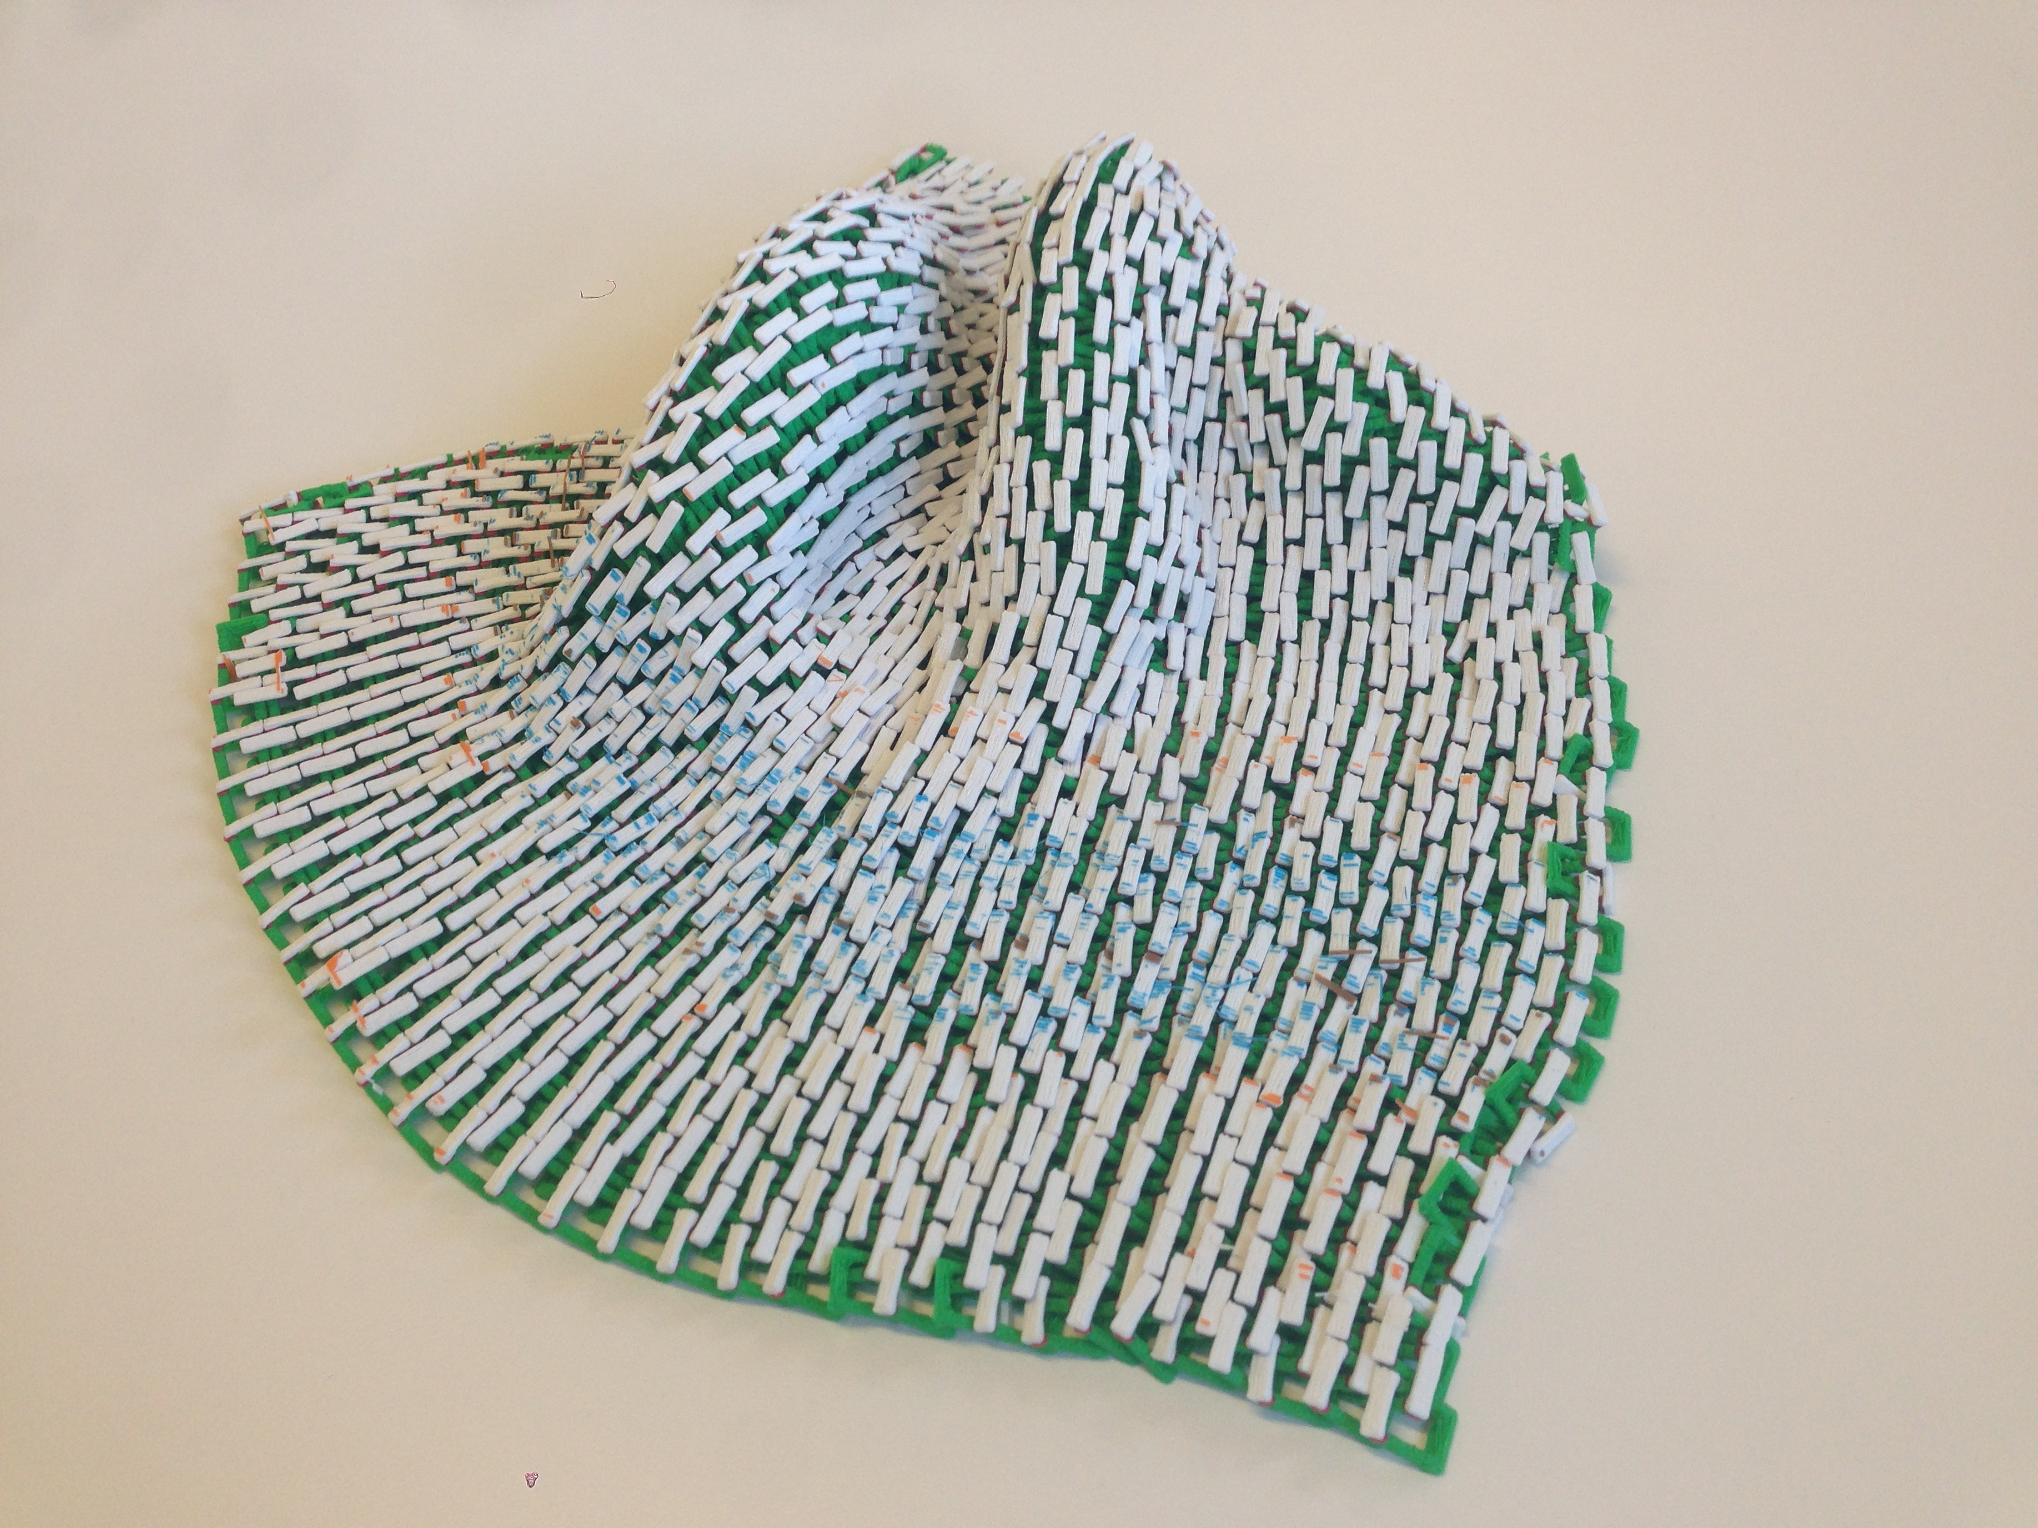
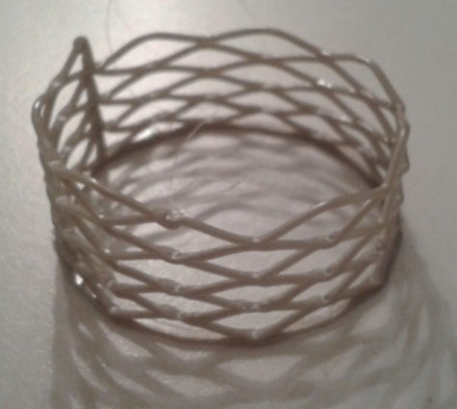
Design Tools for Fabrication
Exploit ‘drawbacks’
Visual anisotropy
Transparency
Filament ‘drooloops’
Exploit properties of filament
Wire meshes
Chainmail
Multi-material
soft, conductive, etc.
[Super Flowers, Peetersm, CC BY-SA 3.0]
[Printing in 3 dimensions, Joris, YouMagine]

Slide 13
Open Challenges / Q&A
http://webloria.loria.fr/~slefebvr/sig15fdm/

