Slide 1
Hexahedral-Dominant Meshing
Dmitry Sokolov, Nicolas Ray,
Lionel Untereiner and Bruno Lévy

Slide 2
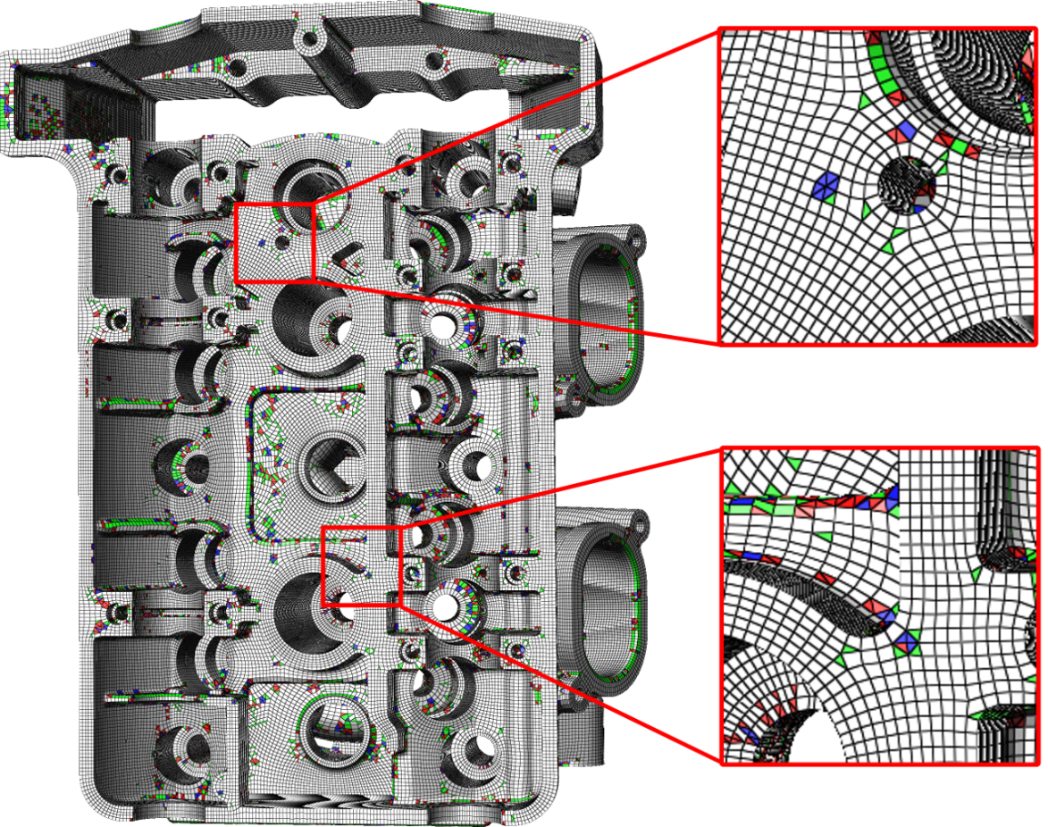
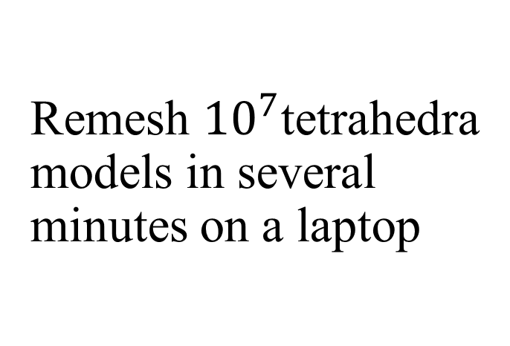
Teaser!
Remesh ${10}^{7}$tetrahedra models in several minutes on a laptop

Slide 3
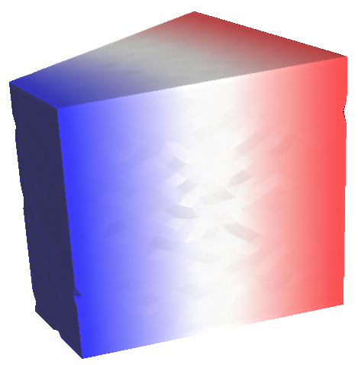
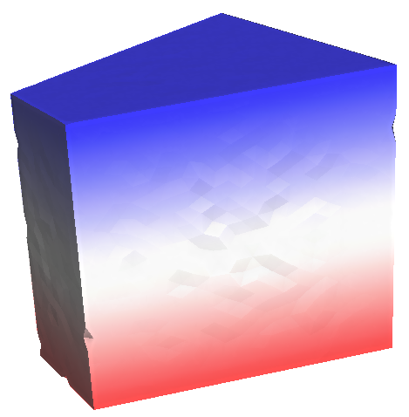
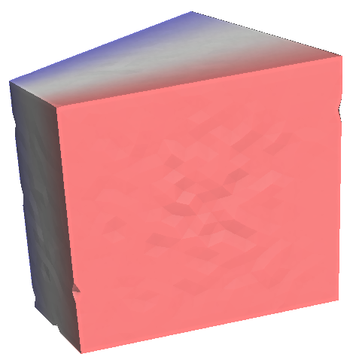
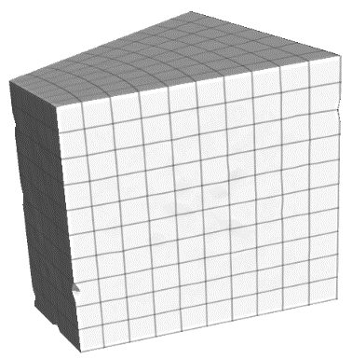
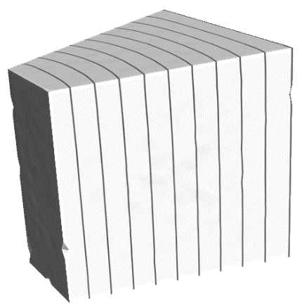


Main idea: compute 3 scalar fields and cut along integer isovalues
u
v
w
in other words, compute texture coordinates (u,v,w) and apply a grid texture

Slide 4
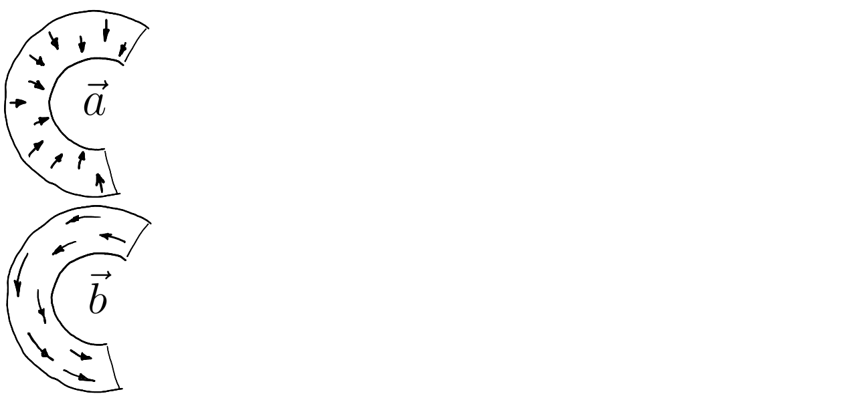
Introductory example 1 out of 3
Directional Field Synthesis, Design, and Processing
SIGGRAPH 2017 course
Vaxman, M. Campen, O. Diamanti, D. Panozzo,
D. Bommes, K. Hildebrandt, M. Ben-Chen

Slide 5
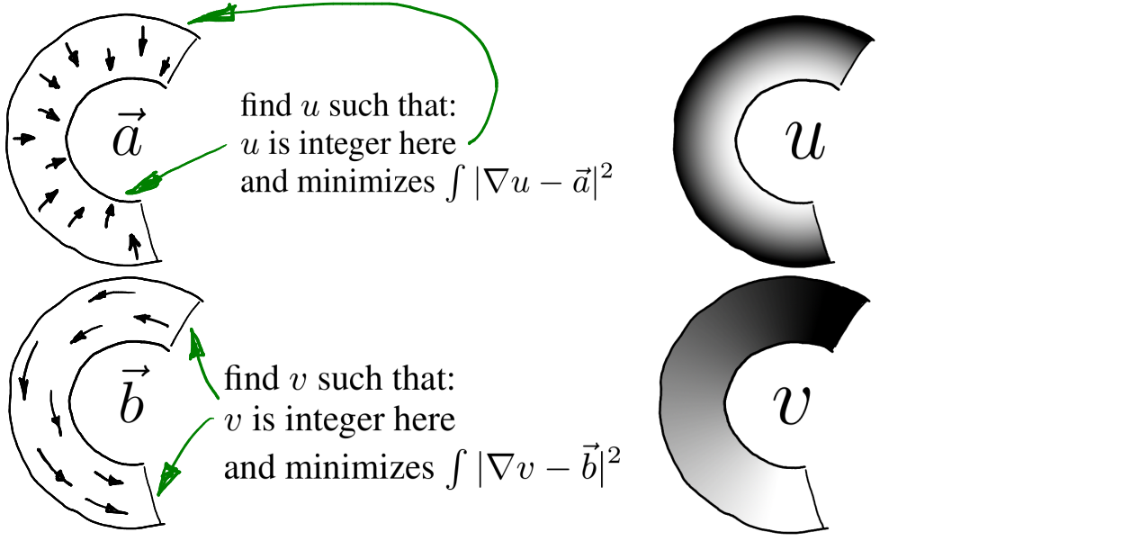
Introductory example 1 out of 3

Slide 6
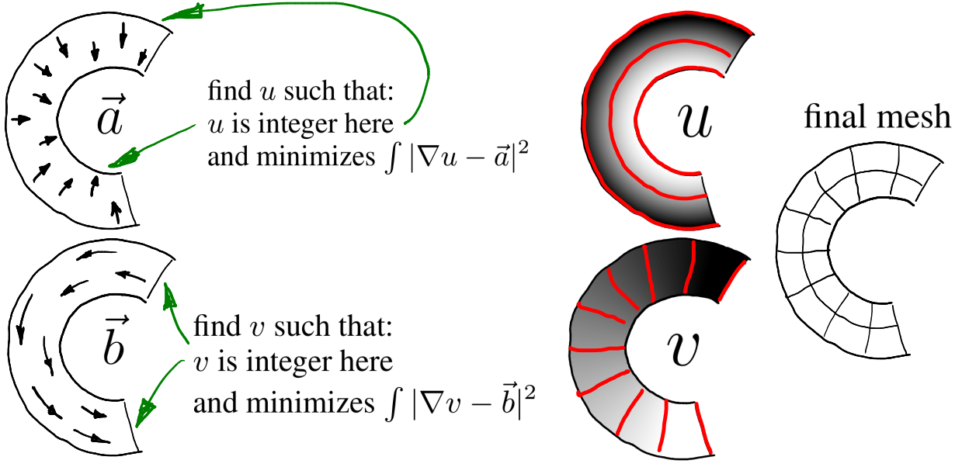
Introductory example 1 out of 3

Slide 7
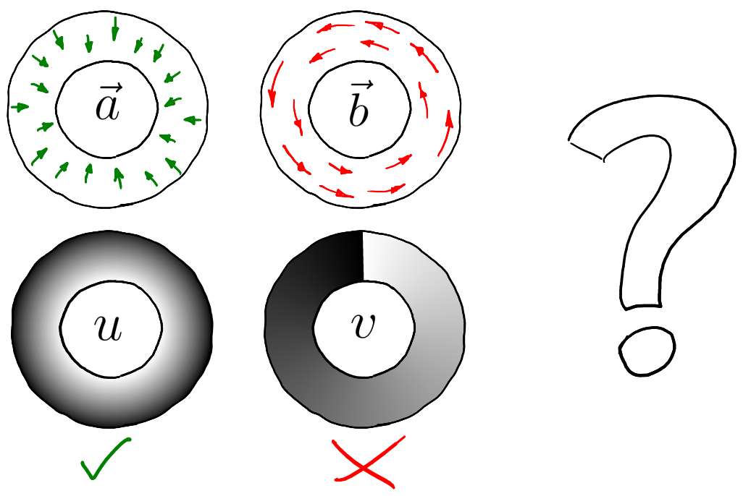
Introductory example 2 out of 3

Slide 8
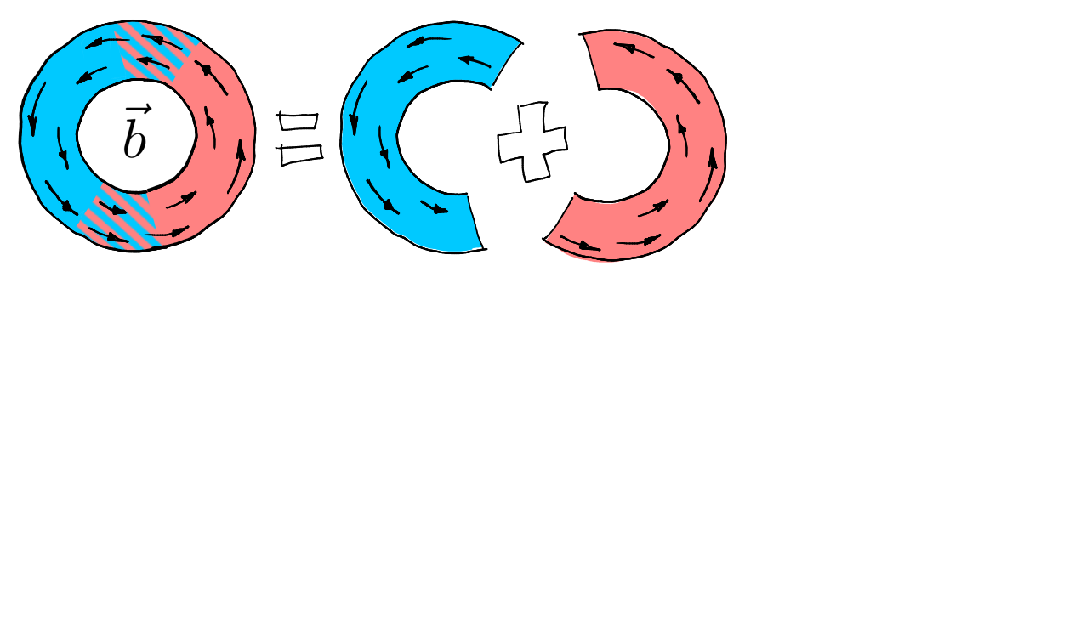
Introductory example 2 out of 3

Slide 9
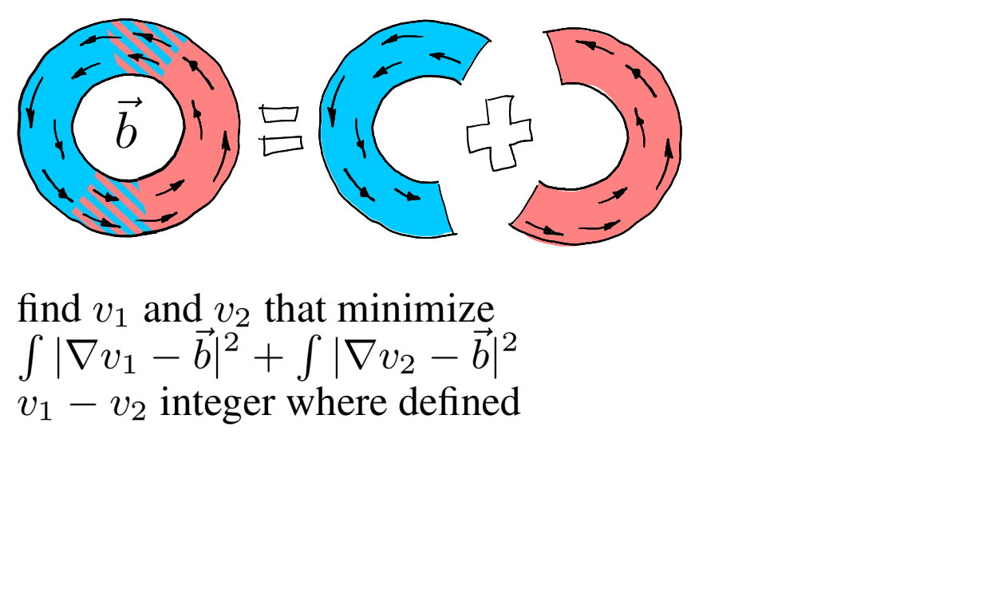
Introductory example 2 out of 3

Slide 10
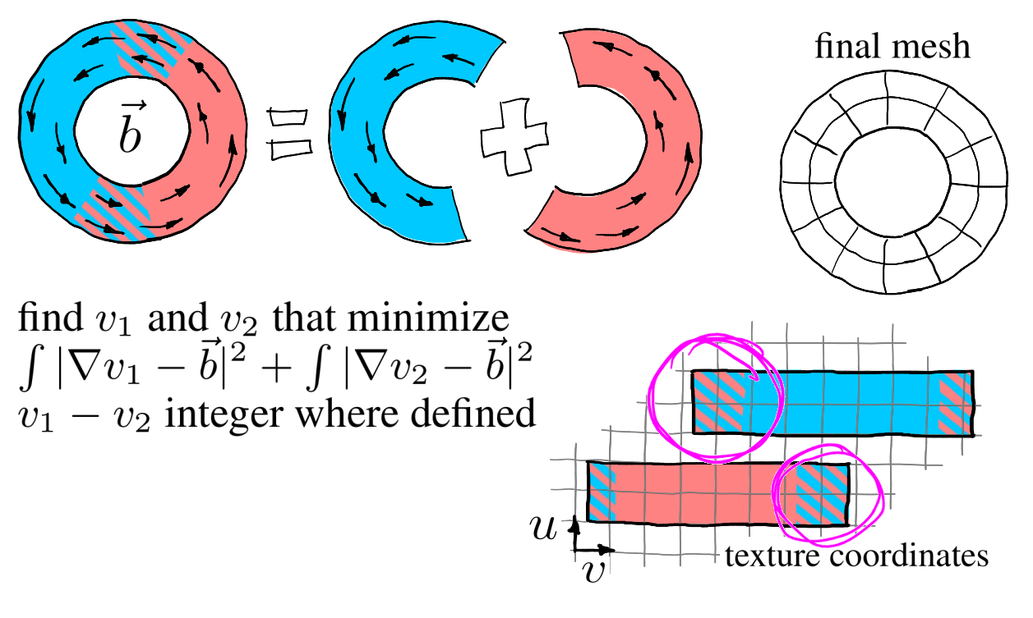
Introductory example 2 out of 3

Slide 11
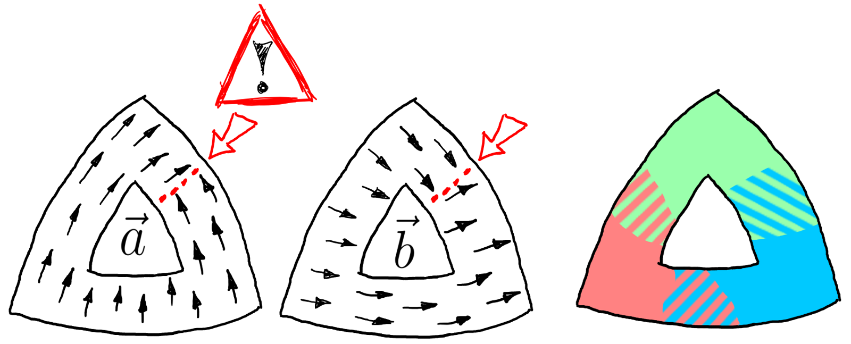
Introductory example 3 out of 3

Slide 12
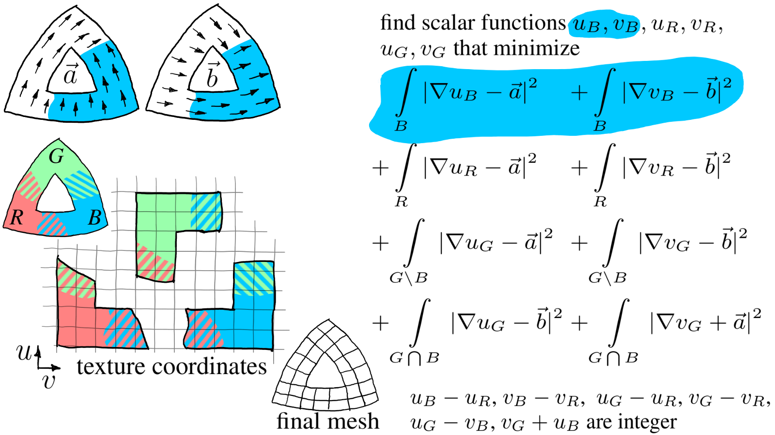
Introductory example 3 out of 3

Slide 13
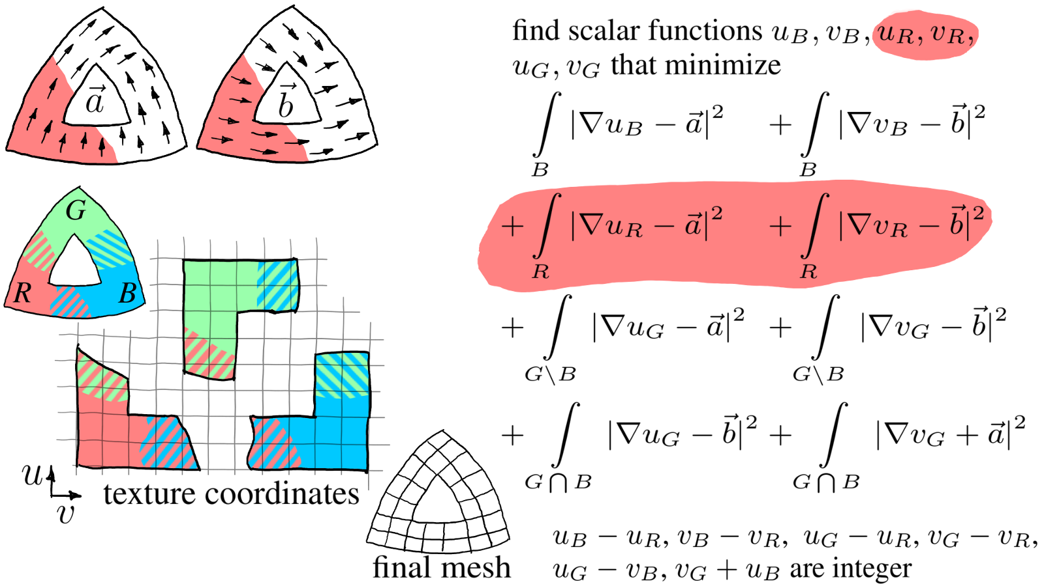
Introductory example 3 out of 3

Slide 14
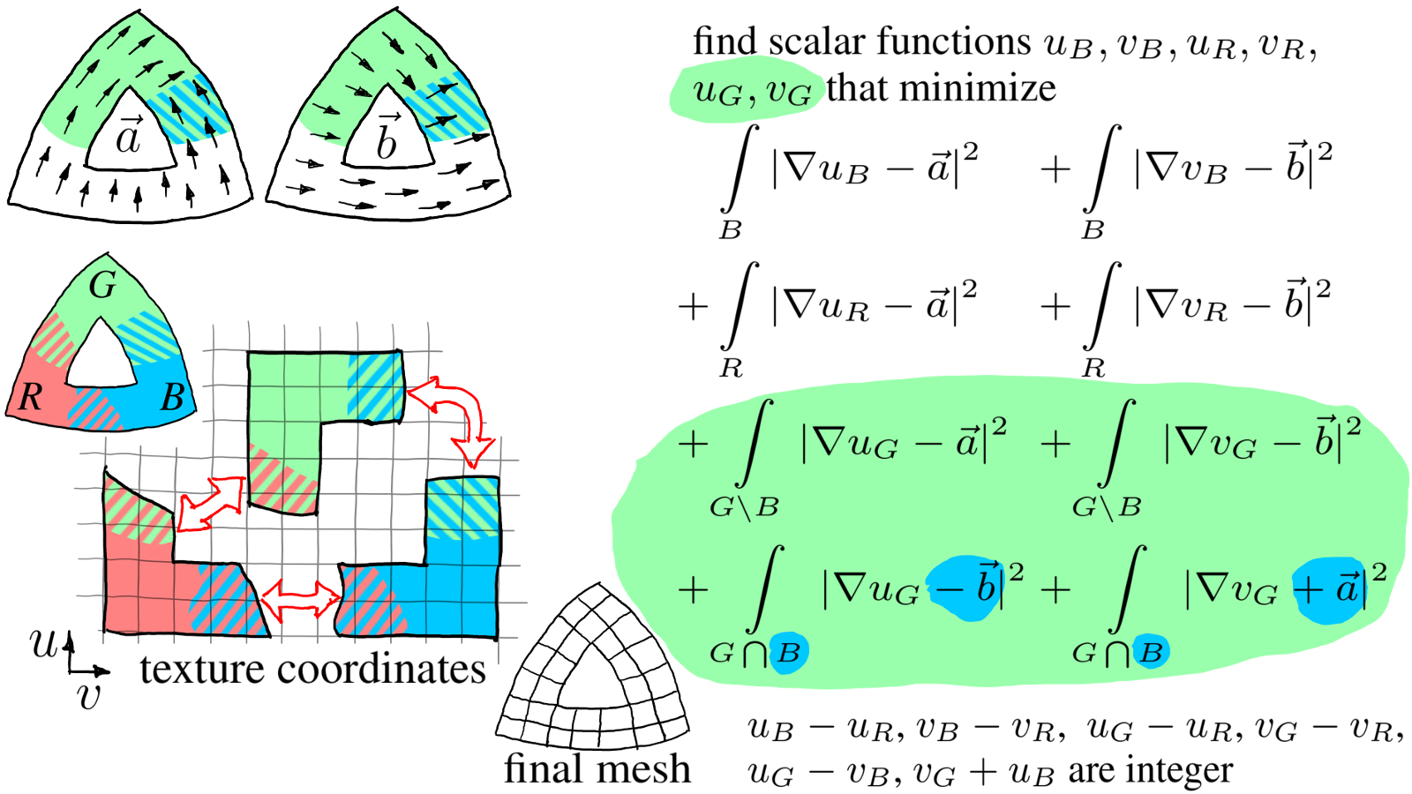
Introductory example 3 out of 3

Slide 15
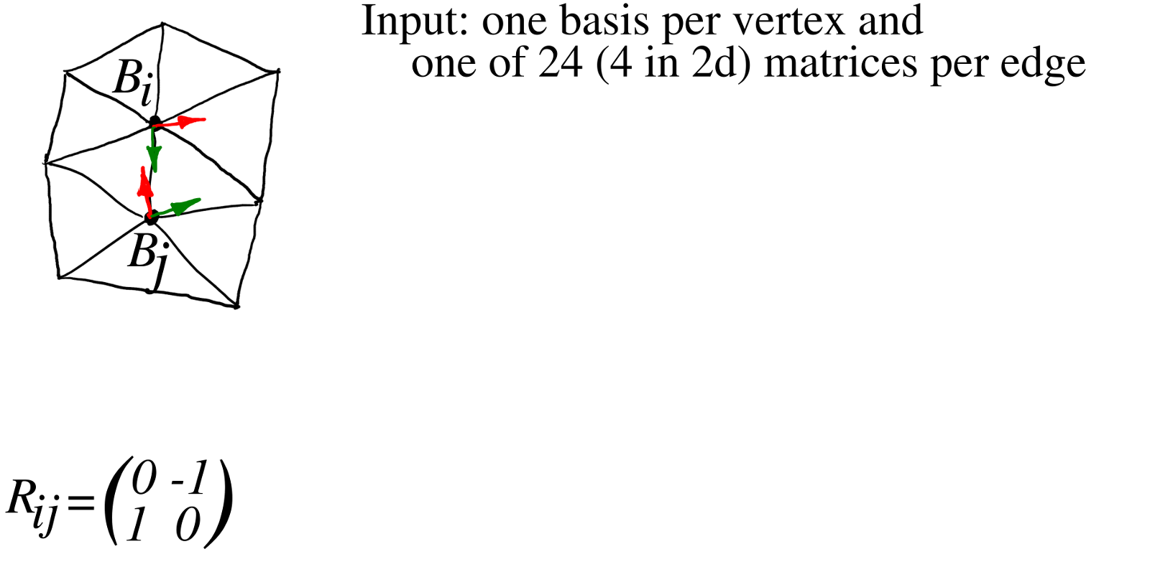
Global parameterization: problem statement

Slide 16
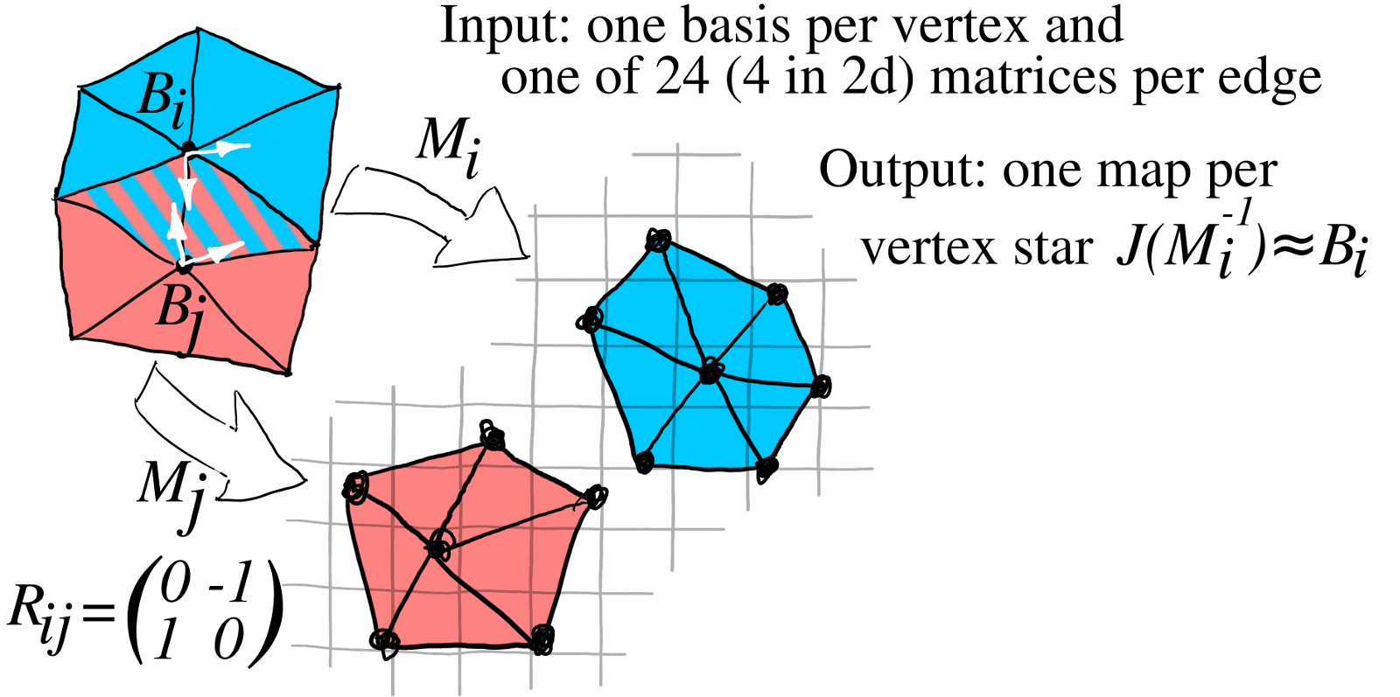
Global parameterization: problem statement

Slide 17
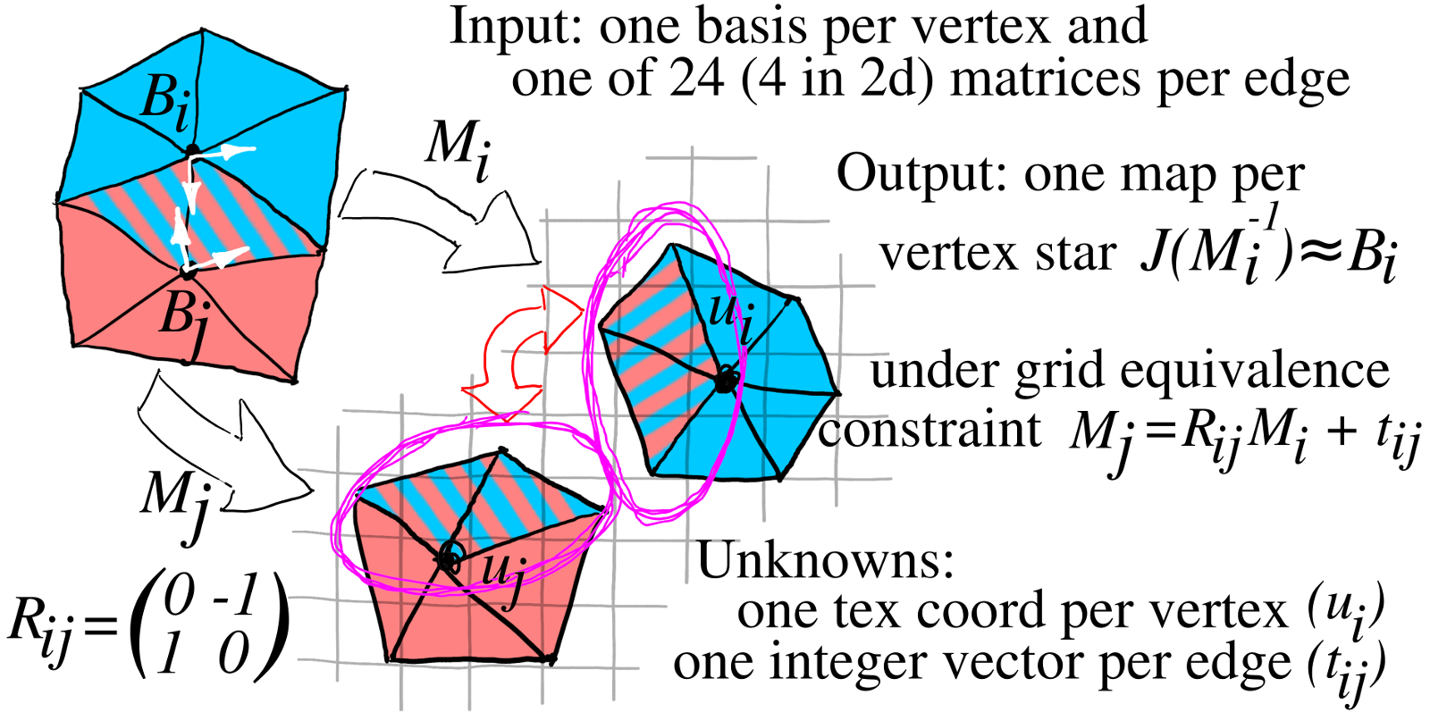
Global parameterization: problem statement

Slide 18
Global parameterization: problem statement
The problem is to find an atlas of grid-equivalent maps;
each map is linear per tet, thus 4 points suffice to enforce the gr. eq. constraint:
for a tet
, maps
and
must satisfy:
2 out of 4 constraints are naturally satisfied with our choice of the variables

Slide 19
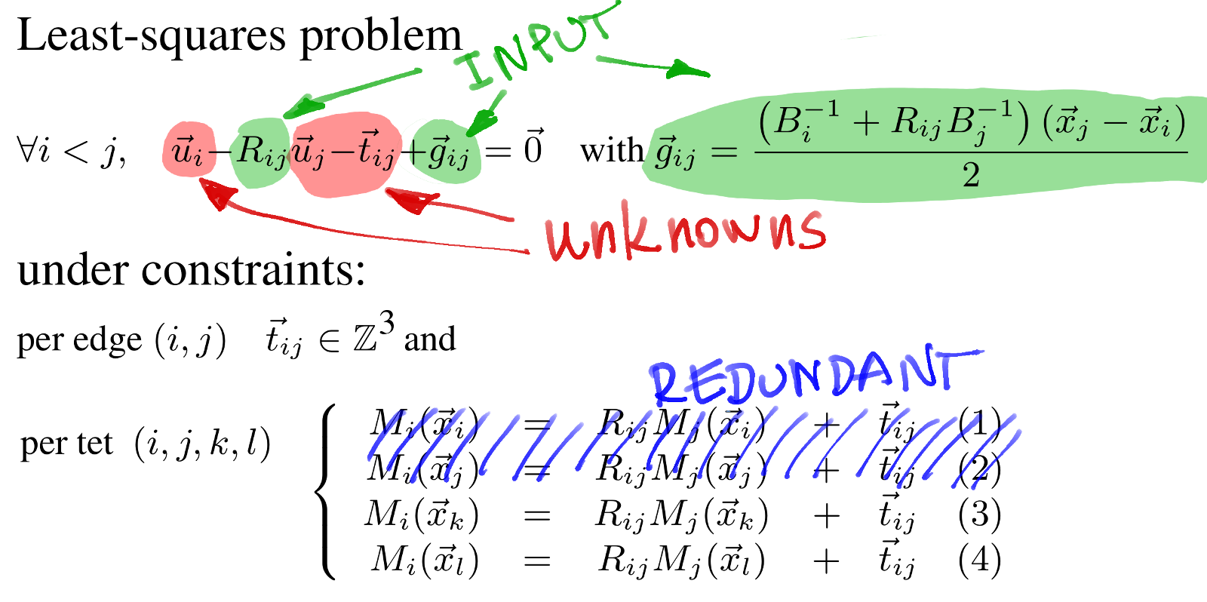
Global parameterization: problem statement

Slide 20
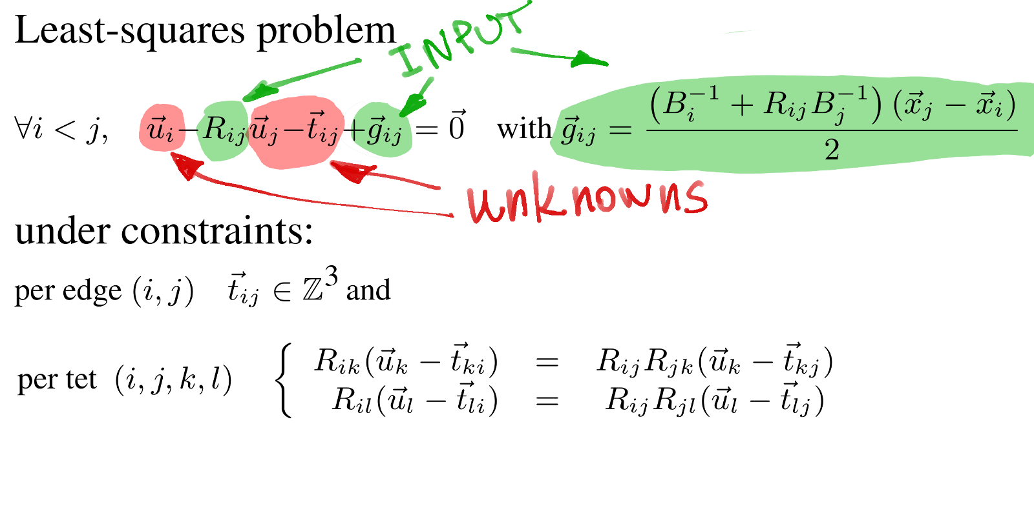
Global parameterization: problem statement

Slide 21
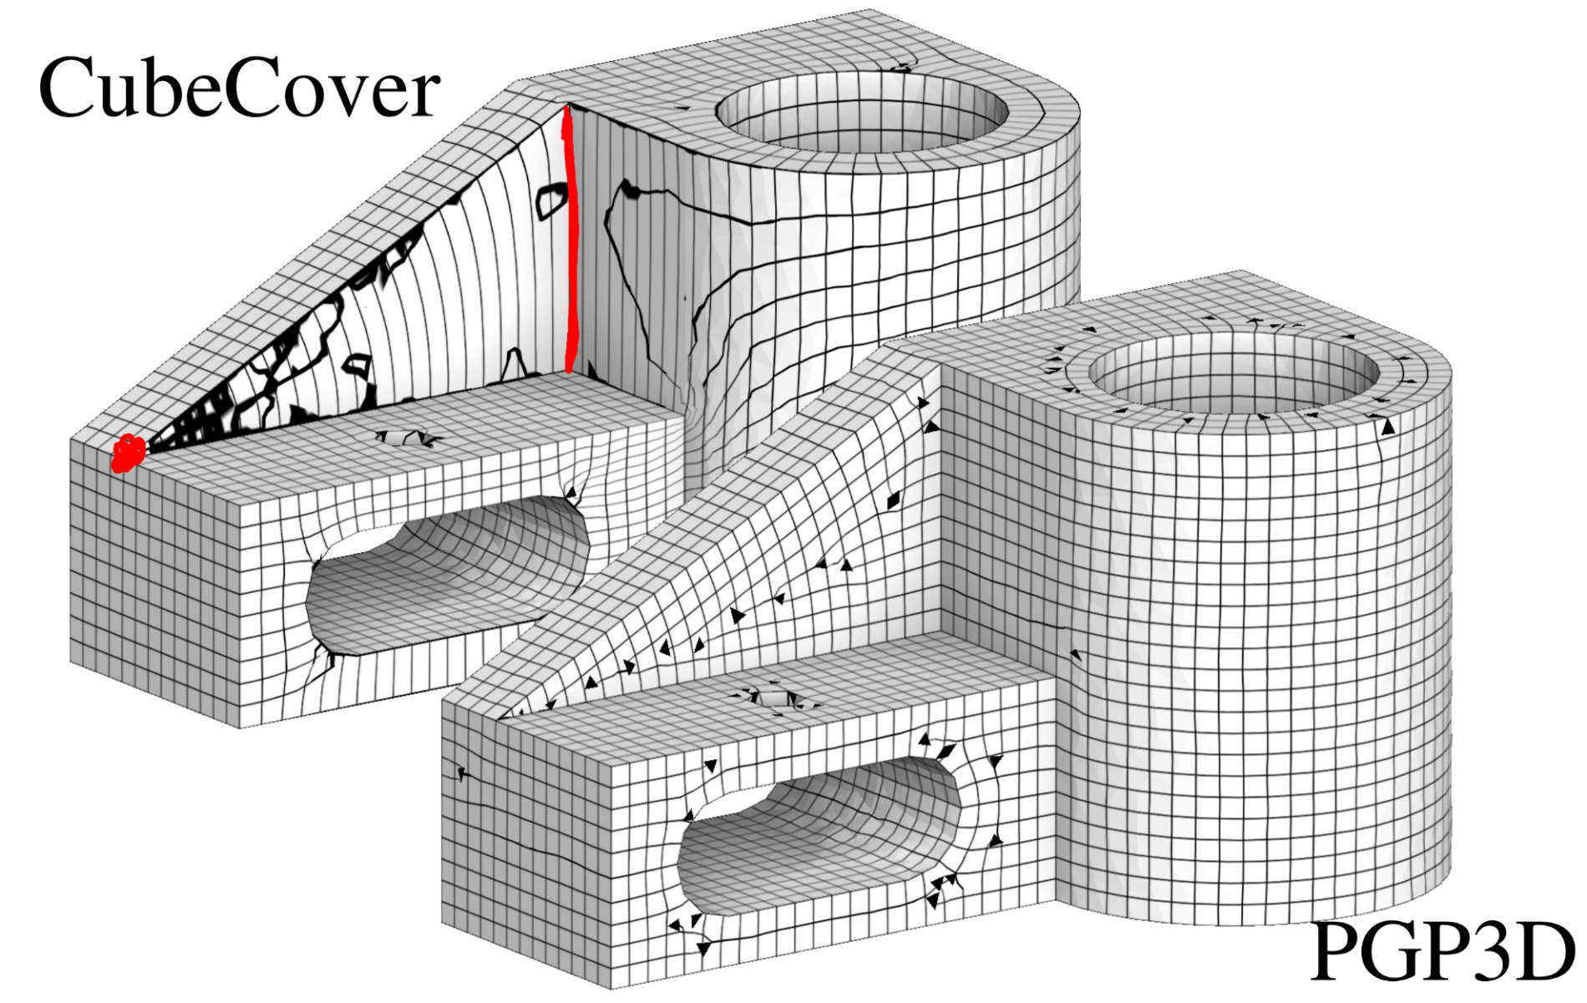
Global parameterization: solution mechanism
CubeCover [Nieser et al, 2011] enforces all the constraints, whereas the we ignore half of grid equivalence constraints (it is a feature, not a bug).

Slide 22
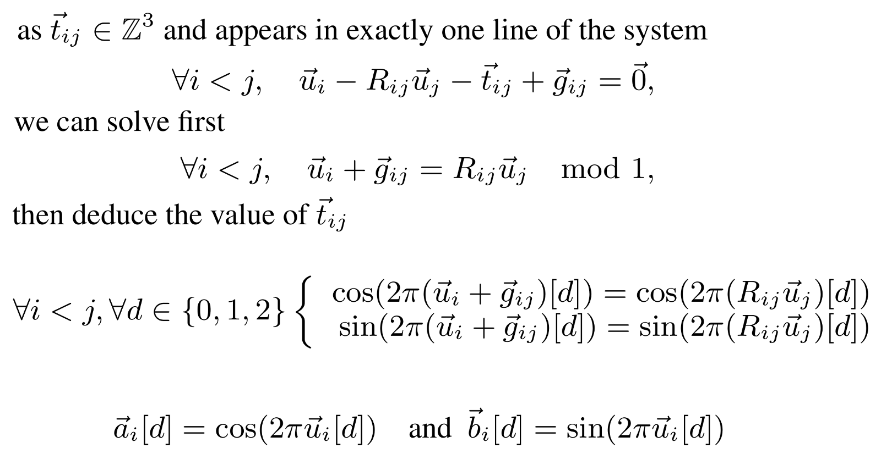
Periodic global parameterization

Slide 23
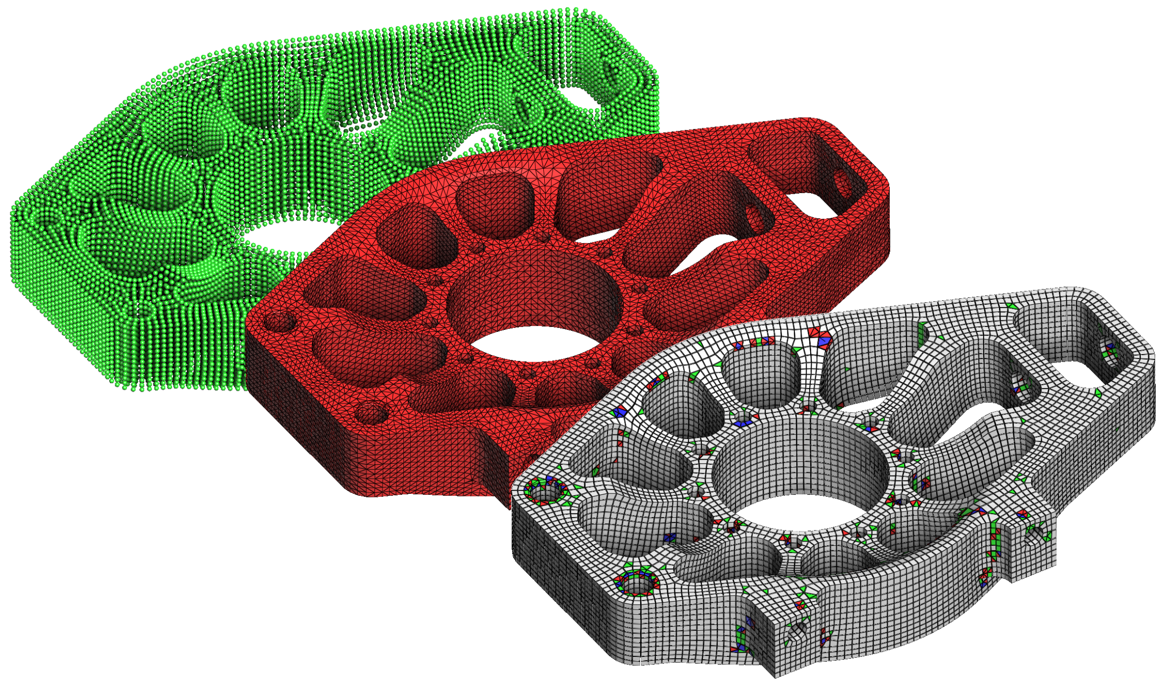
Extract the hex-dominant mesh

Slide 24
Extract the hex-dominant mesh
Read an update:
Combining tetrahedra into hexahedra: a vertex based strategy
[Pellerin et al IMR2017]

Slide 25
Extract the hex-dominant mesh
Read an update:
Combining tetrahedra into hexahedra: a vertex based strategy
[Pellerin et al IMR2017]
Or use another approach:
Hexahedral Meshing: Mind the Gap!
Robust Hex-Dominant Mesh Generation Using Field-Guided Polyhedral Agglomeration

Slide 26
Thank you for your attention!

